Slide 1


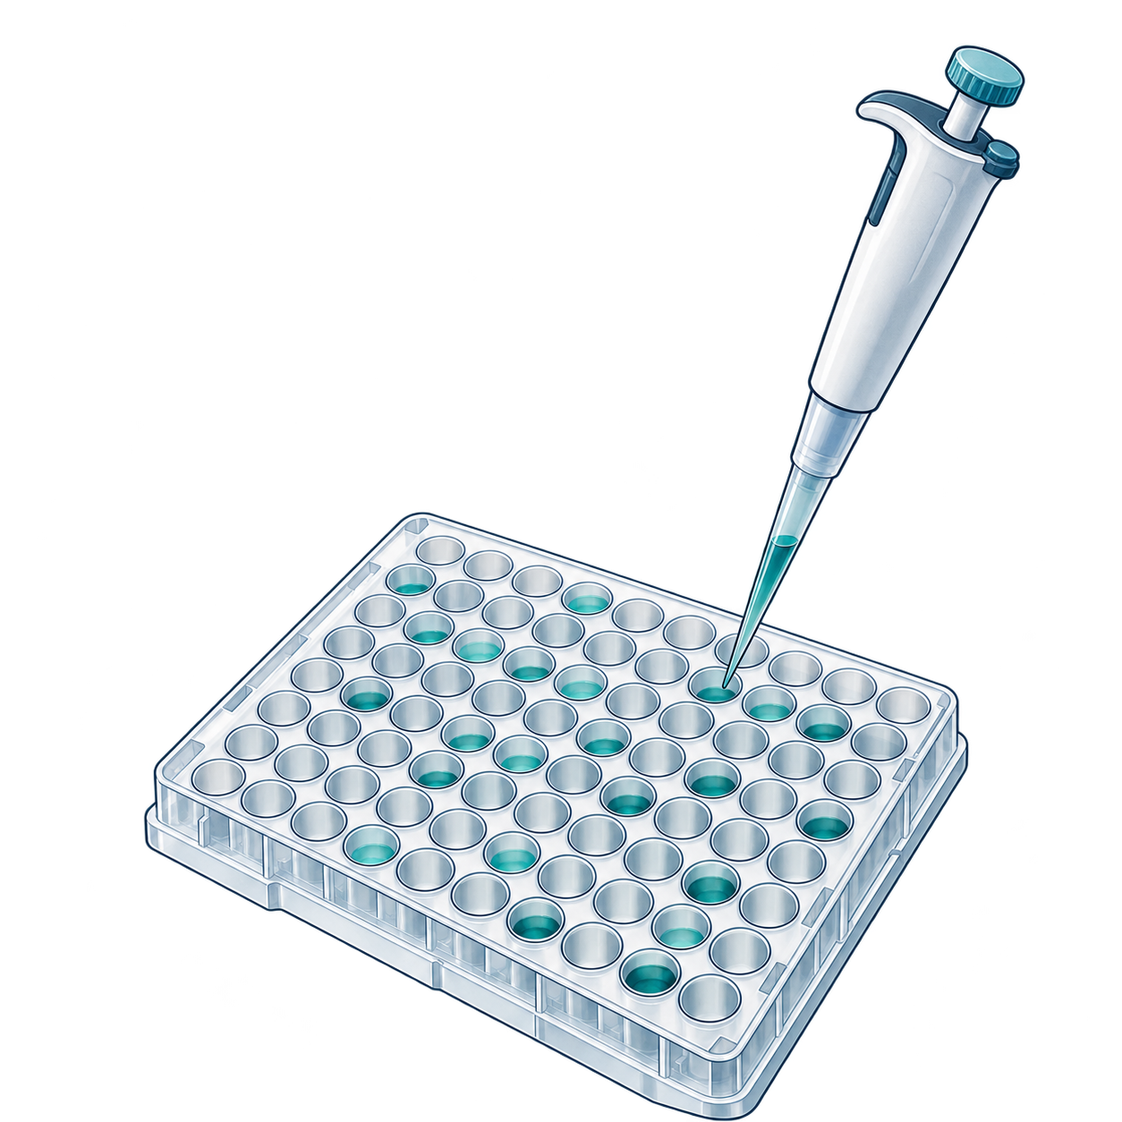
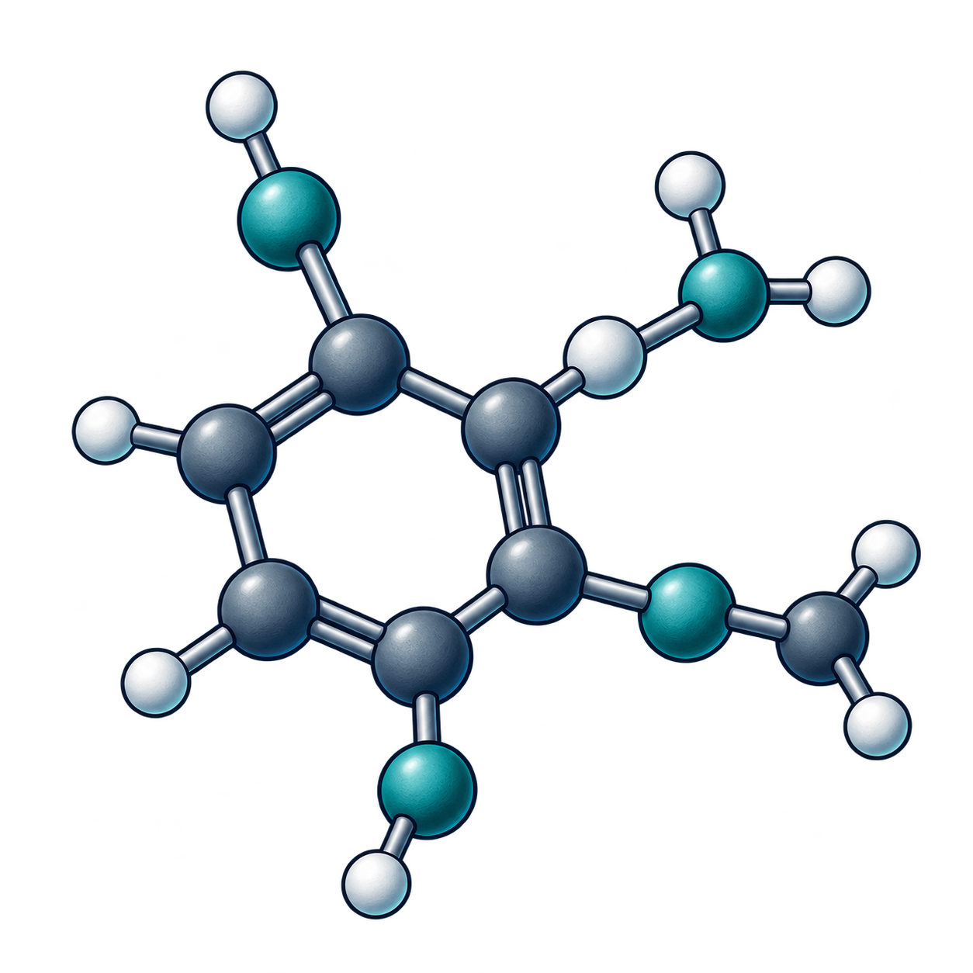

Evidence changes with the stage
1
Disease and
mechanism
2
Target
identification
3
Target validation
Cohort
Stable IDs
Intervention
tissue
isoform/state
dose
perturbation
direction
model system
time
disease context
rescue or orthogonal
evidence
phenotype
confounders
4
Assay and data
strategy
5
Hit discovery
6
Hit confirmation
Protocol
Search space
Orthogonal assay
units
target state
purity
censoring
selection budget
interference checks
controls
prospective test
concentration response
batch
provenance
7
Hit-to-lead
8
Lead optimisation
9
Candidate nomination
Series identity
Multi-parameter
objectives
Integrated efficacy
potency
safety
selectivity
uncertainty
DMPK
exposure
constraints
CMC
synthesis
synthesis cycle
translational
rationale
Filled squares mark required records. They do not indicate completed measurements.
AI-generated conceptual illustrations. Native labels and relationships.
Notes:
Stage evidence contracts. Nine numbered stages retain the minimum required records from the canonical stage table. Each compact group pairs its stage identity and conceptual object with a native checklist. Filled squares denote required fields, not completed measurements. The rows follow the source-table order. The contracts describe what must be argued at each stage and do not establish that a candidate satisfies them. Baselines and frequent failures remain separate in the adjacent table. The illustrations are AI-generated and conceptual.
Source: report/aidd-commons-living-report-v0.1.md#the-target-to-candidate-pipeline
The conceptual PNG assets are independently movable/replaceable, not vector-editable.
All text, symbols, shapes and directional arrows are native PowerPoint objects.
AI-generated conceptual artwork is not scientific evidence. Actual backend identity is recorded privately when exposed.

