Slide 1

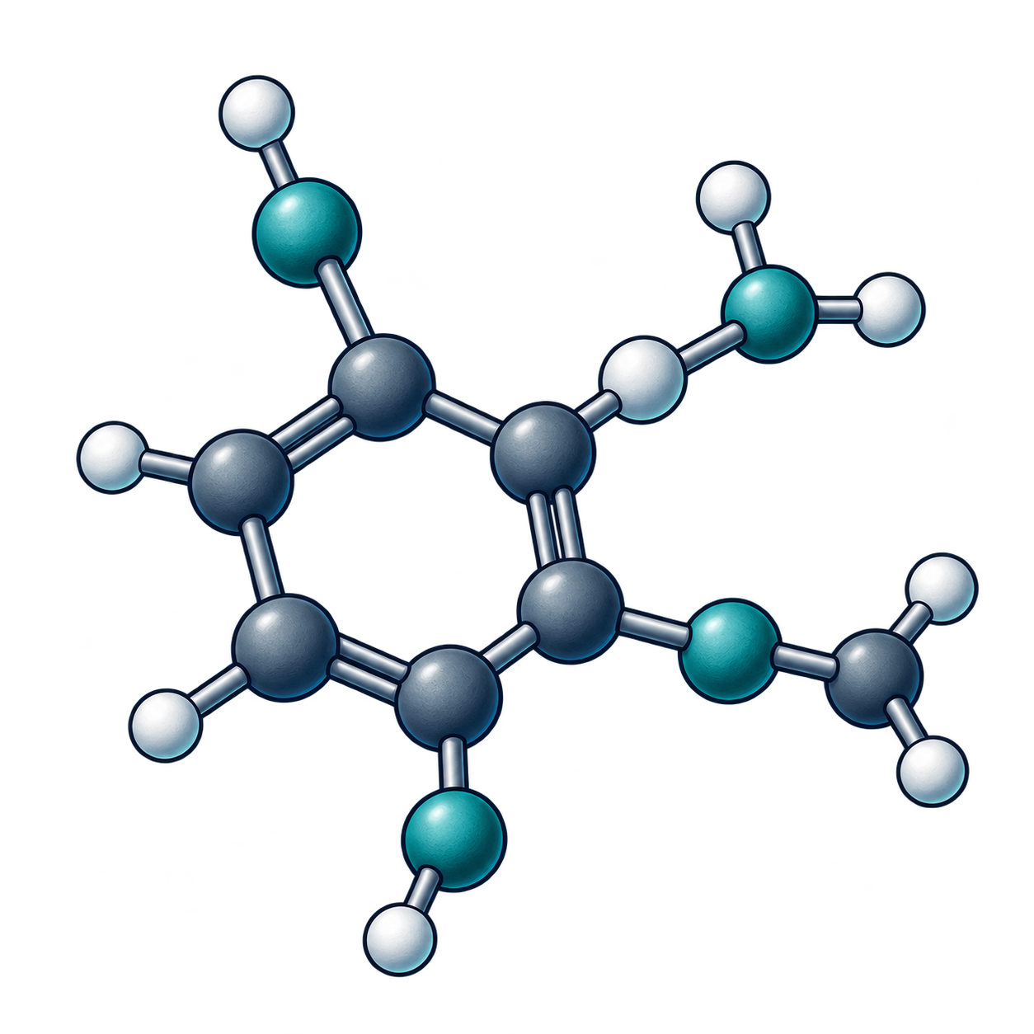
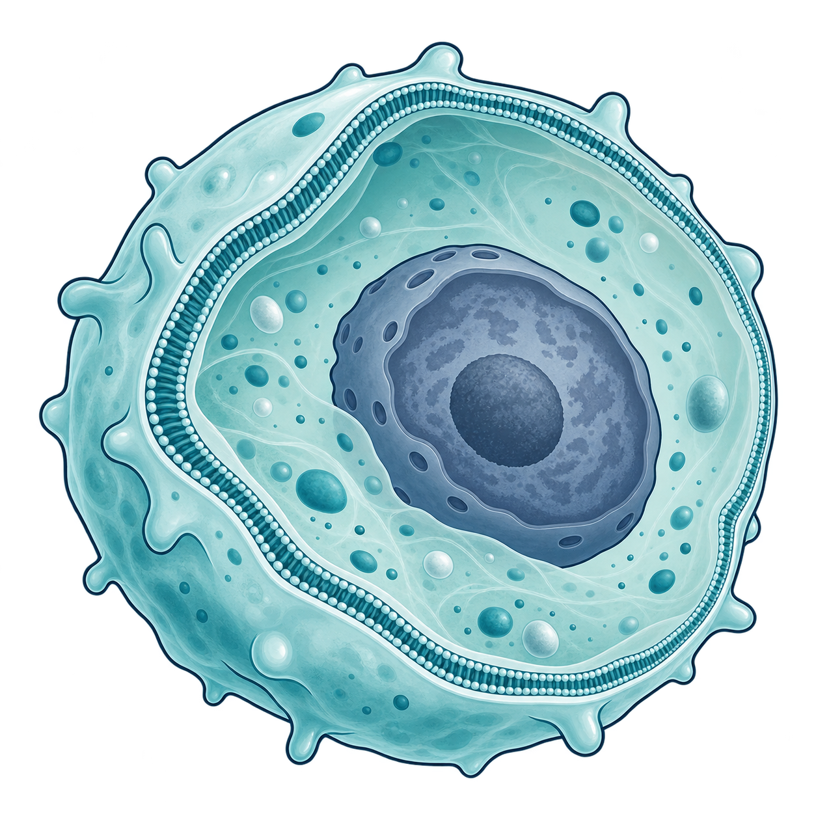
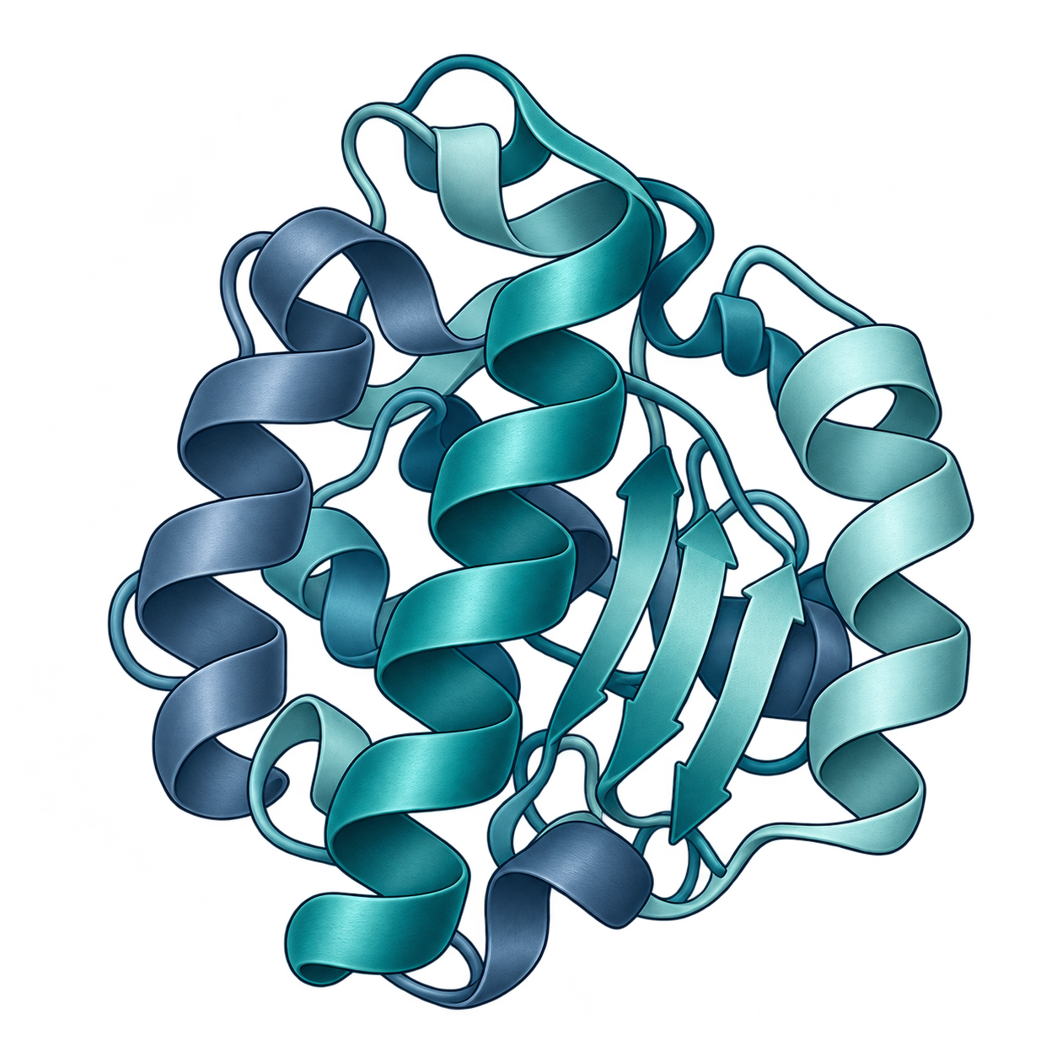
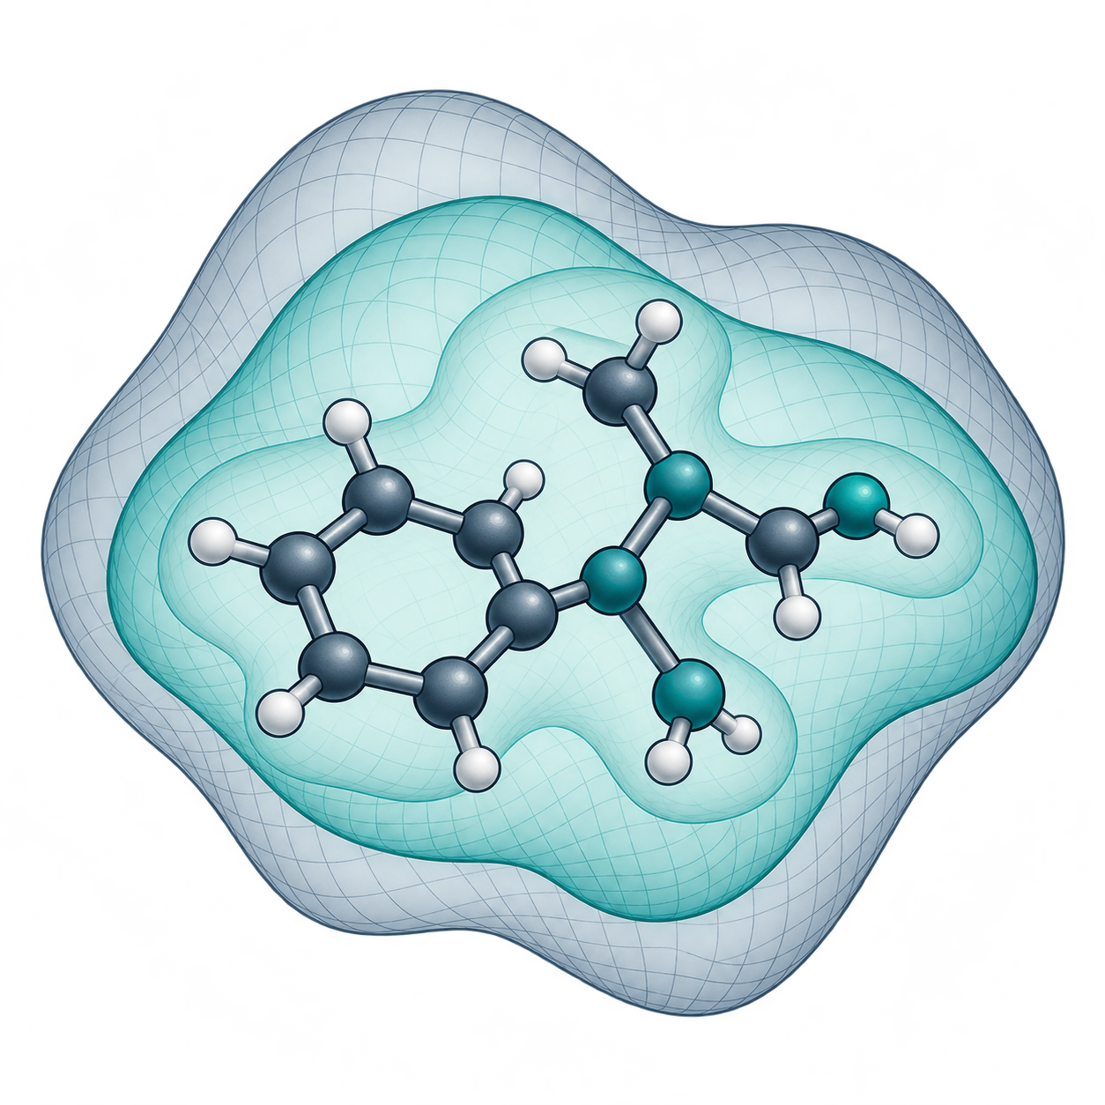
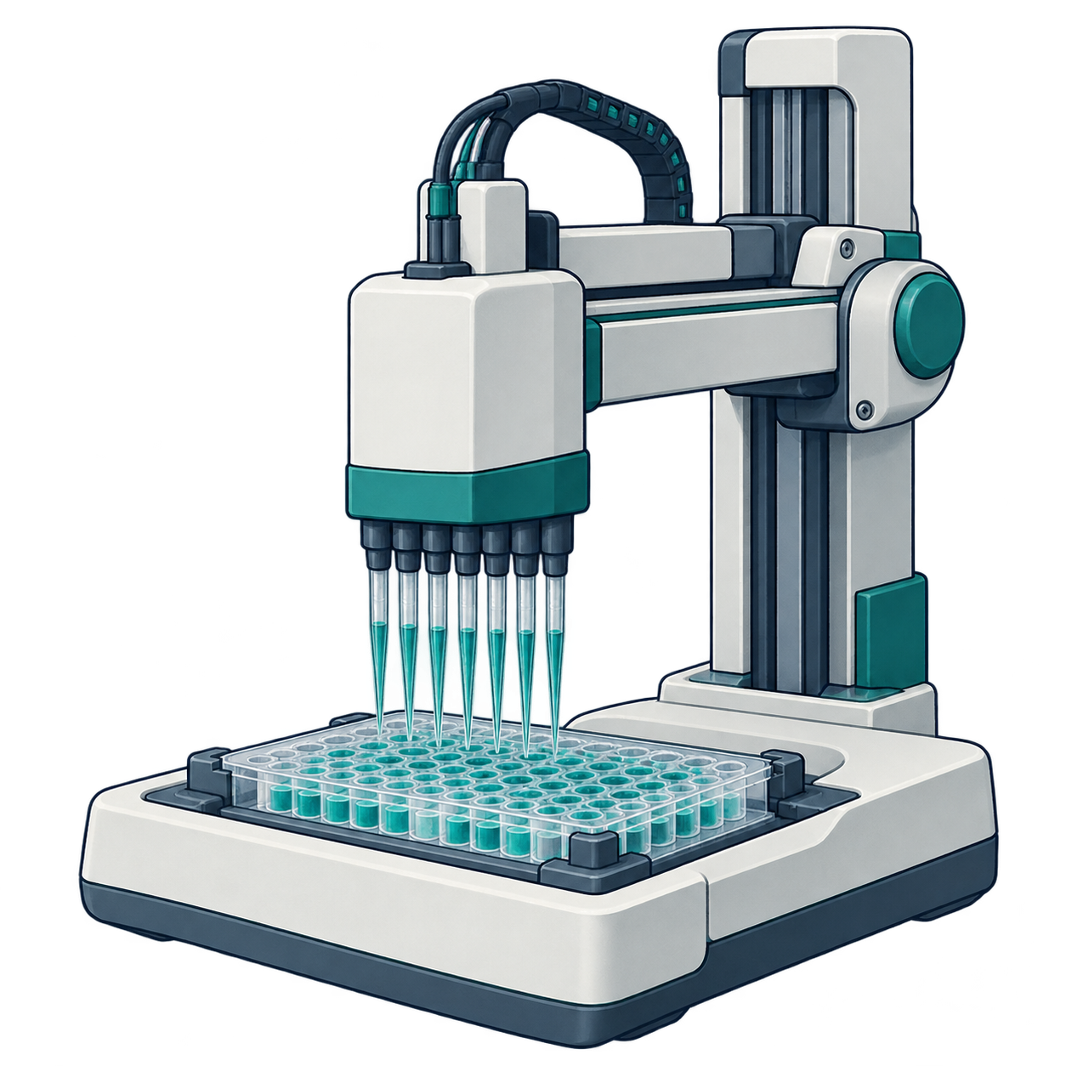
Shared prerequisites connect the learning paths
Core route
Small
molecules
Targets
and cells
Biologics
Structure
and
physics
Agents
and
feedback
Shared lesson
25
29
16
17
15
14
listed lessons
5
Evidence claim boundaries
3
Therapeutic decision framing
3
Biological representations
2
Identity lineage and reuse
1
Docking and free energy
2
Model table construction
2
Baseline fitting and validation
1
Metrics and uncertainty
1
Regression and classification
errors
1
Uncertainty to decisions
Stated prerequisite
Also listed in core
10 lessons 21 prerequisite relations
AI-generated conceptual illustrations. Native labels and relationships.
Notes:
Prerequisites across six learning paths. The current curriculum YAML names 10 shared prerequisite lessons and 21 prerequisite relations across five specialist routes. A filled circle in the incidence matrix denotes a stated prerequisite. A dashed square denotes one of the 8 shared lessons also listed in the core route, a different relation. Row badges count the routes that require the lesson. Header badges count each route's listed lessons and are derived directly from the current YAML. The core route states no prerequisites. Counts describe the map, not difficulty, coverage or observed learning. Route illustrations are AI-generated and conceptual.
Source: catalog/curriculum/tracks.yaml#learning_paths
The conceptual PNG assets are independently movable/replaceable, not vector-editable.
All text, symbols, shapes and directional arrows are native PowerPoint objects.
AI-generated conceptual artwork is not scientific evidence. Actual backend identity is recorded privately when exposed.

