Slide 1
Volumetric Additive Manufacturing via Tomographic Resolution
By: Atom Rousseau, Aiden Aerni, Francisco Sanchez-Cardenas, Miguel Hernandez
Shiferaw Alemseged, Huy Le

Slide 2
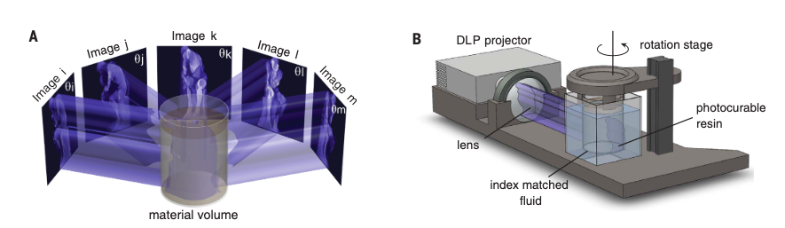
What does it do?
The working material is centered within the printer
The working material is cured using light rays from a 360 Degree Viewpoint
The part is completed once the material is cured by the light
Computed Axial Lithography (CAL)

Slide 3
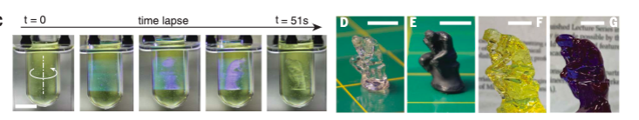
Advantages Over FDM
Allows solid objects inside the jelly when printing
Faster time in general
Better Finish
Works with higher viscosity materials
No supports

Slide 4
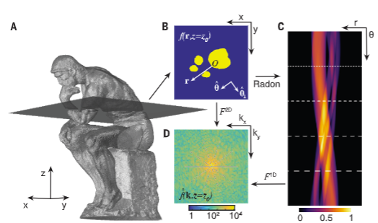
Disadvantages Over FDM
Sometimes parts are stuck in resin and need to be cleaned
Interior voids would be filled with resin or solid
Newer technology so not as well tested
Currently no consumer market
Expensive
Limited material

Slide 5
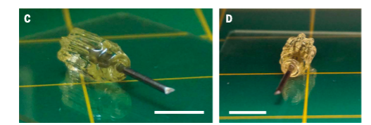
Application / Impact
Medical
Hobby
Tools
Manufacturing
Art

