Slide 1
Green Rooftops
On Large Public Schools
By Aiden, Fernando, Fawaz

Slide 2
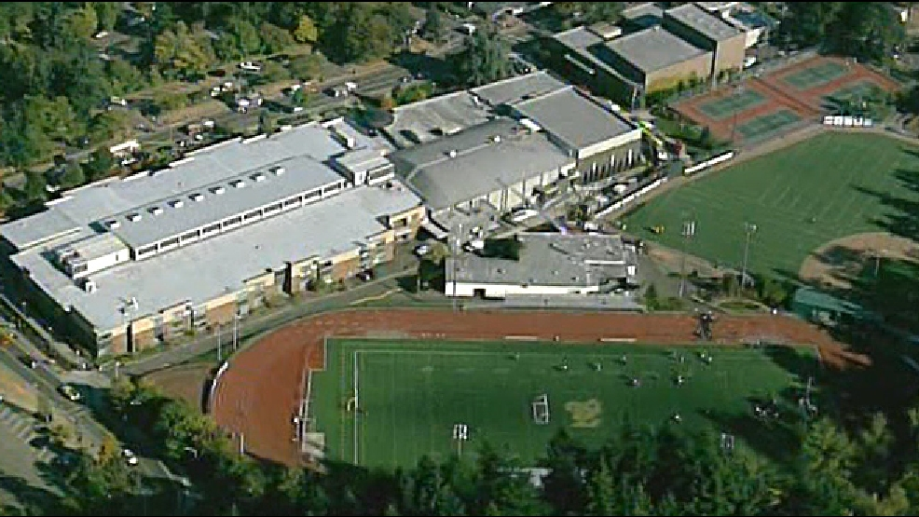
School Architectures: The Downsides
High Water Runoff
High Heat Absorption
Removes Large Habitat Space
Uses More Materials Over Time
Provides no Environmental Benefit
Offers No Educational Value
Extreme Heat Islands: 85% of k-12 students NYC (Climate Central)
(West Linn High School: West Linn, Oregon)

Slide 3
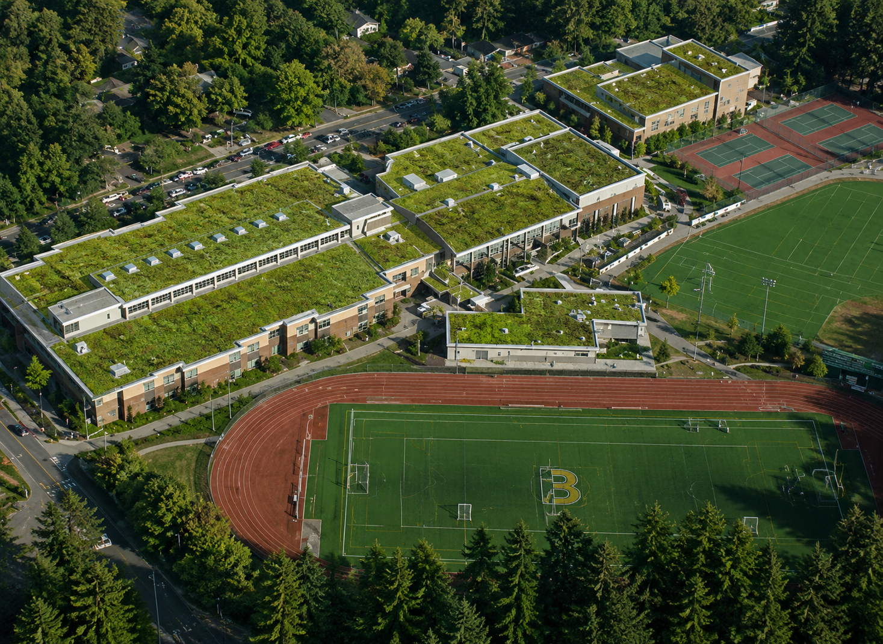
Green Rooftops on Schools: Benefits
Reduce Cooling Costs
Longer Roof Life
Improves Air Quality
Increased Biodiversity
Improved Water Runoff
Social Sustainability
Can provide educational opportunities at schools.
No new lands needed to be built.
(West Linn High School, Modified for Green Roof Application)

Slide 4
Background / Literature Review
Singapore:
Singapore is a strong example of country that has invested heavily into green rooftops, especially with offering government incentives programs for people that incorporate these.
It is a very small but highly densely populated area, meaning that they do not have a lot of space to build new buildings or on new land. Singapore then transitioned to planning their city-state to help preserve their green space. The now have 148 acres of vegetative roof space to help combat urban heat islands and to improve their long term sustainability. [6]
Chicago CIty Hall Rooftop (Historical Building):
The Chicago City Hall is considered to be a historical building, and studies have shown that the green rooftop has helped in increasing the lifespan of it’s rooftop.
Studies have also shown that he has reduced noise pollution by 40 decibels, reducing energy consumptions by at least $5,000 annually, and is 7 degrees cooler than nearby rooftops. [9]

Slide 5
Feasibility of Green Rooftops On High Schools
Structural Feasibility:
Many modern high schools already have large flat roofs that can support these systems. Only really add between 15-35 more pounds per square foot, buildings would just need to be inspected to see if they can hold the extra weight on roofs.
New schools can be built to be designed to support these systems more efficiently.
Technical Feasibility:
Green roofs use materials that are already available and require no newer technology to implement them. Such as native vegetation, waterproof membranes, soil, drainage layers, root barriers etc.
Cost:
Higher upfront cost than normal roofs.
Long-term savings from energy efficiency and roof protection due to building cooling demands being reduced.

Slide 6
Technological Advancement
Measureable Cooling Efficiency
In direct sunlight, conventional roofing materials such as Thermoplastic Polyolefin (TPO) may reach temperatures of 150 degrees Fahrenheit.
Green roof systems ensure roof temperatures no hotter than 95 degrees Fahrenheit. This is due to plants and soil shading the roof, and cooling by evaporation.
It can be proven by heat transfer equation that a green roof system transfers less heat, requiring less cooling requirements.
For an indoor temperature of 75 Degrees Fahrenheit:
ΔT (TPO) = 150−75 = 75∘F
ΔT (Green Roof) = 95−75 = 20∘F
20/75 = 0.267
The green roof transfers %26.7 heat of what the traditional TPO roof does

Slide 7
Stormwater Reduction Example:
According to the the EPA green roofs can retain between 50% to 80% of annual rainfall. Lets a assume a school has retention rate of 70% and has 20,000 sq ft worth of available flat roof top space. Volume = Area x Depth is the unit conversion formula, and 1 ft^3 is the equivalent of 7.48 gallons of water runoff.
20,000 x 1/12 = 1,667 ft^3
1,667 x 7.48 = 12,470 gallons of runoff
12,470 x 70% = 8,729 gallons of water runoff prevented

Slide 8
Evaluations + Alternatives:
Evaluation
Green rooftops are a practical and sustainable option for large public schools.
They help reduce stormwater runoff, lower building temperatures, and improve air quality.
Although installation costs are higher than traditional roofs, the long-term savings and environmental benefits make them a worthwhile investment.
Alternatives
Cool Roofs: Reflect sunlight and reduce heat absorption, but do not improve biodiversity or manage stormwater as effectively.
Solar Panels: Generate clean energy and lower electricity costs, but provide fewer environmental benefits than green roofs.
Traditional Roofs: Lower upfront cost, but require more cooling energy and offer little environmental value.

Slide 9
Conclusion:
Green rooftops are a particular and sustainable solution for large public schools. They help reduce cooling costs, improve air quality and decrease stormwater runoff. Although they require a higher environmental and economic benefits outweigh the costs. Based on our sources, green roofs can make schools more environmentally friendly while also providimg educational and community benefits.

Slide 10
Sources
National Education Association (NEA). (2024, July 24). Urban heat zones are making schools even hotter. National Education Association. https://www.nea.org/nea-today/all-news-articles/urban-heat-zones-making-schools-even-hotter
U.S. Environmental Protection Agency (EPA). (n.d.). What are heat islands? U.S. Environmental Protection Agency. https://www.epa.gov/heatislands/what-are-heat-islands
Center for Green Schools. (n.d.). What is a green school? Center for Green Schools. https://centerforgreenschools.org/about/what-green-school
U.S. Environmental Protection Agency (EPA). (n.d.). Using green roofs to reduce heat islands. U.S. Environmental Protection Agency. https://www.epa.gov/heatislands/using-green-roofs-reduce-heat-islands
National Park Service (NPS). (2022, March 31). Green roofs on historic buildings: Green roof benefits. U.S. Department of the Interior. https://www.nps.gov/articles/000/green-roofs-on-historic-buildings-green-roof-benefits.htm
Green Roof Technology. (2013, December 23). Green roofs in Singapore. Green Roof Technology. https://greenrooftechnology.com/green-roofs-in-singapore/
Structure Studios. (n.d.). How to calculate pool gallons easily. Structure Studios. https://www.structurestudios.com/blog/how-to-calculate-pool-gallons-easily
12 Stones Roofing & Construction. (2026). Uncovering the most common TPO roof membrane problems. Retrieved June 2, 2026, from https://12stonesroofing.com/blog/uncovering-the-most-common-tpo-roof-membrane-problems/
Land8 . (2015, March 30), How the Chicago City Hall Green Roof is Greening the Concrete Jungle. https://land8.com/how-the-chicago-city-hall-green-roof-is-greening-the-concrete-jungle/

