Slide 1
The Mantis Shrimp
Aiden Aerni, Jacob McCulloch, Julian Hamley

Slide 2
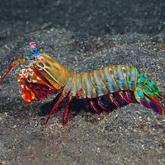
Why the Peacock Mantis Shrimp?
This Mantis Shrimp uses a striking hammer exhibiting peak forces close to 500 N for hunting prey.
Biological mechanical advantages in its lever arm.
We can model using our FDM 3D printing resources.
This general system may be applied in multiple ways.

Slide 3
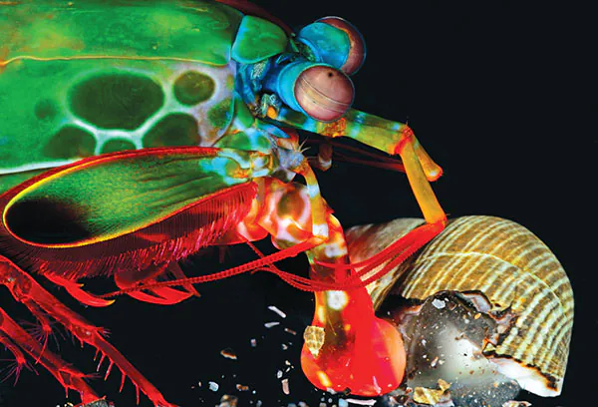
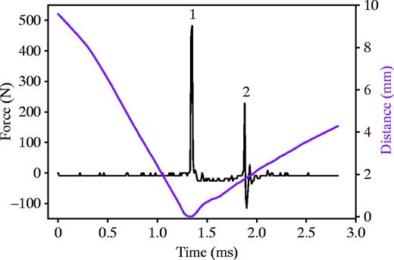
Some “Striking” Info
The Peacock Mantis Shrimp has impressive hammer specifications:
The hammer is used to smash rocks and coral to build dens.
Hammer may reach accelerations of 10⁵ m/s²
Some tests reached peak strikes of almost 500N.
Initial Strike
Cavitation

Slide 4

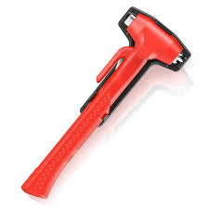
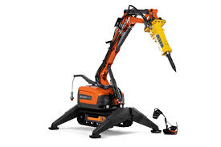
Important Because…
Upon mastering this system and achieving similar specs, there could be many applications:
Small scale equipment for demolition projects and excavation.
Emergency use, glass breaking tool in vehicles.
Robotics
Could launch objects at extremely high speeds, aerospace potential.

Slide 5
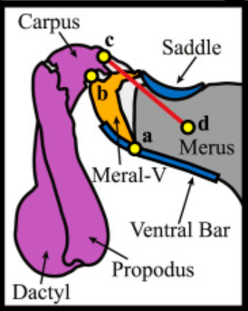
Biomechanics of the Mantis Shrimp Strike
Tendon pulls back to load the springs
Releases significant amount of potential energy once critical point is reached
The body and arm rotate outward with high acceleration causing high impact force
Dactyl is highly calcified to withstand high forces

Slide 6
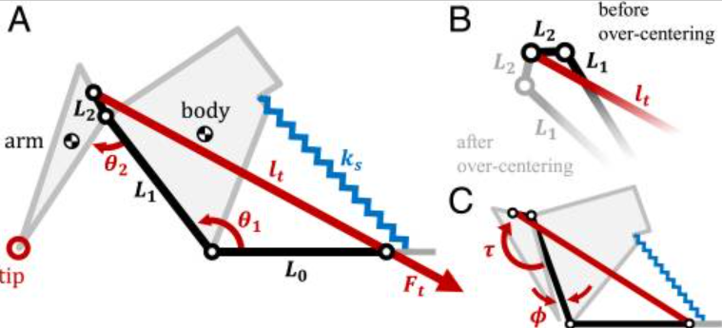
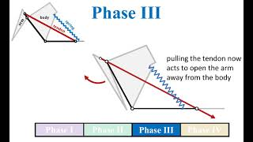
Biomechanics continued

Slide 7
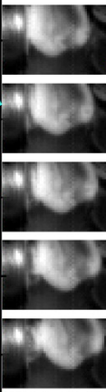
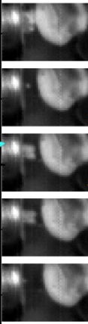
Cavitation
What is happening?
Fast strike speeds cause drop in pressure between dactyl and target
The low pressure causes water to boil
Steam bubbles collapse with significant force and can generate light flashes

Slide 8
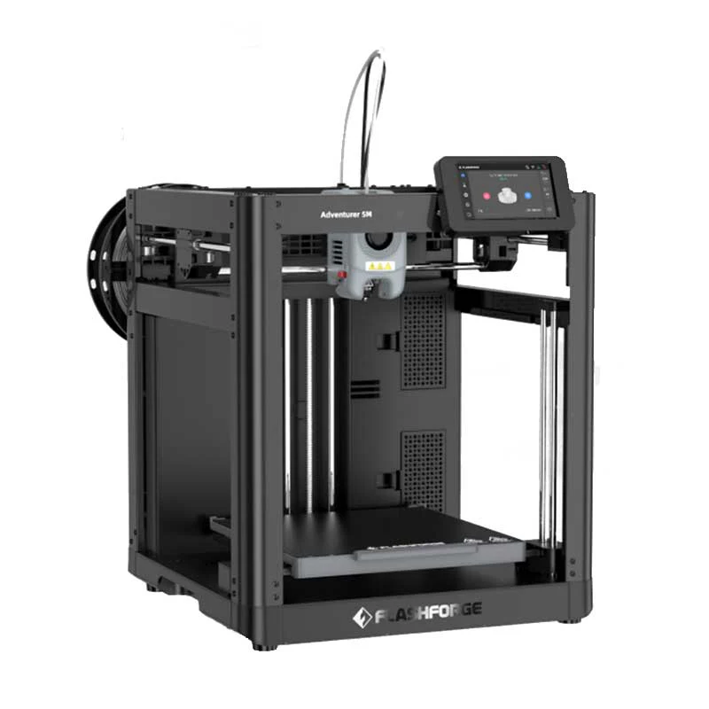
Printing Plan
FDM or SLA?
FDM printing better suits this application due to the material variety available.
A Flashforge Adventurer 5M and Bambu Labs P1S will be used for printing
PETG will be used to create prototypes
Initial prototypes will have low infill to minimize weight

Slide 9
Additional Materials
Springs - torsion, tension, and compression springs are all possibilities depending on how we model the system.
Bearings and pins - ideal to reduce friction however these can be printed as well
Testing Materials such as fixtures and weight blocks

Slide 10
Testing Procedure
We plan to test the model with different infills and examine how the resulting force changes.
Not all components will have the same infill. The weight of the striking arm will be the primary variable that we will change.
Alternatively we may keep the infill consistent and change the spring to achieve a greater resulting force.

Slide 11
Citations
Patek, S. N., and Caldwell, R. L., 2005, “Extreme Impact and Cavitation Forces of a Biological Hammer: Strike Forces of the Peacock Mantis Shrimp Odontodactylus scyllarus,” J. Exp. Biol., 208(19), pp. 3655–3664.
Steinhardt, E., Hyun, N. P., Koh, J., Freeburn, G., Rosen, M. H., Temel, F. Z., Patek, S. N., and Wood, R. J., 2021, “A Physical Model of Mantis Shrimp for Exploring the Dynamics of Ultrafast Systems,” Proc. Natl. Acad. Sci. U.S.A.,

Slide 12
Links
Mantis Shrimp
https://makerworld.com/en/models/770364-mantis-shrimp?from=search#profileId-706137
https://journals.biologists.com/jeb/article/208/19/3655/15838/Extreme-impact-and-cavitation-forces-of-a
https://movie-usa.glencoesoftware.com/video/10.1073/pnas.2026833118/video-4

