Slide 1
It’s Lunch Time Final Presentation
Aiden Aerni
Khamza Yerken
Daniel Eastman
Austin Walker
December 5th, 2024
Notes:
Khamza

Slide 2
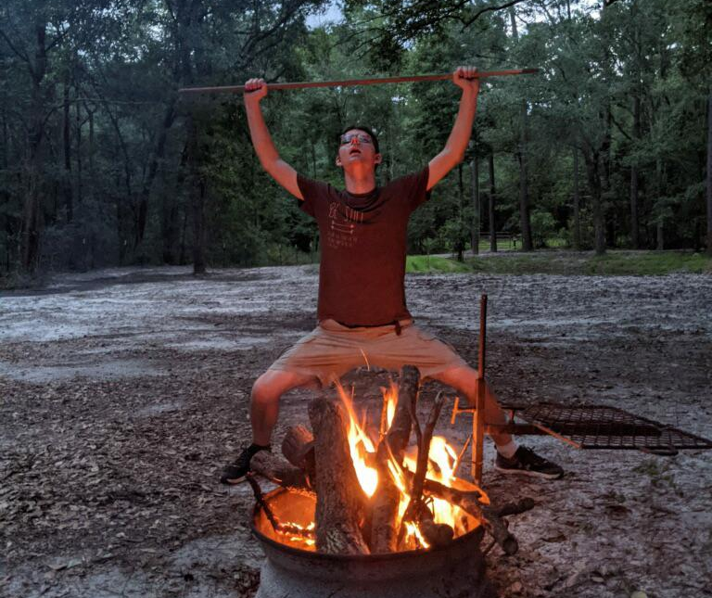
Our Project
The Problem: Turning food on a roasting stick over a fire is too much work.
The Solution: A device that automatically rotates the food over a fire.
Notes:
Khamza

Slide 3
Project Requirements
The Primary Requirements of this Prototype are:
Rotates food automatically
Able to withstand high surrounding temperatures
Operarable independent from the user
Semi-collapsible for storage
Adjustable components
Adjustable rotation speed
Accessible and convenient power source
User friendly
Notes:
Aiden

Slide 4
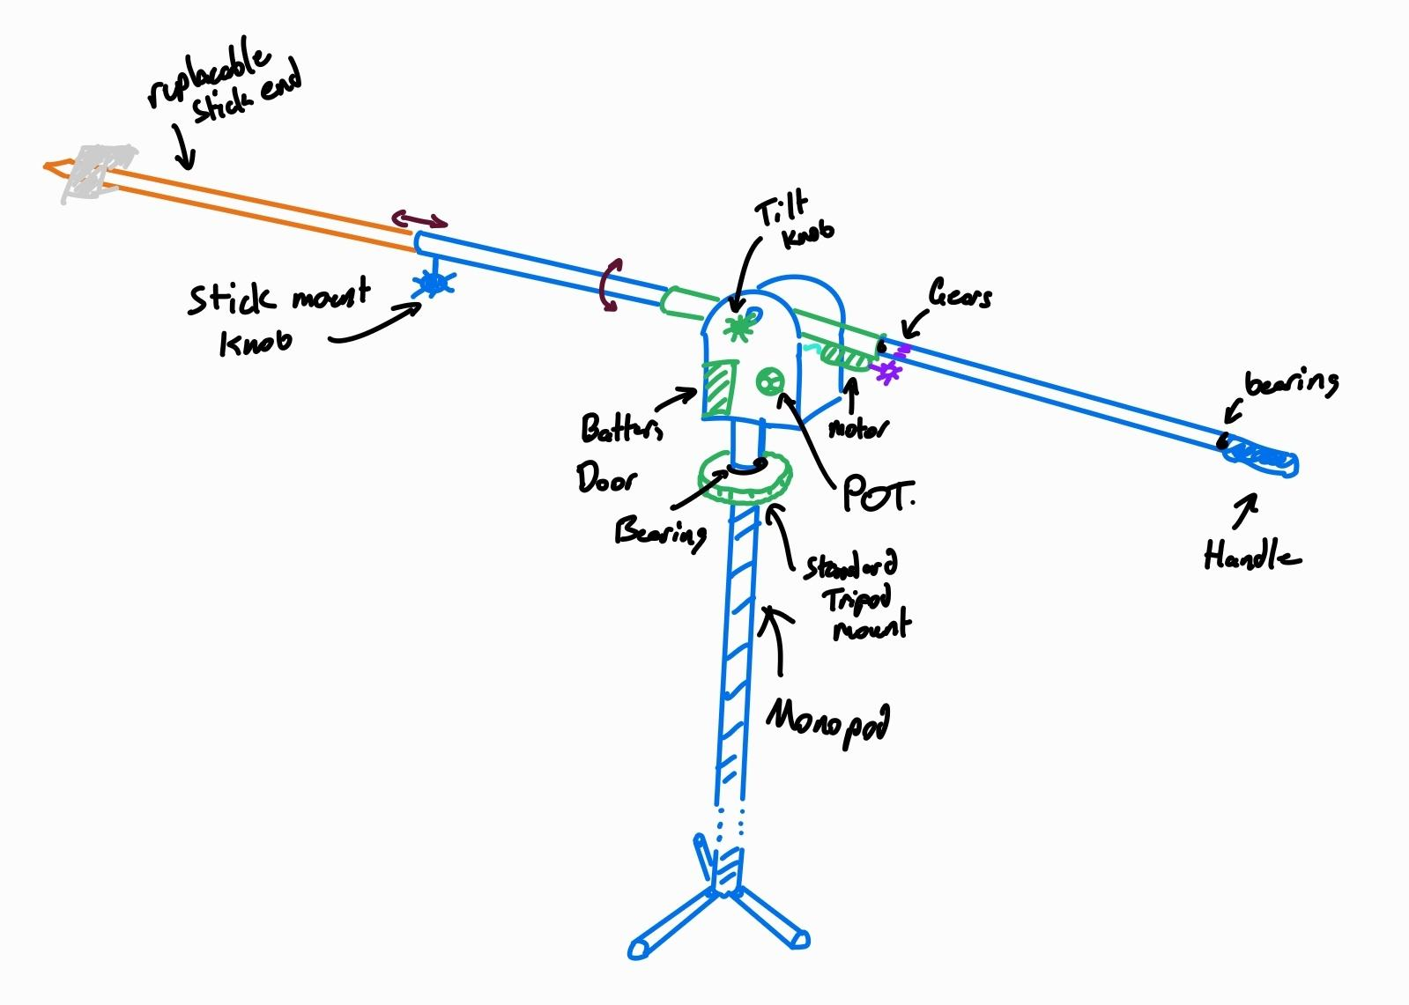
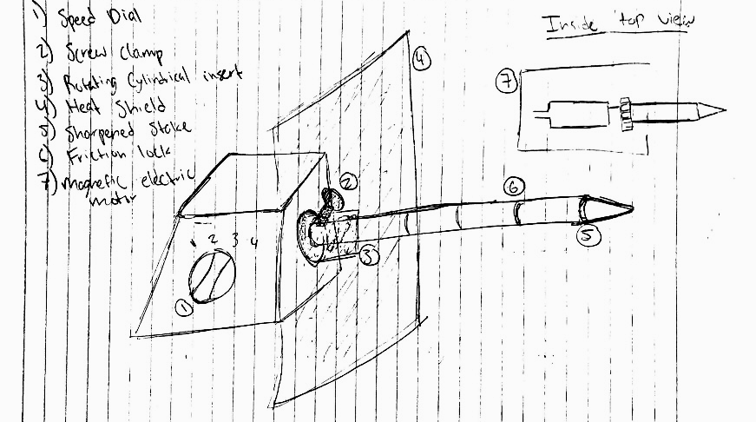
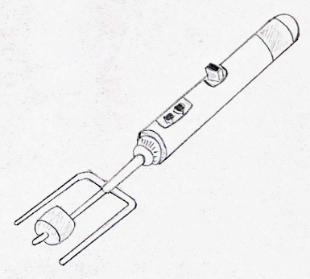
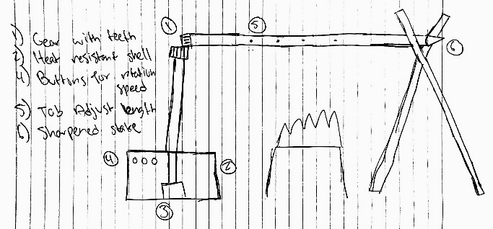
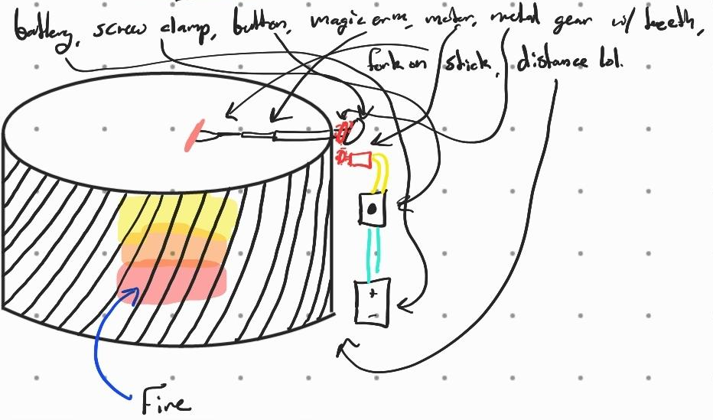
Design Development
Daniel 2
Aiden 1
Khamza 3
Austin 4
Aiden 5
Notes:
Khamza

Slide 5
Design Development
Pros:
Versatile
Easy to Manufacture
User-friendly
Efficient
Cons:
Safety/durability
Weight balance issues
Stackability/size
Safety of power mechanism
Notes:
Daniel

Slide 6
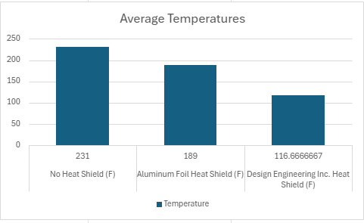
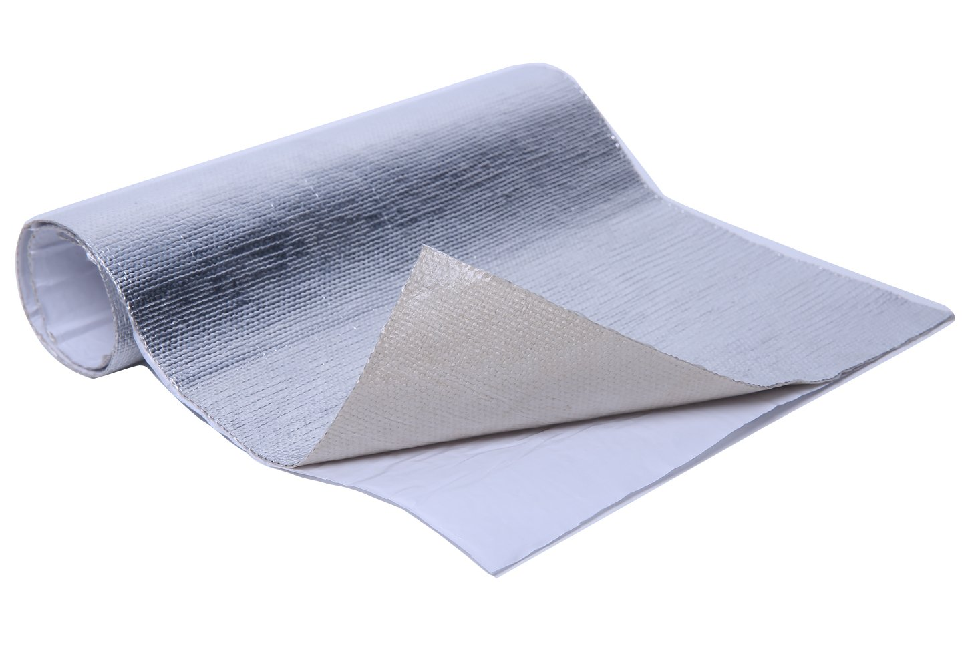
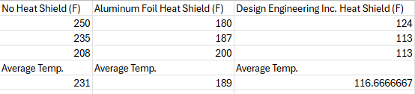
Design Development
Design Analysis (Experimentation):
Conducted an experiment for the heat
shield
The chosen heat shield reduced heat
on our product by 50%
We chose to use a material composed
of mylar, fiberglass, with an aluminized
surface from Design Engineering Inc.
Notes:
Aiden

Slide 7
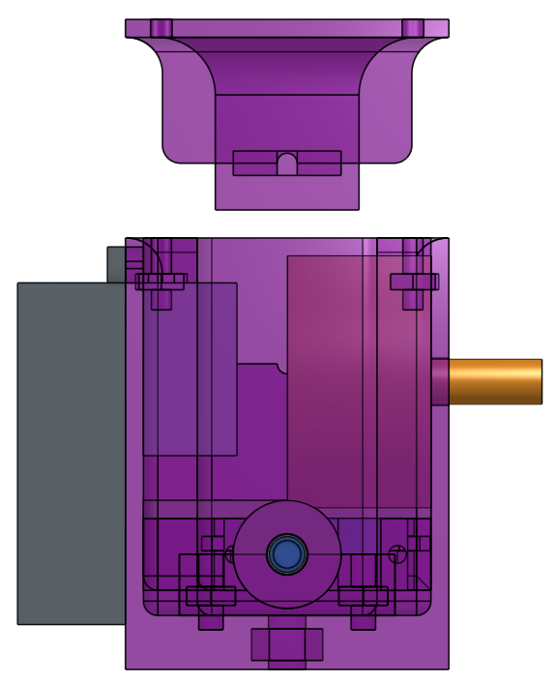
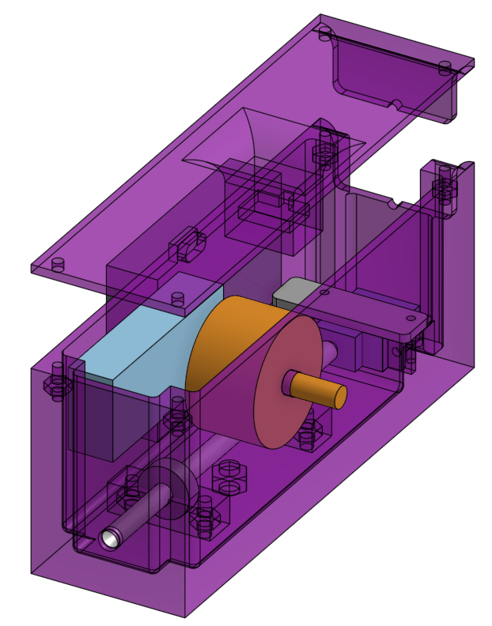
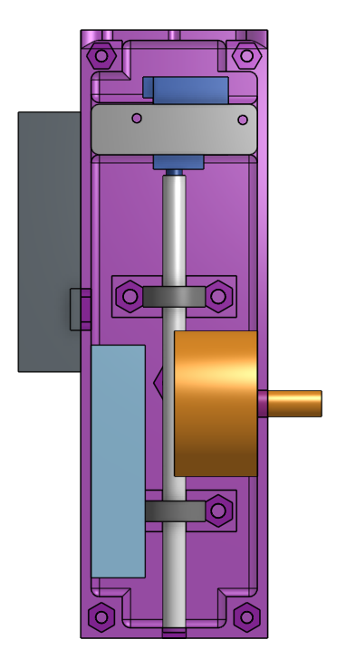
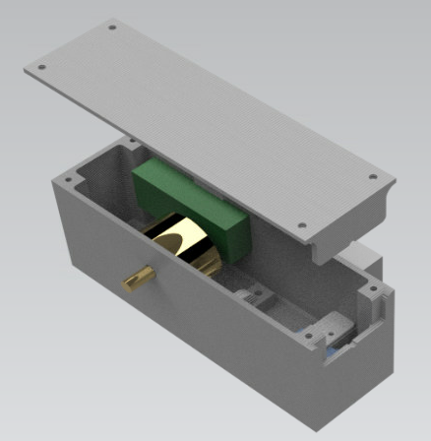
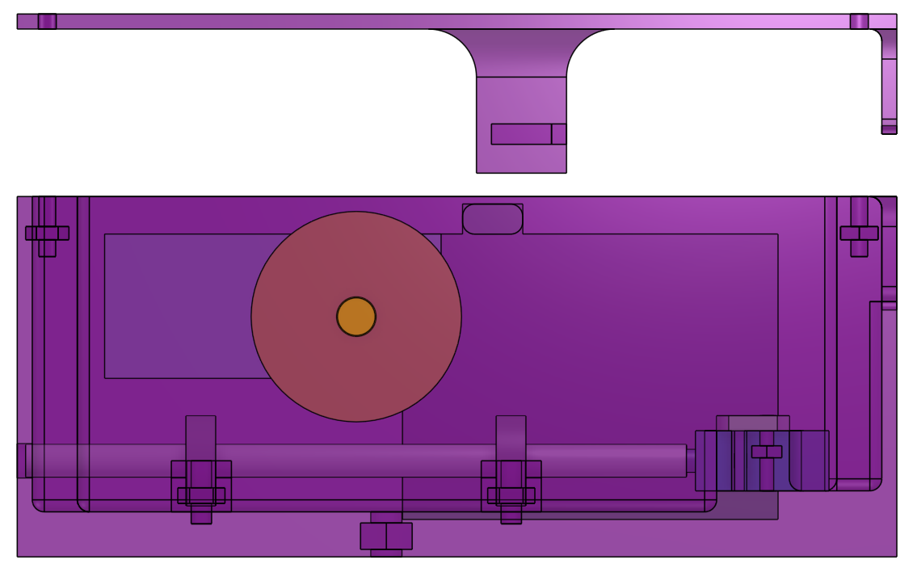
Design Solution
ISOMETRIC:
FRONT:
TOP (w/ lid off):
PHOTOREALISTIC:
RIGHT:
Notes:
Austin

Slide 8
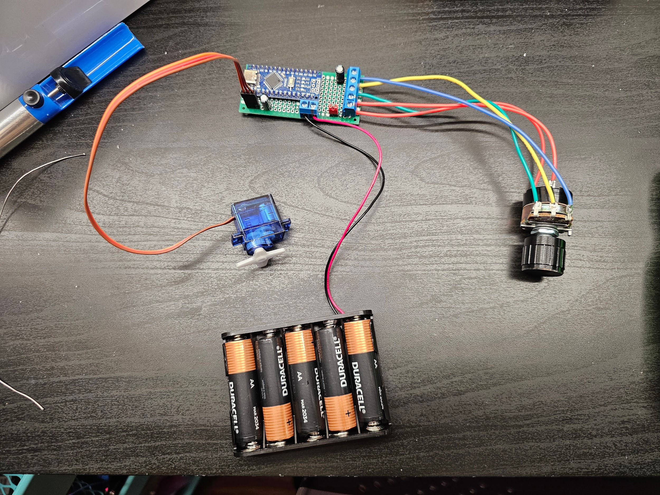
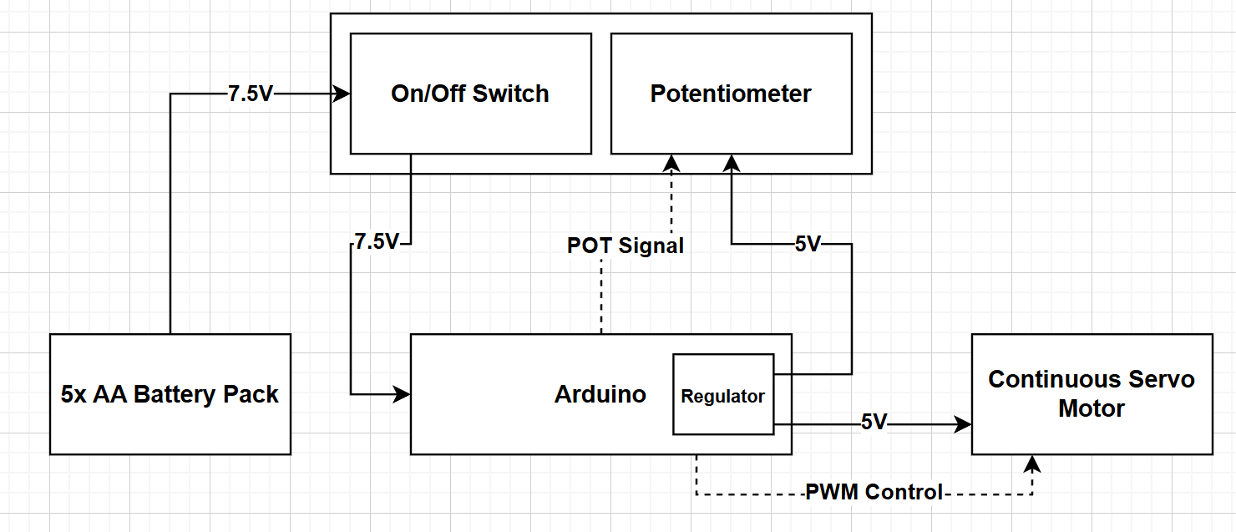
Design Solution
Electrical Block Diagram:
Notes:
Daniel

Slide 9

Prototype
Time to show it off 😈
Notes:
Austin

