Slide 1
Waste Management
By Emma, Wyrd, Aiden, Alessandra

Slide 2
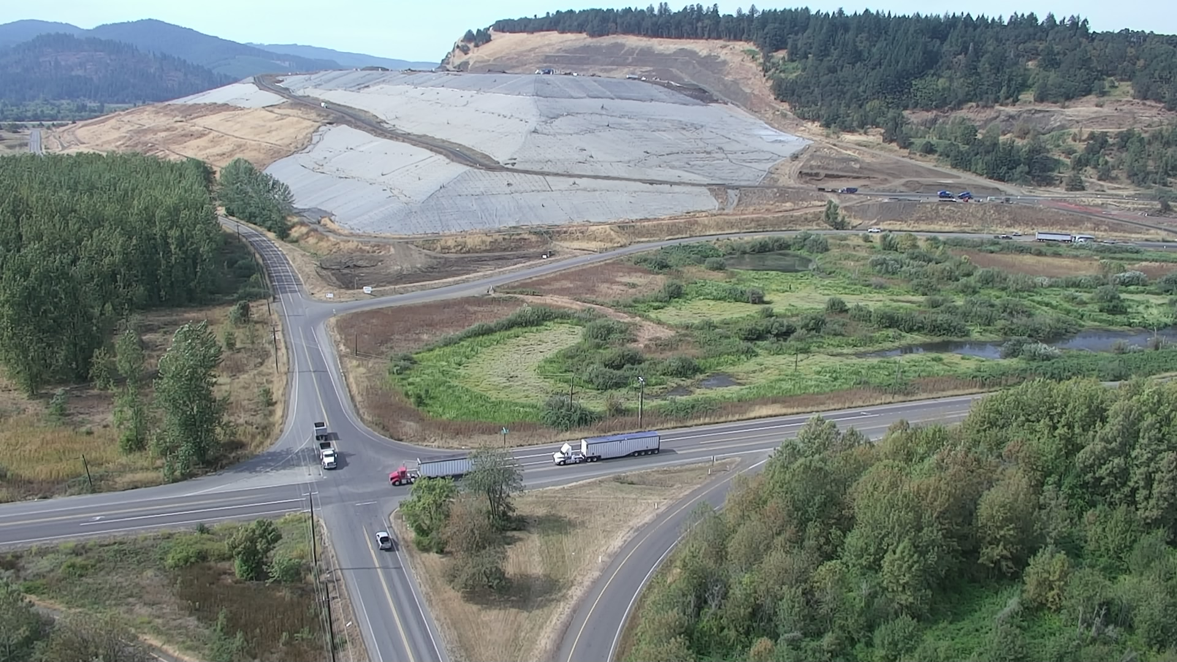
Landfills: A Chemical & Pollutant Melting Pot
What is the purpose of a landfill?
Is this waste material ever removed?
How can we stop the expansion of these landfills?
(Coffin Butte located just outside Corvallis, Oregon)

Slide 3

The first landfills are known to be utilized as far back as 3,000 BCE.
First Landfills Located in Knossos, Crete
Legislation for mandatory dumping at these sites around 300 BCE
The issue of landfills and waste management is historically recognized
(Knossos, Crete ancient civilization)

Slide 4
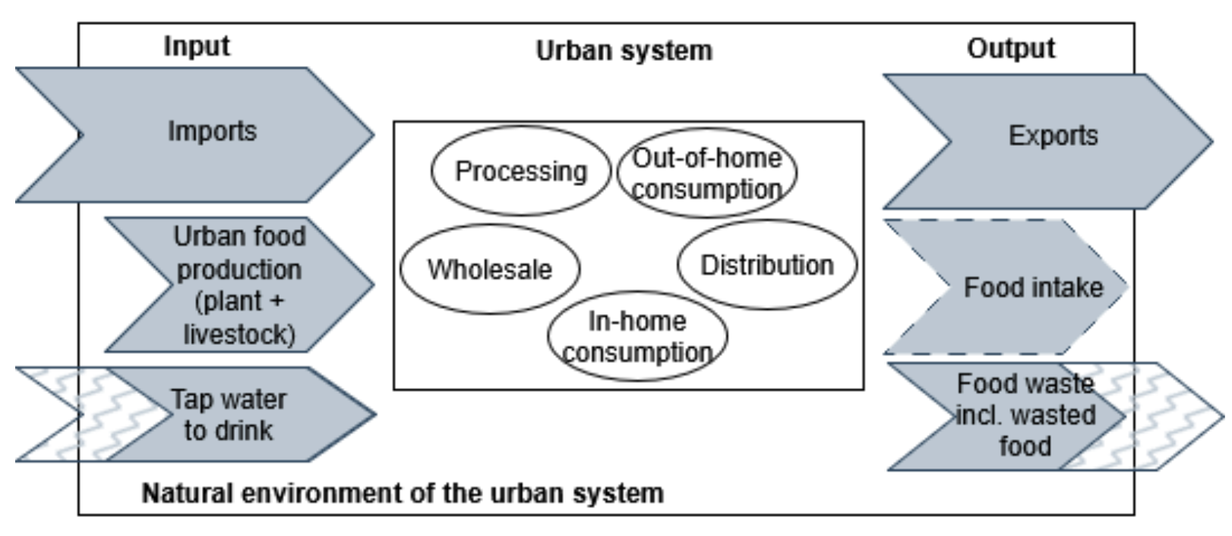
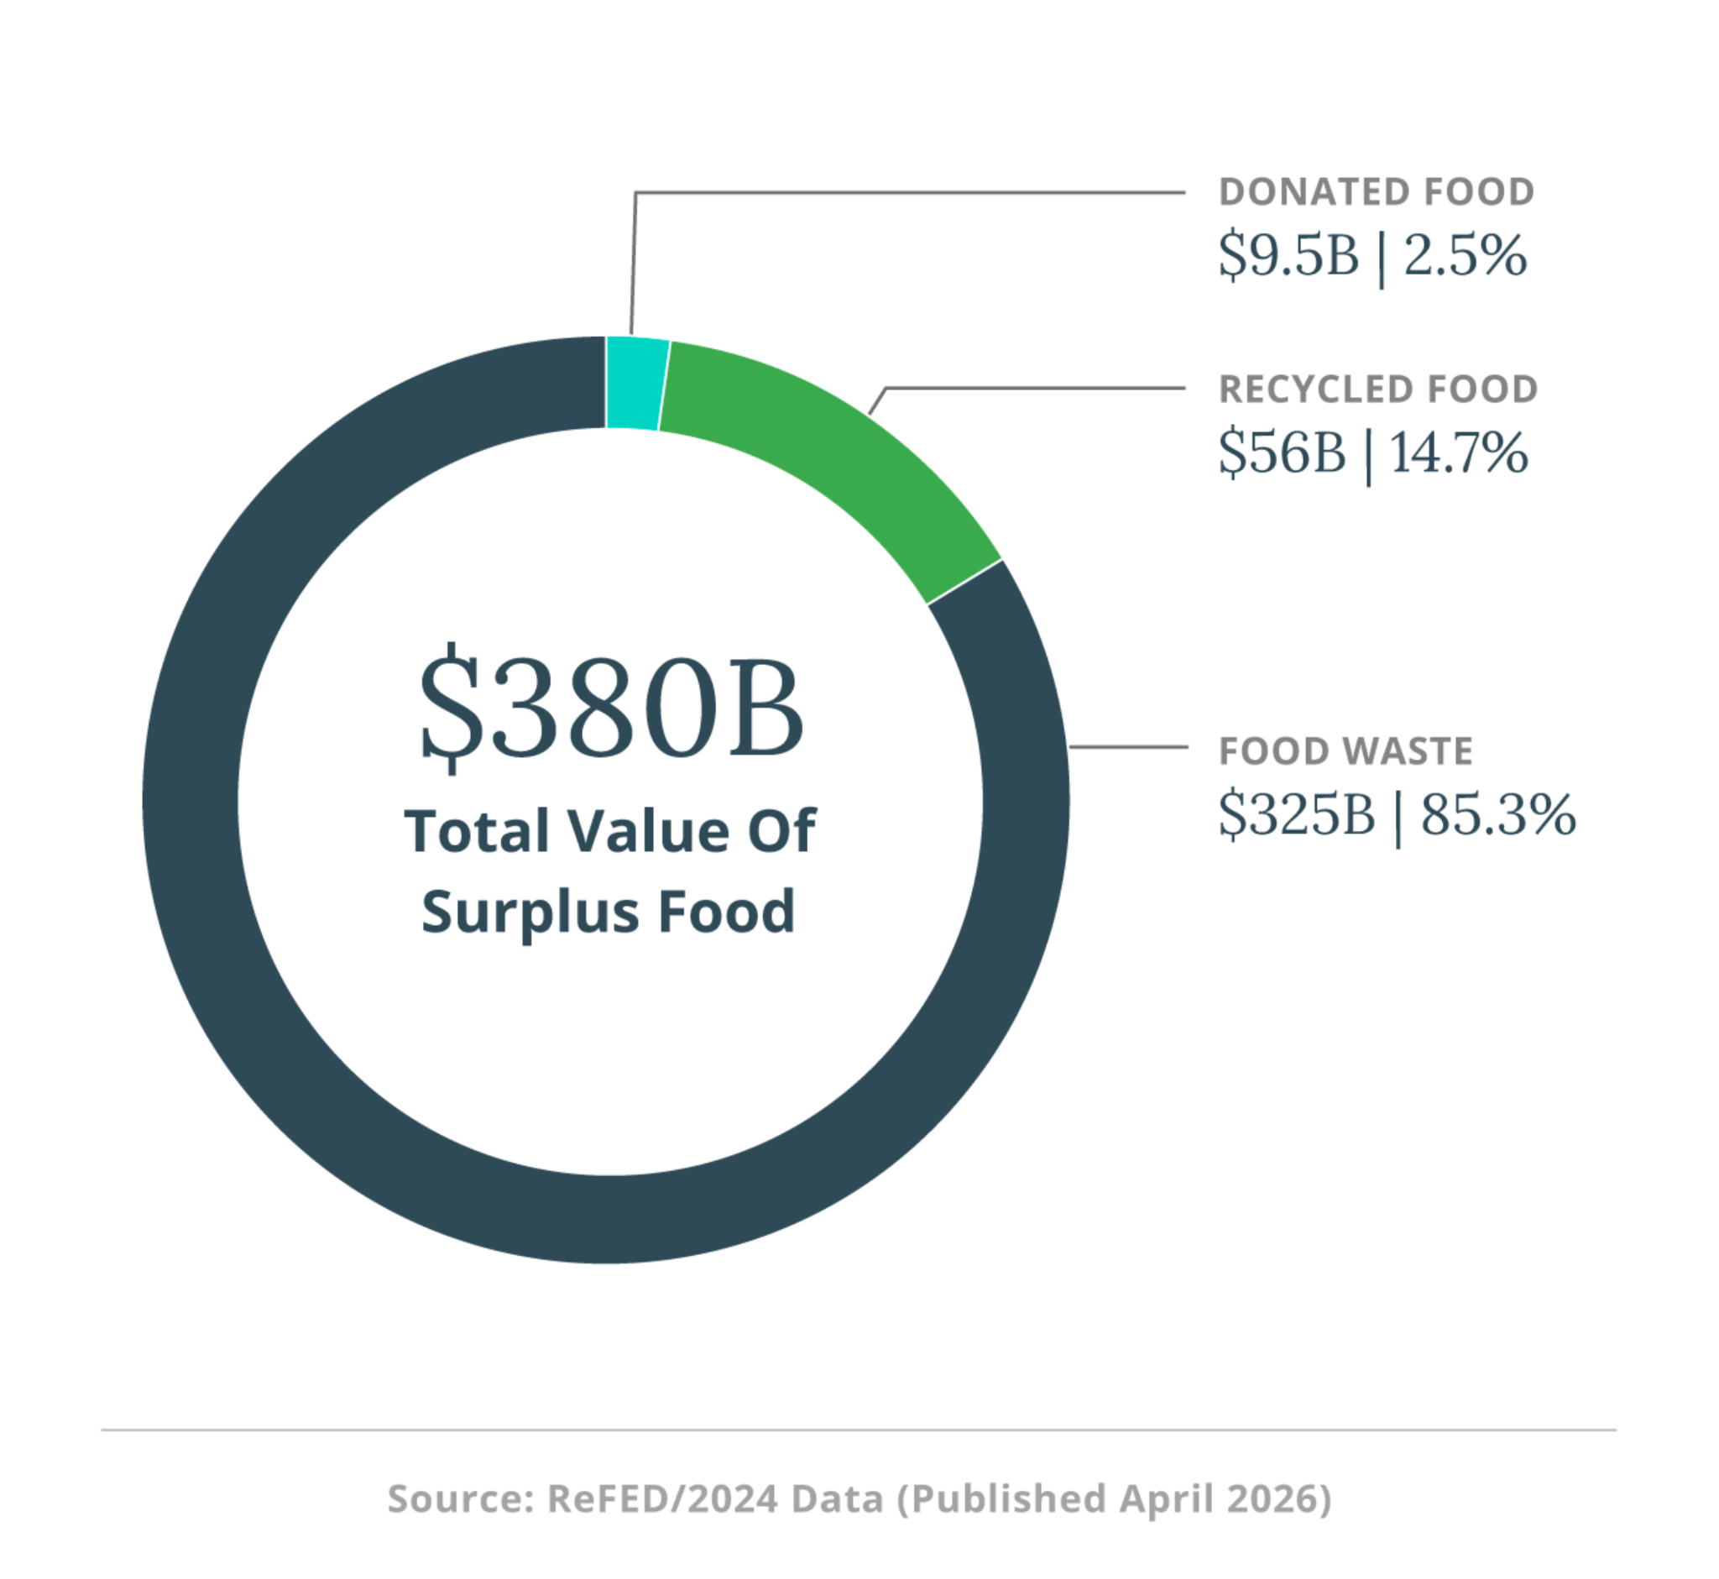
Current food systems contribute excess waste that results in an increased demand for landfills.
Redlingshöfer, B. (2025). Conceptual model of the urban food metabolism.
https://circulareconomyjournal.org/ojs/JoCE/article/view/65/106
ReFED. (2026). Food waste data—causes & impacts. ReFED. https://refed.org/food-waste/the-problem/#what_is_the_impact

Slide 5
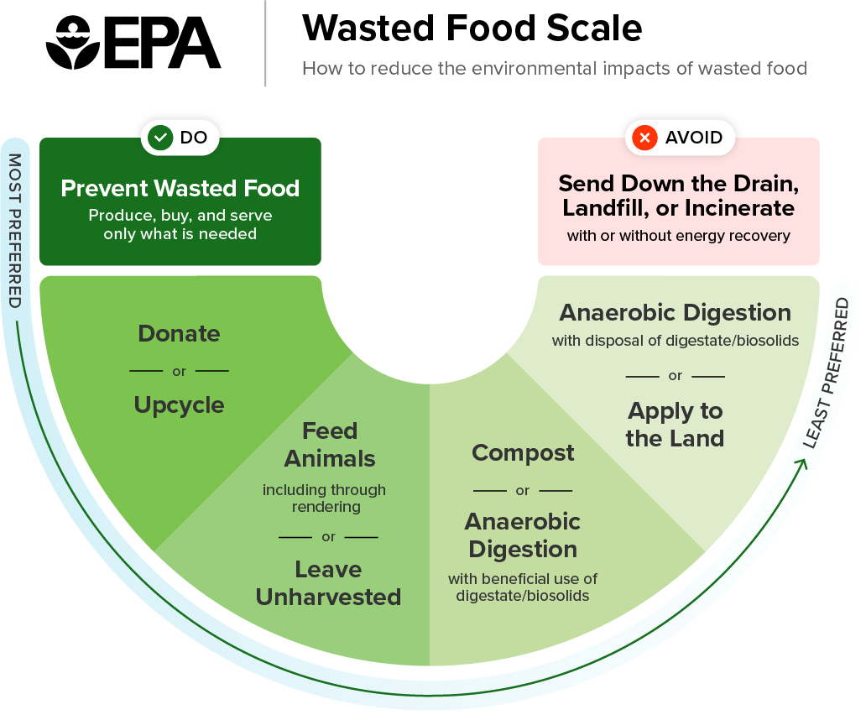
Food Waste is Pollution
Currently, the US wastes between 30-40% of our food supply
Goals have been set by the EPA to cut food waste in half by 2030.
This is a systemic issue that is seen globally as a result of capitalism and the breakdown of communities.
This waste can happen at any stage of production or consumption, so many actions can be taken to mitigate this.
US EPA, 2025

Slide 6
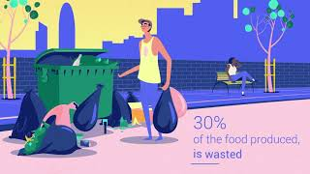
Waste Management as a Human Rights Issue
UN EP, 2021

Slide 7
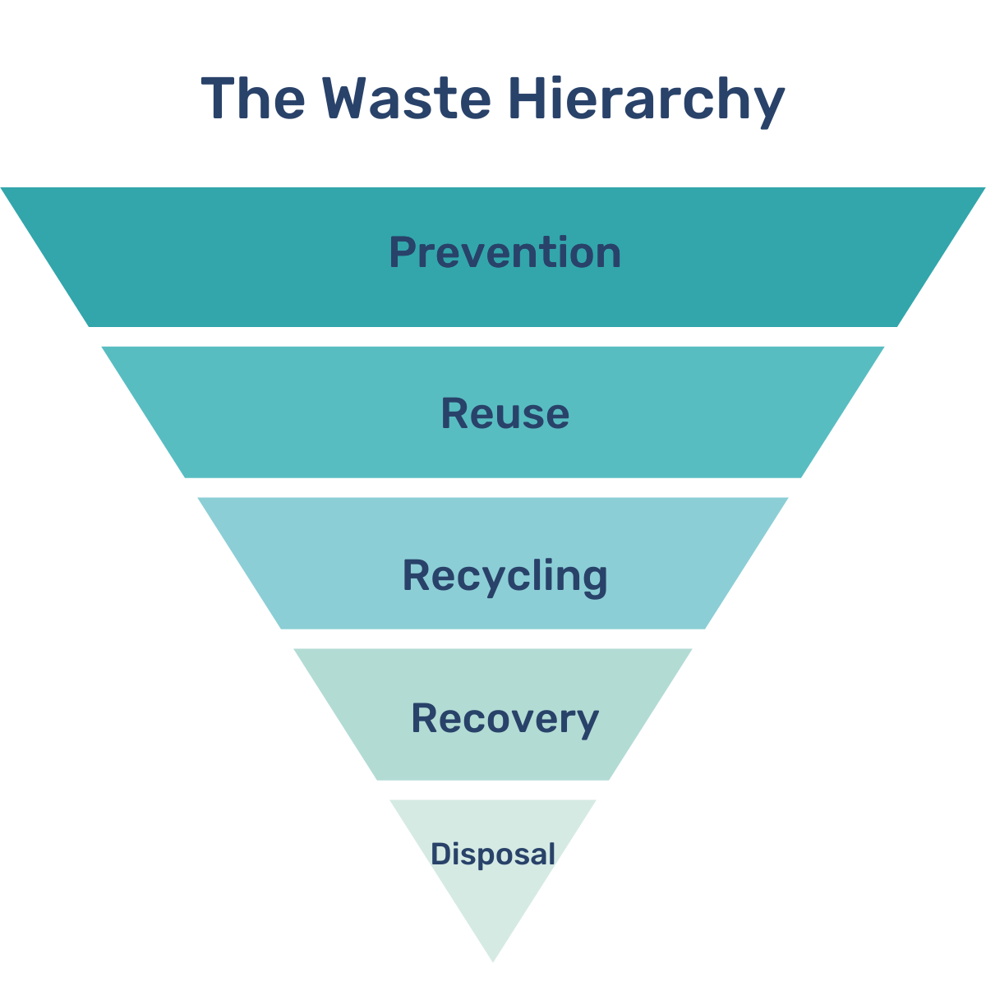
Waste Management as a Sustainability Issue
Prevention
Minimize consumption and packaging
Reuse
Repair, clean, donate, upcylce
Recycling
Separation, collection, production
(Energy) Recovery
Combustion, anaerobic digestion, gasification
Disposal
Landfill, incinerator
(Nord Sense, 2022)

Slide 8
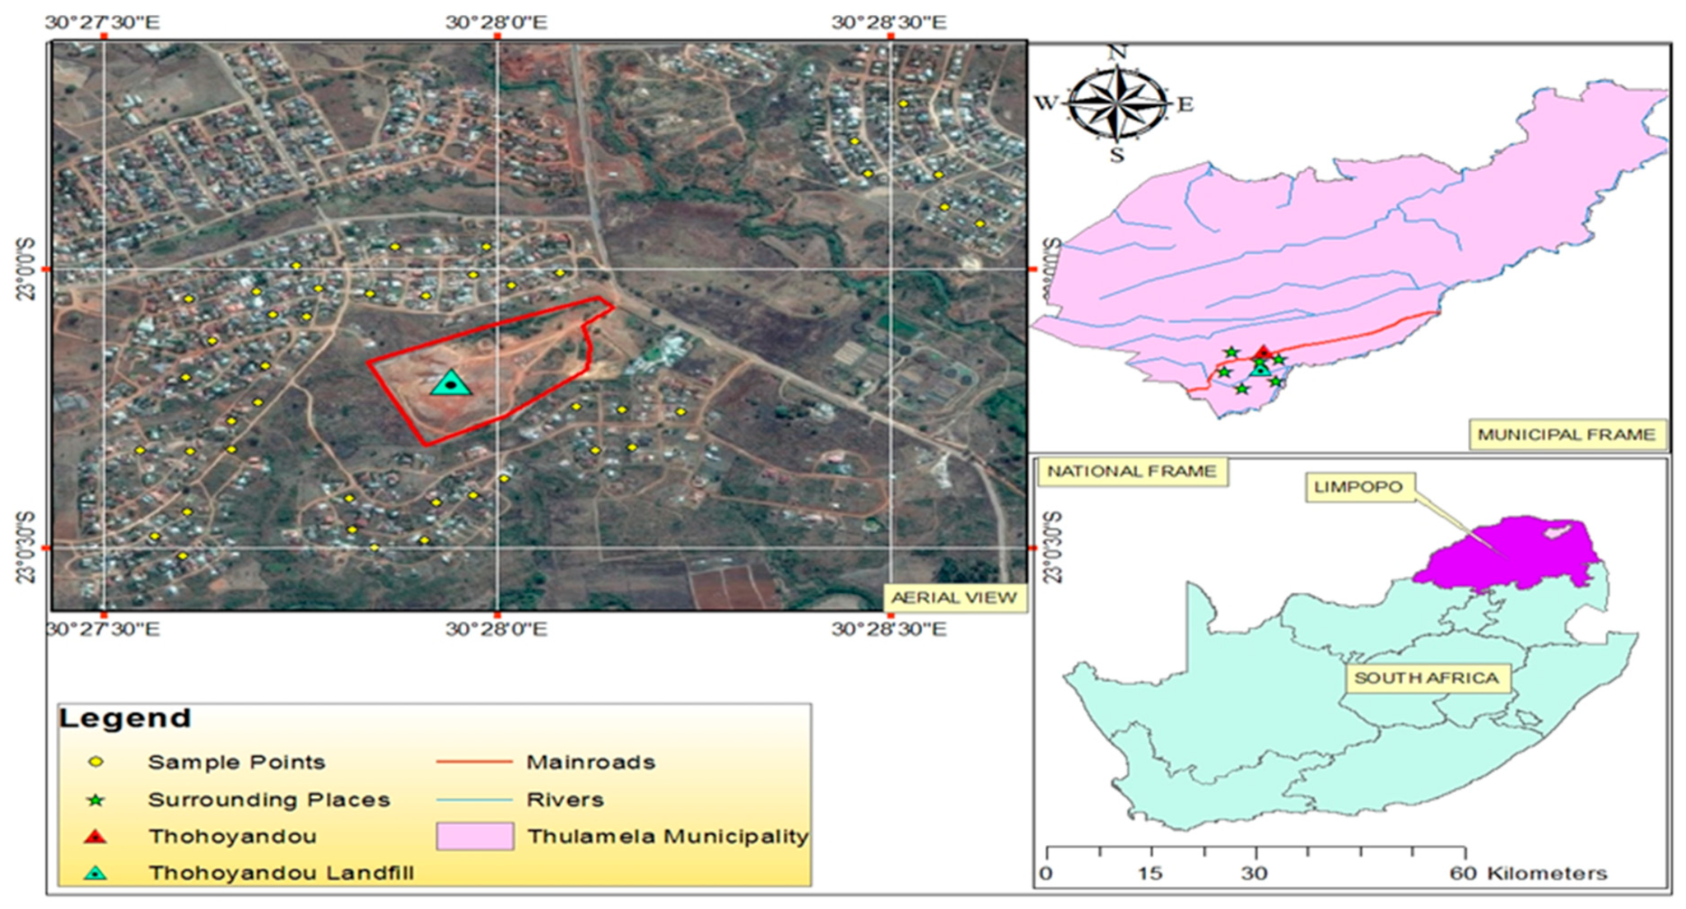
Our Case Study
Thohoyandou Landfill in Limpopo Province, South Africa
In operation since 2005
Research conducted by the University of Venda
Njoku, P. O., Edokpayi, J. N., & Odiyo, J. O. (2019).
Thohoyandou landfill site and nearby residents.
https://doi.org/10.3390/ijerph16122125

Slide 9
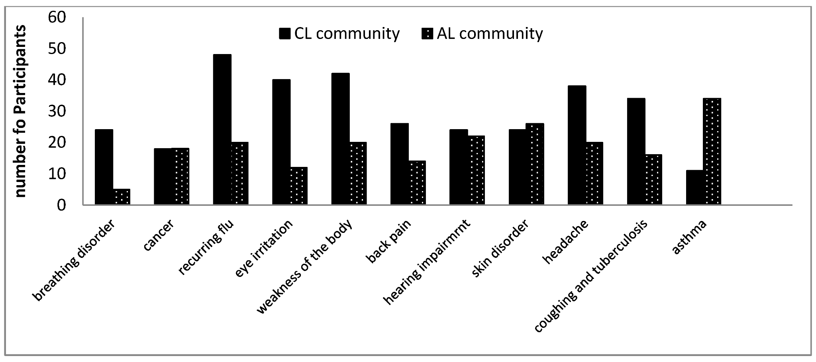
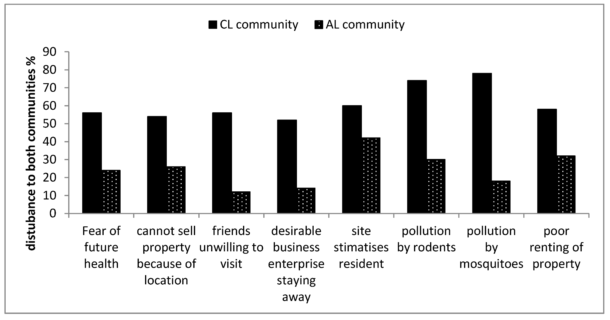
Our Case Study
1. Comparison between both communities showing how frequent the illnesses impact them.
CL - “Closer to the landfill site”
AL - “Far away from the landfill site”
CL = Within 100-500 m
AL = Between 1-2 km
CL residents consistently reported higher rates of illness and disturbance.
2. Comparison between both communities showing how disturbing these external factors were to them.
1&2. Njoku, P. O., Edokpayi, J. N., & Odiyo, J. O. (2019). https://doi.org/10.3390/ijerph16122125

Slide 10
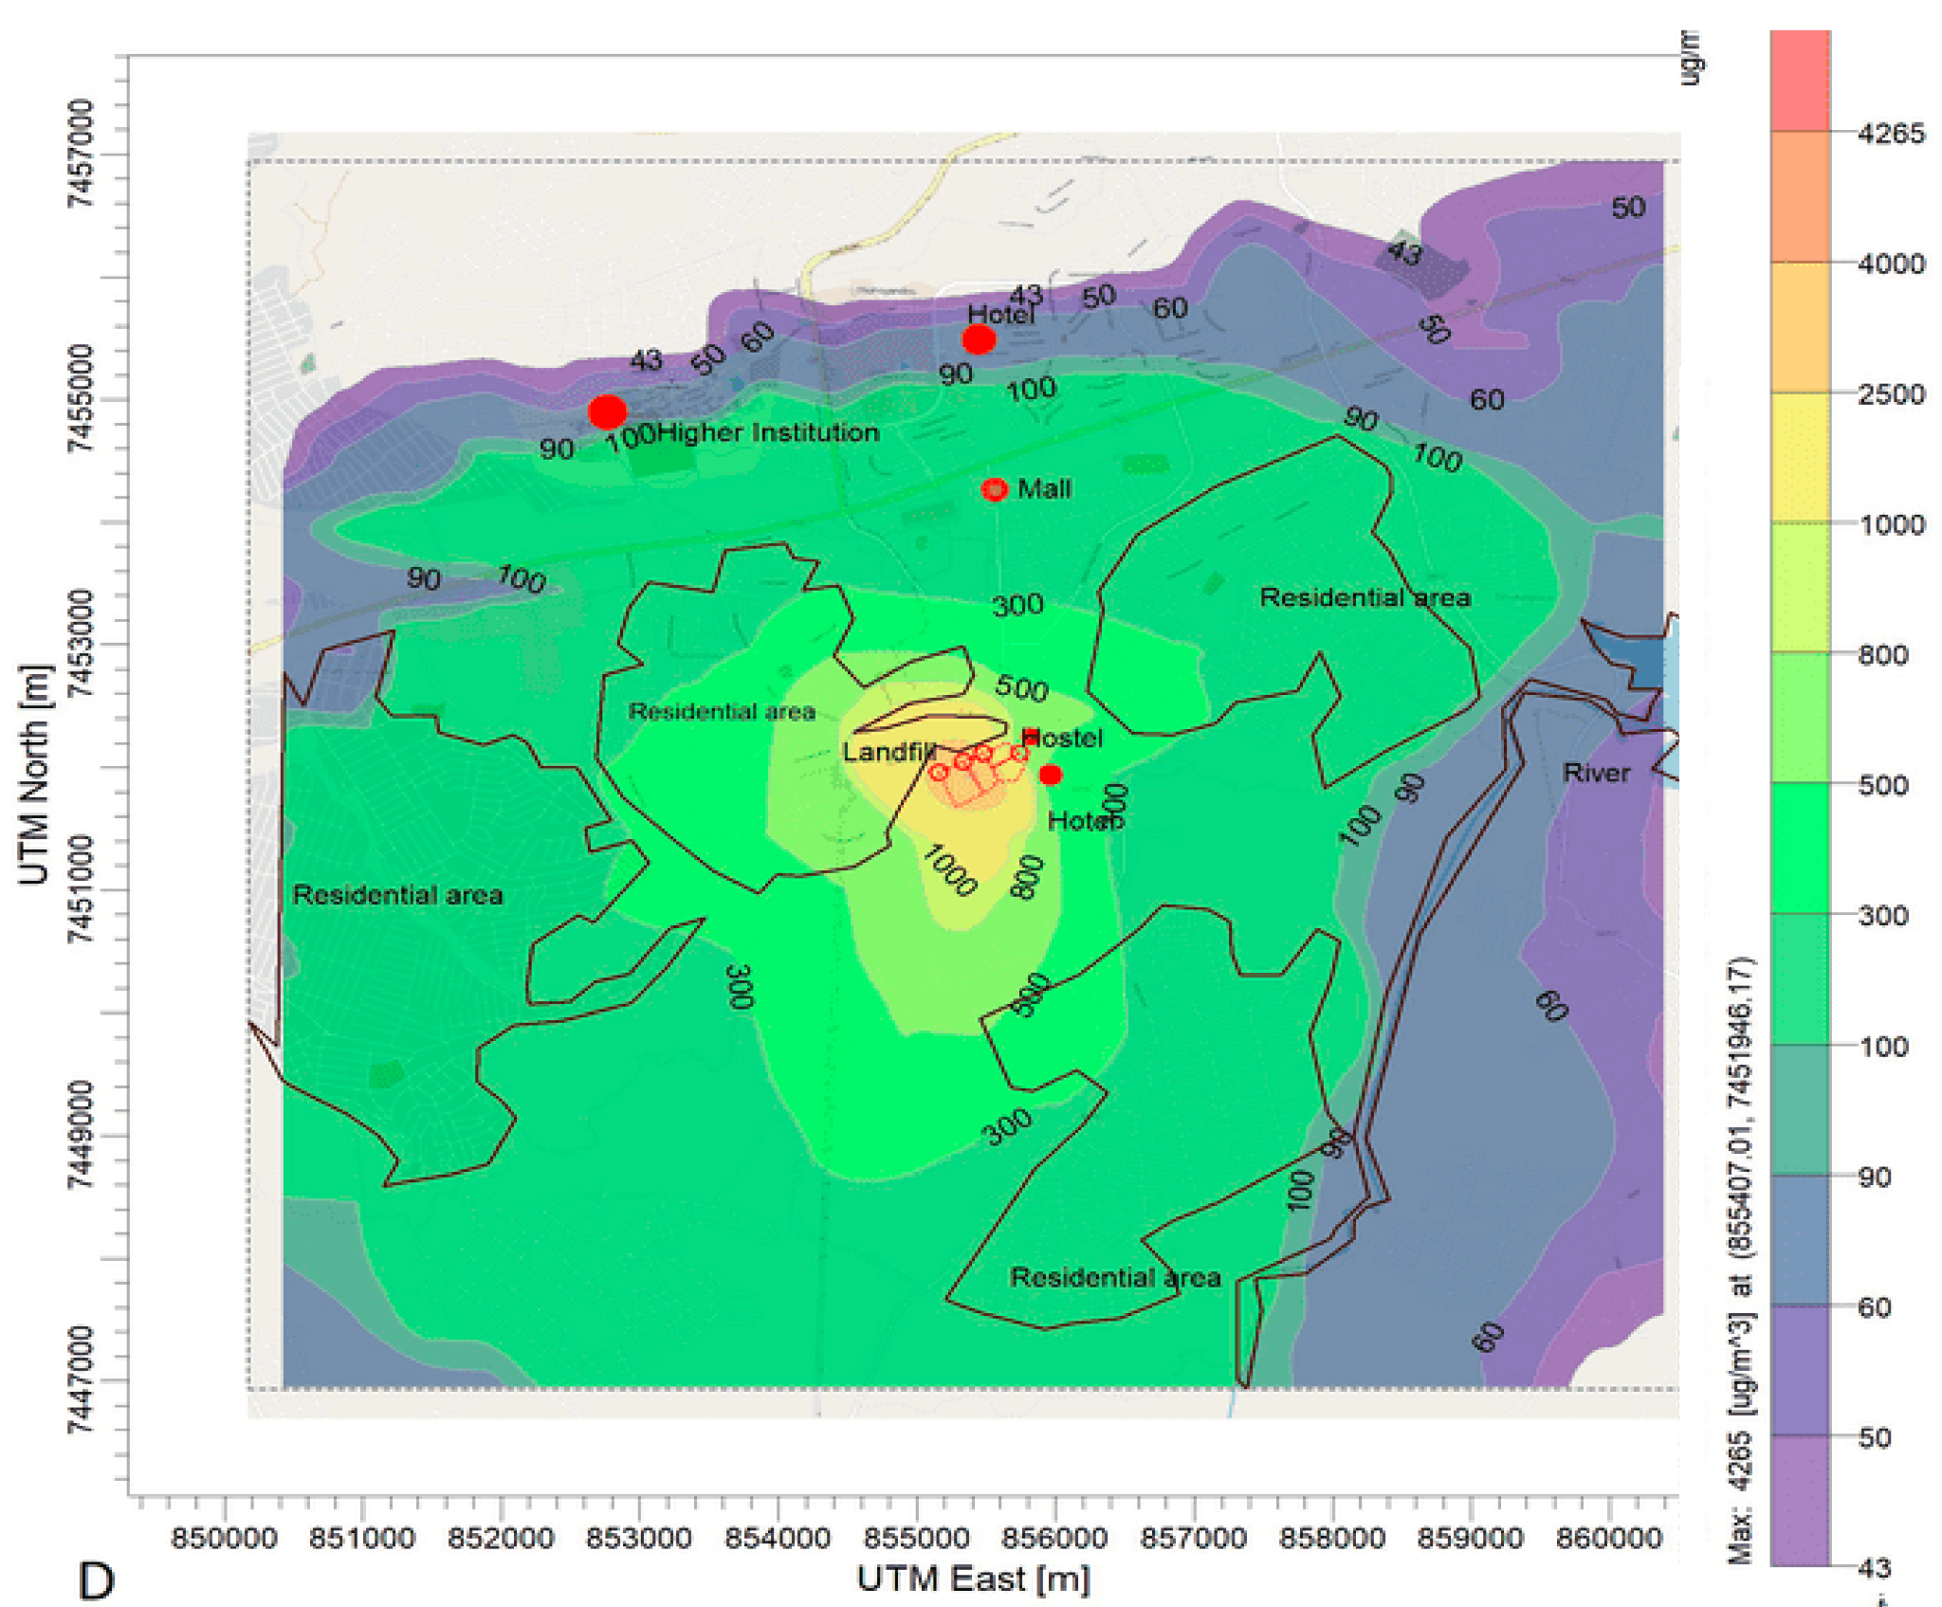



Threats Caused by Poor Waste Management
Health Issues
Chronic exposure to methane is one of the greatest risk factors, leading to issues including:
Respiratory problems:
Breathing disorders
Chronic flu symptoms
Airway inflammation
Other symptoms:
Eye irritation
Headaches
Fatigue
1. Annual average CH4 dispersion emissions using the AERMOD model
1. Njoku, P. O., Edokpayi, J. N., & Makungo, R. (2025). https://doi.org/10.3390/atmos16121402

Slide 11



Threats Caused by Poor Waste Management
Social and Environmental Issues
Environmental impacts include:
Odor pollution
Dust pollution
Spread of litter
Greenhouse gas emissions
Groundwater contamination
Increased pest populations (including mosquitoes and rats)
Social impacts include:
Lower satisfaction with life
Fear/anxiety about health
Reduced property desirability (both for buying/selling and renting)
Barriers to socializing and community connection

Slide 12
Threats Caused by Poor Waste Management
Power and Inequality Issues
1. “On the day of our visit to the landfill, there were complaints about the bulldozers for daily covering of waste not functioning for several months.”
Waste management is not just a technical issue, it is also deeply political.
Landfills are often built near vulnerable and underprivileged populations.
Least ability to influence or resist policy decisions
Easiest to ignore when concerns are raised
Health and economic impacts further increase inequality
1. Njoku, P. O., Edokpayi, J. N., & Odiyo, J. O. (2019). https://doi.org/10.3390/ijerph16122125

Slide 13
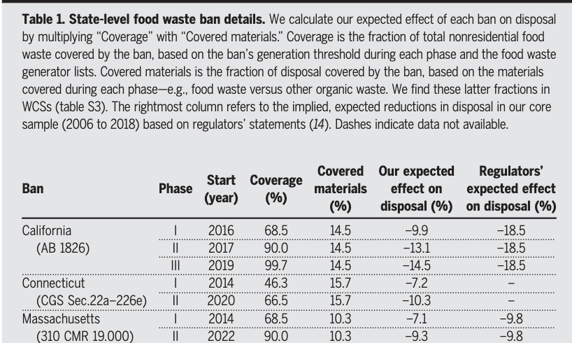
Current solutions to waste management issues…
Anglou, F. Z., Sanders , R. E., & Stamatopoulos, I. (2024). State-level food waste ban details. https://doi-org.oregonstate.idm.oclc.org/10.1126/science.adn4216
Notes:
California policy aims to divert 75% of organic waste from landfills to industrial composting facilities, which Perez et al. (2023) found can reduce greenhouse gas (GHG) emissions by 39-84% compared to landfill disposal.
Organic waste is important because:
Passively generates a large portion of GHG production globally
Shown to be beneficial to compost for economies of scale and significantly reduce environmental impacts
Reduces GHG emissions by:
Aerobic vs Anaerobic decomposition
Aerobic Compost: nearly 50% reduction in Methane and other GHGs
Landfill (oxygen deprived): generates an abundance of organic gases and liquids that affect local air and water quality
Landfilled compostable organic wastes
While these policies are already reducing landfill waste in some regions, researchers are also exploring newer technologies and long-term waste management strategies.

Slide 14

Potential & Future Solutions
Waste Diversion:
Composting infrastructure expansion
Food waste reduction policies
The Milan Urban Food Policy Pact
Energy Recovery:
Landfill methane capture
Using anaerobic systems for natural gas
Waste-to-Energy systems
Emerging Research:
Black Soldier Fly larvae
Improved gas-capture efficiency
Scalable composting systems
Notes:
Waste Diversion
Community composting bins, commercial waste valorization facilities, and more
Beyond current composting infrastructure, researchers are looking for additional ways to reduce env and human health impacts of organic waste.
Policy
Cali, Connecticut, and Massachusetts
Paris agreement
Intl. pact to reduce organic waste to help meet paris agreement goals
Energy Recovery
Landfill gas capture
Using that natural gas in closed loop systems or as a fuel in power plants.
Burns to CO2 and H2O
CO2 can be captured from exhaust in catalytic converter
Emerging Research
Bioconversion Efficiency Factors
Aerobic env
Localization of waste and bioconverting organisms.
To increase efficiency of organic waste processing systems
Even with these advancements, many practical and scientific questions still remain unanswered.

Slide 15
Further Questions
How can smaller cities afford methane-capture infrastructure?
Can composting systems scale globally?
How effective are emerging bioconversion technologies?
What policies best protect communities near landfills?
How can waste reduction become economically sustainable?
Notes:
Altho many promising solutions exist, there are still major questions about scalability, affordability, and long-term effectiveness. Smaller communities may not have the infrastructure necessary for methane capture or industrial composting systems, and many emerging technologies remain difficult to implement outside research settings. Future research will likely focus on balancing environmental sustainability, public health and economic feasibility.

Slide 16
Sources
Anglou, F. Z., Sanders, R. E., & Stamatopoulos, I. (2024). Of the first five US states with food waste bans, Massachusetts alone has reduced landfill waste. Science, 385(6714), 1236–1240. https://doi.org/10.1126/science.adn4216
Njoku, P. O., Edokpayi, J. N., & Odiyo, J. O. (2019). Health and environmental risks of residents living close to a landfill: a case study of Thohoyandou Landfill, Limpopo Province, South Africa. International Journal of Environmental Research and Public Health, 16(12). https://doi.org/10.3390/ijerph16122125
Nord Sense. (2022, July). Sustainable Waste Management Solutions. Nord Sense. https://nordsense.com/wp-content/uploads/2022/07/The-Waste-Hierarchy.png
Redlingshöfer, B. (2025). Minimizing then Closing Material Cycles: The Ignored Potential of Food Waste Reduction to Transform the Urban Food Metabolism of the Paris Metropolitan Area. Journal of Circular Economy, 3(3). https://doi.org/10.55845/joce-2025-3365
ReFED. (2026). Food waste data—causes & impacts. ReFED. https://refed.org/food-waste/the-problem/#what_is_the_impact
Sustainable management of food. (2015, April 16). US EPA. https://www.epa.gov/sustainable-management-food

