Slide 1
GREENLINE
Know Your Bets.
Find Your Edge.
Behavioral analytics for the 60M+ casual sports bettors the sportsbooks built to lose.
Rohith Chemitiganti · CEO & Co-Founder
Connor Donnelly · CMO & Co-Founder
Indiana University · Kelley School of Business · New Venture Planning

Slide 2
Sportsbooks profit when you don't know yourself.
7.5¢
60%+
0
lost on every $1 wagered
of adults 20–45
behavioral metrics
by the median U.S. sports bettor
now hold an active sportsbook account
shown to users by FanDuel or DraftKings
The casual bettor isn't dumb — they're uninformed. Sportsbooks give just enough data to bet, never enough to learn. That gap is GreenLine.

Slide 3
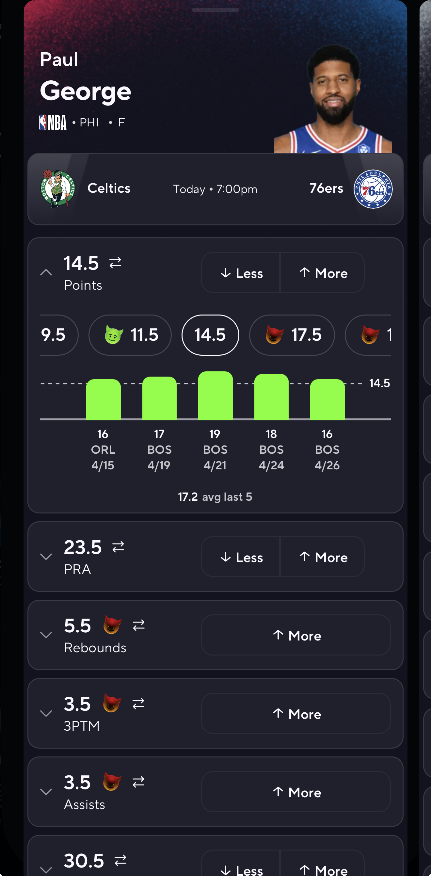
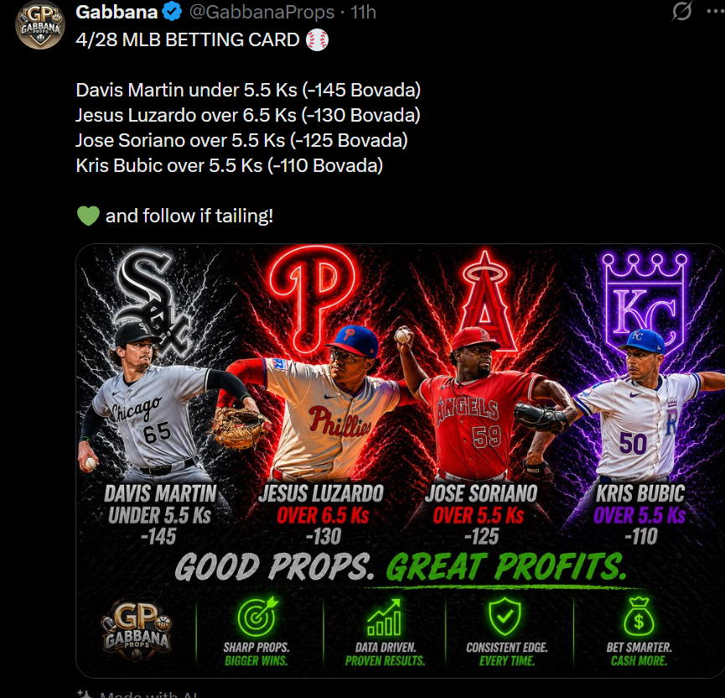

How people choose to bet right now
10
minutes
It takes sports bettors up to 10 minutes to put a bet in

Slide 4




GreenLine: a band-aid built for a wound nobody is treating.
Four pillars of the platform
GREENLINE
Behavioral Dashboard
Bankroll Management
Mission
To empower sports bettors with the tools to make more responsible decisions — turning gut-feel gamblers into informed financial decision makers.
P/L by sport, bet type, team, and time of day.
Total ROI plus unit-size & strategy guardrails.
Pattern Recognition
Community & Leaderboards
Tagline
“Know Your Bets. Find Your Edge.”
“Betting personas” drive personalized recs.
Insight-sharing, retention loops, social proof.
Subscription analytics. Web + iOS + Android.
Notes:
Add appendix

Slide 5
Phyllis & Phyllis' Friends — the intermediate bettor.
Path to reach them
PRIMARY PERSONA
The Intermediate Bettor
01
IU Campus Beta
20–30 active student bettors as design partners and testimonials.
Age
20–45 (focus 18–35)
02
r/sportsbook + Twitter/IG
Gender skew
Predominantly male
800k+ engaged community; share data-backed insights to earn trust.
Volume
5–15 bets / week
03
Influencer Ambassadors
Behavior
Cares about profit, follows online “gurus”
3–5 creators (10k–100k followers) on commission-based affiliate.
Pain
No risk management, no unit sizing
04
Content & SEO
TikTok, YouTube, IG: “what does responsible betting look like?”
Willingness to pay
$5–$10 / month range
05
Referral Loop
One free month of Premium per converted referral.

Slide 6



Indiana-born, fully remote, AWS-native.
Indiana LLC
Fully Remote, Then in Person
AWS-Native Stack
Registered as Indiana LLC: founder protection, no double taxation, flexible equity.
Future option: Delaware C-Corp at Series A — investor-preferred, tax-friendly, pro-gambling regulation.
No office or fixed overhead through Year 2.
Daily standups via Slack/Teams; quarterly in-person team off-sites to build culture.
Hosted on Amazon Web Services for scale, security, and managed databases.
Founder relationships at AWS unlock startup credits and architecture review.
Why Indiana? Founders are at IU Kelley — direct access to advisors, faculty, and a built-in beta community.

Slide 7
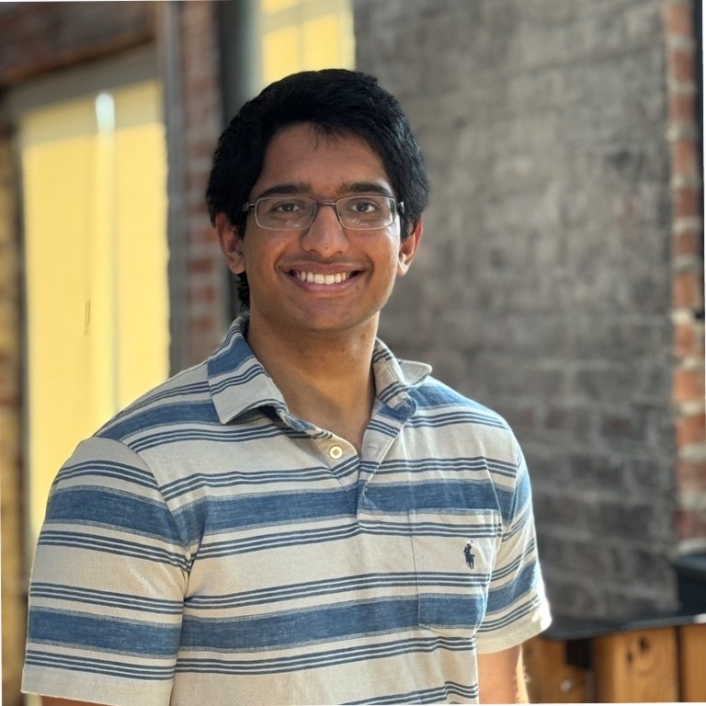



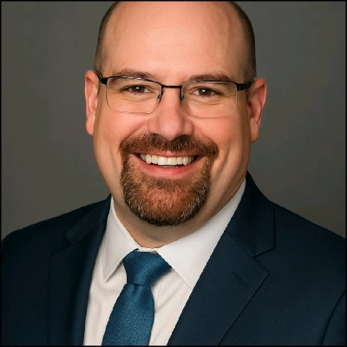
Two founders. Three hires. Three advisors.
Rohith Chemitiganti
BUILDER
Connor Donnelly
C
GROWTH
CEO & Co-Founder
CMO & Co-Founder
Healthcare-AI startup (C3rX.ai); 2.5 yrs lead TA in data analytics at IU. Owns back-end models and front-end UX.
Marketing strategy analyst + product development intern (financial services). Owns brand, GTM, customer acquisition.
Key hires before launch
Board of advisors
01
Math / Probability Lead
3rd co-founder candidate; tunes models & builds credibility.
Joey Baird
IU Senior Lecturer · former founder
Community building & game development.
02
Sports Analytics Engineer
Has shipped on betting/sports datasets; early tester + content.
Oliver “OG” Wells
Sportsbook projection-model expert
Industry navigation & B2B path.
03
Community / Forum PM
Owns social mechanics, retention loops, and leaderboard design.
Brian Jagger
ML engineer · serial AI founder
Tech architecture & security.
Targets: Alex Monohan (OddsJam founder) · Kelsey Allen (ex-Rithmm) · Breithan Sweich (creator).

Slide 8
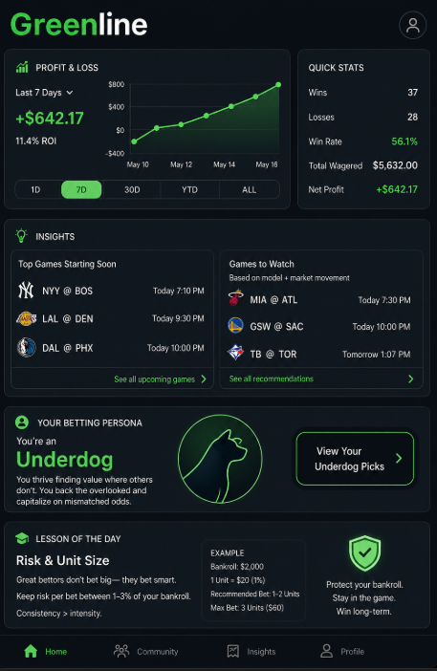
A bettor's first “one-stop shop” for self-knowledge.
9:41 GreenLine
Behavioral Analytics
ROI
Win rate
Profit/Loss by sport, bet type, team, and time of day. The “mirror” sportsbooks won't show you.
+8.4%
54.1%
Bankroll Management
Bankroll · 30d
Personalized ROI view + adaptive unit-size logic and warnings before tilt.
Pattern Recognition
PERSONA · Weekend Parlay
“Betting personas” drive recs based on expected value AND your real history.
Recommended for you
Community + Leaderboards
NFL · Sunday early slate
NBA · Player Props
Insight-sharing, weekly trivia, points system — keeps users engaged off-game-day.
MLB · Run line
Notes:
Clean it up

Slide 9
Two giant industries — and the gap between them is ours.
Where we play in the bettor pyramid
$125B
$5.7B+
Pro
~2–3% · Built their own
Global Sports Betting
Sports Analytics Software
Intermediate
But not where we play.
Crossed in 2025; projected $29.7B by 2034.
5–15 bets/wk · OUR BULLSEYE
Beginner
Vulnerable · Future dependency
PRIMARY RESEARCH · 75 RESPONDENTS
What people want
Financial dashboard
78%
“If proven results” was a top tier of conversion intent.
Time-of-day patterns
64%
Pattern detection
61%
Beginners convert on trust. Mitigates with testimonials and historical accuracy.
Strategy guides
58%

Slide 10


Why GreenLine wins the casual bettor.
Platform | Audience | Behavioral Insights | One-Stop UX | Price
Rithmm | Intermediate | Partial | Medium | $20+/mo
OddsJam | Pro / Power | Limited | Heavy | $70+/mo
Outlier | Pro | No | Light | $29.99/mo
Pikkit | Tracker users | Light | Light | $29.99/mo
Parlay Savant | Casual | Limited | Light | Free / $$
GreenLine | Intermediate + Beginner | Yes — core | Yes — built for it | $9.99/mo
Built for the bullseye
Most platforms hunt pros. We're built for the underserved 5–15 bets/week bettor.
Behavior > Picks
We don't sell picks. We sell self-knowledge so users build their own edge.
Aggregator, not adversary
We partner with data aggregators — not antagonize sportsbooks. They become future customers.
PARTNERSHIP STRATEGY Data aggregators (licensors to sportsbooks) · AWS · IU faculty + advisors · Sports-betting creators

Slide 11




Freemium subscriptions with a 90% gross margin.
FREE
PREMIUM
$0
$9.99
$9.49 ARPU
~90% gross margin
forever
per month · $99/yr
30/70 monthly/annual mix; conservative weighted avg.
COGS = AWS hosting + Stripe (2.9%/txn).
✓
Account + betting history sync
✓
Full behavioral analytics
✓
Basic win/loss dashboard
✓
Bankroll & unit-size engine
✓
Community read access
✓
Persona-based recommendations
✓
Leaderboards + community posting
Y1 breakeven: 134 Premium subs
$25K seed required
Reachable in <3 months post launch.
MVP build $15K + ~$1.1K/mo OpEx · paid back in <2 years.
Top of funnel · zero friction
Below Outlier ($29.99) and Pikkit ($29.99)

Slide 12
Three years from beta to break-out.
Year 1
Year 2
Year 3
~$30K
~$170K
~$530K
2,500 / 350 prem (14%)
10,000 / 1,800 prem (18%)
28,000 / 5,600 prem (20%)
Loss · MVP build
Founders draw $30K each
~$360K net income
Premium subscribers · year-end
ACQUISITION FUNNEL
1
Discovery
2
Acquisition (free acct)
3
Activation (sync)
4
Conversion (Premium)
5
Retention
6
Referral

Slide 13
Four phases. Public launch: November 2026.
NOW – Q2 2026
Q3 – Q4 2026
NOV 2026 – Q2 2027
Q3 2027 +
Phase 1 · Build the Core Product
Phase 2 · Pre-Launch
Phase 3 · Public Launch
Phase 4 · Scale & B2B Pivot
Indiana LLC formed
MVP backend + UI prototypes
First 10 IU beta testers
Closed beta (20–30 testers)
Influencer partnerships seeded
BetSync integration finalized
Web + iOS + Android Availability
NFL playoff push
Hit 134 paying users → breakeven
Hire FT engineer + 3 advisors active
Begin sportsbook B2B conversations
10k users target

Slide 14


We've considered our weaknesses — here's the playbook.
Sportsbook API access
Industry credibility / trust
Regulation in flux
Risk
Risk
Risk
No public APIs; data pipelines are fragile.
Bettors won't trust unproven analytics.
State + federal rules (CFTC vs gaming commissions) are shifting.
Mitigation
Mitigation
Mitigation
Partner with data aggregators (sportsbook licensors) — operate as their client, not opponent.
Recruit math advisor + pro bettor; lead with primary research and testimonials.
Educational positioning keeps us out of gambling regulation; data-privacy counsel retained.
AI security & data privacy
User retention dropoff
B2C ceiling
Risk
Risk
Risk
Sensitive financial behavior data carries real risk.
Casual interest spikes high then simmers fast.
Pure consumer betting tool has a low ceiling.
Mitigation
Mitigation
Mitigation
Backend models are non-AI by default (Jagger guidance); encrypted storage, clear data policy.
Community + leaderboards + weekly trivia + push prompts to keep open-rate up.
Pivot to data analytics for sportsbooks — exit strategy is acquisition by FanDuel / DraftKings.

Slide 15
THE ASK
Help us launch GreenLine.
$25K
3
1
Seed Capital
Beta Connections
Math / Probability Co-Founder
$15K MVP build + 10 months runway. Paid back in under 2 years on plan.
Intros to active intermediate bettors. Help us test, learn, and ship better.
Senior advisor or candidate for our 3rd founding seat.
60 million Americans now bet on sports. Almost none of them know what they're doing.
GreenLine doesn't tell them what to bet. It helps them know themselves — and that's the line worth crossing.
rohith@greenline.co · connor@greenline.co · greenline.co

Slide 16

Exit strategy: from B2C insurgent to B2B asset.
01
02
03
04
05
B2C launch
Community engine
Data flywheel
B2B pivot
Acquisition
Casual + intermediate bettors on Premium.
Trivia, leaderboards, retention loops.
Behavioral dataset becomes the moat.
License recommendations + behavior data to sportsbooks.
Strategic exit to FanDuel, DraftKings, ESPN BET, or Caesars.
Why sportsbooks ultimately buy us
More time spent in app = more bets placed
Behavioral data they can't legally collect from competitors
Recommendation engine that ports directly into their UX
First-mover advantage on a regulatory shift toward 'responsible betting' tooling

Slide 17
Breakeven math and unit economics.
Year 1
Year 2
Year 3
134
1,728
~2,300
paying users to break even
paying users to break even
paying users to break even
~$1,100/mo OpEx + $15K MVP
+1 FT engineer; founders draw $30K each
Sustained profitability; ~$360K NI
<3 months post launch
~10 months in
Investment fully repaid
Key assumptions
Conv. Rate
Churn
ARPU
Gross Margin
Founder Salary
14% → 20%
5.5% → 3%
$9.49 / mo
~90%
$0 Y1 → $30K Y2

Slide 18
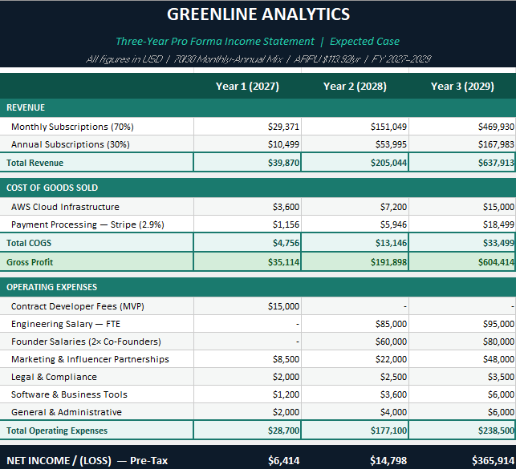
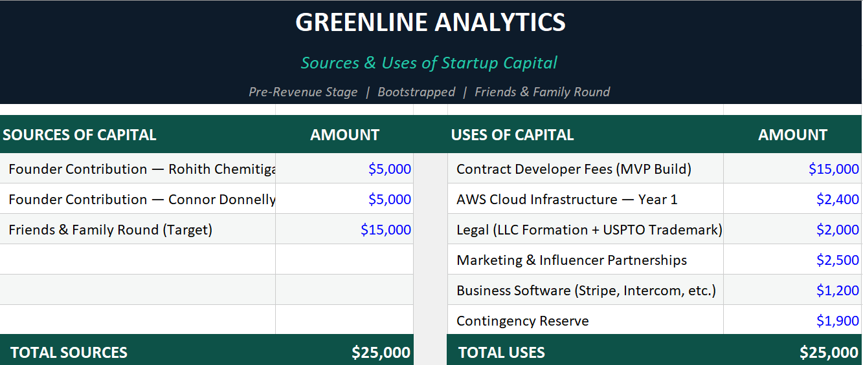
GREENLINE
Appendix
Financials
Indiana University · Kelley School of Business · New Venture Planning

Slide 19
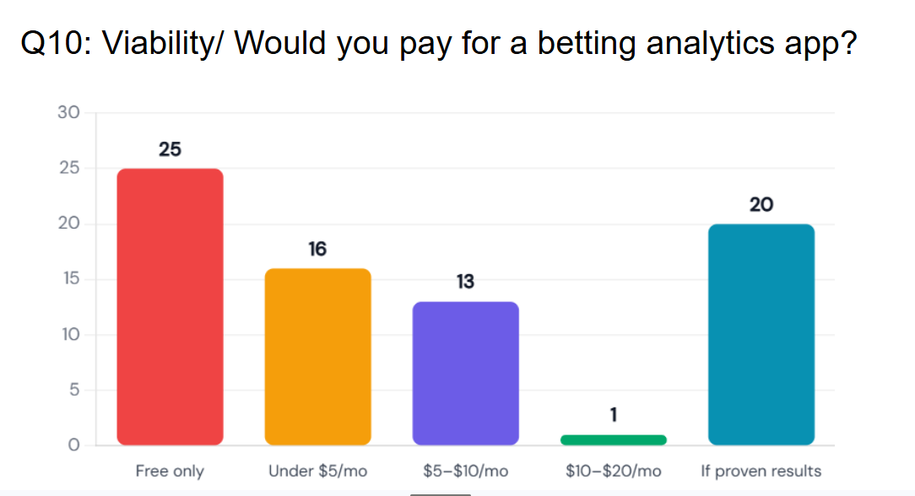
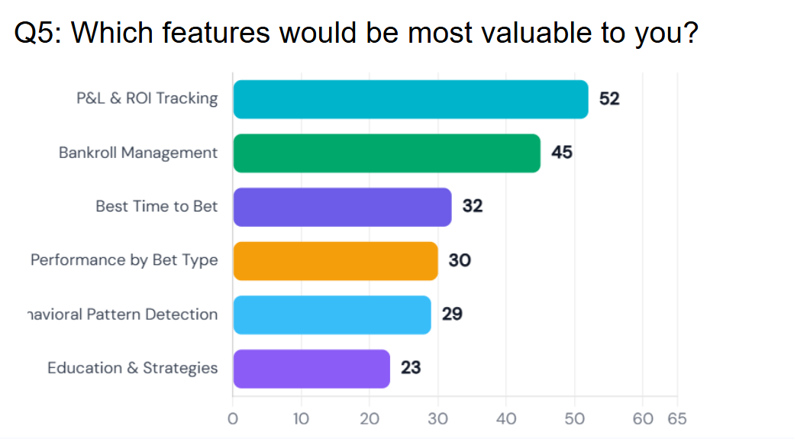
GREENLINE
Appendix
Customer Research
Indiana University · Kelley School of Business · New Venture Planning

Slide 20
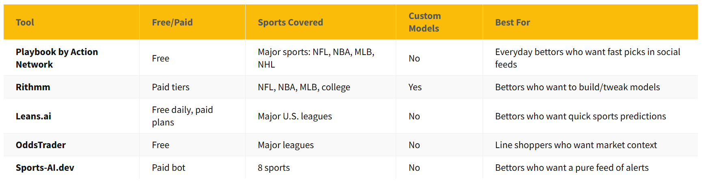
GREENLINE
Appendix
Competitive Landscape
Indiana University · Kelley School of Business · New Venture Planning

Slide 21
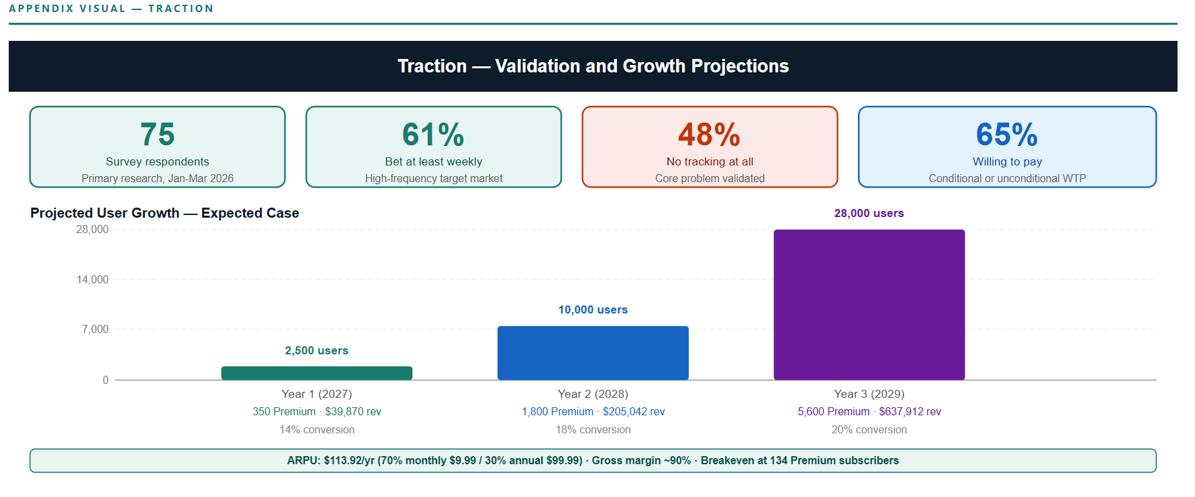
GREENLINE
Appendix
Traction
Indiana University · Kelley School of Business · New Venture Planning

Slide 22
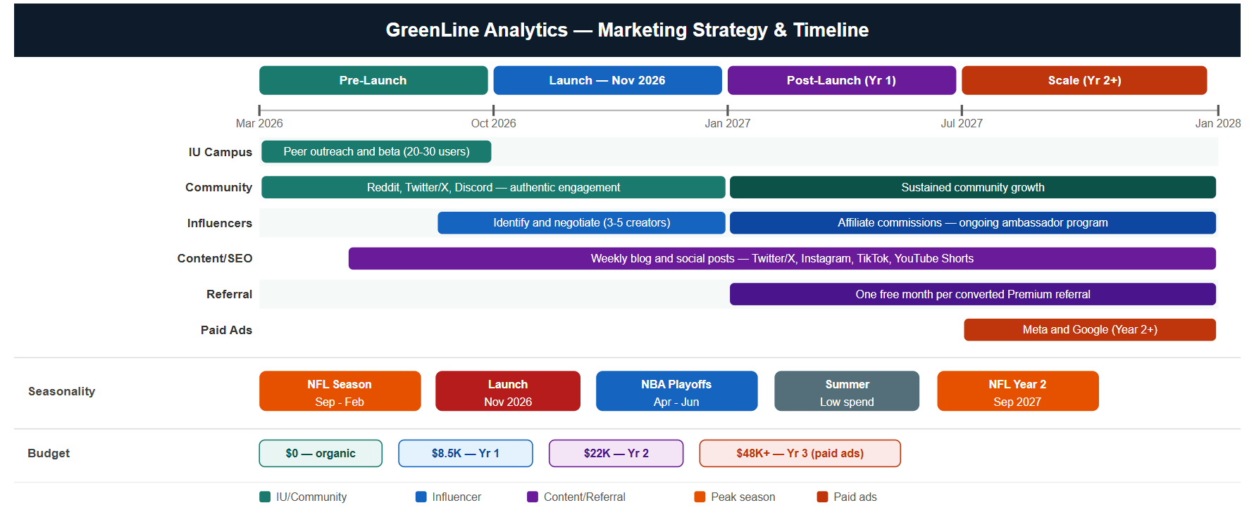
GREENLINE
Appendix
Marketing Strategy - Timeline
Indiana University · Kelley School of Business · New Venture Planning

Slide 23
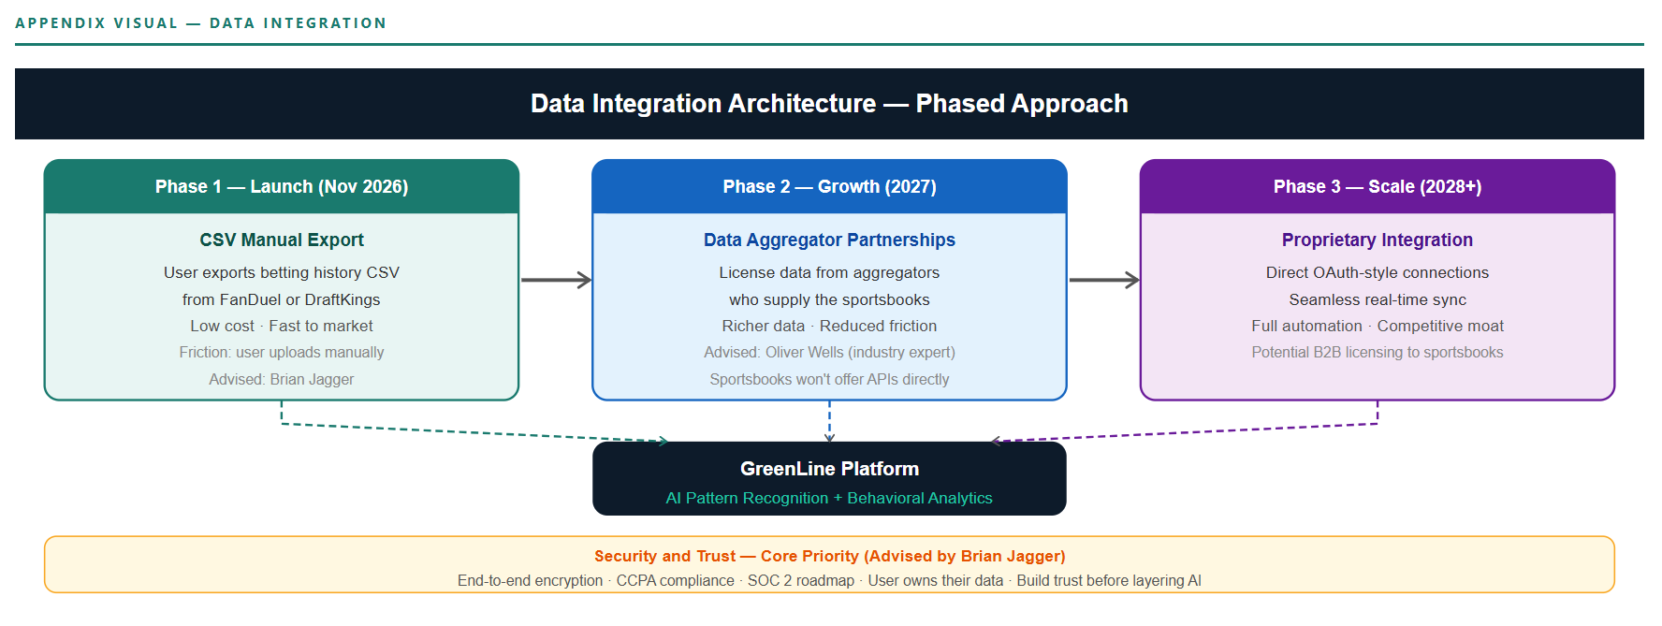
GREENLINE
Appendix
Data Integration Details
Indiana University · Kelley School of Business · New Venture Planning

Slide 24
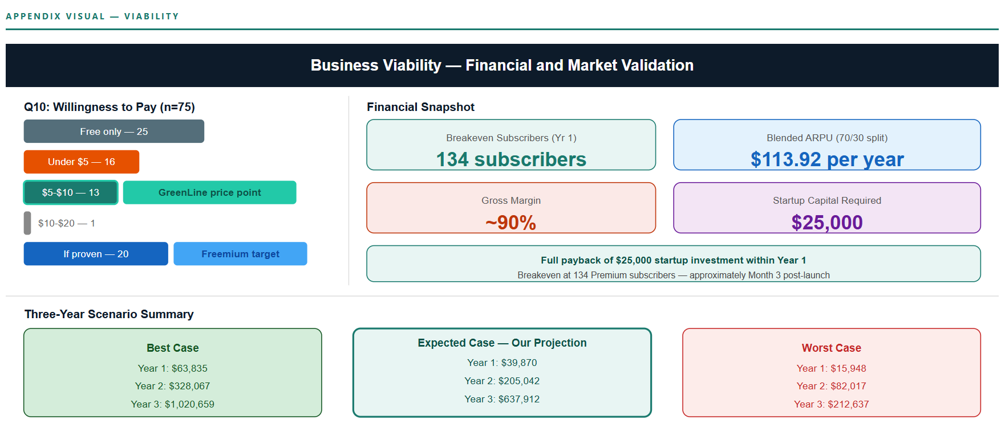
GREENLINE
Appendix
Viability
Indiana University · Kelley School of Business · New Venture Planning

Slide 25
GREENLINE
Appendix
App Info
Indiana University · Kelley School of Business · New Venture Planning

