Slide 1

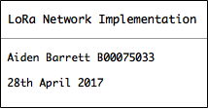
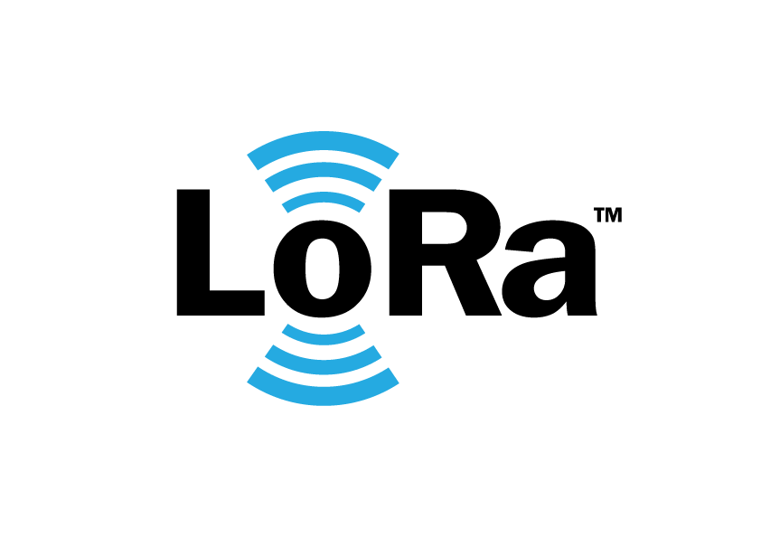

Slide 2
LoRa Network
Implementation
Aiden Barrett B00075033
Project Supervisor: Ben Toland
Notes:
The title of my project is LoRa Network Implementation

Slide 3
Introduction
Project Concept and Objectives
System Overview
Project Design
Technology and Components
Discussion of Project
Notes:
As INTRO TO THIS PRESENTATION, BRIEFLY list the topics I'm going to talk about today...
1 Project Concepts / Goals / Objectives
PROVIDE an Overview of entire system and BLOCK Diagrams to show OPERATION
2 DETAIL the Project Design and its Implementation
3 Talk about the technology and components used throughout,
Finally, DISCUSS the project delivery, the testing, troubleshooting and any IMPROVEMENTS that could be made

Slide 4
What is LoRa?
Wireless modulation technology
It provides significantly longer range than competing technologies
Low bandwidth, Low power
Excellent range and penetration
Operates in the unlicensed ISM bands
• 433MHz, 868MHz, 915Mhz
Within regulation (power, duty-cycle, bandwidth)
Notes:
SO what is LoRa?
1 Wireless Modulation technique that has longer range than most!
LoRa is the actual Physical Radio Layer
2 Range and penetration due to combination of the low frequency and its modulation technique.
3 - ISM bands within regulation -
limits on Power that you can transmit at.
duty cycle limits how often you can transmit.
bandwidth how much you can send at once.

Slide 5
Project Objectives
Design and implement a proof of concept LoRa Network
Integrate network server/cloud connectivity
Develop an Android application to query the backend
Make system fully bi-directional
Notes:
Bi-directional so that it can transmit data in one direction while simultaneously receiving data from the other direction. Uplink and downlink capability.

Slide 6
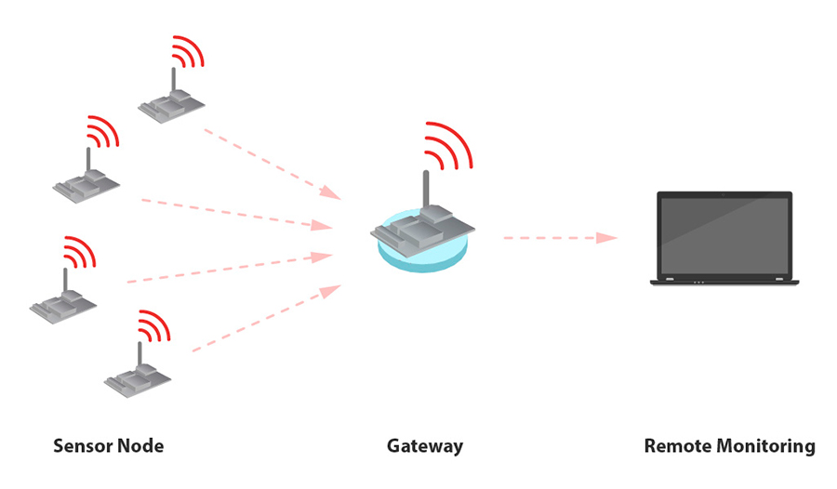
A LoRa Network consists of:
Gateways
Remote Devices
Network Servers
Notes:
Network Servers for remote viewing and monitoring of the network activity.

Slide 7
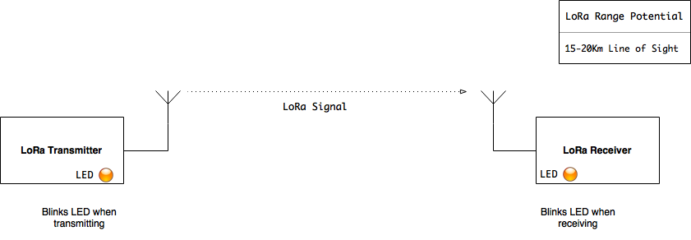
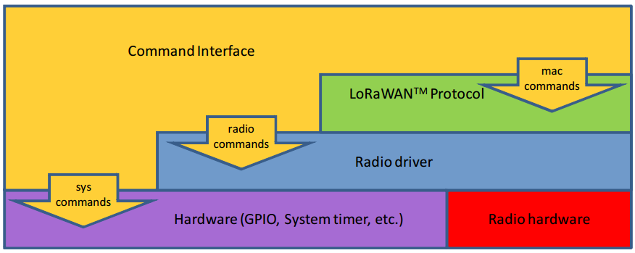
Basic Design Concept
Notes:
Initially, I found that there was a steep learning curve required to understand what was available and what was possible for this project.
The hobbiest community were using a widely adopted setup from IBM called a LoRa LMIC Single Channel Gateway. This was complex in nature and only had uplink capability. Developed by team of engineers, so to learn from top down perspective, not time effective considering the constraints of the project timetable.
I decided to work from the ground up and begin by getting the radios to talk.
Just to send a basic radio command from one module to another. This is a called point to point system.

Slide 8
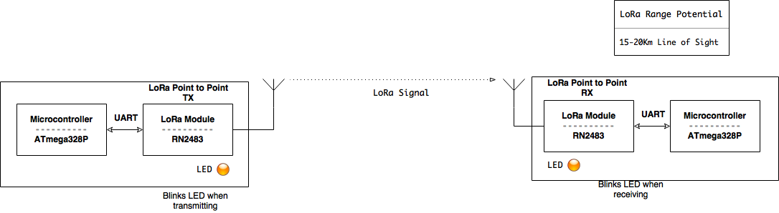
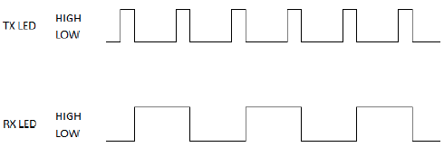
Point to Point System
Notes:
In my point to point system, I have two devices, each with an ATmega328p microcontroller, which is interfaced via software serial, with a Microchip RN2483 LoRa radio module which is connected to an 868MHz quarter-wave antenna.
(I used Software serial because the Serial Monitor uses the Hardware Serial port on the Arduino which I needed for debugging at the start.)

Slide 9
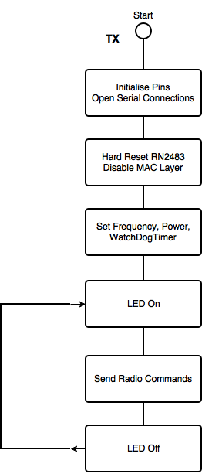
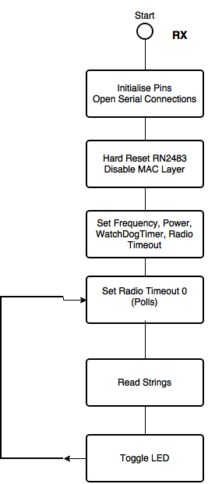
Point to Point System
Notes:
To quickly run through the setup, the transmitter and receiver both initialise pins, open serial connections. The radio is hard reset once at the start to pull up to high impedance state. The Mac Layer is disabled. The frequency, power and other variables are set.
On the transmitter, led on function is called, radio commands, led off.
On the receiver, polls, reads in strings, toggles led.
Now, I'm slightly conscious of time so I'm going to quickly go through the next iterations of design upgrades.

Slide 10
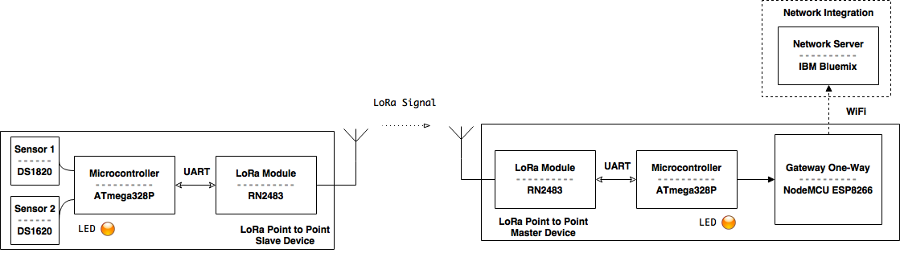
Point to Point
Master and Slave
Notes:
Next, I upgraded the system to a One-Directional master and slave setup.
I added temperature sensors to the slave for transmitting live data instead of the radio command feedback strings on previous system.
On the master I added in a NodeMCU-ESP8266 WiFi module, which linked to my bluemix cloud account with my authentication tokens, via MQTT.
This allowed for viewing the live data in a graph visualisation on bluemix.

Slide 11
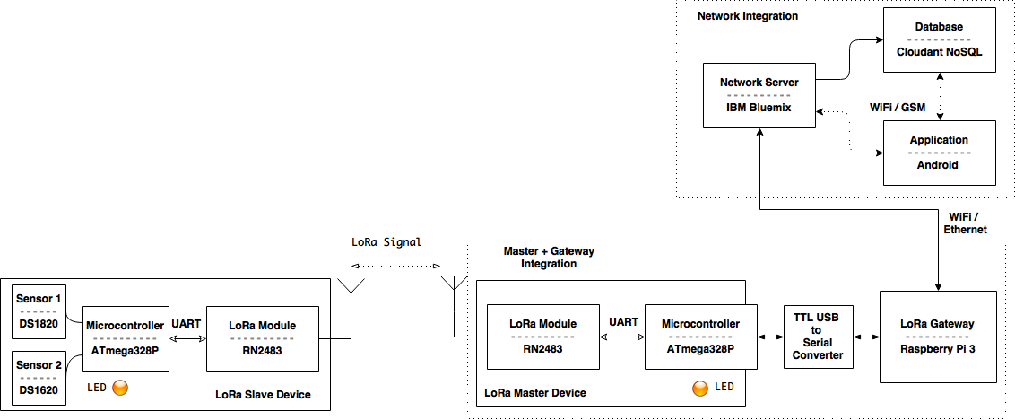
Bi-Directional
Single Master, Single Slave
Notes:
Next, I incorporated a Linux based gateway in the form of a Raspberry Pi 3, initially I had it operating in one direction only and was using a python script and an MQTT Mosquitto client and host service to connect to Bluemix.
This was prone to errors and very flaky overall.
Next I moved all of the gateway functions up into NODE RED and used it to directly talk to the UART serial port for incoming and outgoing messages.

Slide 12
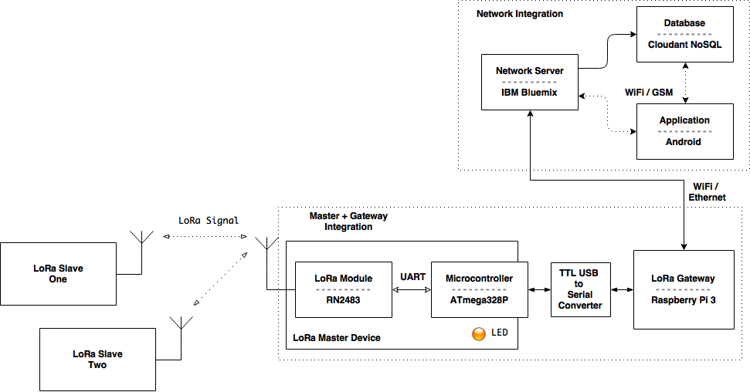
Bi-Directional
Single Master, Multiple Slave
Notes:
The Final Upgrade! Bi-Directional One Master, Multiple Slave
It can transmit data as uplink, and receive downlink commands from app.
Master Device Issues transmit command to Slave 1.
Slave 1 Receives transmit command from Master device. Reads sensor values.
Converts values from ASCII to Hex, encrypts data as Hex string.
Sends data back to Master device via LoRa radio protocol.
Master Device Receives data from Slave 1.
Decrypts Hex string, converts data from Hex to ASCII.
Sends data to Gateway via USB to serial convertor.
Master Device Issues transmit command to Slave 2 via LoRa protocol.
Slave 2 Receives transmit command from Master device.
... Process repeats, alternating between Slave 1 and Slave 2.

Slide 13
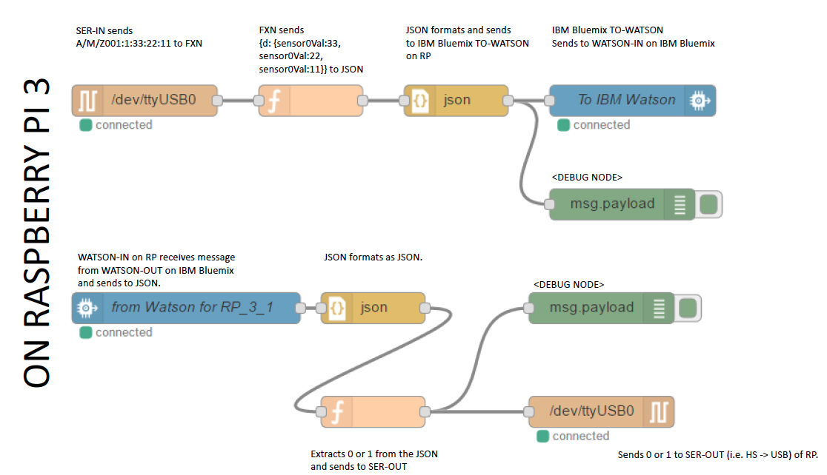
Gateway Setup
Notes:
To have a look at the gateway, it shows that it Polls the serial port, receives data from Master device.
Parses data, then converts to JSON object.
Uploads JSON object to IBM Bluemix via Watson IoT.

Slide 14
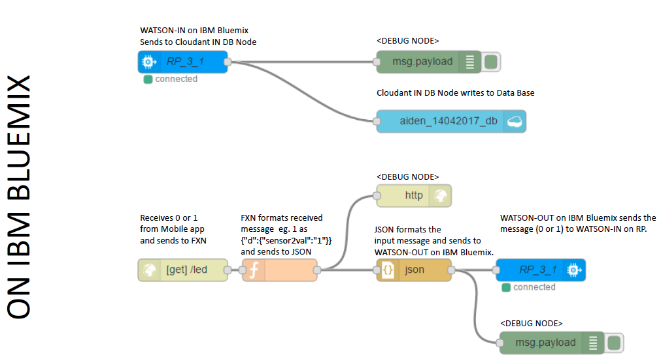
Network Server Setup
Notes:
Network Server
Bluemix Watson IoT receives JSON object from Gateway.
Stores JSON object in Cloudant NoSQL database.
Android Application (Database)
Connects to Internet via WiFi or GSM.
Connects to Bluemix and Cloudant via API, URL keys.
Parses JSON data in Cloudant for sensor values.
Textviews store and display sensor values.
Android Application (LED)
User toggles LED on/off buttons in App.
Slave no. and command is sent to Bluemix via API URL.
Bluemix receives Slave no. and command via HTTP.
Watson IoT receives, Gateway forwards to Master.
Master transmits command to Slaves via LoRa protocol.

Slide 15
Project Discussion
Ground up development hinders end goal delivery
Power consumption reduction
Prototype master and slave setup is backwards for testing reasons
Scalability is becomes complex when dealing with several nodes
App integrates geo-location share features
Notes:
1 Didn't foresee the complexity involved in bi-directional setup, project version 1 with python script and MQTT was not efficient. Long learning curve.
2 Current design does not implement any ultra power saving/deep sleep. Using ATmega raw helped but could be improved. Raw AVR, maybe TI MSP430, build entire gateway from C++ to handle everything.
Slave devices are awake at all times and polling to enable testing and debugging.
Ideally, they should sleep all the time, only waking up to send data now and again.
3 The receiver polls constantly, the duty cycle regulations are also ignored for testing purposes as I required constant data transfer to debug issues.
4 The extra slaves data was difficult to separate, database volume increased rapidly. Requires some collision detection/avoidance technique.

Slide 16
Thank You. Questions?
Notes:
I hope that provided enough information, although somewhat rushed!
Any questions?

Slide 17
LoRaWAN
LoRaWAN is the Network MAC Layer of the LoRa stack.
Communication protocol and architecture that utilizes the LoRa physical layer to enable wide area network capability.
Supports
secure bi-directional communication,
mobility
Localization
Security – AES 128bit

Slide 18
Range Improvements
Increase the height of gateway and antenna
Outdoor signal is better than indoor
Keep short distance between gateway and antenna to reduce attenuation
Use a good connector (N-type)
Use omni-directional antenna
Prevent multipath propagation by having obstacles close to antenna
Avoid strong interference from GSM/WiFi, etc.

