Slide 1
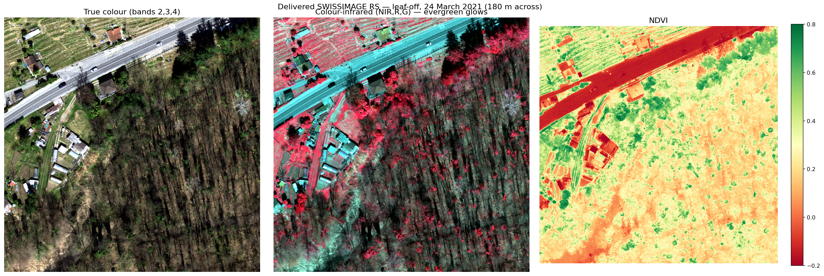
SESSION REPORT · 24 JULY 2026
The Near-Infrared
Data Arrived
Handling the SWISSIMAGE RS delivery: what came, why nothing would open, and what the NIR band actually reveals.
Prepared for: Project Lead

Slide 2
THE DELIVERY
What swisstopo sent
25
6
66 GB
TILES
DATES
ON DISK
4-band NIR/R/G/B, 16-bit, 10 cm
incl. leaf-off 24 Mar 2021
flight strips, ~1 GB each
Not what we asked for — better
BAND ORDER (CONFIRMED)
We requested a single 1 km² tile to keep cost down.
They sent 25 strips across 6 acquisition dates.
Crucially that includes a leaf-off March flight — the exact phenology needed to separate evergreen from dormant deciduous.
Band 1
NIR 808–882 nm
Band 2
Red
Band 3
Green
Band 4
Blue
QGIS labels these 'Band 1 (Red)' etc. — that is display-slot naming, not content.
02

Slide 3
FILE ANATOMY
Why every .tif has a twin .tfw
.tif — the pixels
.tfw — the world file
A grid of numbers: 4 bands × ~10 000 × ~20 000 uint16 values. On its own it knows nothing about where on Earth it belongs — it is just an image.
Six plain-text numbers that pin those pixels to the map. Same basename, different extension — that is the entire link. Lose it and the image floats free.
20240810_0840_12504_0_18.tfw
0.100
→ pixel size in X — 10 cm
0.00000
→ rotation (0 = north-up)
0.00000
→ rotation (0 = north-up)
-0.100
→ pixel size in Y — negative: rows run north→south
2717648.750
→ E of the upper-left pixel centre
1116990.850
→ N of the upper-left pixel centre
Together they are an affine transform: pixel (col,row) ⇄ map (E,N). That is all georeferencing is.
03

Slide 4
PROBLEM 1
The tiles knew where — but not on which planet
A .tfw gives coordinates but never says which coordinate system they are in.
All 25 tiles reported crs = None. The numbers were right; the label was missing — so QGIS had no idea they were Swiss LV95 and placed them nowhere. That is what looked like "the coordinates are off".
Symptom
Tiles invisible or landing in the ocean; rasterio reports crs=None
Diagnosis
Georeferencing lives only in the sidecar .tfw; no CRS embedded in the GeoTIFF
Fix
Stamp EPSG:2056 into each tile's metadata — in-place, metadata-only, no pixel rewrite
Done now, not later: georeferencing belongs with the data, so every tool — QGIS, GDAL, the pipeline — gets it right for free. The 33 GB original zip is untouched.
04

Slide 5
PROBLEM 2
Why the checking script would not run
AttributeError: module 'inspect' has no attribute 'signature'
Thrown from deep inside rasterio's imports — nothing to do with the data, and the traceback points nowhere near the real cause.
1
The script was named inspect.py
The rule
Never name a file after a standard-library module.
2
Python puts the script's own folder FIRST on the import path
3
rasterio does import inspect → gets the local file, not the standard library
Also risky:
random.py · json.py
email.py · types.py
logging.py · io.py
4
That file was empty, so inspect.signature does not exist → rasterio dies
Replaced by scripts/check_swissimage_rs.py — reports bands, CRS, dates and which tiles cover the AOI.
05

Slide 6
THE PAYOFF
What the NIR band actually reveals
Same 180 m of leaf-off forest, 24 March 2021 — three renderings of the same four bands
True colour
Colour-infrared
NDVI
Dormant forest is a flat brown mush. This is the RGB-only problem that stalled us.
Live evergreen foliage flares red against the dark leafless canopy.
Discrete green dots — individual evergreen crowns — resolved against tan dormant forest.
This is the discrimination RGB could not provide — exactly the case made in the data request.
06

Slide 7
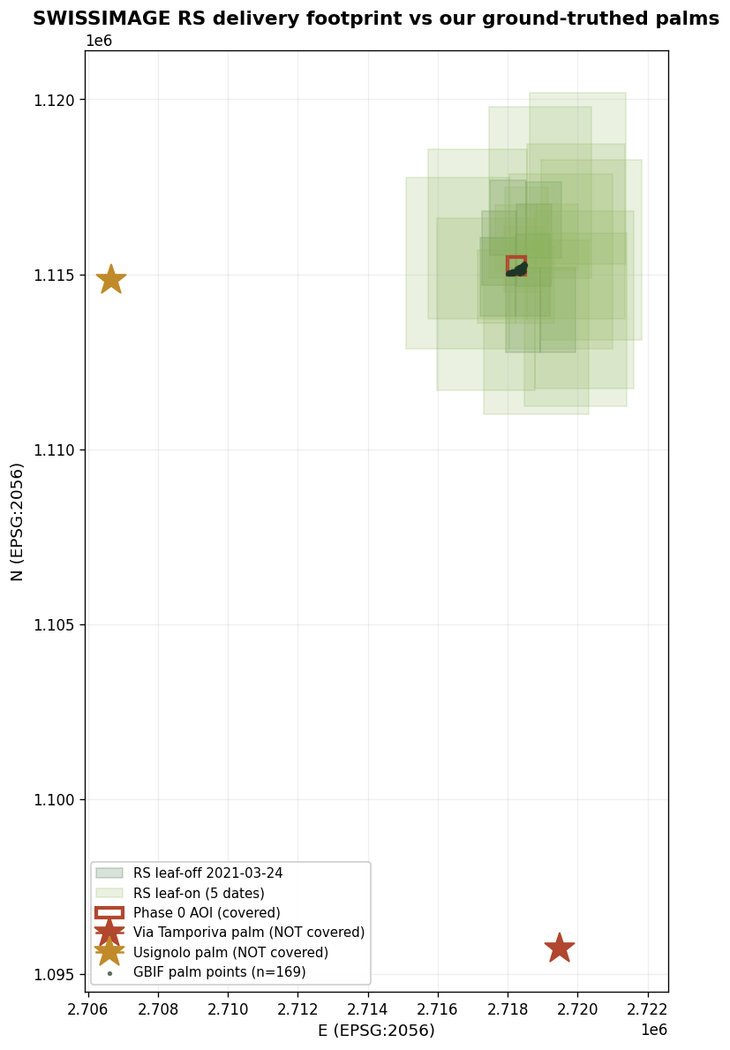
THE CATCH
It does not cover our confirmed palms
The sample is centred on the AOI I chose from GBIF point density — not on the palms we personally verified.
COVERED
Phase 0 AOI + 169 GBIF occurrence points
NOT COVERED
Via Tamporiva — the palms you confirmed in person (~15 km south)
NOT COVERED
Usignolo playground — the Street-View-confirmed palm (~12 km west)
Action: name E 2 719 475 / N 1 095 726 explicitly in the next request.
So the delivery validates the mechanism, not a specific palm.
07

Slide 8
HOUSEKEEPING
Codebase reorganised around the new data
BEFORE — scattered
AFTER — inside the repo
palmTrack/
Sample_SWISSIMAGE_RS/ 66 GB loose
Sample_SWISSIMAGE_RS.zip
check_rs.py outside repo
inspect.py empty, broken
deck/ outside repo
.vscode/ .DS_Store cruft
files/
ticino-palm-mapper/ the actual repo
ticino-palm-mapper/
data/raw/swissimage_rs/
lugano_delivery_2026-07/ 25 tiles
bern_sample_2019/
scripts/
00–05 pipeline
check_swissimage_rs.py
reports/
*.pptx + src/ build tooling
src/ configs/ docs/
Committed & pushed. The 66 GB of imagery and node_modules are gitignored — the commit is 24 MB of code, reports and figures.
08

Slide 9
STATUS · NEXT
NIR is in hand and it works.
DONE THIS SESSION
NEXT
25 RS tiles inventoried, CRS repaired
Broken checker diagnosed and replaced
NDVI resolves individual evergreen crowns
Repo reorganised, committed, pushed
Retile RS strips onto the 10 cm grid
Extend stacks to [R,G,B,NIR,NDVI,CHM]
Request coverage over a confirmed palm
ML: Dataset, model, training (project lead)
The blocker was never the imagery — it was knowing what the pixels meant.
Repo: github.com/aidenfairman12/ticino-palm-mapper

