Slide 1
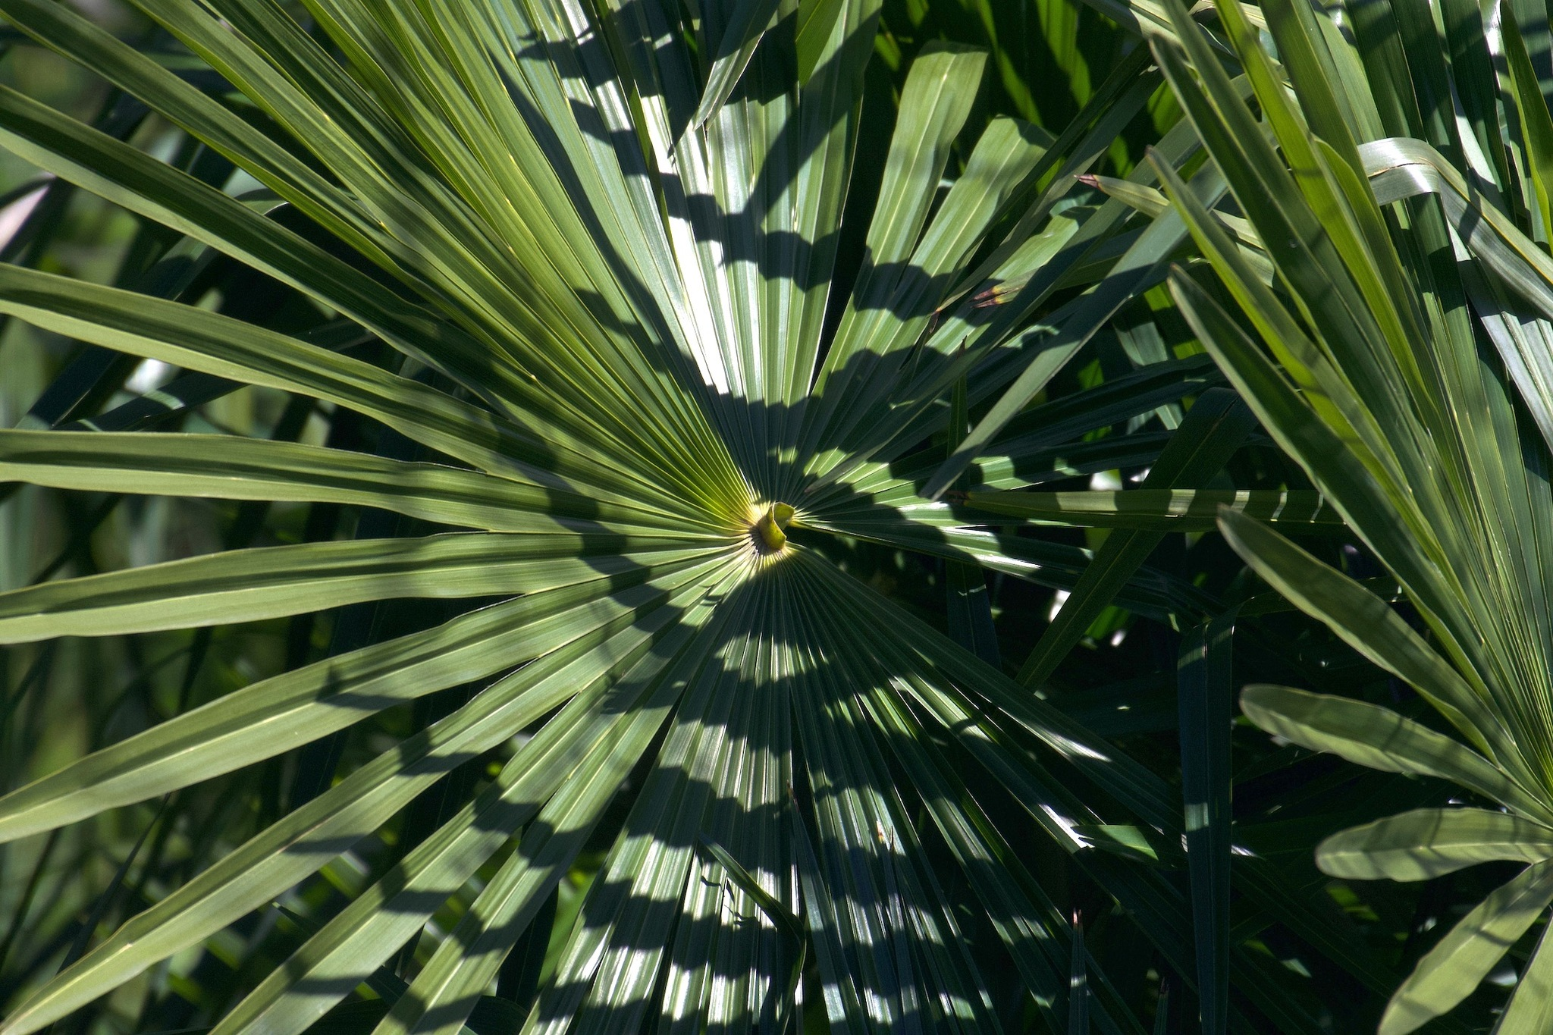
SESSION REPORT · 21 JUNE 2026
Mapping an Invasive Palm
from the Sky
Ticino Palm Mapper — Phase 0: data pipeline built, and a hard look at how we will actually label the palms.
Prepared for: Project Lead
From: ML / Data Engineering

Slide 2
THE ONE-SLIDE VERSION
What happened this session
6
7,118
3
SCRIPTS
GBIF RECORDS
IMAGERY LAYERS
Phase 0 pipeline, end-to-end on live data
free palm occurrences evaluated as labels
RGB + LiDAR height + 2018/21/24 temporal
THE BINDING CONSTRAINT IS LABELING
Not imagery, not compute — labels. The plan assumed we could eyeball palms in the orthophotos and hand-label from them. We stress-tested that and it does not hold: at 10 cm RGB, individual crowns are not reliably separable by eye — even against a confirmed, ground-truthed palm.
The way forward: fuse weak signals (RGB texture + LiDAR height + temporal persistence) in a trained model, and build the test set from ground truth — not from eyeballing.
02

Slide 3
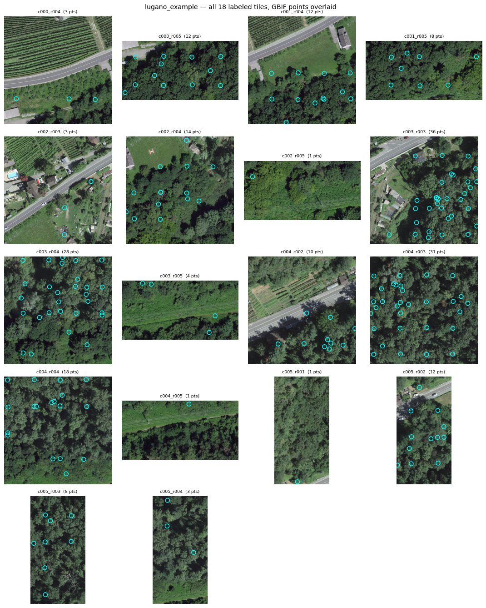
DELIVERABLE
An end-to-end Phase 0 data layer
00
Fetch SWISSIMAGE 10 cm RGB tiles (swisstopo STAC COGs, memory-safe)
01
Fetch occurrence points from the GBIF API, reprojected to EPSG:2056
02
Align points to the tile grid (point GeoJSON + raster masks)
03
Add co-registered LiDAR height → [R,G,B,CHM] feature stacks
04
Fetch the 2018 / 2021 / 2024 time series (aligned per tile)
05
HTML labeling-assist sheet: crop + GBIF + Street View links
Pipeline output: aligned RGB tiles + occurrence points
Shipped to a private GitHub repo (github.com/aidenfairman12/ticino-palm-mapper). Data is gitignored; ML modules left as stubs for the ML owner.
03

Slide 4
FRAMING
Why labeling is the whole ballgame
A model is only as honest as its test set
Report precision/recall on a small, exhaustively-labelled hold-out set — or the headline map is unverifiable.
Occurrence points are presence-only
They say 'a palm was seen near here', not which crown, and not 'every palm in this tile'. Absence of a point ≠ absence of a palm.
So the labels must be earned
Cheap label sources exist; trustworthy ones do not come for free. This session was about finding out how trustworthy each source really is.
04

Slide 5
THE EVOLUTION
Five attempts at labeling, one lesson
→
→
→
→
1
2
3
4
5
Info Flora
manual export
GBIF API
occurrence points
Eyeball the
orthophoto
Ground photo +
Street View
Multi-signal
fusion
No coordinates
Too imprecise
Can't see them
Confirms, can't
localise
Promising
Each source was abandoned for a concrete reason — the next slide is the scorecard.
05

Slide 6
METHODS SCORECARD
What we tried, and why each fell short
Method | The promise | Why it fell short / its limit | Verdict
Info Flora 'AtlasWS' export | Official Swiss flora data | It's a per-square species checklist — no coordinates at all | UNUSABLE
GBIF occurrence points | 7,118 free CH points, with coords | 55% at 18 m (=180 px); a '1 m' point landed on a rooftop | WEAK ANCHOR
Eyeball the RGB orthophoto | Free, needs no labels | Crowns not separable from native/ornamental at 10 cm; forest occlusion | UNRELIABLE
iNaturalist photo match | Confirms the species | Photos are close-ups — no scene context to match to the ortho | CAN'T LOCALISE
Street View cross-reference | Oblique, eye-level ID | Confirms a palm, but RGB ortho still ambiguous; leaf-off branches mimic palms | GT ONLY
NIR (SWISSIMAGE RS) | Spectral separability | Not freely available — request / paid only | BLOCKED
LiDAR canopy height (CHM) | Free; separates veg vs ground | A 5 m palm looks like a 5 m shrub — height alone can't ID | FEATURE
Multi-signal fusion | Combines the weak signals | Needs a trained model + a ground-truthed test set | RECOMMENDED
06

Slide 7
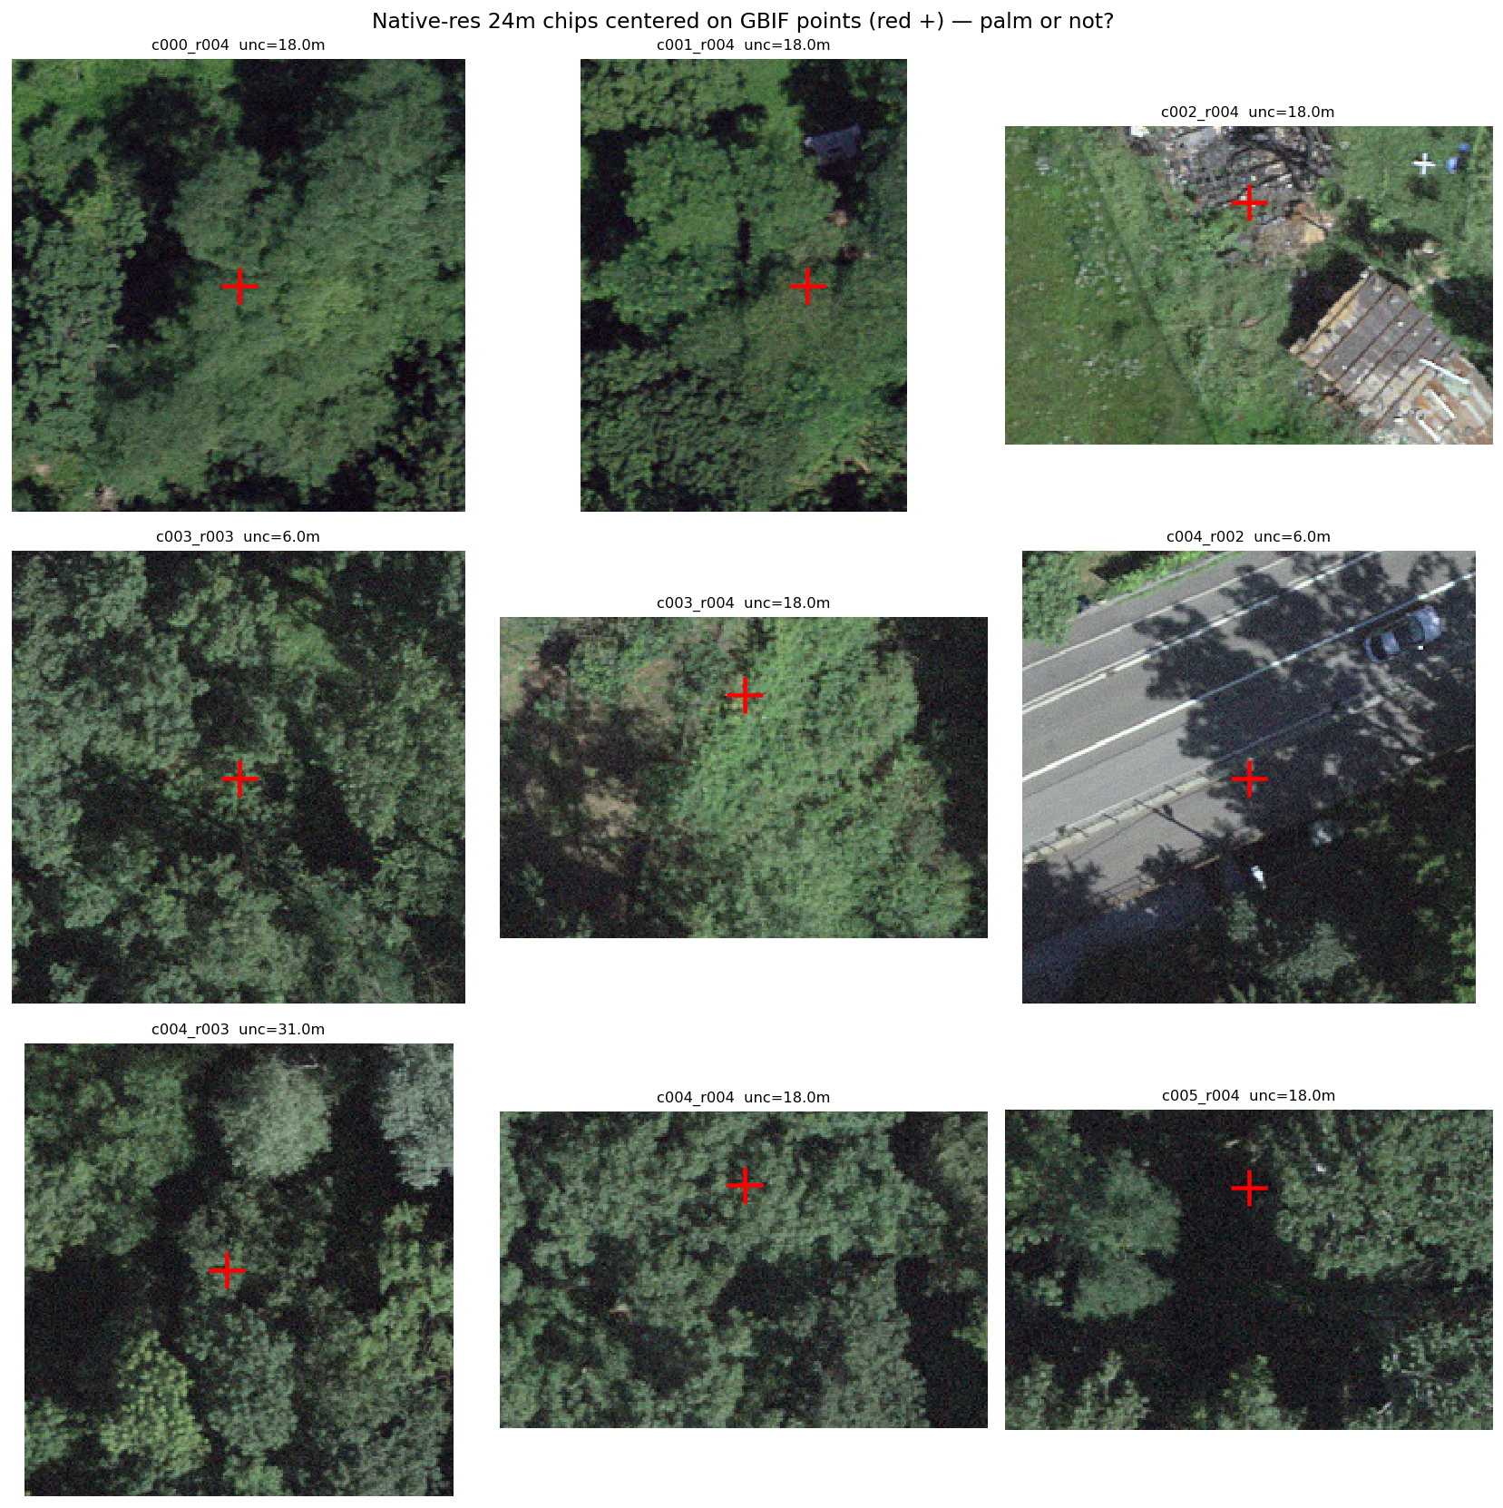
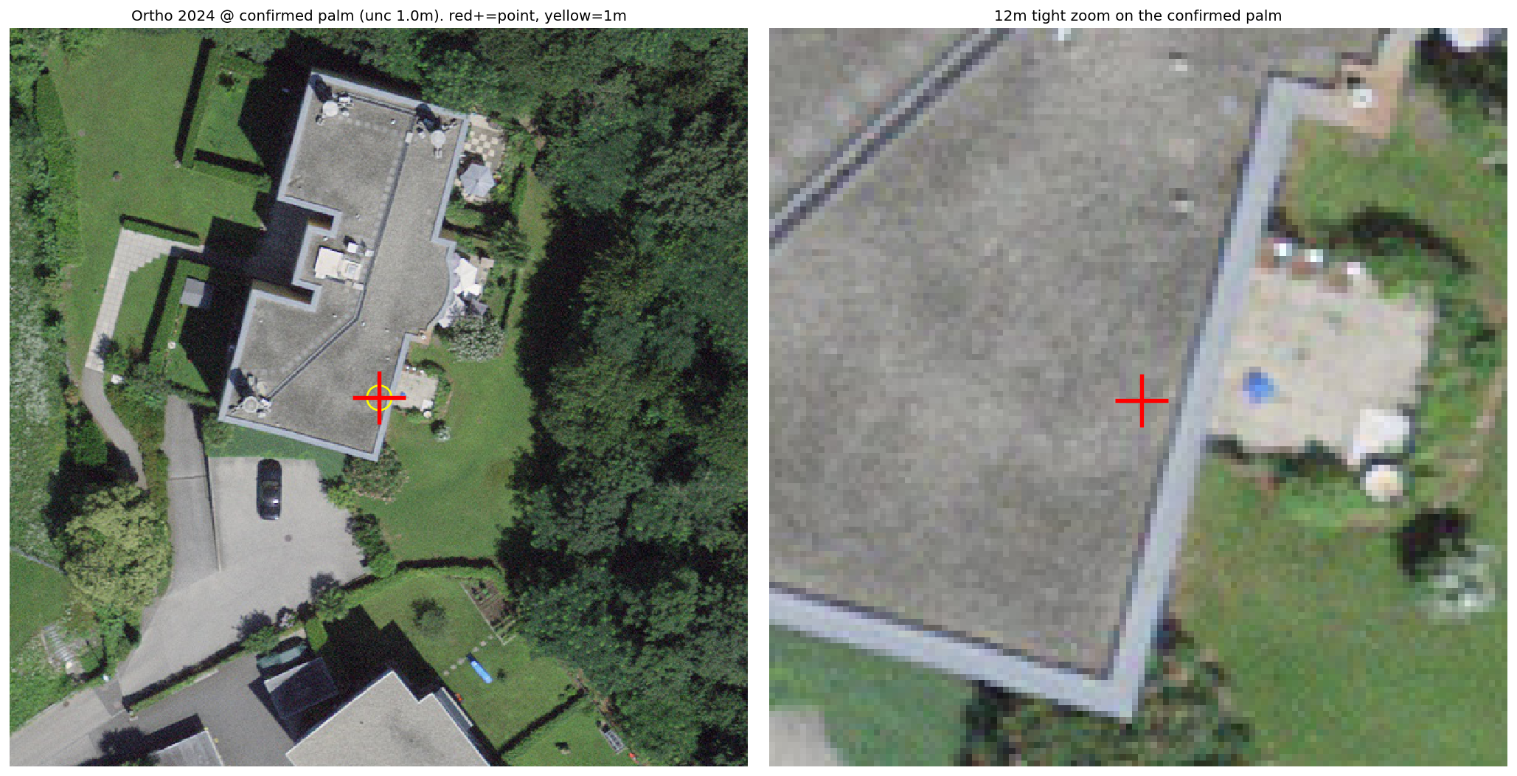
EVIDENCE · 1
Occurrence points do not sit on palms
A GBIF point tagged 1 m uncertainty — lands on a rooftop
Most points carry 18 m uncertainty; markers fall on generic canopy
Takeaway: 'coordinate uncertainty' reflects the phone's GPS accuracy, not the plant's true position. Treat all occurrence points as tile-level weak positives — never as crown labels.
07

Slide 8
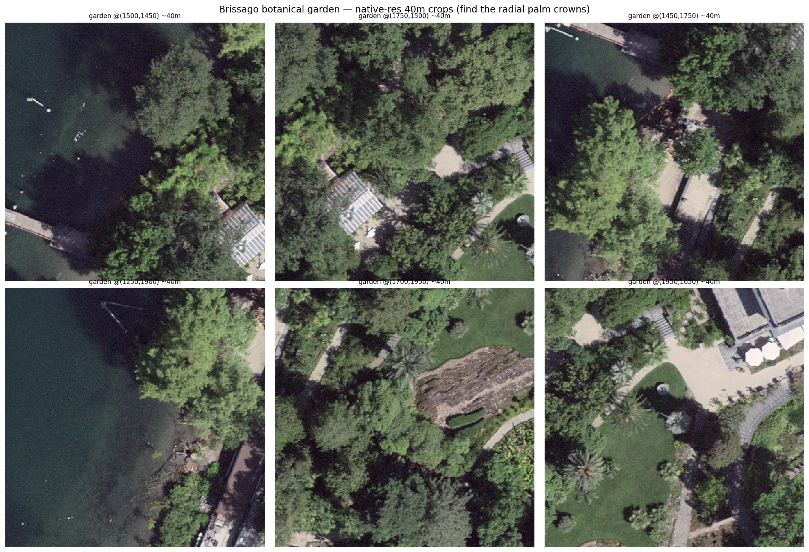
EVIDENCE · 2
A confirmed palm — still can't be picked out from above
Street View → iNaturalist confirms Trachycarpus at a known spot
Yet in 10 cm RGB — here a botanical garden full of palms — the radial crown isn't separable by eye
Takeaway: leaf-off imagery doesn't rescue it either — a bare deciduous tree's branches radiate like palm fronds and produce false positives. The eye (and RGB alone) is not enough.
08

Slide 9
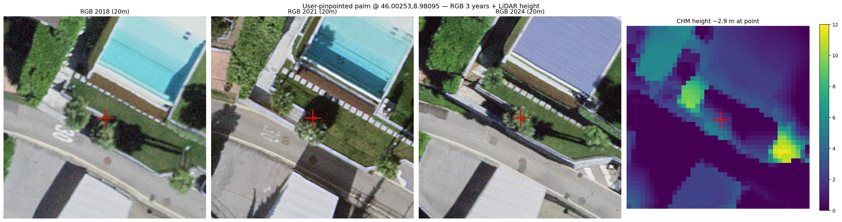
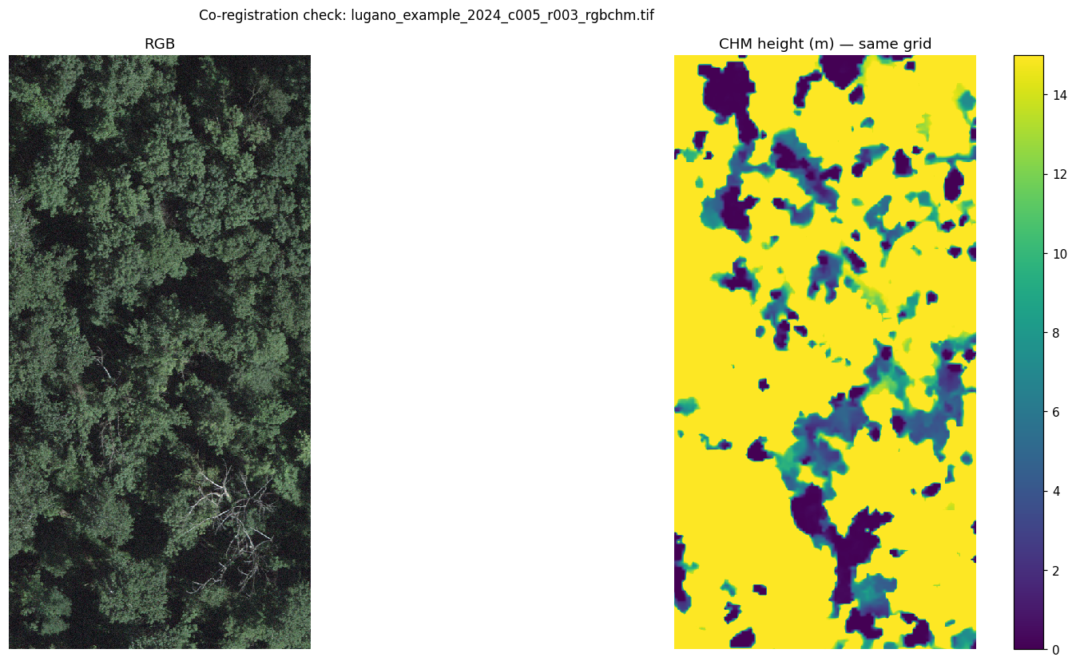
EVIDENCE · 3
The signal is in the combination
User-pinpointed palm — RGB 2018/2021/2024 + LiDAR height. Each panel alone is weak; together they agree.
Three weak signals that agree:
Evergreen & persistent
present across all three vintages (deciduous & construction are not).
~3 m height in the CHM
a real object, not lawn or shadow.
Plausibly radial crown
consistent with a fan palm.
CHM co-registered to the 10 cm RGB grid
09

Slide 10
WHAT THE DATA ALLOWS
Free signals vs the one that isn't
RGB · SWISSIMAGE 10 cm
FREE
LiDAR height (CHM)
FREE
Resolves crowns by size (~20–30 px). The base layer.
DSM−DTM. Masks ground, gives height. A feature, not an ID.
Temporal 2018/21/24
FREE
NIR · SWISSIMAGE RS
REQUEST / PAID
Evergreen persistence vs change. Aligns per tile for free.
Likely the single best discriminator — but not freely served.
Design note — at 10 cm, two adjacent palms merge into one blob (we saw this on a pin that was actually two trees). Favour density / counting over exact instance separation in Phase 1.
10

Slide 11
RECOMMENDATIONS
Five moves for the next phase
1
Make height + temporal core inputs
Move CHM and the multi-vintage stack into Phase 1 — not the 'optional v2' the plan assumed.
2
Request SWISSIMAGE RS (NIR) now
Long lead time, and likely the strongest single discriminator for evergreen palms.
3
Ground-truth the test set
Build it with the Street View labeling tool (script 05). Occurrence points stay as weak positives only.
4
Target density first
Counting / density map as Phase 1; precise individual detection as the stretch goal.
5
Budget for labeling, not compute
Compute is ample. Trustworthy labels are the real cost — plan the effort explicitly.
11

Slide 12
STATUS · NEXT
Phase 0 is done. The data layer is ready.
DELIVERED
NEXT (ML OWNER)
6-script pipeline: RGB + LiDAR + temporal + labels
Labeling feasibility characterised end-to-end
Pushed to a private GitHub repo
Dataset over the [R,G,B,CHM] feature stacks
Baseline density / counting detector
Hand-label seed + ground-truthed hold-out set
Repo: github.com/aidenfairman12/ticino-palm-mapper (private)
Honest feasibility work is itself a result: we now know exactly where the hard part is.

