Slide 1
Predicting Star Types
By: Aiden Hammond, Sneha Kummarapurugu, Juan Hernandez

Slide 2
Our Objective
The goal of this project is to use the key stellar features to build and evaluate classification models that predict a star's type into one of the target labels. The target labels for prediction are: Red Dwarf, Brown Dwarf, White Dwarf, Main Sequence, Supergiants, and Hypergiants.

Slide 3
Exploratory Analysis

Slide 4
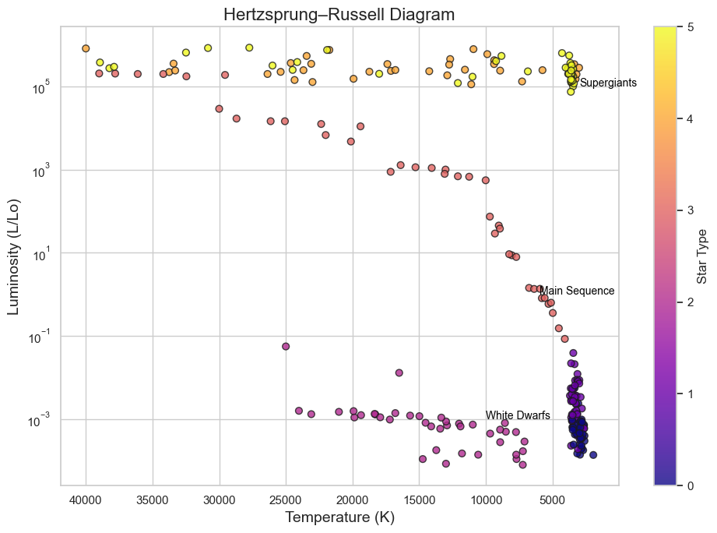

Slide 5
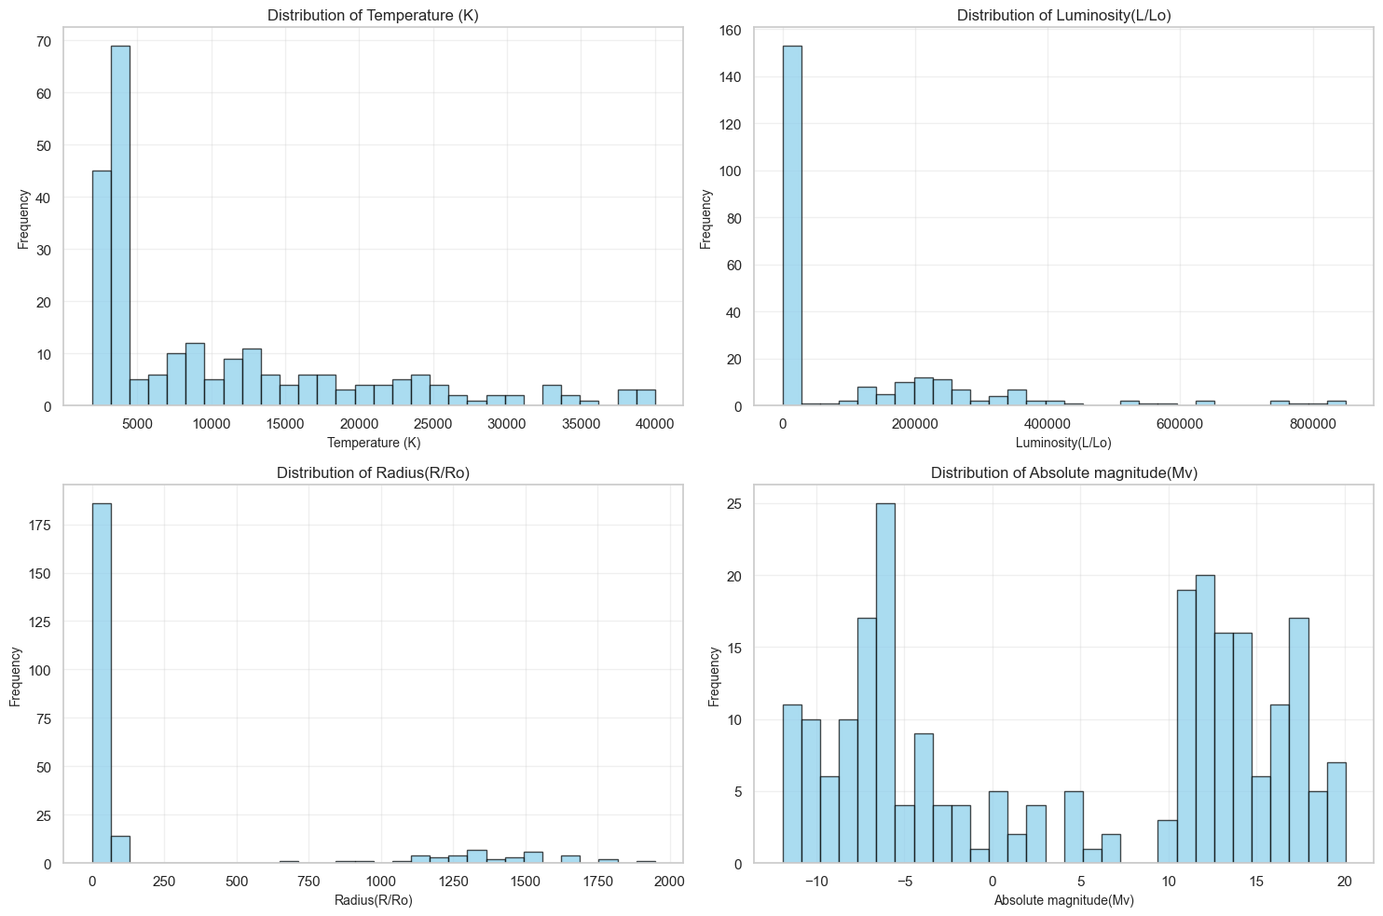

Slide 6
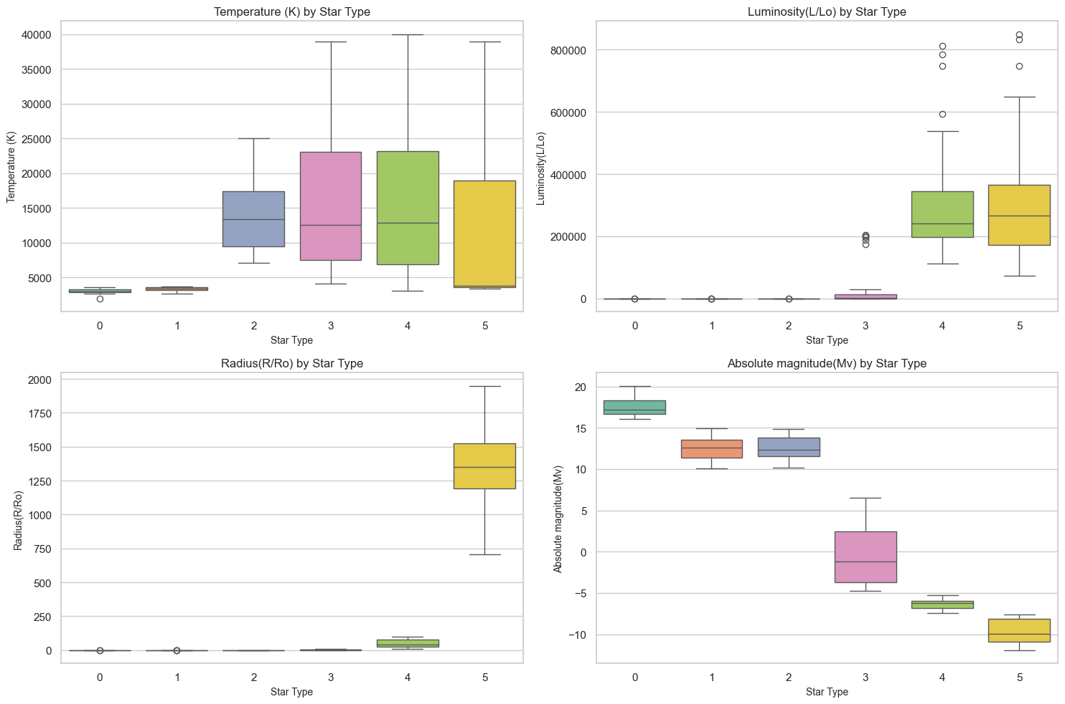

Slide 7
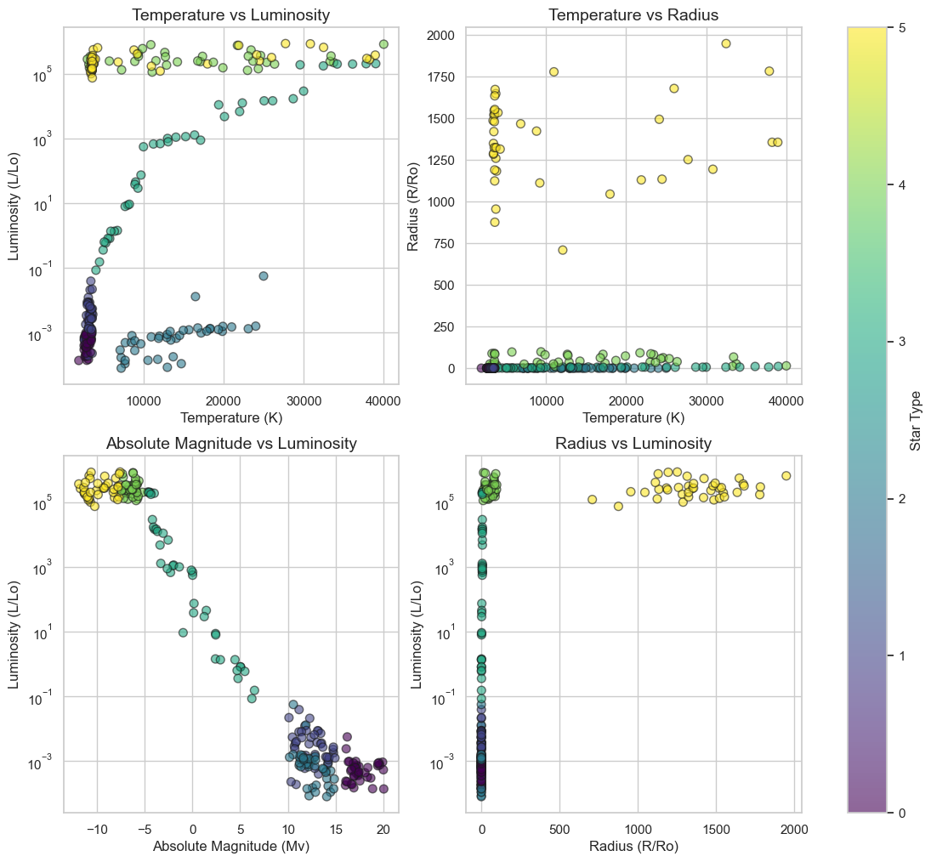

Slide 8
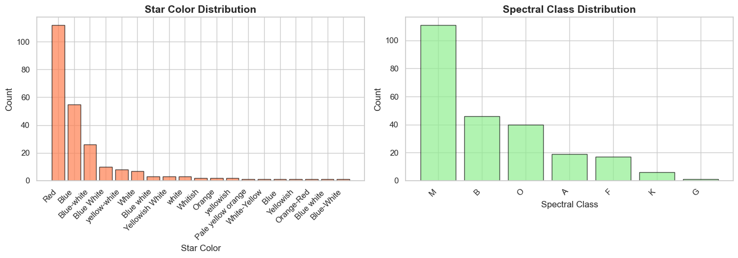
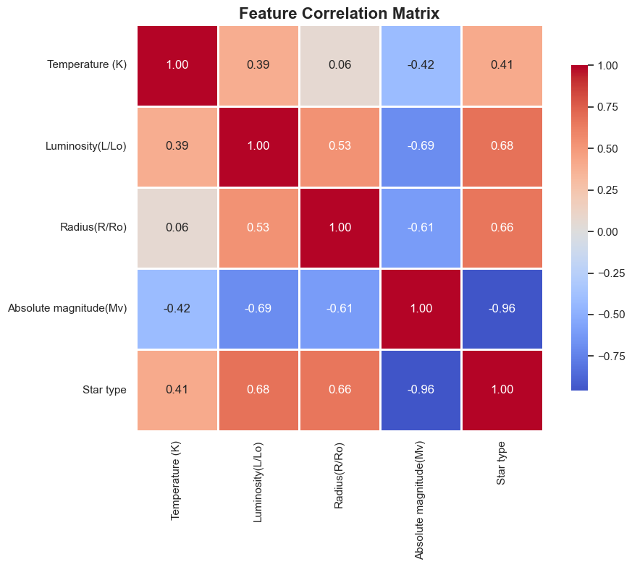

Slide 9
Predicting Star Types using the Decision Tree model

Slide 10
Predicting Star Types using K-Nearest Neighbor model (KNN)

Slide 11
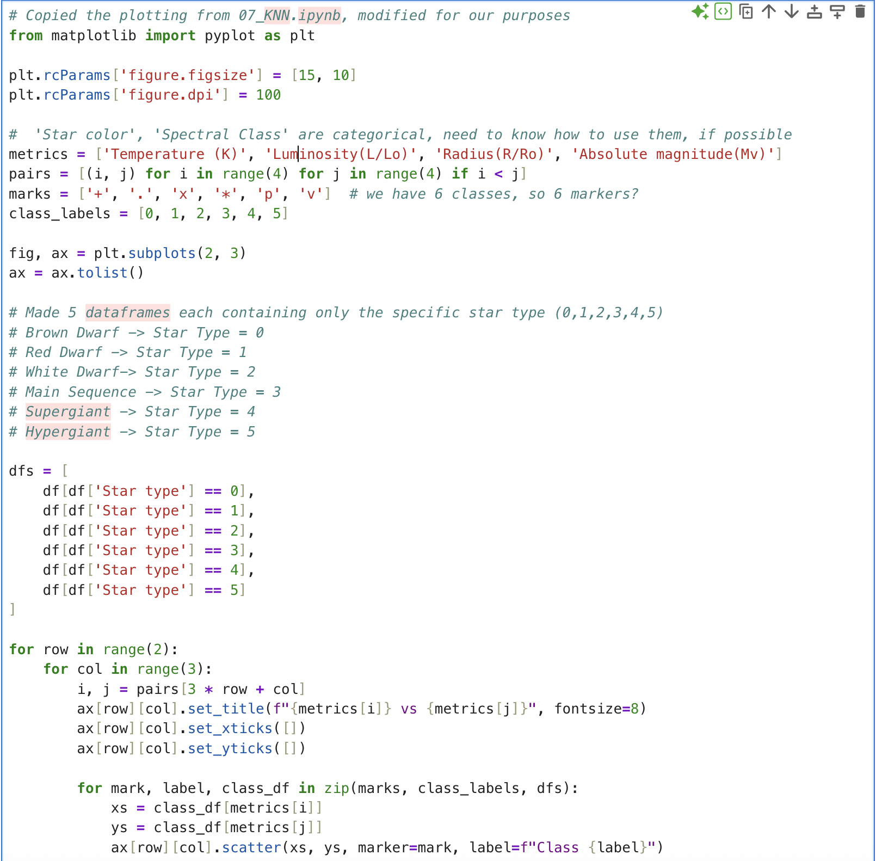
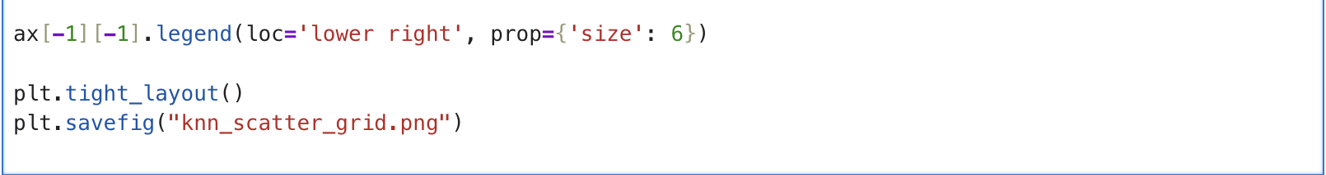
Code

Slide 12
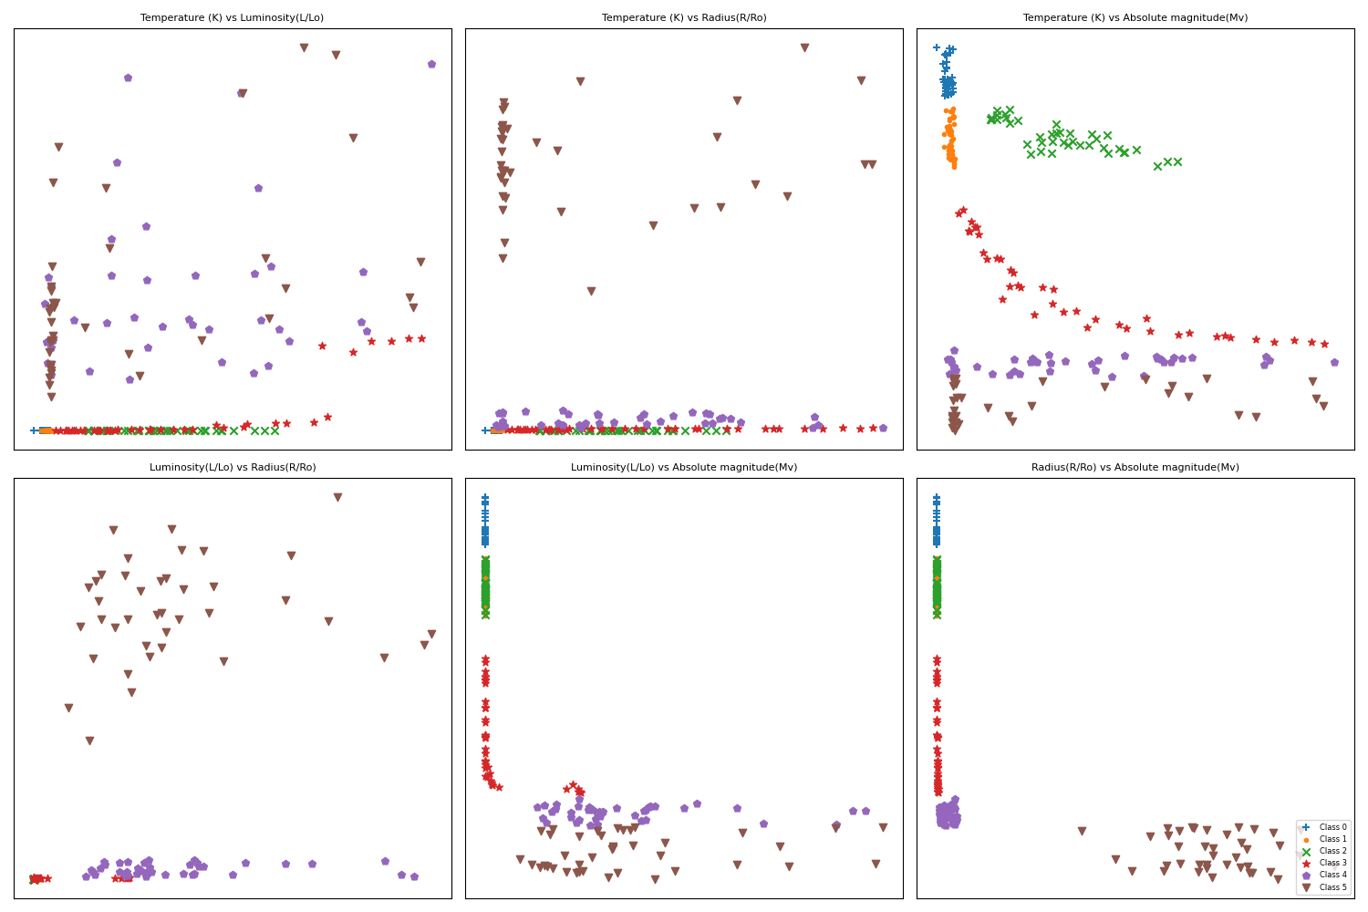

Slide 13
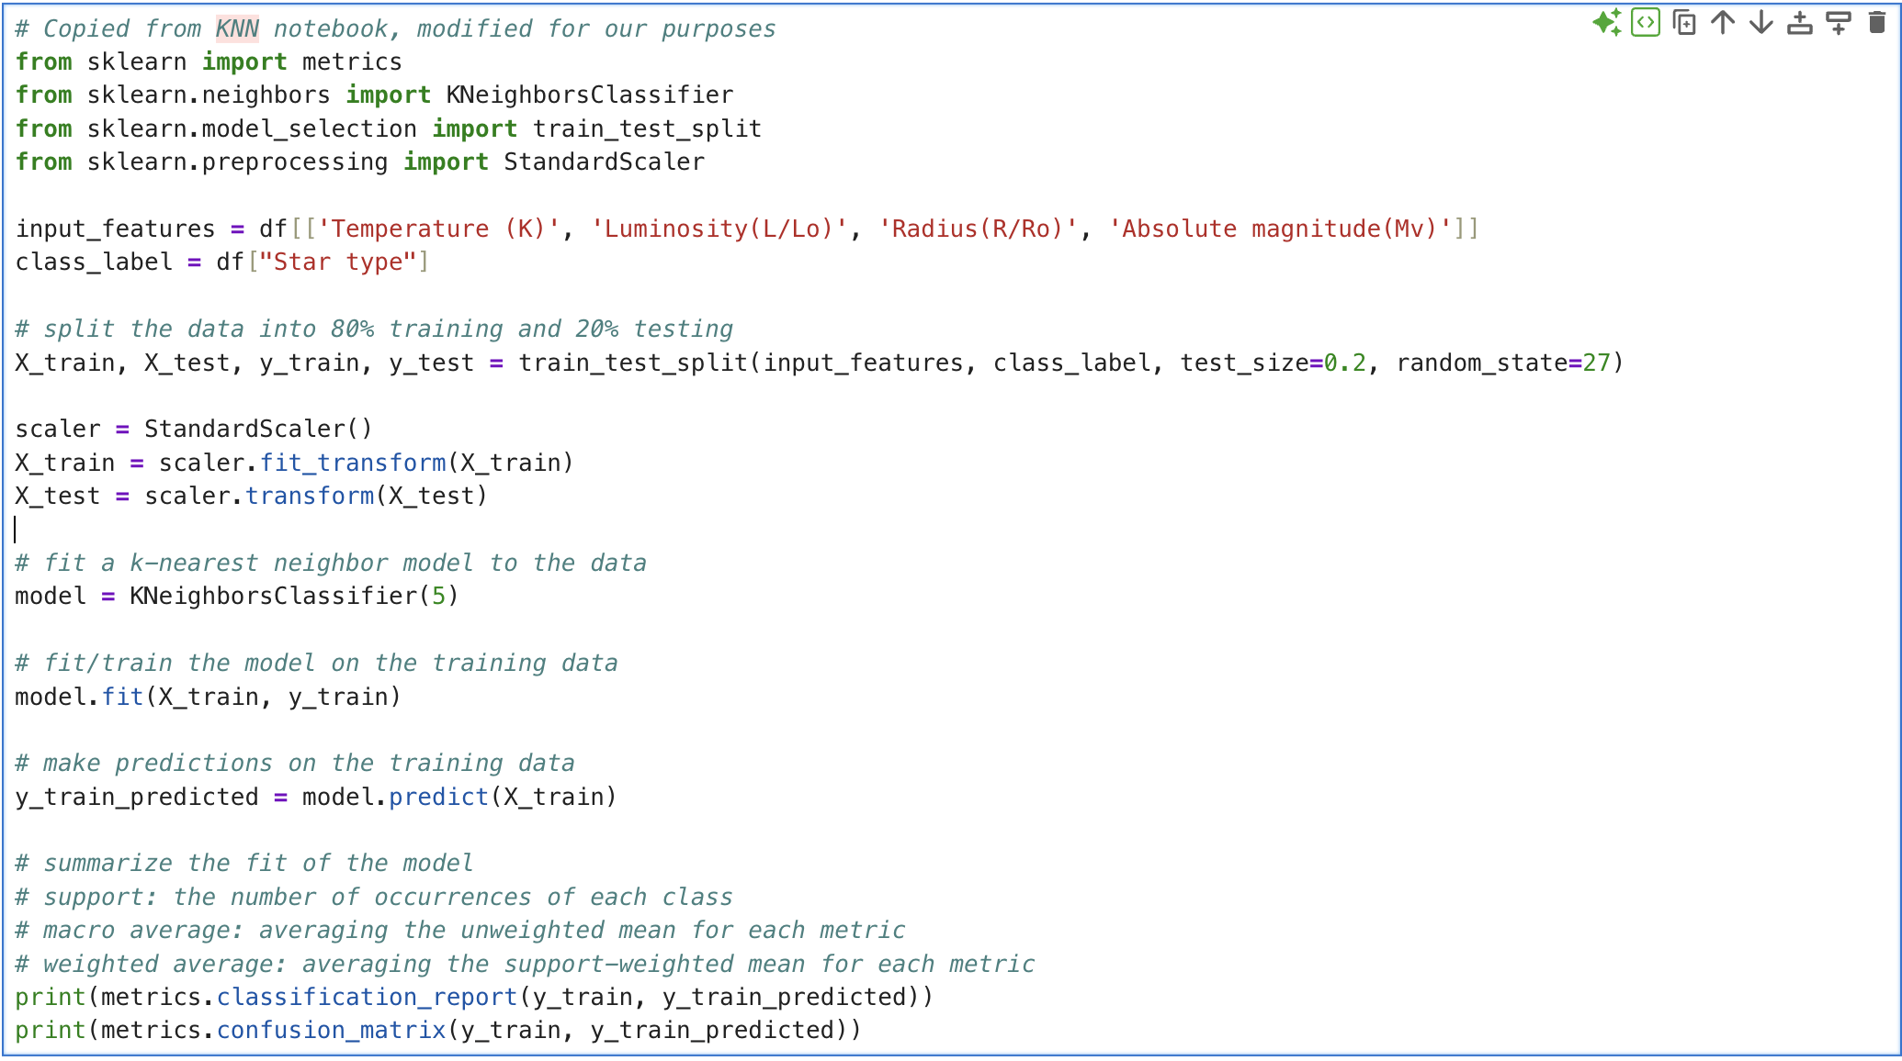
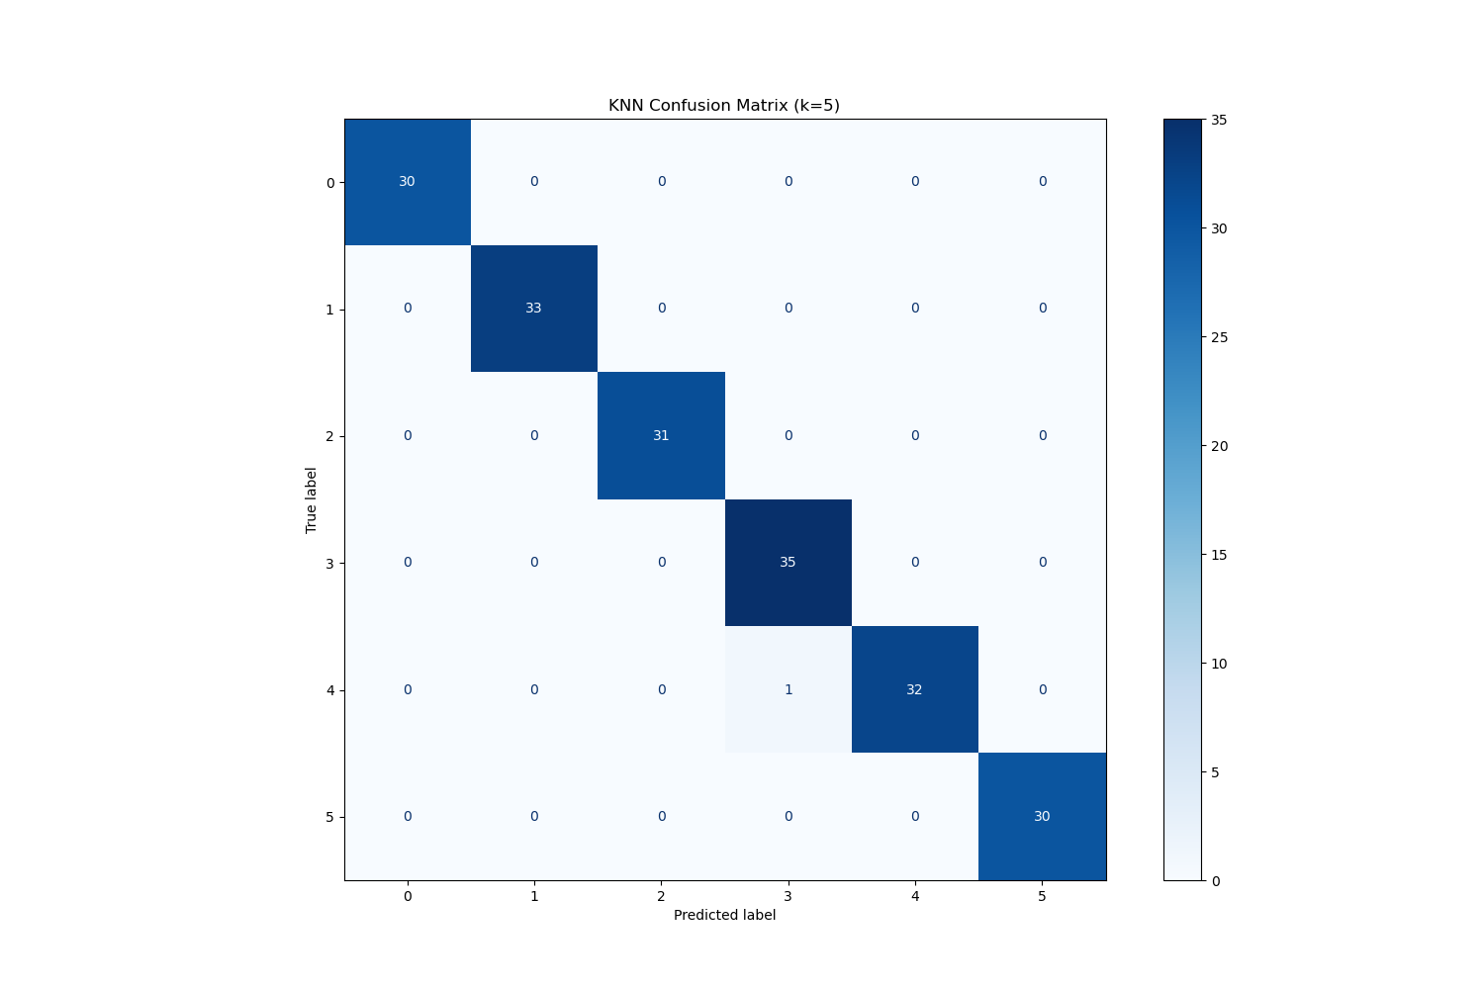
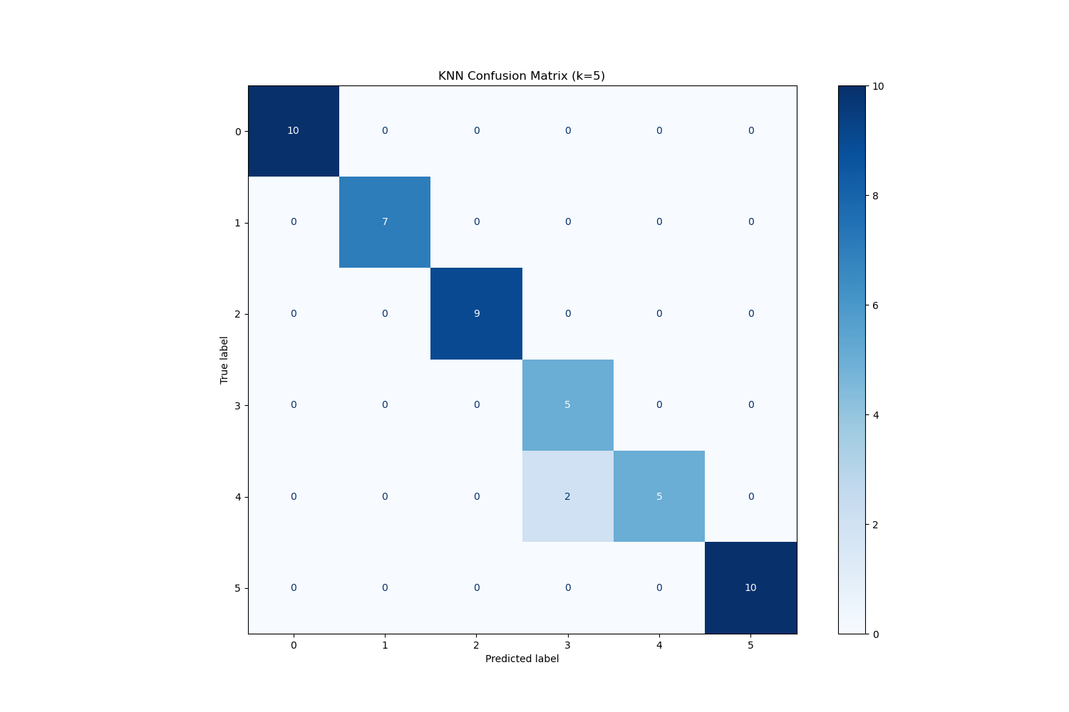
Initial Experiment with K=5 with split train/test (80/20)

Slide 14
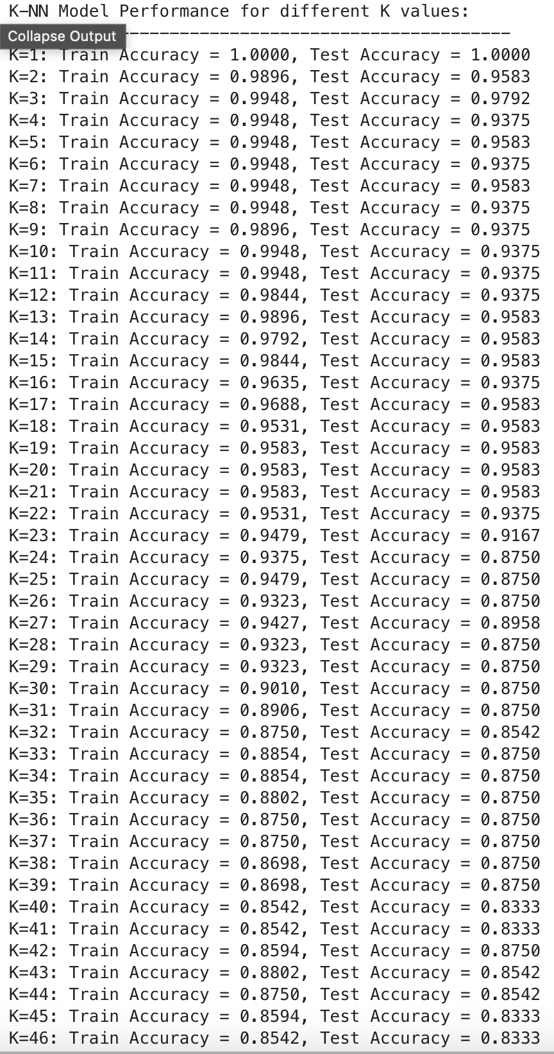
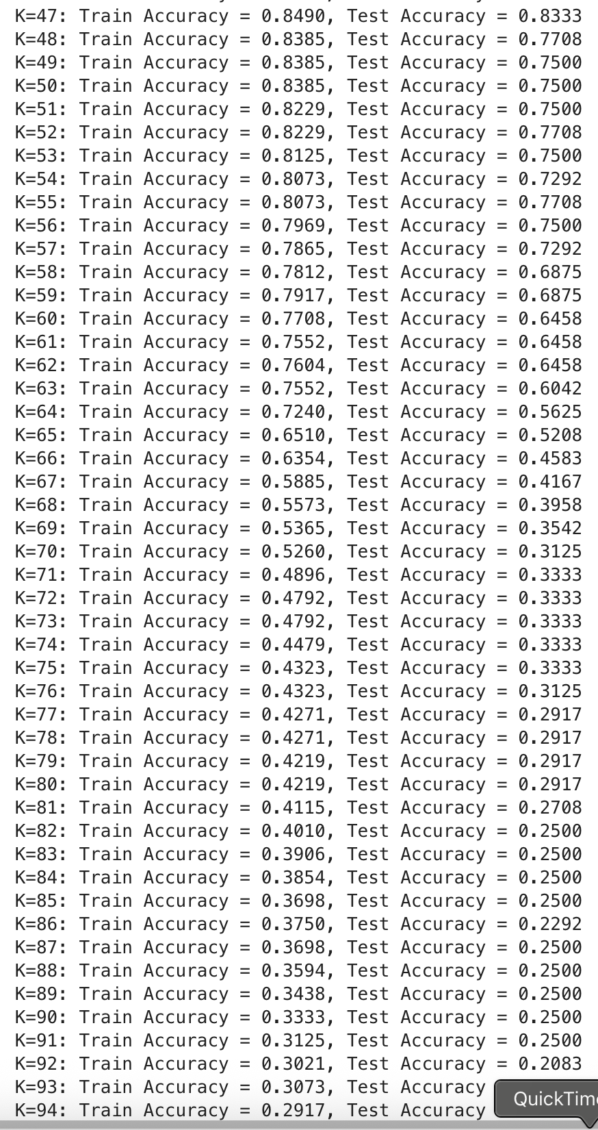
Ran 94 experiments of KNN models with different K’s ranging from 1 to 94 to observe accuracy

Slide 15
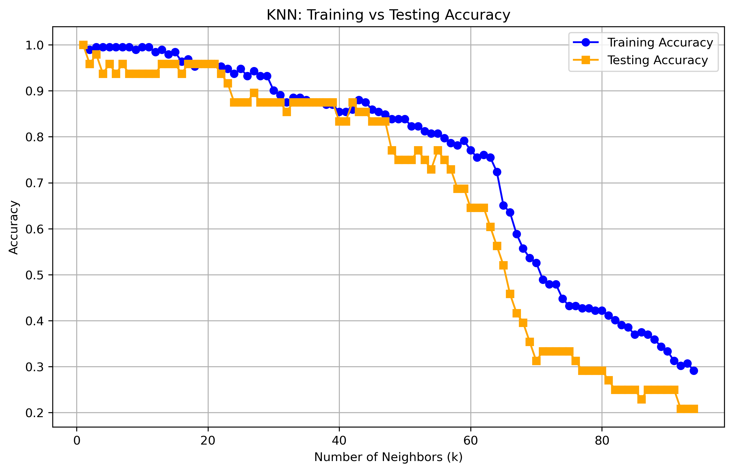

Slide 16
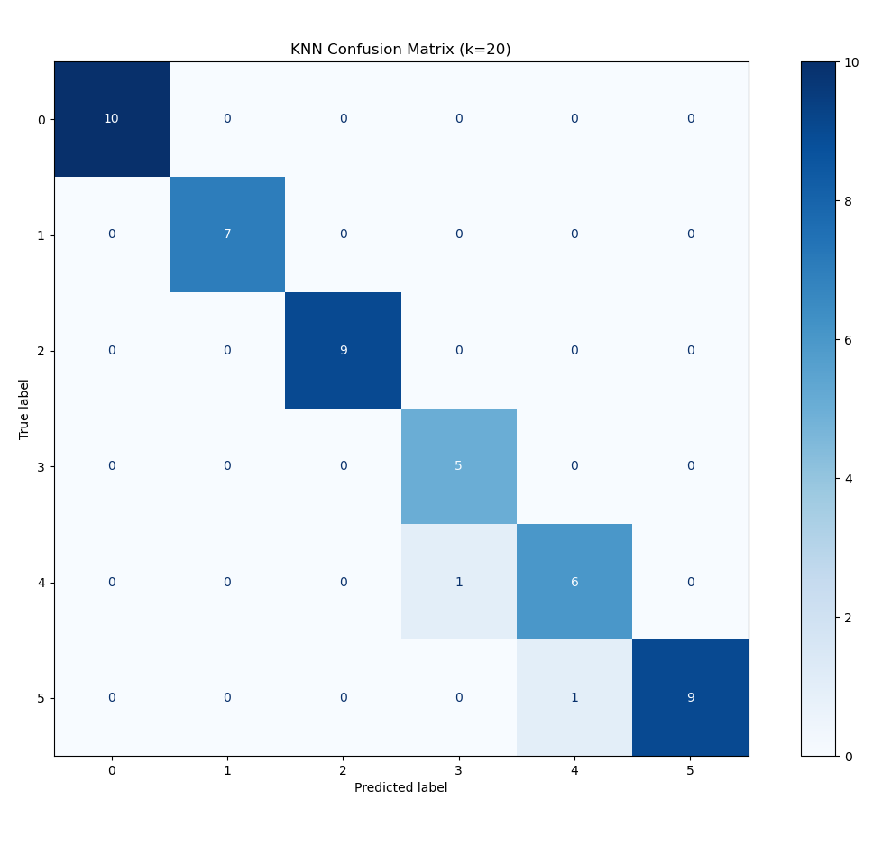
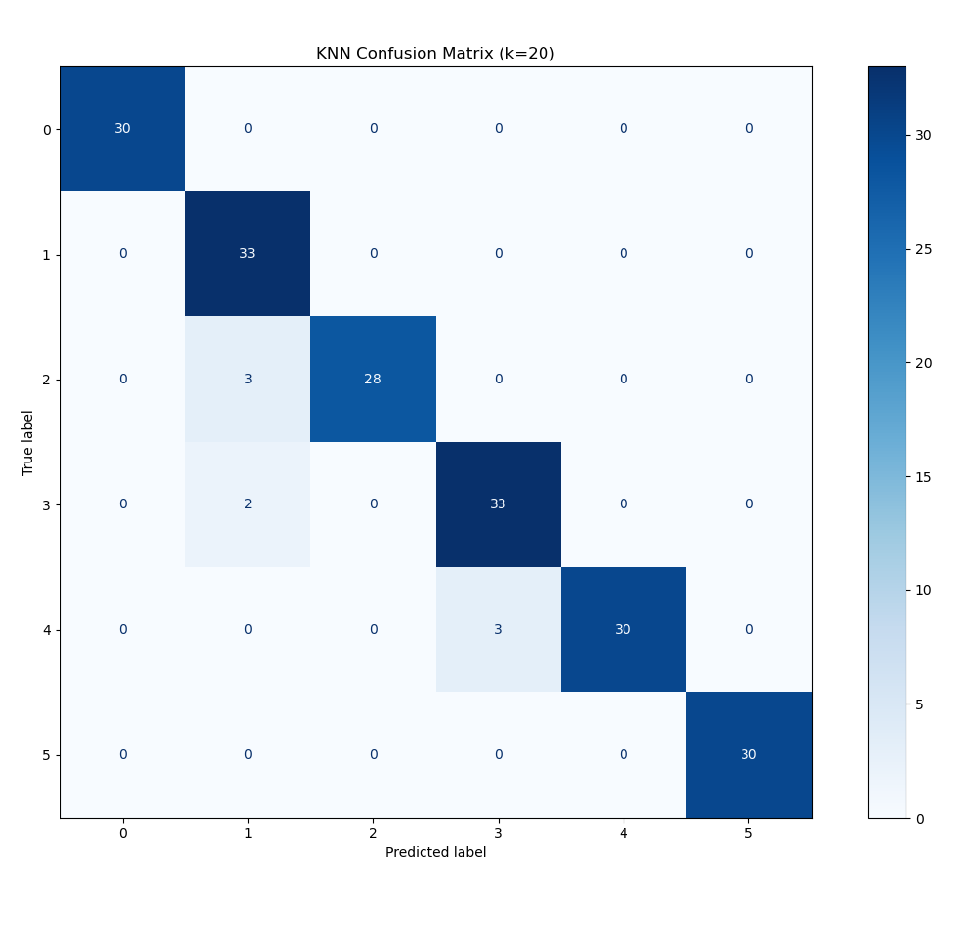

Slide 17
Predicting Star Types using the OPTICS model

Slide 18
Code

Slide 19
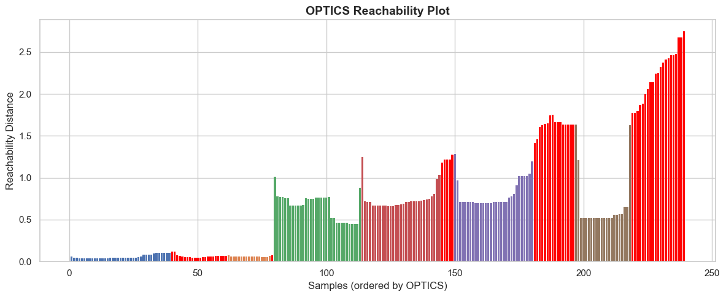

Slide 20
