Slide 1
Frequent Pattern Mining and Anomaly Detection of Service Requests to Identify Major Community Concerns
COMP 4710 group 6
Notes:
Hello everyone, my name is Mei, and my group members are Aiden, Kelvin, and Shika. Today, we’ll be presenting our project titled Frequent Pattern Mining and Anomaly Detection of Service Requests to Identify Major Community Concerns.

Slide 2
Project Overview
Outline
In this presentation we will cover:
Why did we choose this topic(mining 311 requests)
Methods and Technologies we used in the process
Sample results and Interpretation
Challenges and Future Plans of the project
Notes:
In this presentation, we will cover:
Why we chose this topic, focusing on mining 311 service requests.
The methods and technologies we used during the process.
Sample results and their interpretation.
And finally, the challenges we encountered and our future plans for the project.

Slide 3

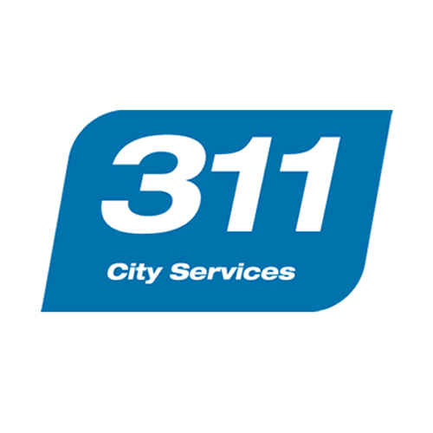
About 311
311 requests are used to get information about services and programs from the local government or to make a request for service.[1]
Usages
Notes:
As technology continues to advance, cities collect a wide range of data, including service requests, to monitor their conditions in real time.
In our study, we focused specifically on analyzing 311 requests. 311 is a service that Winnipeg citizens can use to either inquire information about local government services and programs or to request services and report concerns.
These service requests offer valuable insights into the issues that citizens encounter in their daily lives. By analyzing this data, governments can identify frequent patterns and anomalies, helping to uncover systemic service disruptions or areas of inefficiencies in city service. (this can also be removed)

Slide 4
Motivation and Real Life Applications
Government Resource Allocation
Improve Service Quality
Identify major community concerns
Notes:
Our motivation is to create a model that identifies areas of frequent service disruption and inefficiencies or bottlenecks in city services, by analyzing frequent service request patterns and anomalies in service request case durations. This same model could be applied by other cities using their own service request data to improve the quality of their city services.
It can help other local governments identify areas that require additional resources, (based on location and also by request category).
It can uncover ongoing or past issues related to various city services.
By monitoring trends, it’s possible to determine if local conditions have improved—for instance, fewer complaints about water leaks might indicate successful resolution efforts.

Slide 5
Our Contributions
Discover Frequent Patterns
Identify Anomalies
Using FP-Growth Algorithm to identify frequent patterns in Winnipeg’s 311 request database.
Use seasonal decomposition and standardized residual analysis to detect unusual patterns or outliers
Notes:
To analyze frequent patterns in Winnipeg's 311 request data, we utilized the FP-growth algorithm from the SPMF library. By setting a suitable minimum support, we identified the top K frequent patterns for each cardinality, providing insights into recurring issues reported by the community.
For anomaly detection, we applied seasonal decomposition and standardized residual analysis, which enabled us to pinpoint requests with unusually long case durations, highlighting service inefficiencies or bottlenecks that may require further investigation.
The combination of these two methods allow us to have a more comprehensive approach in identifying specific service areas that require improvement.

Slide 6
Related Works
Distributed Big Data Computing for Supporting Predictive Analytics of Service Requests
Comparison with related works:
Focus more on frequent patterns and Anomaly detection.
Combination of the 2 techniques will give important insights about the 311 data.
Notes:
In comparison to related work, the 2021 study titled "Distributed Big Data Computing for Supporting Predictive Analytics of Service Requests" by Tianlei Wang et al., our project takes a different approach.
While their study primarily focused on predictive analytics, we go a step further by combining frequent pattern mining with anomaly detection. This dual focus allows us to uncover not only common trends but also unusual or unexpected patterns that may require immediate attention or further investigation.
By doing so, our work provides a deeper understanding of major community concerns and supports more efficient allocation of municipal resources to address pressing issues effectively.

Slide 7
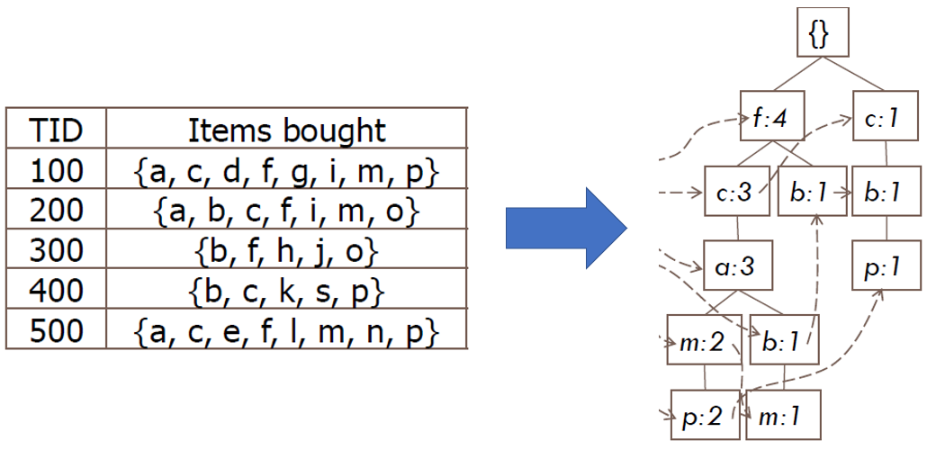
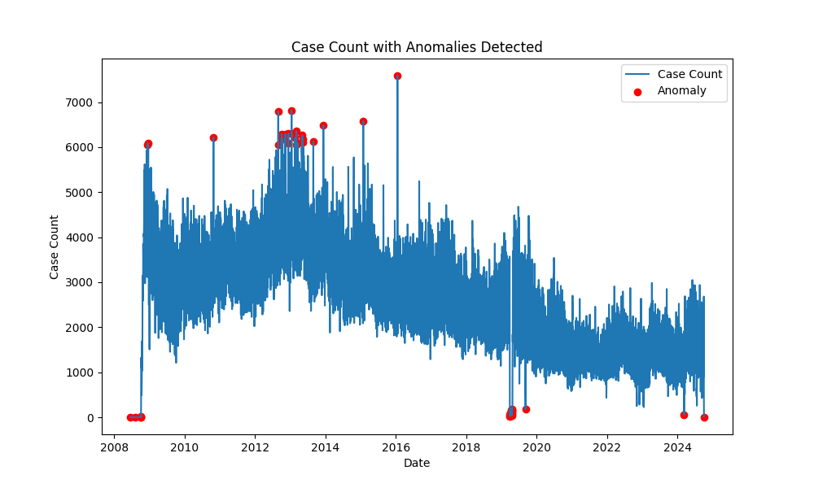
Analysis Methods
FP-Growth Algorithm
FP-Growth Algorithm
Anomaly Detection
Notes:
(leave it out) Here, we have visuals representing the two key methods used in our project. The image on the left illustrates the FP-growth algorithm, while the image on the right showcases examples of potential anomalies identified in the data. Next, we will be going over the 2 analysis methods we used step by step.

Slide 8
Step by Step Procedure - Frequent Pattern Mining
Step
Description
Purpose
Clean up data from 311 request database.
Focus on service requests and remove information requests.
STEP
1
Format the data.
Make sure the data following the format for acceptable input for the SPMF library.
STEP
2
Choose an appropriate Minimum support using trial and error.
Make sure enough Frequent patterns are generated for each cardinality.
STEP
3
Run the FP-Growth Algorithm on the formatted data and obtain result, convert the result back to human readable form.
Easier Interpretation of results.
STEP
4
Notes:
(should probably remove, if content is too long)The first analysis method we used on the 311 database is frequent pattern mining using FP-growth algorithm. It consists of 4 steps, step one, cleaning of data, step 2, formatting the data, step 3, choosing appropriate minimum support, step 4, run the FP-growth algorithm and obtain the results.

Slide 9
Frequent Pattern Analysis

Slide 10
Frequent Pattern Mining Step 1 - CLEAN UP
Example Data Entries after cleaning:
Reason | Type | Neighbourhood | Ward
Water and Waste | Breached Damage, Theft, Operator Standards | Mcmillan | Fort Rouge - East Fort Garry
Public Works | Snow Removal Street Priority 1 Reg | Saskatchewan North | St. James
Water and Waste | Missed Yard Waste Collection Deficiency | Springfield North | North Kildonan
Parking Authority | Broken Meter Report | South Portage | Fort Rouge - East Fort Garry
Any entry without a neighborhood specified is removed.
All information requests are removed, only service requests are kept.
Only the columns “Reason”, “Ward”, “Neighborhood” and “Type” are considered important and kept in the data entries.
Notes:
Step 1 of frequent pattern mining was data preparation. To start, we removed information requests since they don’t include neighborhood data, making them less useful for our analysis. Next, we streamlined the dataset by retaining only the columns “Reason,” “Ward,” “Neighborhood,” and “Type.” This allowed the algorithm to focus on identifying frequent itemsets from the meaningful content of the service requests.

Slide 11
Frequent Pattern Mining Step 2 - FORMAT
Example Data Entries after Formating:
1 2 3 4
5 6 7 8
1 9 10 11
4 12 13 14
Format the data after it has been cleaned so that it is readable by the algorithm in the SPMF library.
Any unique string in each cell is matched to a unique number.
Example:
1 = “Water and Waste”,
2 = “Breached Damage, Theft, Operator Standards”...
3 = “Mcmillan”
Notes:
Step 2 involves formatting the data for the algorithm by converting strings into numbers. For instance, “Water and Waste” becomes 1, and “Breached Damage, Theft, Operator” becomes 2, and continuing this pattern for all entries.

Slide 12
Frequent Pattern Mining Step 3 - Choose Minsup
Choose a meaningful Minimum support to apply on the dataset through trial and error.
Our Process: 0.02 - 0.01 - 0.007
0.007 was found to be the most appropriate value that gives enough data without missing information.
Notes:
In step 3, we used trial and error to determine the appropriate minimum support for the FP-growth algorithm. Starting with a min support of 0.02, we found no frequent neighborhoods. Lowering it to 0.01 still produced no useful itemsets. Finally, at 0.007, we achieved sufficient output without losing important data for further analysis.

Slide 13
Frequent Pattern Mining Step 4 - Obtain Result
Example Results from the Algorithm:
Convert the result obtained from the FP-growth algorithm back to human readable form.
Collect the top 10 Frequent Itemsets from each cardinality.
Cardinality: The number of items in an itemset.
Interpret the results.
Itemset | Support
1 | 88902
3 | 21314
Itemset | Support
Water and Waste | 88902
Mcmillan | 21314
Notes:
After running the algorithm, we use a script to convert its output back into readable form by matching numbers to their original strings, reversing step 2. We then extract and interpret the top 10 frequent itemsets for each cardinality, where cardinality refers to the number of items in an itemset—for example, a cardinality of 1 means single-item sets.

Slide 14
Service Request Density by Neighbourhood -
Analysis step before result interpretation
Neighbourhood | Service Request Density
William Whyte | 11.61
St. John's | 7.85
Wolseley | 6.98
Chalmers | 5.43
Daniel Mcintyre | 5.21
Jefferson | 4.87
Rossmere-A | 4.13
Fort Richmond | 3.79
River Park South | 3.79
The Maples | 3.25
To better understand the intensity of requests sent by each neighborhood.
Service Request Density = number of requests / the population of the neighborhood
Findings:
William Whyte have the highest Service Request Density.
Notes:
Before presenting the results of the FP-growth algorithm, we also conducted an analysis of request intensity by neighborhood. This involved calculating the service request density for each neighborhood, revealing that William Whyte had the highest request density.

Slide 15
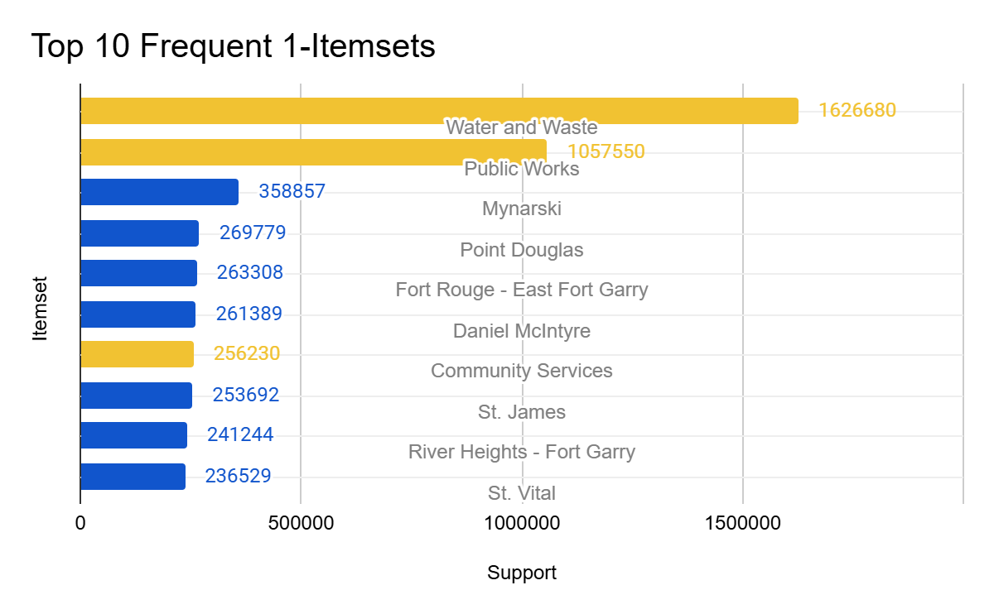
Orange Bars represent items from the column “Reason”
Blue Bars represent items from the column “Ward”
Notes:
In the frequent 1-itemset analysis, we identified the most common request reasons and wards.
Key findings include:
That eight wards appear in the top 10, showing an uneven distribution of service requests across the city, with some wards generating far more requests than others.
And Public Works stands out as the second most frequent category, emphasizing the prominence of infrastructure-related requests in the dataset.

Slide 16
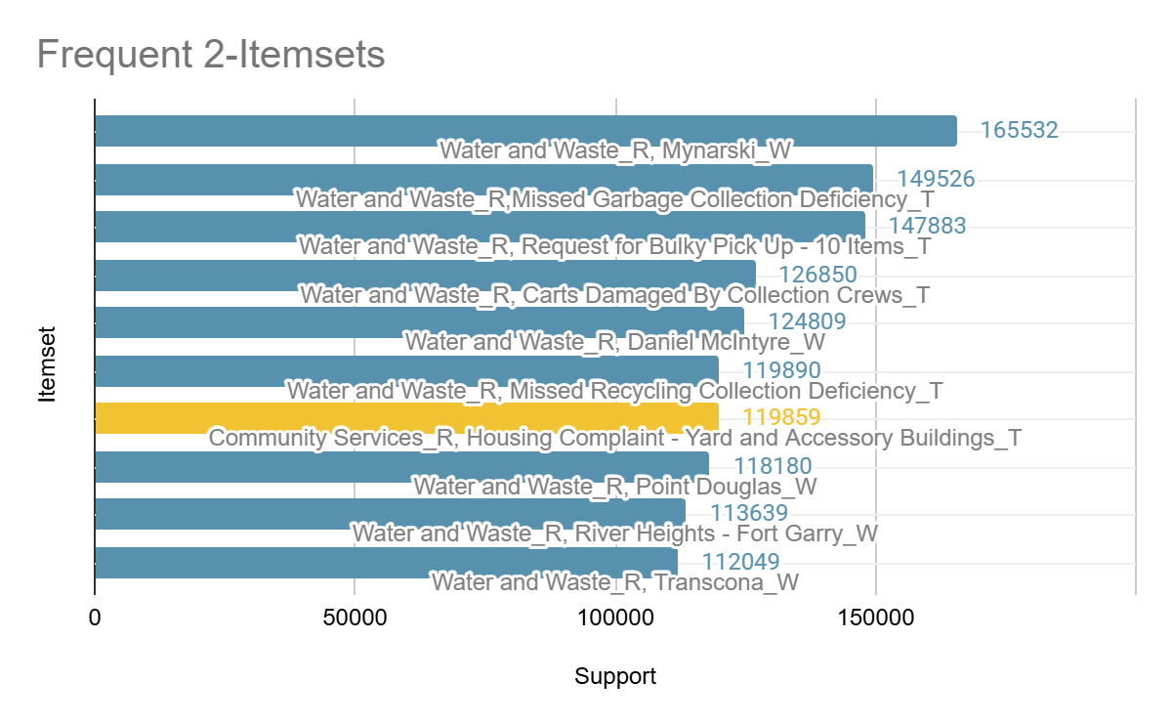
Orange Bars represent itemsets containing “Community Services”
Blue Bars represent itemsets containing “Water and Waste”
.
Notes:
For frequent 2-itemsets, we analyzed pairs like (Ward and Reason) and (Reason and Type).
This analysis highlights Water and Waste as a significant concern across Winnipeg, with issues like missed collections standing out. It also reveals disparities in service needs among wards, offering valuable insights for more effective resource allocation.

Slide 17
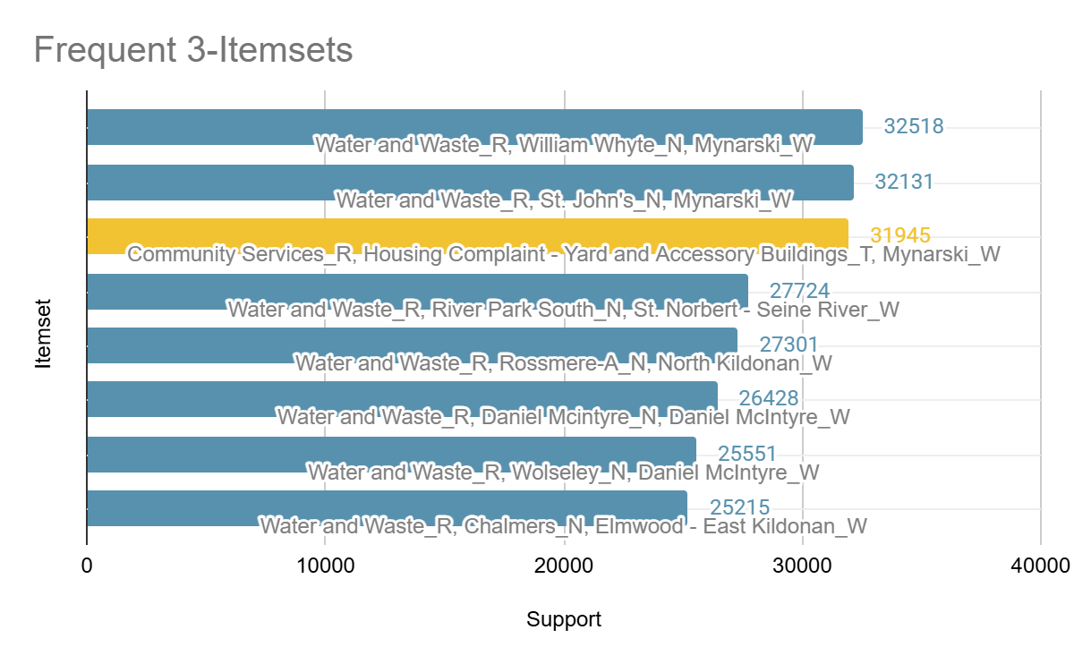
Orange Bars represent itemsets containing “Community Services”
Blue Bars represent itemsets containing “Water and Waste”
Notes:
In itemsets of cardinality 3, we see itemsets which also include Neighbourhoods, which allow us to gain more location-specific insights.These results further reinforce the prominence of water and waste management concerns across Winnipeg, alongside localized issues in specific wards like Mynarski.

Slide 18
FP-Growth Results
Point Douglas
Mynarski Ward
Water and Waste
Housing Complaint
Public Works
Community Services
Notes:
Finally what we found from this analysis is that Water and Waste Management is a significant concern across multiple neighborhoods and wards in Winnipeg, with particular emphasis on Mynarski Ward.
We also observed a notable prevalence of yard and housing complaints citywide. This could indicate widespread property maintenance issues or a higher level of community engagement in reporting such concerns.

Slide 19
Anomaly Detection

Slide 20
Step by Step Anomaly detection
Step
Description
Purpose
Clean up data from 311 request database
Focus on service requests and remove information requests.
STEP
1
Detrend/Smoothen the data using seasonal decomposition.
To understand the data underlying with the time series datastream
STEP
2
Analysis of anomaly with statistic approach–Duration of a Case.
To find out the outliers
STEP
3
Run repeatedly with additional features -Type
To look for any additional informations
STEP
4
Notes:
Use this slide to explain the steps you took

Slide 21
Data Cleaning
Example Data Entries after cleaning:
Clean data to the target feature
Subject : [Service Request]
Duration : [Close Date] - [Open Date]
Groupby : ‘Type’
Type | Open Date | Close Date | Duration(Hours)
Poor Pressure | 2016-01-04 | 2016-01-05 | 17.05
Flex/Payment Down | 2014-05-26 | 2014-05-26 | 0.0
Notes:
We focus on service request
We find the durations
We group the data for Type

Slide 22
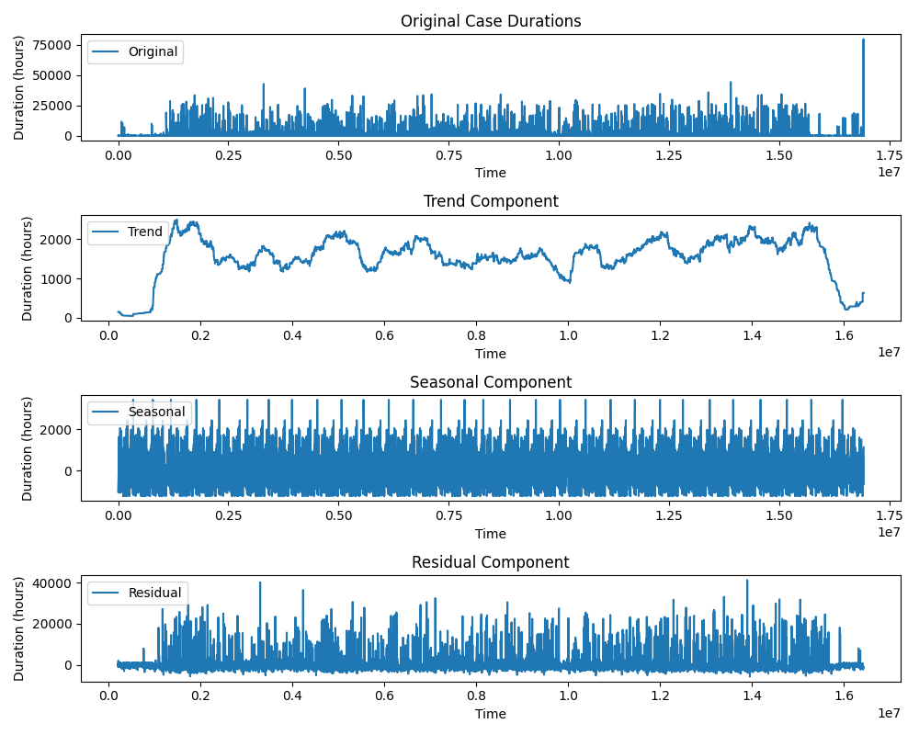
Seasonal Decomposition
detrend the data/ smoothen the data
residual = original data - trend - seasonal
Residual is the detrended data
Then apply Standardized residual analysis
Repeat the same analysis for each Type

Slide 23
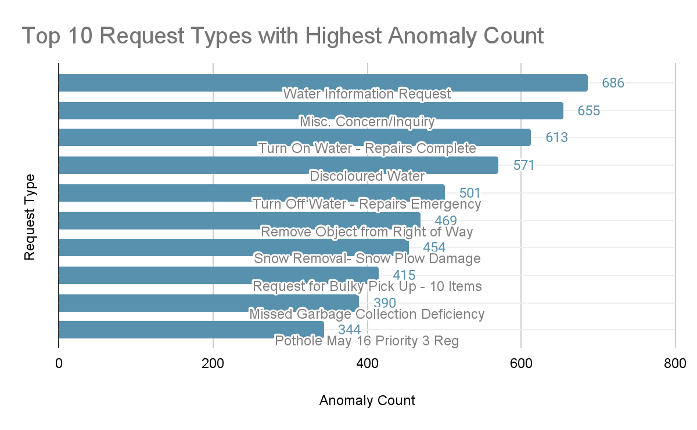

Slide 24
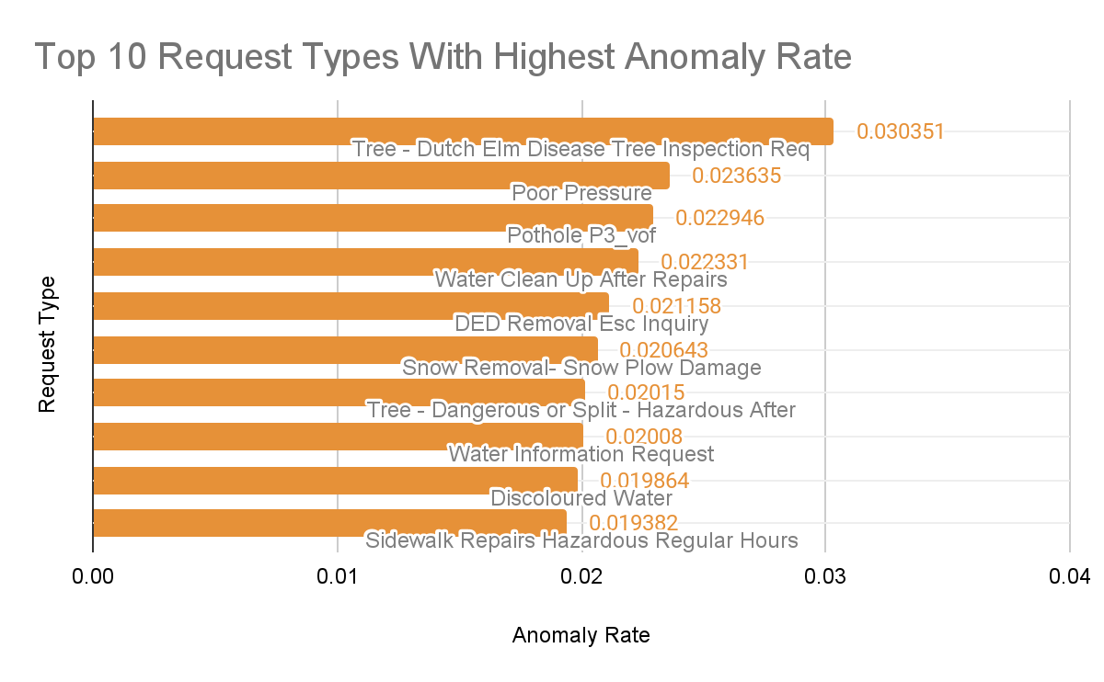

Slide 25
Challenges
Data formatting challenges
Choosing an appropriate Minimum support:
Notes:
While working on this project, we encountered a few challenges:
Initially, each item in our data was not prefixed. This meant that after running FP-growth on our data, it was hard to distinguish wards from neighbourhoods, and reasons from types. To resolve this, we added suffixes like "_W" and "_N" to make it easier to understand our frequent patterns.
Next, determining the appropriate minimum support was challenging as well. Since we had limited prior knowledge about the dataset, we had to rely on trial and error to find a suitable value, which added complexity to our analysis.
In our anomaly detection, we face a situation of choosing the right method as there are many factors included, such as time series, discrete data or sequential data. We spend a lot of time to find out which suit better for the dataset and which could achieve our research goals.
These challenges provided valuable lessons and insights for refining our methodology for future work.

Slide 26
Limitations & Future Work
Current trends
Time decay model
Notes:
Next, we also identified limitations in our study. The frequent patterns we identified are based on service request data collected since 2008, which means the analysis doesn’t account for changes in trends or the current relevance of older data.
One way to improve this would be to implement a time-decay model, which would give more weight to recent data while reducing the influence of older, less relevant patterns. This could provide a more accurate and up-to-date analysis of community concerns
Another challenge we encountered is that some request types and reasons lack sufficient context, making it difficult to determine how pressing these issues are. Since the 311 website does not provide detailed explanations for all types and reasons, we may need to reach out directly to gain a clearer understanding.
We hope to address these limitations in our future research.

Slide 27
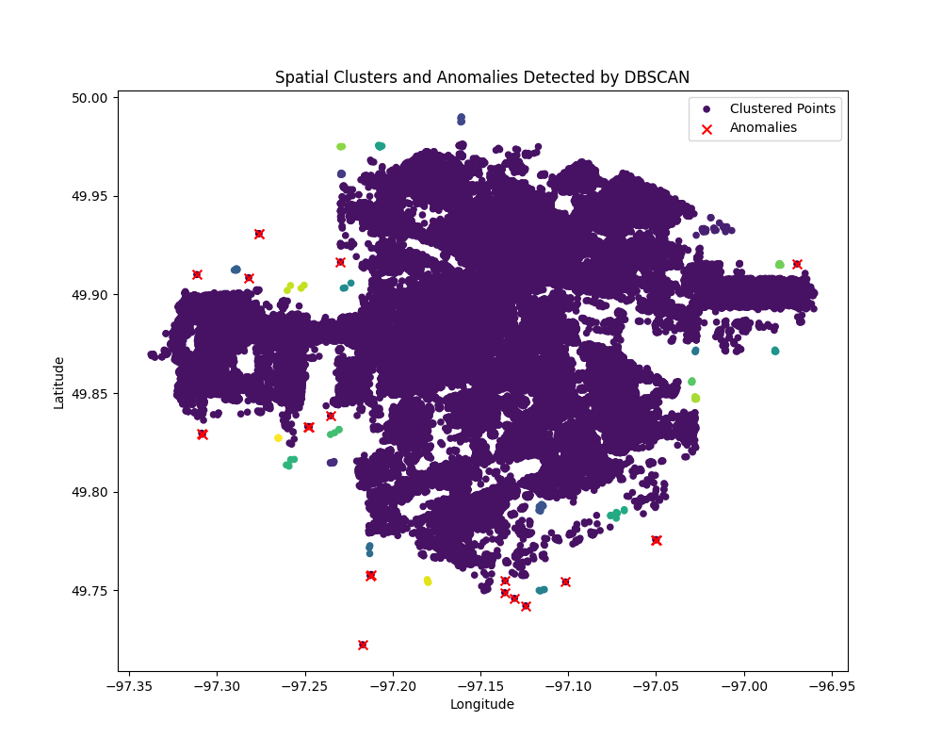
Limitation & Future Work
Isolation Forest
DBSCAN
Total Case count
2020 Public Work
Notes:
In terms of anomaly detection, we encounter challenges from the reliability of the dataset
For instance, we find out there are information inquiry in the Service request, after we filter the data to service request, when they originally have two category specialize for Service request, or Information Request.
Also, when we calculate the duration of the type, there may have the exact same time for open and close time, leading 0 in duration, which is not possible in real life, and may affect the accuracy on our analysis/
Our team also tried different anomaly detection, such as finding anomalies on case count over years, which show on left; and using dbscan to find out low case density based on geographic relationship.
Due to time factor, we have to put it on future work.

Slide 28
References
[1] “About 311,” City of Winnipeg, https://www.winnipeg.ca/311-city-services/about-311#:~:text=311%20is%20your%20resource%20to,your%20questions%20and%20provide%20assistance. (accessed Nov. 23, 2024).
[2] T. Wang et al., “Distributed Big Data Computing for supporting predictive analytics of service requests,” 2021 IEEE 45th Annual Computers, Software, and Applications Conference (COMPSAC), pp. 1723–1728, Jul. 2021. doi:10.1109/compsac51774.2021.00257
[3] “311 requests: Open data: City of winnipeg,” 311 Requests | Open Data | City of Winnipeg, https://data.winnipeg.ca/Contact-Centre-311/311-Requests/u7f6-5326/about_data (accessed Nov. 12, 2024).
Notes:
Here are the references we used.

