Slide 1

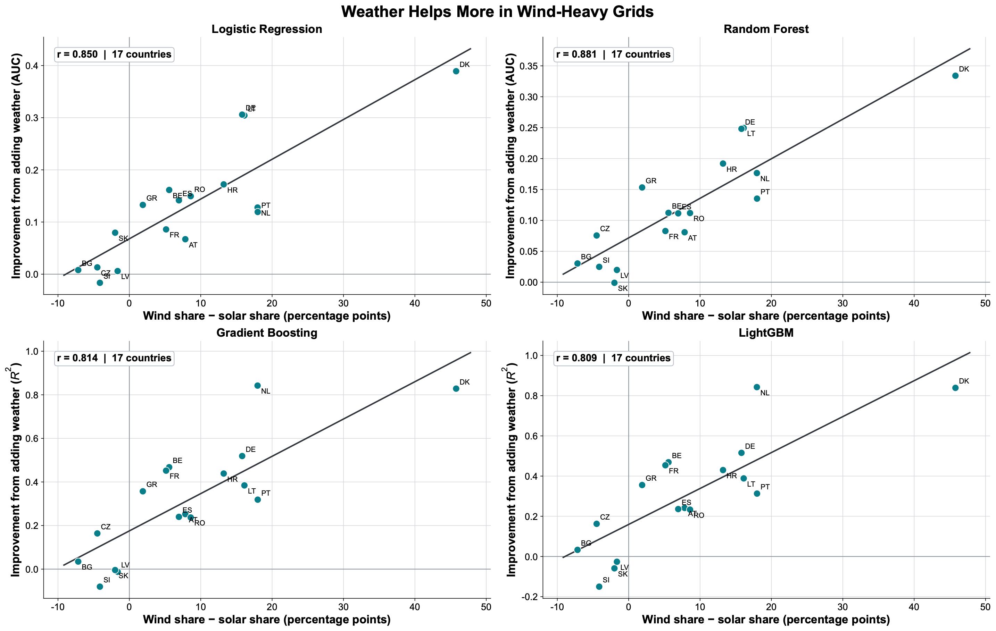
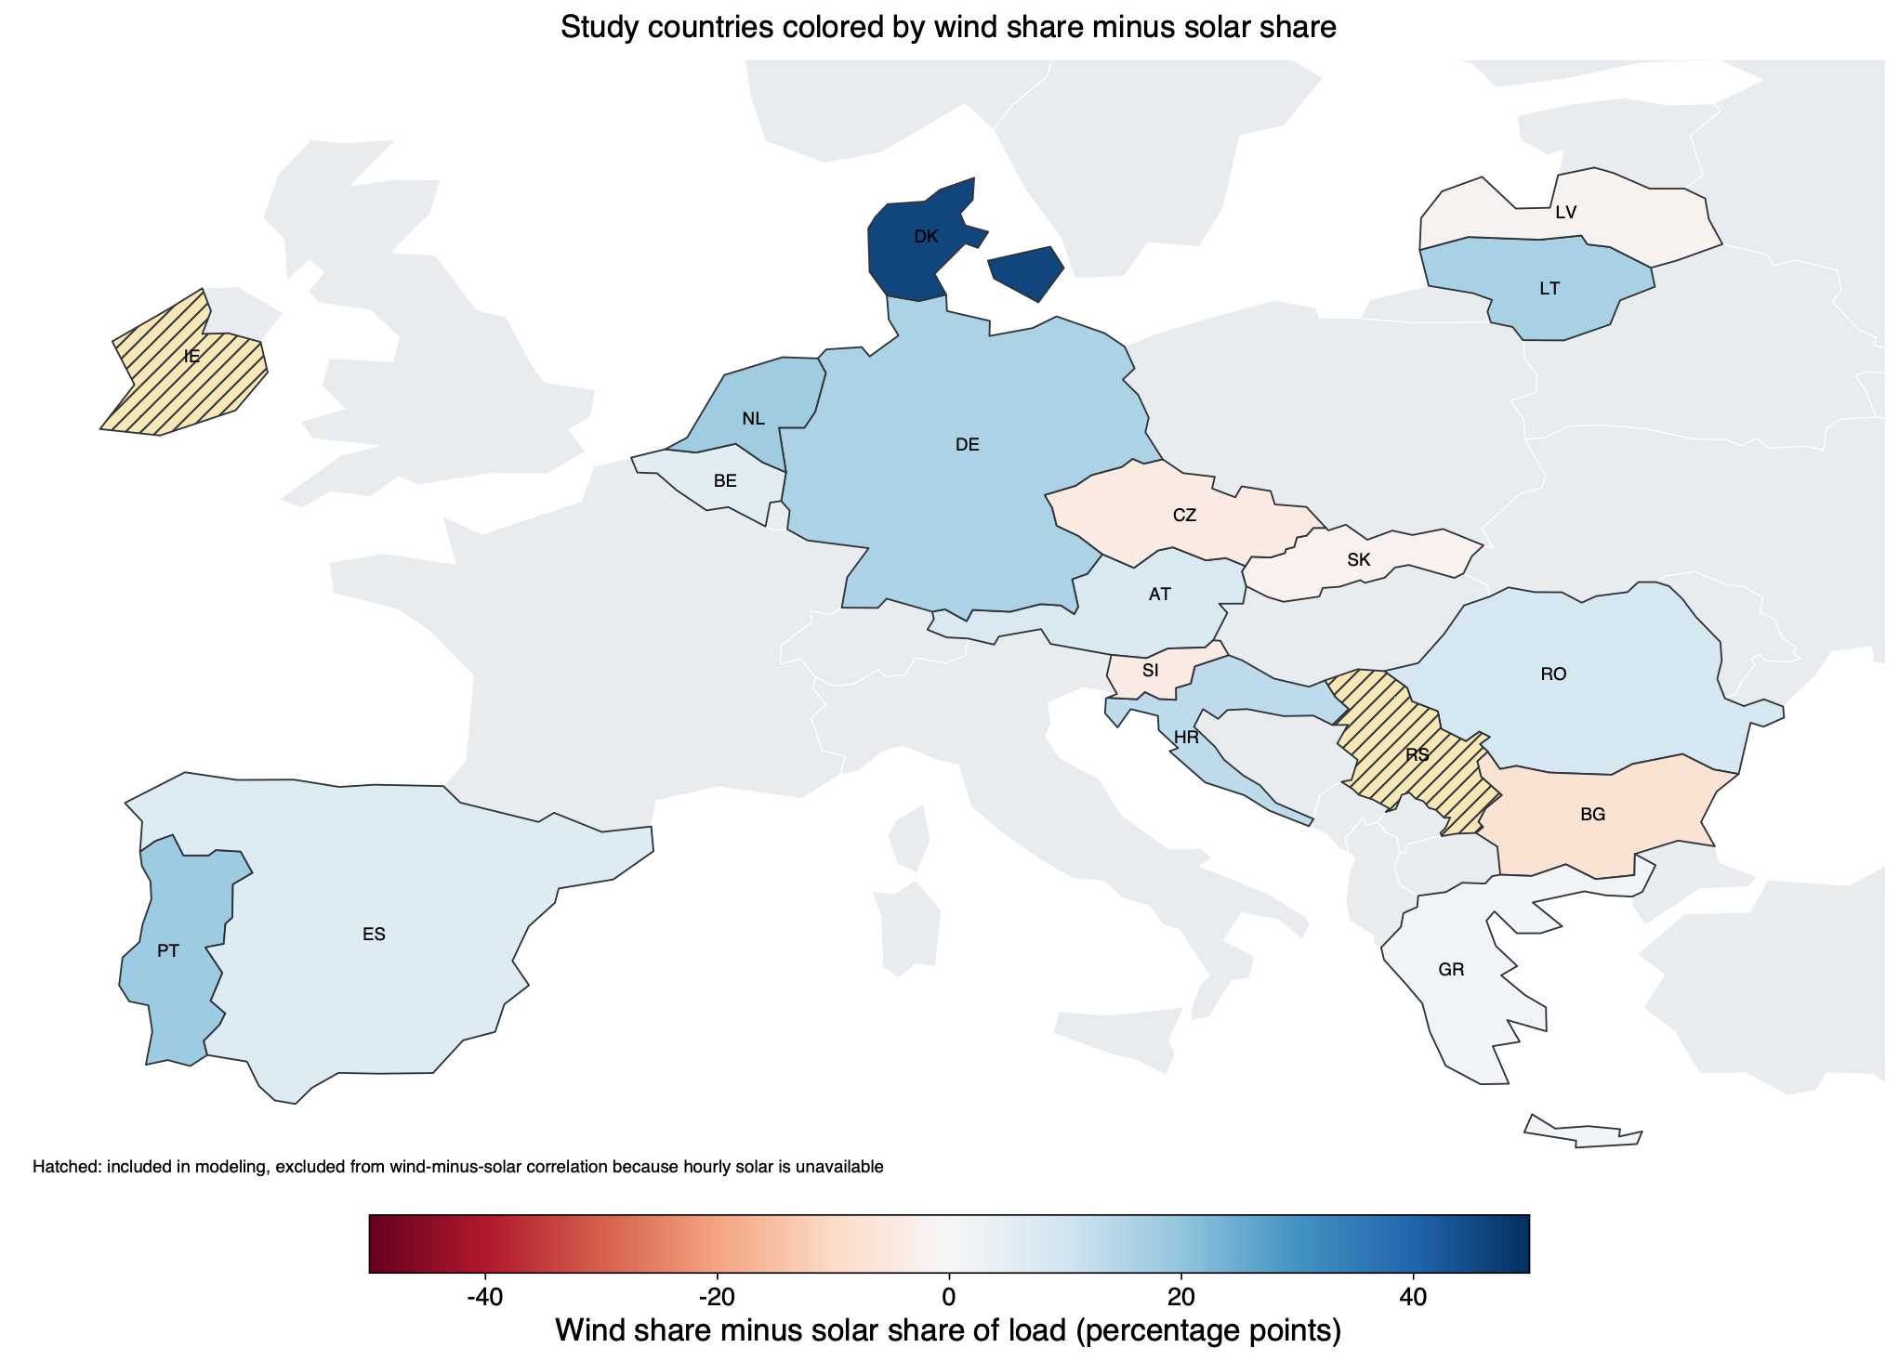
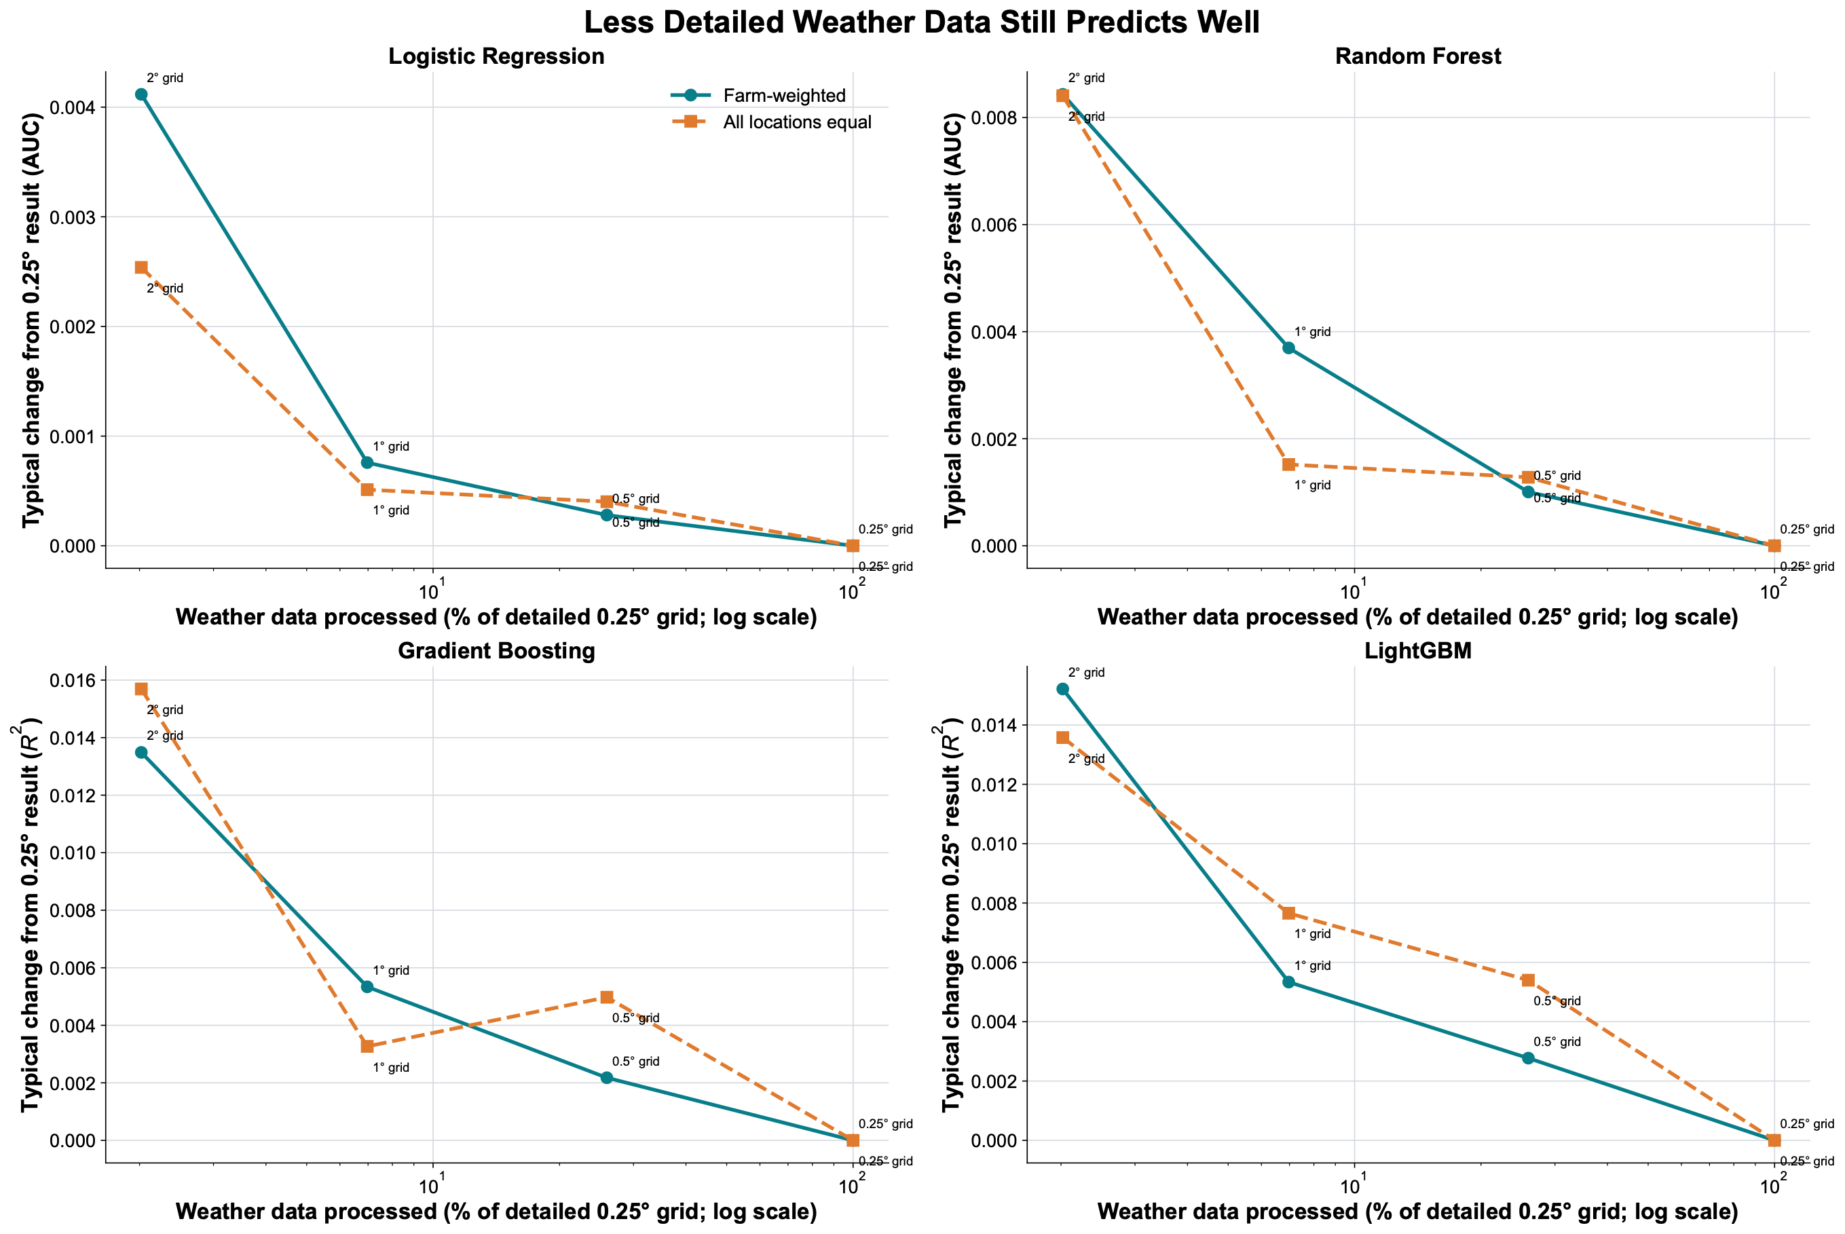
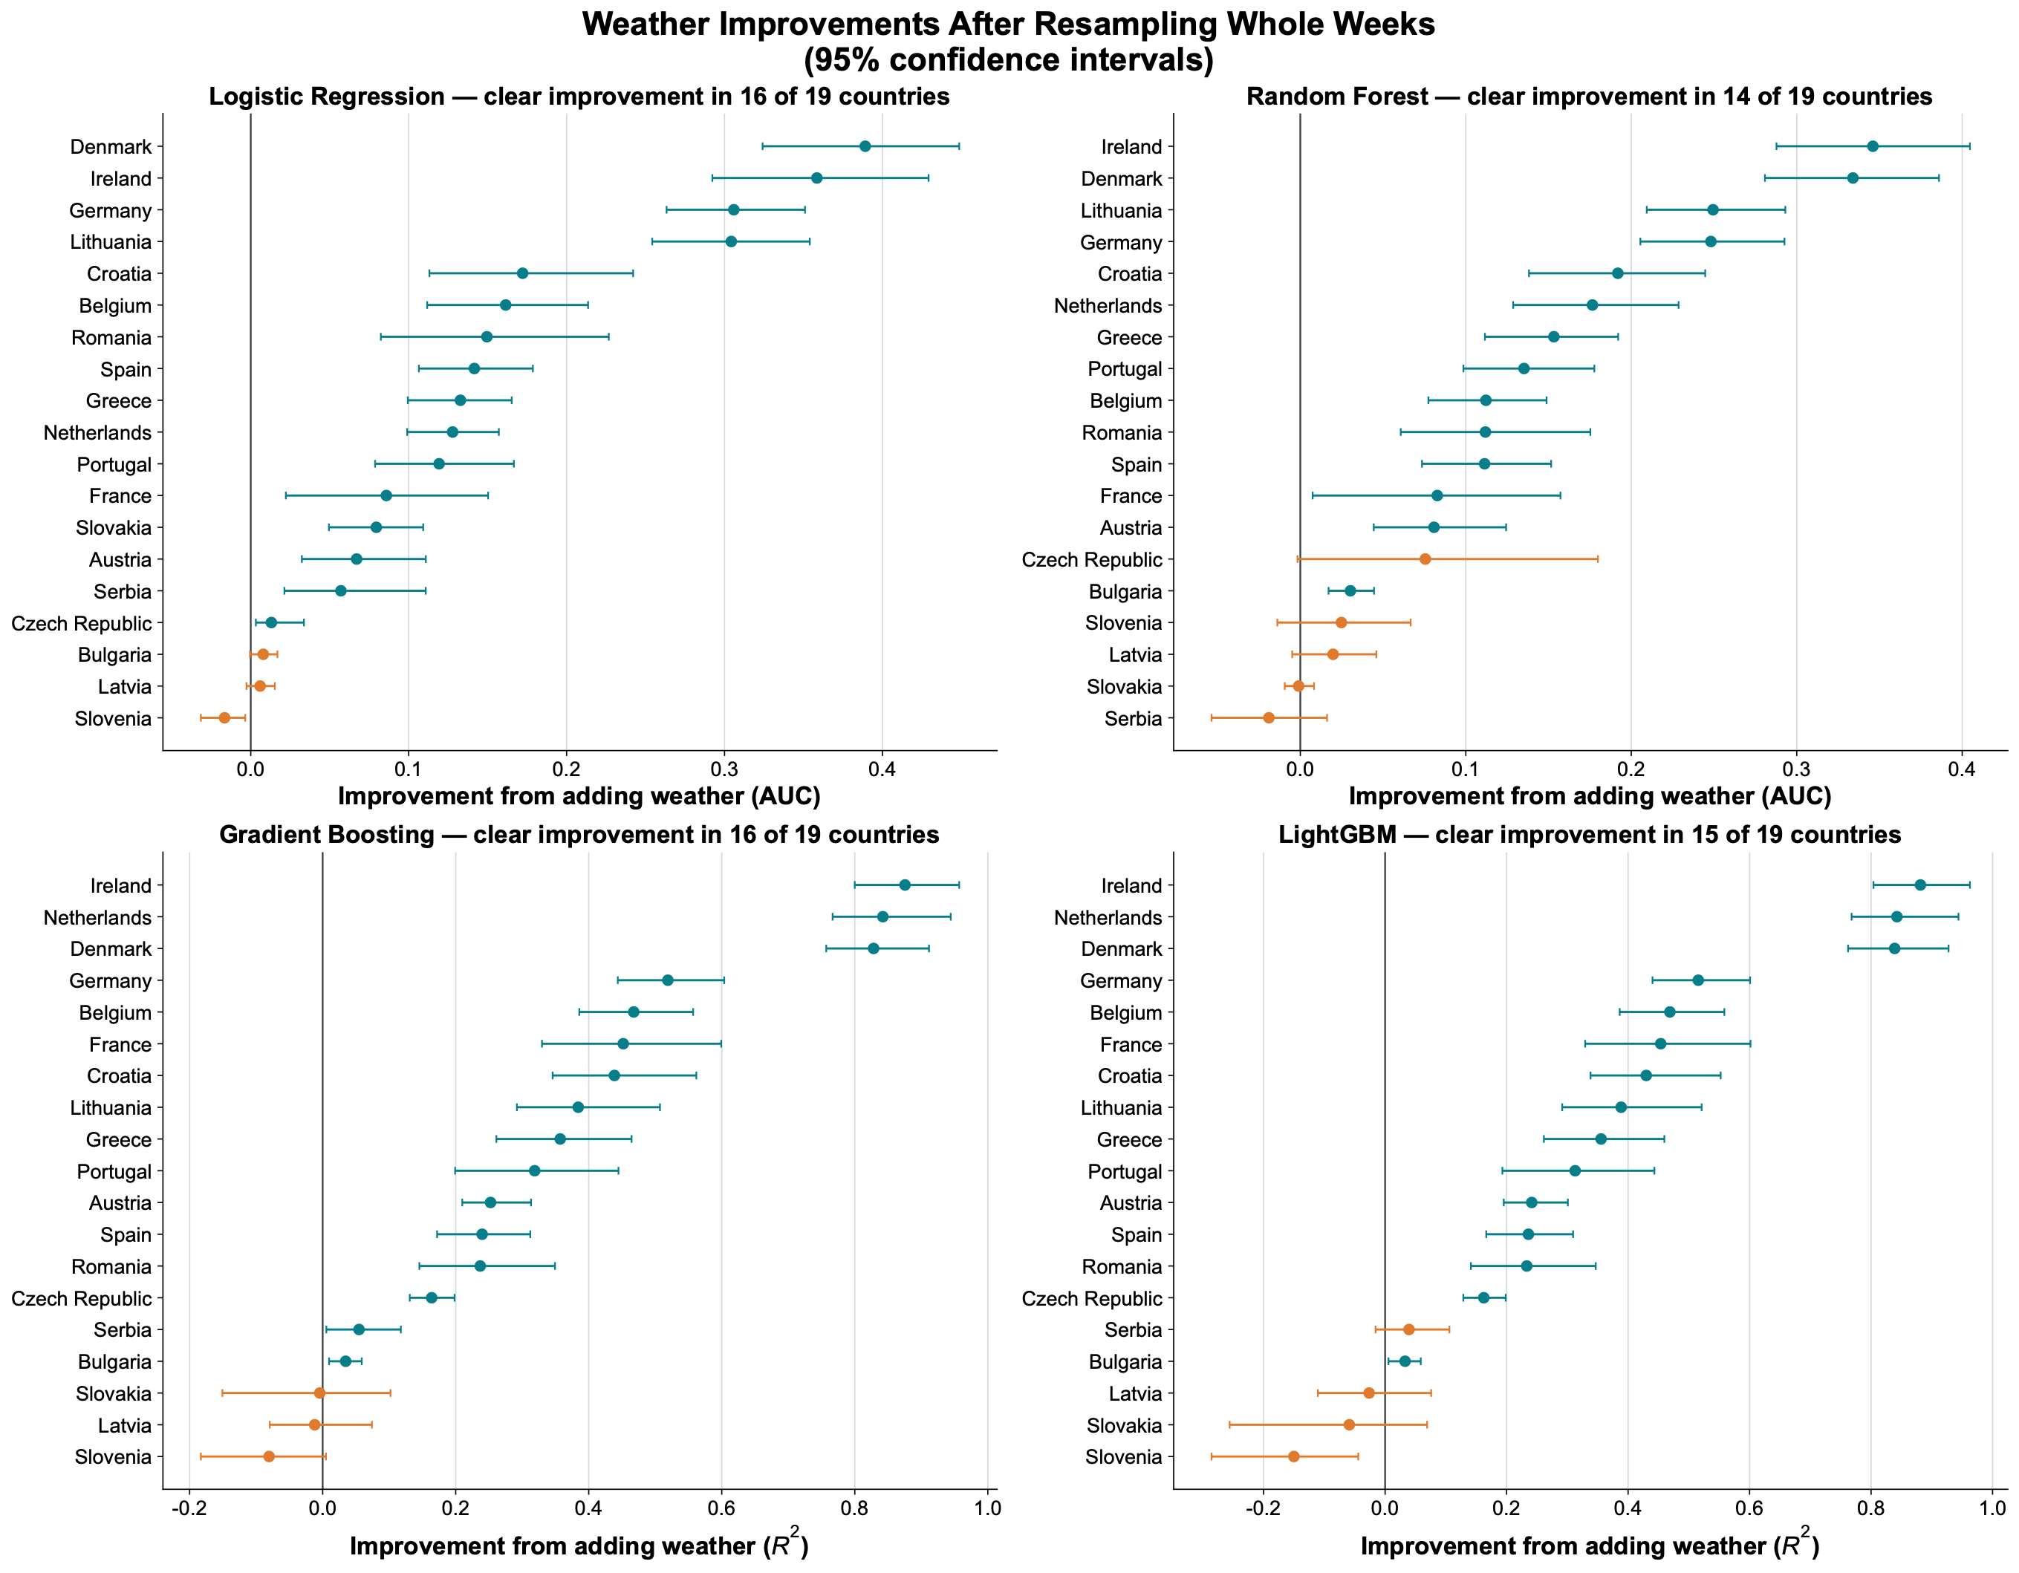
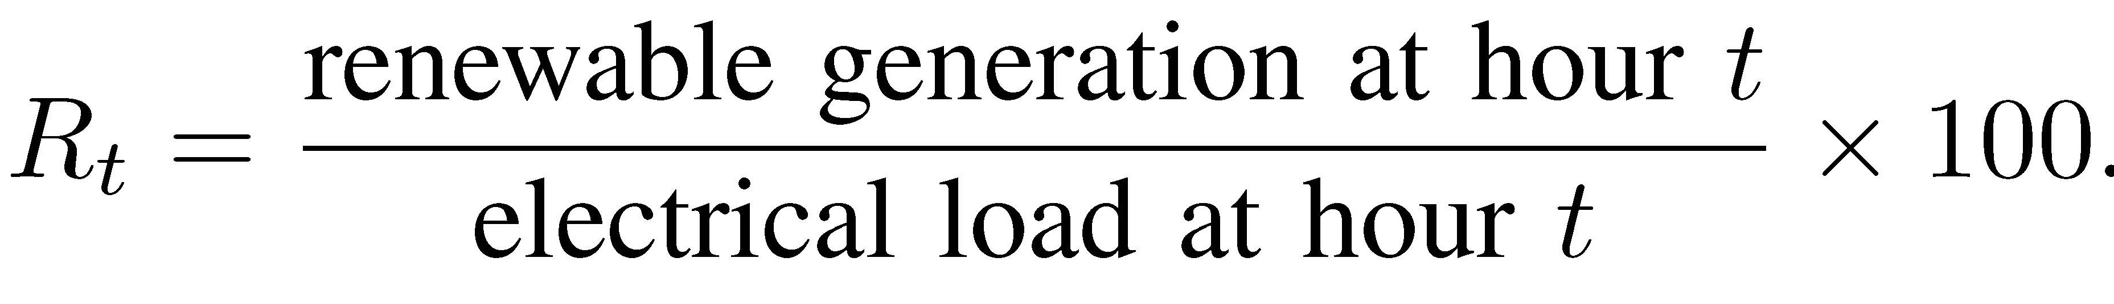
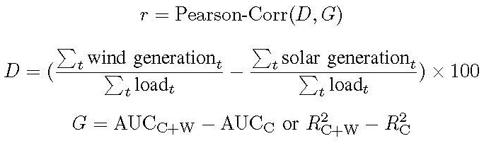
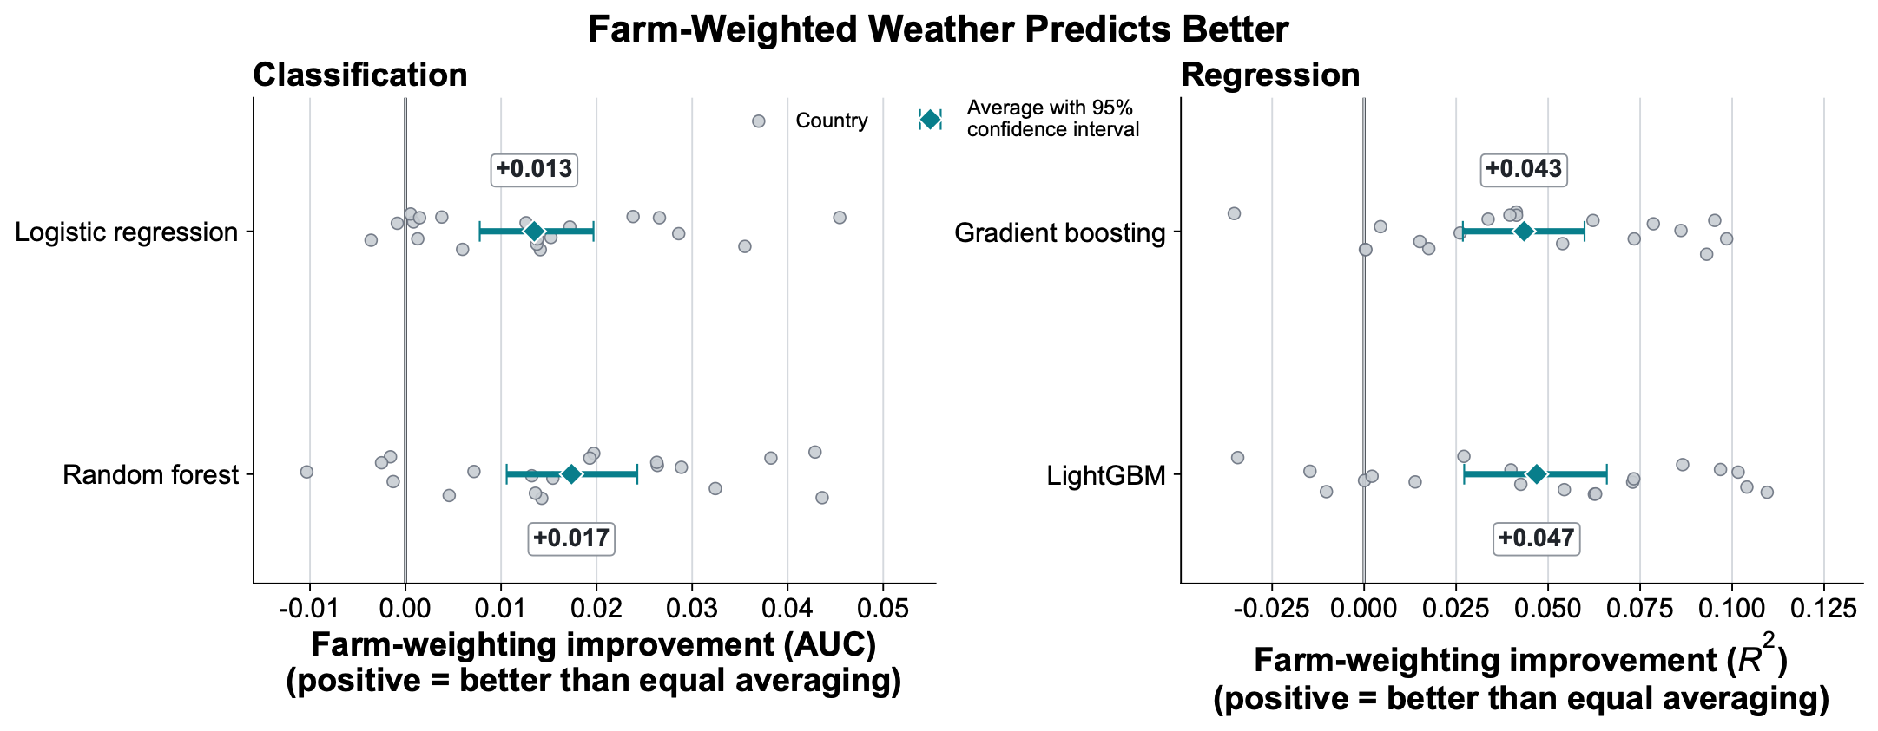
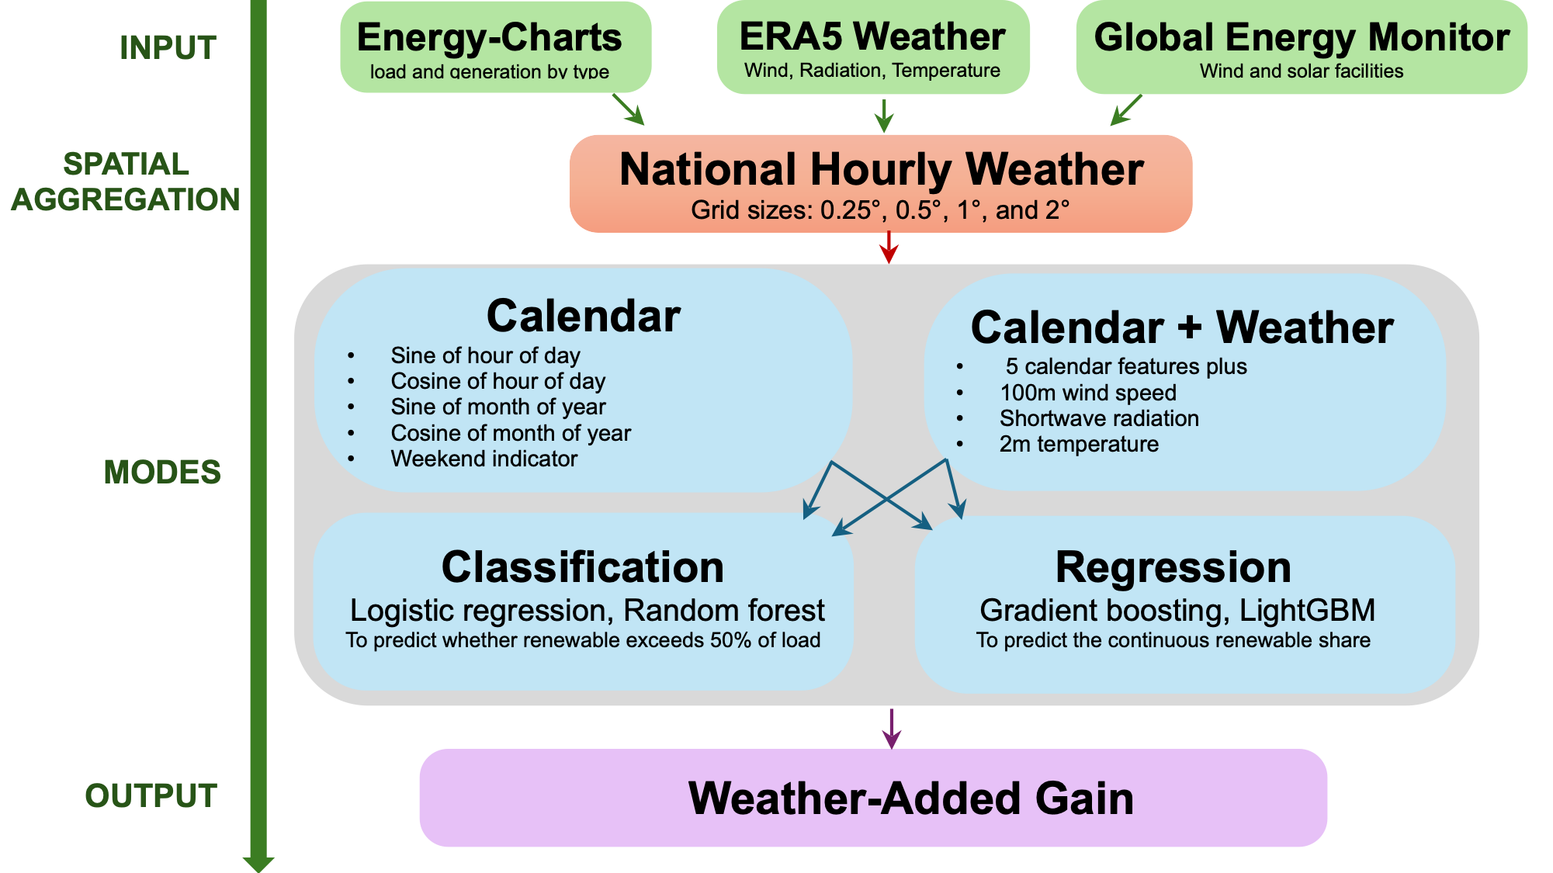
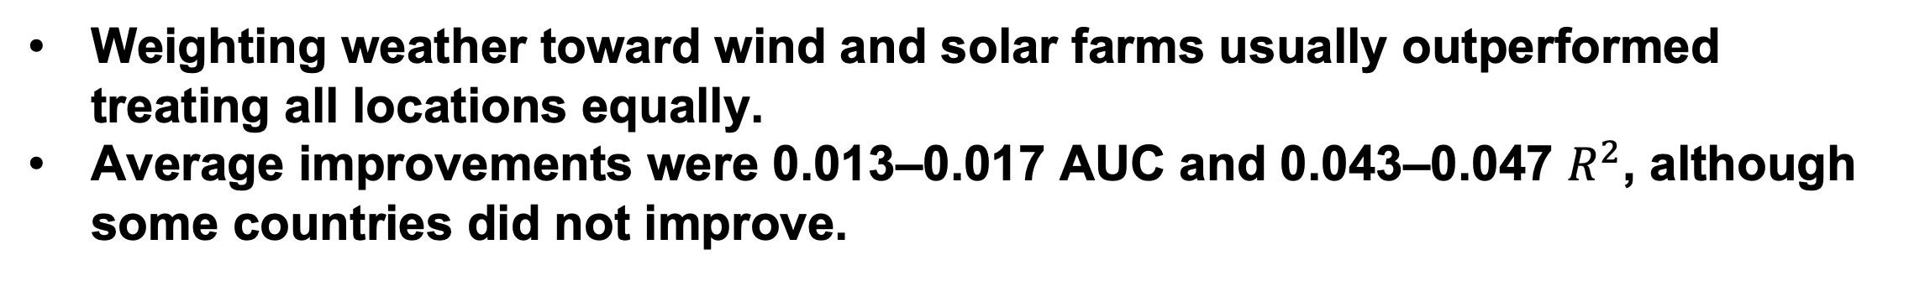
How Much Weather Is Enough for Predicting Renewable Grid Share?
QR
Aiden Wang¹ Zhiling Lan^{2,3 1} Evanston Township High School, Evanston, IL ² University of Illinois Chicago ³ Argonne National Laboratory
SC26 Research Posters · Chicago, IL · 17–19 November 2026
Research Question
Wind-Dominant Grids Benefit from Weather
Wind- vs Solar-Dominant Systems
How much accuracy ERA5 wind, radiation, and temperature add beyond calendar features;
Whether this gain is predictable from a grid’s wind-versus-solar mix;
How far resolution can be coarsened, and whether weighting cells toward mapped generation facilities matters more than grid fineness.
Study countries colored by wind minus solar share of load.
Wind-dominant systems appear dark blue; Solar-dominant systems appear in warm tones.
Ireland and Serbia lack solar observations and are marked unavailable.
Data
We analyzed 19 European countries from 2022 to 2026.
Used 36,000–38,000 hourly Energy-Charts observations per country.
Combined electricity data with ERA5 weather weighted by wind and solar farm locations and capacities from Global Energy Monitor.
Coarser Weather Grids Preserve Accuracy
Methodology
Two feature sets:
Calendar (C): five calendar features
Calendar + Weather (C+W): five calendar features + 3 weather features
Two predictions:
Classification: (a) To predict whether renewable share R_{t} exceeds 50% of load; (b) Area Under the Curve (AUC) metric.
Regression: (a) To predict the continuous renewable share R_{t ;} (b) coefficient of determination R² and Mean Absolute Error (MAE) metrics.
Weather-added gain:
To analyze whether G increases with the wind dominance using the Pearson correlation r
Weather-added gain increased with wind dominance for all four models.
Correlations ranged from $r=0.809$ to $r=0.881$
The relationship used 17 grids with complete wind and solar data.
Weather-Added Gains Are Robust
Moderate coarsening maintained nearly the same prediction quality while reducing weather data processed from 100% at 0.25° to 25.9% at 0.5° and 7.0% at 1°.
Power-Plant-Weighted Weather Predicts Better
Conclusions
Weighting weather toward wind and solar farms usually outperformed treating all locations equally.
Average improvements were 0.013–0.017 AUC and 0.043–0.047 $R^{2}$, although some countries did not improve.
AI disclosure: OpenAI Codex assisted with code, figures, and editing. All results and conclusions were verified by the authors.
Conclusions
References:
[1] Fraunhofer Institute for Solar Energy Systems ISE, "Energy-Charts.” https://www.energy-charts.info.
[2] H. Hersbach et al., "The ERA5 global reanalysis," Quarterly Journal of the Royal Meteorological Society, vol. 146, no. 730, pp. 1999–2049, 2020.
[3] Global Energy Monitor, "Global Wind Power Tracker" and "Global Solar Power Tracker." https://globalenergymonitor.org
[4] F. Pedregosa et al., "Scikit-learn: Machine learning in Python," JMLR, vol. 12, pp. 2825–2830, 2011.
[5] G. Ke et al., "LightGBM: A highly efficient gradient boosting decision tree," NeurIPS, vol. 30, 2017.
[6] OpenAI, “Codex,” AI-assisted code development, visualization, and editing, 2026. https://openai.com/codex/
Weather improved renewable-share predictions in most countries.
Wind-heavy grids benefited most from weather data.
Coarse grids are enough: 0.5°–1° grids preserve nearly all predictive value
Adding weather clearly reduced prediction errors in most countries, depending on the model.
Wind-heavy countries generally showed the largest and most consistent improvements.

