Slide 1
BUILD WEB GAMES
CHAPTER 11: Review

Slide 2
HTML DOCUMENT STRUCTURE
<!DOCTYPE html>
<html>
<head>
<title>
</title>
<style>
</style>
</head>
<body>
<div>
</div>
<script>
</script>
</body>
</html>
Meta information not visible on page
Content visible on page

Slide 3
HTML tags
!DOCTYPE html
html
head
title
style
header
body
script
form
div
label
input
…

Slide 4
HTML tag attributes
HTML tag attribute provides additional information for the tag
They come in name/value pair such as name=”value”
<div class="row">
<div id="0_0" onclick="onElementClicked(this)">

Slide 5
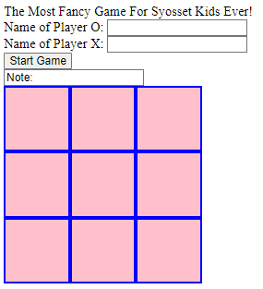
HTML tag examples
<header>
The Most Fancy Game For Syosset Kids Ever!
</header>
<form>
<div>
<label for="oName">Name of Player O: </label>
<input id="oName" type="text">
</div>
<div>
<label for="xName">Name of Player X: </label>
<input id="xName" type="text">
</div>
<input id="startGame" type="button" value="Start Game"> <br/>
<input id="idNote" type="text" value="Note: ">
</form>

Slide 6
HTML CSS
<style> contans CSS (Cascading Style Sheets) rules for styling content
Defines how to display HTML elements
.row div {
background-color: pink;
}
.row {
clear: both;
}
header {
border: 3px solid yellow;
}
#idNote {
width: 400px;
}

Slide 7
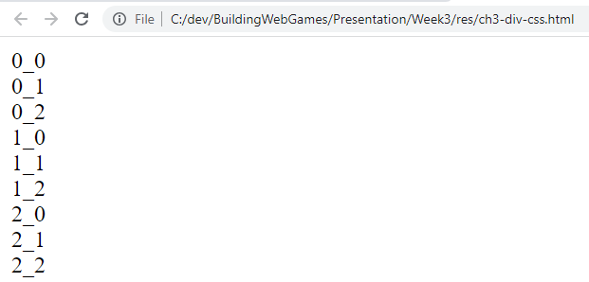
Review of the simple example - plain contents
<!DOCTYPE html>
<html>
<head>
<title>
</title>
<style>
</style>
</head>
<body>
</body>
</html>
<body>
<div>0_0</div>
<div>0_1</div>
<div>0_2</div>
<div>1_0</div>
<div>1_1</div>
<div>1_2</div>
<div>2_0</div>
<div>2_1</div>
<div>2_2</div>
</body>

Slide 8

Review of the simple example - CSS
<!DOCTYPE html>
<html>
<head>
<title>
</title>
<style>
</style>
</head>
<body>
</body>
</html>
<style>
div {
border: 3px solid blue;
height: 75px;
width: 75px;
background-color:pink;
color: blue;
text-align: center;
font-size:32px;
}
</style>

Slide 9
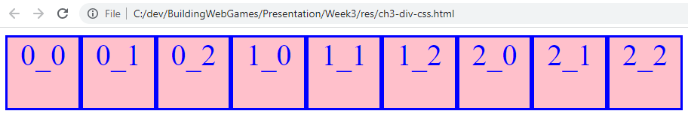
Review of the simple example - Updated CSS
<!DOCTYPE html>
<html>
<head>
<title>
</title>
<style>
</style>
</head>
<body>
</body>
</html>
<style>
div {
border: 3px solid blue;
height: 75px;
width: 75px;
background-color:pink;
color: blue;
text-align: center;
font-size:32px;
float: left;
}
</style>

Slide 10
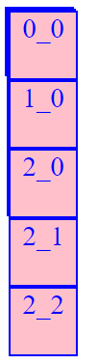
Review of the simple example - hierarchy
<!DOCTYPE html>
<html>
<head>
<title>
</title>
<style>
</style>
</head>
<body>
</body>
</html>
<div>
<div>
<div>0_0</div>
<div>0_1</div>
<div>0_2</div>
</div>
<div>
<div>1_0</div>
<div>1_1</div>
<div>1_2</div> </div>
<div>
<div>2_0</div>
<div>2_1</div>
<div>2_2</div> </div>
</div>

Slide 11
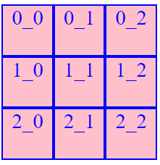
Review of the simple example - hierarchy with CSS
<!DOCTYPE html>
<html>
<head>
<title>
</title>
<style>
</style>
</head>
<body>
</body>
</html>
<div>
<div class="row">
<div>0_0</div>
<div>0_1</div>
<div>0_2</div>
</div>
<div class="row">
<div>1_0</div>
<div>1_1</div>
<div>1_2</div> </div>
<div class="row">
<div>2_0</div>
<div>2_1</div>
<div>2_2</div> </div>
</div
<style>
.row div {
…
}
.row {
clear: both;
}
</style>

Slide 12
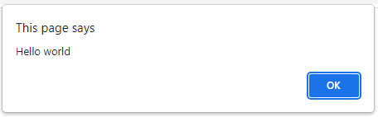
Review of the simple example - JavaScript
<!DOCTYPE html>
<html>
<head>
<title>
</title>
<style>
</style>
</head>
<body>
<div> </div> <script> </script>
</body>
</html>
<script>
function onPageLoaded(str) {
window.alert("Hello " + str);
}
onPageLoaded("world");
</script>

Slide 13
JAVASCRIPT
Key word ‘function’ to define a function
Function name
Function parameter name
function onPageLoaded(str) {
window.alert("Hello " + str);
}
onPageLoaded("world");
window is a built-in object
alert is a method in built-in window object
Function call
Parameter

Slide 14
JAVASCRIPT
<!DOCTYPE html>
<html>
<head>
<title>
</title>
<style>
</style>
</head>
<body>
<div> </div> <script> </script>
</body>
</html>
<script>
function onPageLoaded(str) {
window.alert("Hello " + str);
}
onPageLoaded("world");
</script>

