Slide 1
BUILD WEB GAMES
CHAPTER 20: Snake game – mouse control & random fruit

Slide 2
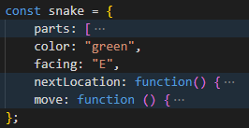
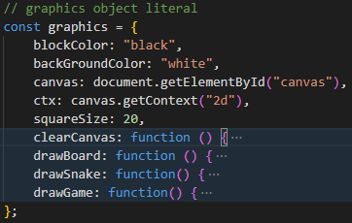
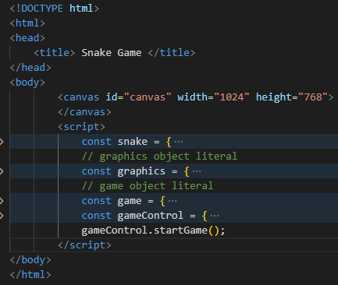
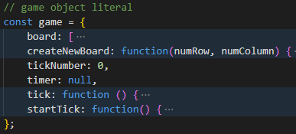

Code structure: details

Slide 3
const game = {
// ...
tick: function () {
game.tickNumber++;
snake.move();
graphics.drawGame();
},
startTick: function() {
game.timer = window.setInterval(game.tick, 500);
},
};
const gameControl = {
startGame: function() {
game.createNewBoard(20, 20);
game.startTick();
window.addEventListener("keydown", gameControl.processInput, false);
},
processInput: function(event) { /**/ },
};
gameControl.startGame();
Program workflow

Slide 4
How snake moves: JavaScript Array operation

Slide 5
Process mouse click event
window.addEventListener("click", (event) => {
console.log(`Mouse clicked at ${event.x}, ${event.y}`);
});
const onMouseClick1 = function(event) {
console.log("1: Mouse clicked at", event.x, ",", event.y);
}
window.addEventListener("click", onMouseClick1);
const onMouseClick2 = (event) => {
console.log("2: Mouse clicked at", { x: event.x, y: event.y });
}
window.addEventListener("click", onMouseClick2);

Slide 6
Random and floor operation
const num = Math.random();
const multiplier = 100;
const multiNum = num * multiplier;
console.log("num = ", num);
console.log("multiNum = ", multiNum);
console.log("floor number = ", Math.floor(multiNum));
console.log("ceil number = ", Math.ceil(multiNum));

Slide 7
This Week:
Snake facing with mouse click
- Random fruits

