Slide 1
BUILD WEB GAMES
CHAPTER 19: Snake game – eating fruit

Slide 2
Overview

Slide 3
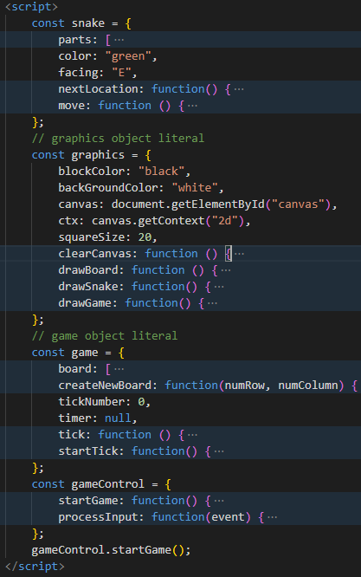
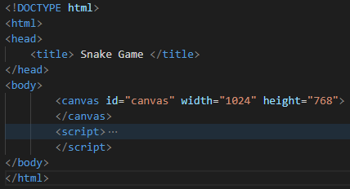
Code structure

Slide 4
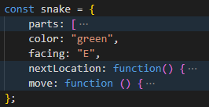
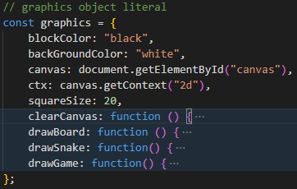
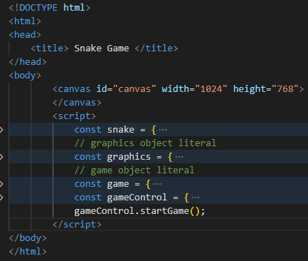
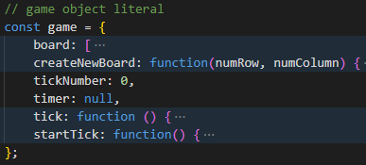

Code structure: details

Slide 5
const game = {
// ...
tick: function () {
game.tickNumber++;
snake.move();
graphics.drawGame();
},
startTick: function() {
game.timer = window.setInterval(game.tick, 500);
},
};
const gameControl = {
startGame: function() {
game.createNewBoard(20, 20);
game.startTick();
window.addEventListener("keydown", gameControl.processInput, false);
},
processInput: function(event) { /**/ },
};
gameControl.startGame();
Program workflow

Slide 6
How snake moves: JavaScript Array operation
0
1
2
3
4
5
0
 |  | 2,2 | 3,2 | 4,2
const snake = {
parts: [
{x: 4, y: 2},
{x: 3, y: 2},
{x: 2, y: 2}
],
facing: "E",
nextLocation: function() {
//..
},
move: function () {
const location = snake.nextLocation();
snake.parts.unshift(location);
snake.parts.pop();
}
};
1
2
‘E’
3
snake.parts ===
[{x: 4, y: 2},{x: 3, y: 2}, {x: 2, y: 2}]]

Slide 7
How snake moves: JavaScript Array operation
0
1
2
3
4
5
0
const snake = {
parts: [
{x: 4, y: 2},
{x: 3, y: 2},
{x: 2, y: 2}
],
facing: "E",
nextLocation: function() {
//..
},
move: function () {
const location = snake.nextLocation();
snake.parts.unshift(location);
snake.parts.pop();
}
};
1
2
2,2
3,2
4,2
‘E’ (5,2)
3
const location = snake.nextLocation();
snake.parts ===
[{x: 4, y: 2},{x: 3, y: 2}, {x: 2, y: 2}]]

Slide 8
How snake moves: JavaScript Array operation
0
1
2
3
4
5
0
 |  | 2,2 | 3,2 | 4,2 | 5,2
const snake = {
parts: [
{x: 4, y: 2},
{x: 3, y: 2},
{x: 2, y: 2}
],
facing: "E",
nextLocation: function() {
//..
},
move: function () {
const location = snake.nextLocation();
snake.parts.unshift(location);
snake.parts.pop();
}
};
1
‘E’
2
3
snake.parts.unshift(location);
snake.parts ===
[{x: 5, y: 2}, {x: 4, y: 2},{x: 3, y: 2}, {x: 2, y: 2}]]

Slide 9
How snake moves: JavaScript Array operation
0
1
2
3
4
5
0
 |  |  | 3,2 | 4,2 | 5,2
const snake = {
parts: [
{x: 4, y: 2},
{x: 3, y: 2},
{x: 2, y: 2}
],
facing: "E",
nextLocation: function() {
//..
},
move: function () {
const location = snake.nextLocation();
snake.parts.unshift(location);
snake.parts.pop();
}
};
1
‘E’
2
3
snake.parts.pop();
snake.parts ===
[{x: 5, y: 2}, {x: 4, y: 2},{x: 3, y: 2}]

Slide 10
How snake moves: JavaScript Array operation
0
1
2
3
4
5
0
 |  |  | 3,2 | 4,2 | 5,2
const snake = {
parts: [
{x: 4, y: 2},
{x: 3, y: 2},
{x: 2, y: 2}
],
facing: “N",
nextLocation: function() {
//..
},
move: function () {
const location = snake.nextLocation();
snake.parts.unshift(location);
snake.parts.pop();
}
};
1
‘N’
2
3
snake.parts ===
[{x: 5, y: 2}, {x: 4, y: 2},{x: 3, y: 2}]

Slide 11
How snake moves: JavaScript Array operation
0
1
2
3
4
5
0
 |  |  |  |  | 5,1
 |  |  | 3,2 | 4,2 | 5,2
const snake = {
parts: [
{x: 4, y: 2},
{x: 3, y: 2},
{x: 2, y: 2}
],
facing: “N",
nextLocation: function() {
//..
},
move: function () {
const location = snake.nextLocation();
snake.parts.unshift(location);
snake.parts.pop();
}
};
1
‘N’
2
3
snake.parts ===
[{x: 5, y: 2}, {x: 4, y: 2},{x: 3, y: 2}]

Slide 12
How snake moves: JavaScript Array operation
0
1
2
3
4
5
0
 |  |  |  |  | 5,1
 |  |  | 3,2 | 4,2 | 5,2
const snake = {
parts: [
{x: 4, y: 2},
{x: 3, y: 2},
{x: 2, y: 2}
],
facing: “N",
nextLocation: function() {
//..
},
move: function () {
const location = snake.nextLocation();
snake.parts.unshift(location);
snake.parts.pop();
}
};
‘N’
1
2
3
snake.parts ===
[{x: 5, y: 1}, {x: 5, y: 2}, {x: 4, y: 2},{x: 3, y: 2}]

Slide 13
How snake moves: JavaScript Array operation
0
1
2
3
4
5
0
 |  |  |  |  | 5,1
 |  |  |  | 4,2 | 5,2
const snake = {
parts: [
{x: 4, y: 2},
{x: 3, y: 2},
{x: 2, y: 2}
],
facing: “N",
nextLocation: function() {
//..
},
move: function () {
const location = snake.nextLocation();
snake.parts.unshift(location);
snake.parts.pop();
}
};
‘N’
1
2
3
snake.parts ===
[{x: 5, y: 1}, {x: 5, y: 2}, {x: 4, y: 2}]

Slide 14
How snake moves: JavaScript Array operation

Slide 15
This Week:
Eat fruit

