Slide 1
BUILD WEB GAMES
CHAPTER 18: Snake game – Collision detection

Slide 2
Overview

Slide 3
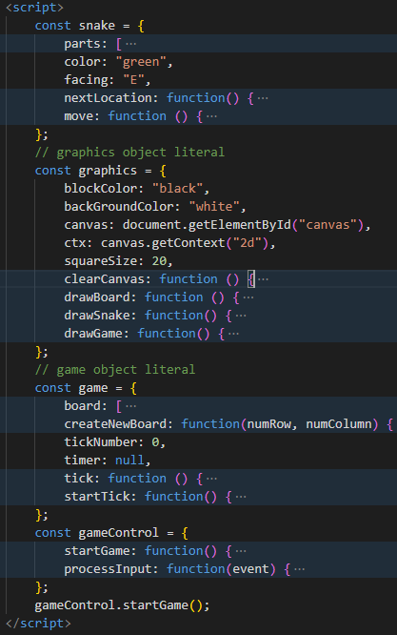
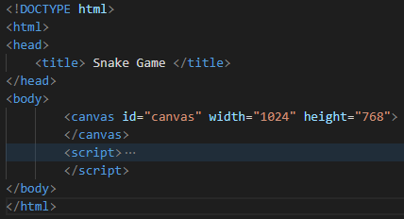
Code structure

Slide 4
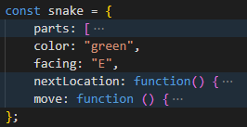
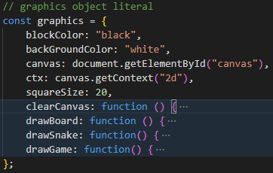
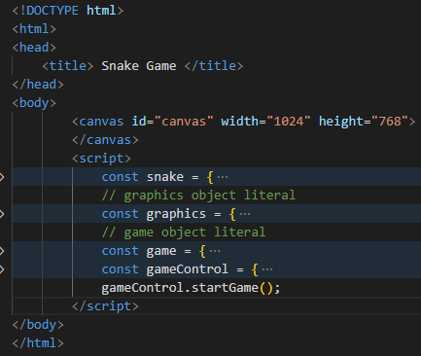
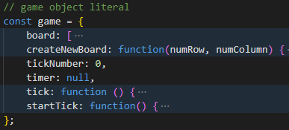

Code structure: details

Slide 5
const snake = {
parts: [
{x: 4, y: 2},
{x: 3, y: 2},
{x: 2, y: 2}
],
color: "green",
facing: "E",
nextLocation: function() {
const snakeHead = snake.parts[0];
let targetX = snakeHead.x;
let targetY = snakeHead.y;
targetY = snake.facing == "N" ? targetY-1 : targetY;
targetY = snake.facing == "S" ? targetY+1 : targetY;
targetX = snake.facing == "W" ? targetX-1 : targetX;
targetX = snake.facing == "E" ? targetX+1 : targetX;
return {x: targetX, y: targetY};
},
move: function () {
const location = snake.nextLocation();
snake.parts.unshift(location);
snake.parts.pop();
}
};
Code structure:
Object literal

Slide 6
const game = {
// ...
tick: function () {
game.tickNumber++;
snake.move();
graphics.drawGame();
},
startTick: function() {
game.timer = window.setInterval(game.tick, 500);
},
};
const gameControl = {
startGame: function() {
game.createNewBoard(20, 20);
game.startTick();
window.addEventListener("keydown", gameControl.processInput, false);
},
processInput: function(event) { /**/ },
};
gameControl.startGame();
Program workflow

Slide 7
This Week:
Wall detection
Add fruit
Eat fruit

