Slide 1
BUILD WEB GAMES
CHAPTER 20: Snake game – random fruit & JavaScript class

Slide 2
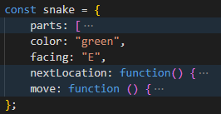
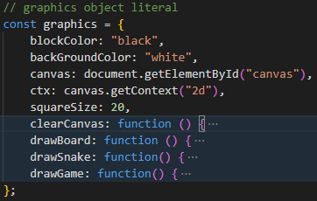
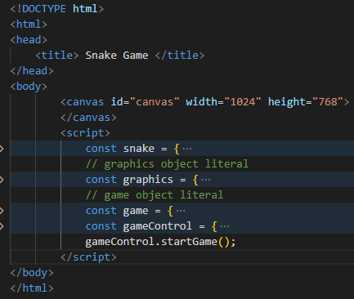
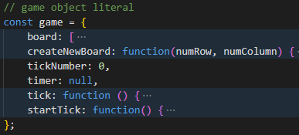

Code structure: details

Slide 3
This Week:
- Random fruits
- JavaScript class

Slide 4
JavaScript class
Why JavaScript class?
- snake currently is an object literal
- What if there are multiple snakes in the game
- Our goal:
- Learn JavaScript class
- Upgrade the snake game with classes from object literals

Slide 5
JavaScript class
Classes are a template for creating objects. They encapsulate data with code to work on that data. (https://developer.mozilla.org/en-US/docs/Web/JavaScript/Reference/Classes)

Slide 6
JavaScript class
Tutorial: https://www.youtube.com/watch?v=2ZphE5HcQPQ

