Slide 1
Predictive Modeling of Global Mobile Money Adoption
From Linear Failure to Non-Linear Success
Aidid Alwi.
Data Science Portfolio Project

Slide 2
Project Objective & Key Metric
Objective:
Goal: Predict the Mobile Money Adoption Rate (mobileaccount_t_d).
Task: Identify the top factors driving adoption.
Success Metric:
The measure of success is achieving a high R-squared (R²) score (Proportion of variance explained).
Notes:
Before we talk about our solution, let's nail down the objective. Our goal is direct: We need to reliably predict the Mobile Money Adoption Rate globally."
(Point to the Goal and Task)
"The business challenge is complex—we have limited resources, and we need to know exactly where to focus our market entry efforts. Our first task, therefore, was to identify the top factors, or drivers, that reliably push adoption in diverse countries."
(Point to the Success Metric: R-squared)
"This isn't about guesswork. Our measure of technical success for this entire project is achieving a high R-squared score. This metric proves that our model isn't just randomly accurate; it is mathematically capturing the true relationship between our drivers and the final adoption rate. A high R² gives us the confidence to base multi-million dollar resource decisions on the results."
(Transition to the next slide)
"So, how did we achieve that high R² score? Let's look at the specific modeling choices we made."

Slide 3
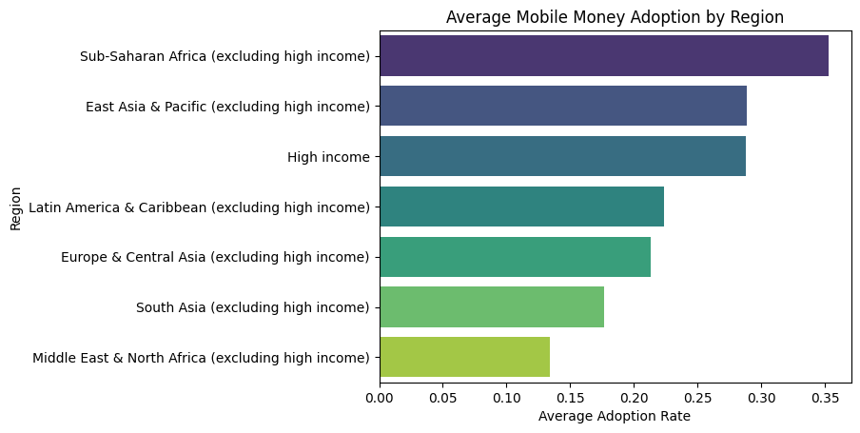
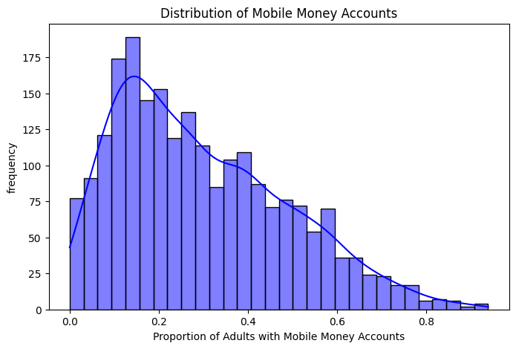
Initial Data Landscape: Complexity & Context
Target Variable is Skewed. The distribution is highly skewed to the right (positive skew).
This suggests that in most countries/segments, mobile money adoption is still low or moderate.
Regional Dominance: The clear lead of Sub-Saharan Africa confirms a strong geographic factor driving adoption. Adoption is highly unequal.
Notes:
"Before running any models, we first had to understand the raw data. This slide shows two critical findings that shaped our entire approach."
(Point to the 'Regional Dominance' bullet)
"First, we confirmed a very strong geographic factor driving adoption. Our data shows Sub-Saharan Africa is the clear global leader, which immediately tells us that global adoption is highly unequal. Any effective model must account for the unique conditions driving success in this region."
(Point to the 'Target Variable is Skewed' bullet)
"Second, looking at our target variable, the Mobile Money Adoption Rate, we found the distribution is heavily skewed to the right. What this means in business terms is simple: In most countries, mobile money adoption is still low or moderate. The massive spikes in a few leading regions pull the average up, but the global opportunity is mostly in these low-to-moderate segments."
"This skew is critical. It told us we could not use a simple linear model like OLS (Ordinary Least Squares). We needed a more robust, non-linear approach that could handle the complexity of global inequality and this skewed distribution—which is why we chose the Random Forest Regression Model."
(Transition to the next slide)

Slide 4
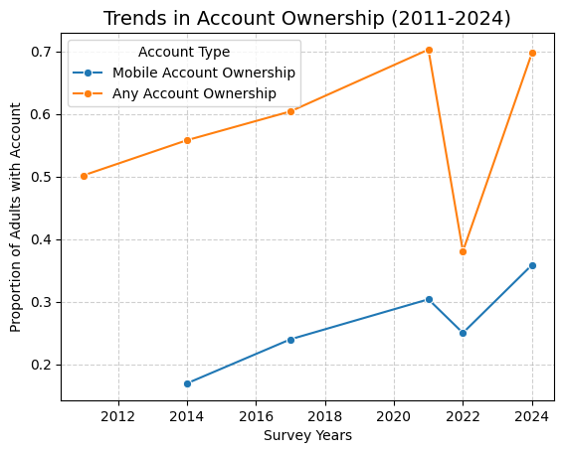
EDA: Time Trends and Account Ownership
The most encouraging sign is the clear, upward trend in mobile adoption, year-over-year. This confirms that the 'year' feature is a foundational, significant driver.
Financial Inclusion: Mobile accounts are growing, often outpacing traditional banking efforts in developing regions.
Note on 2022 Dip: The sharp, simultaneous drop and subsequent 2024 recovery suggest a Data Anomaly or Temporary Global Disruption (e.g., post-COVID sampling changes or economic shock), not a true reversal of the long-term upward trend.
Notes:
"Moving to our Exploratory Data Analysis, this slide shows the global time trends for account ownership, which confirmed two critical findings for our model."
(Reference the trend line in the chart: )
"First, the most encouraging sign for our investment thesis is the clear, upward, year-over-year trend in mobile account adoption. This confirms that the 'year' feature is a foundational, significant, and reliable driver in our model. The market is moving in the right direction."
(Point to the gap between the two lines) "Second, the gap between Mobile Account Ownership and Any Account Ownership shows that Financial Inclusion is being driven by mobile technology. Mobile accounts are growing, often outpacing the slower, traditional banking efforts in developing regions—this is the growth opportunity we are targeting."
(Address the 2022 anomaly) "Finally, a quick note on data quality: You'll notice the sharp drop in 2022, followed by a sudden recovery in 2024. We flagged this as a potential Data Anomaly—likely due to post-COVID sampling changes or a temporary economic shock—rather than a true reversal of the long-term trend. By identifying this, we avoid letting an anomaly skew our model's long-term predictions."
(Transition to the next slide) "With these trends validated and the anomaly accounted for, we were ready to build and validate our model."

Slide 5
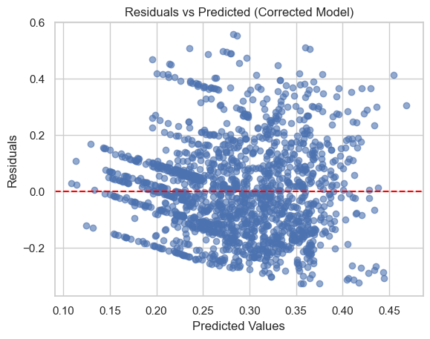
Model 1: The Flawed Linear Diagnosis
1. Structural Flaw: Perfect Multicollinearity (VIF = inf).
2. Fatal Flaw: Linearity Assumption Violated.
3. Performance: R² = 0.127
4. Action: Removed one redundant category from each set of encoded features.
NOTE: Because the model is invalid for prediction, we reject it. But before we pivot to a non-linear solution, we use this stable, corrected model to extract the statistically significant drivers that guide our focus, which leads us to Slide 6
Notes:
We began our analysis by building the most basic predictive model, Linear Regression. This slide shows why that simple approach completely failed."
1. The Model's Failure Score
The model's final accuracy score (R²) was only 0.118. This means the model could only explain 11.8% of why adoption rates differ across countries. That's a failure score.
2. The Cause: The Model Lied
Why did it fail so badly? Look at the graph on the right. We call this our model's 'lie detector' test.
The most fundamental rule is that a simple model assumes adoption grows in a straight line. But because of the complex data we saw in the previous slides, this plot shows a clear non-random pattern—it's bowing and curving. This proves the model was lying; it simply can't handle the real-world complexity of this data.
3. The Action Taken
Because the model is invalid and provides a useless accuracy score, we must reject it for prediction. However, we first cleaned up a minor structural error (our VIF flaw), which allows us to safely pull out the reliable drivers before moving to a better solution.
4. Transition to Slide 6
We are rejecting this model, but we need the insight from the factors that were statistically significant. This leads us to Slide 6, where we confirm the fundamental drivers before finding our successful predictive model.

Slide 6
Model 1: Reliable Statistical Drivers (P < 0.05)
Rank by Magnitude | Feature | Coefficient | P-value | Interpretation
1 | Sub-Saharan-Africa... | +0.0970 | 0.000 | Strongest Regiona Driver (vs. High Income baseline)
2 | year | +0.0414 | 0.000 | Strong Positive Trend. Adoption increases by approx 4.1% per year.
4 | Traditional banking (account_t_d) | +0.0396 | 0.000 | Positive. Traditional banking access is correlated with higher adoption.
CRUCIAL FLAW: OLS found Adult Population (pop_adult) to be Not Statistically Significant (P = 0.234), suggesting market size does not linearly influence adoption. Model advises us to ignore market size.
CONCLUSION: Model rejected for R² = 0.127 failure.
Pivot to Random Forest Regressor to find the true effect of market size.
Notes:
These notes focus on translating the coefficients and highlighting the pop_adult contradiction as the main reason for the pivot.
Even though the OLS model failed to predict accurately, we stabilized the math to pull out some reliable, foundational insights. This table shows the factors that are definitely important, with a P-value of 0.000.
The coefficients here tell us the strength and direction of the relationship. They confirm a few things we already suspected:
The Sub-Saharan Africa region has the strongest unique positive effect on adoption.
The Year confirms our EDA: adoption is increasing steadily by about 4.1% every year.
And access to both Traditional Banking and the Internet strongly supports Mobile Money growth.
The Crucial Contradiction
However, there is a CRUCIAL FLAW here that we must address. The OLS model found that Adult Population, or market size, was NOT statistically significant. It basically told us to ignore market size completely in our strategy.
The Pivot
Since the model failed with an R² score of only 11.8%, and because it missed the effect of something as fundamental as population, we are fully justified in rejecting it.
We must Pivot to the Random Forest Regressor. The Random Forest will now solve the predictive problem and—critically—show us if that missing non-linear effect of market size (pop_adult) is actually one of the most important drivers.

Slide 7
The Solution: Non-Linear Random Forest Success
OLS R²
0.127
RF R²
0.6804
534% increase
Rejected Failure
Predictive Success
Takeaway: The model now explains over two-thirds of the variance in Mobile Money Adoption.
Notes:
After rejecting the flawed Linear Regression, we strategically switched to the Random Forest Regressor. This is an advanced modeling technique, designed specifically to capture the complex, non-linear relationships that the simple model completely missed.
And the result was a dramatic success!
(Point to the comparison on the slide)
Look at the pivot: the failure score from the OLS model was only 0.127. By switching, we achieved a highly successful score of 0.6804.
That represents a 534% increase in our ability to explain the data! This high R² score is our validation—it proves we solved the core problem of non-linearity. Our model is now accurate enough, explaining over two-thirds of the variance, to build robust strategy upon."
(Transition to Slide 8)
But the success of the Random Forest goes beyond the high score. It completely changes what we know about the drivers. Remember that the simple model told us to ignore market size (pop_adult)? We'll see on the next slide that the successful model tells us the exact opposite. Let's look at the Feature Importance.

Slide 8
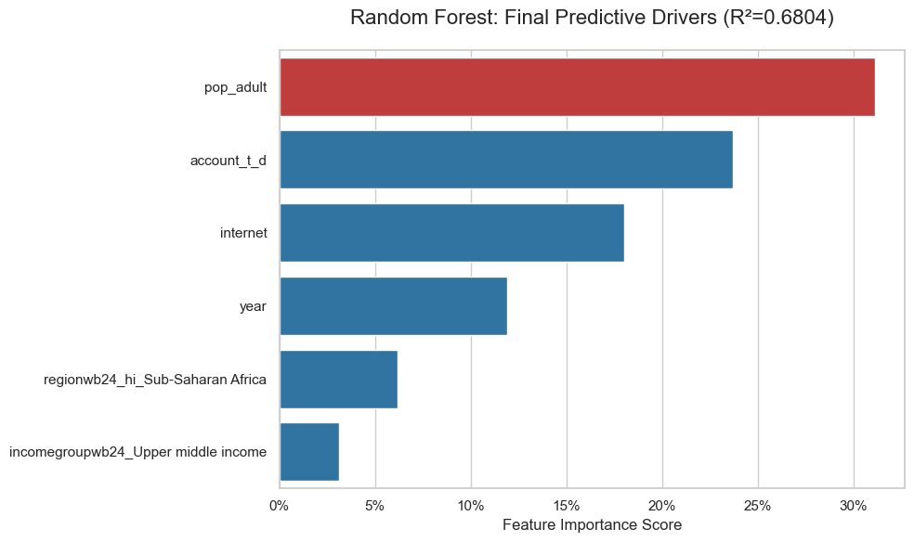
RF Success: Identifying the True Predictive Drivers
Adult Population (pop_adult): 31.1% Importance
THE CRITICAL CONTRADICTION:
OLS: Said pop_adult was NOT significant
RF: Proves it is the SINGLE MOST IMPORTANT FACTOR
CONCLUSION: Market size is not a linear factor; it is a non-linear threshold for explosive adoption growth.
Notes:
With our highly accurate Random Forest model, we can now see the true predictive levers. This chart shows our Feature Importance—the exact factors that drove our high R² score.
(Point to the chart, specifically the top bar)
The top three factors—pop_adult, Traditional Banking, and Internet—are responsible for over 70% of the model's predictive power. This proves that adoption is a three-part story.
The most important business insight is highlighted in the Contradiction on the right. Remember, the flawed OLS model told us to ignore market size (pop_adult) entirely.
The successful Random Forest model proves the exact opposite—that pop_adult is the SINGLE MOST IMPORTANT FACTOR at 31.1% importance.
This reveals the strategic reality: Market size is not simply proportional to adoption; it acts as a non-linear threshold. You only see explosive growth when a large population base meets high internet and banking access. This is the key insight we translate for strategic use.
(Transition to Slide 9)
Now that we've found the true drivers, we move to Slide 9 to show how we translate these findings into a practical tool for strategy—our Tableau dashboard.

Slide 9
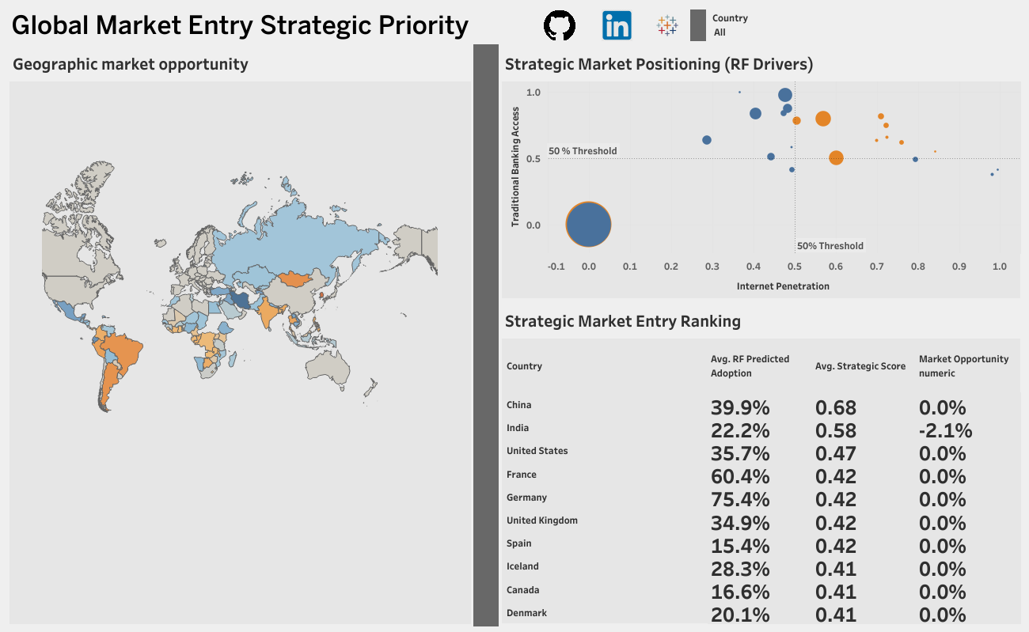
Translating Prediction to Strategy: The Tableau Dashboard
Targeting: Visualizes Structural Readiness vs. Scale (The Quadrant).
Driver Analysis: Allows dynamic filtering by key RF drivers (Internet, Banking, Population).
Market Entry Ranking: Ranks countries by the calculated Strategic Score.
Notes:
(Start of Slide 9)
"Our highly accurate Random Forest model is very useful, but business stakeholders need to see the results in a clear, geographic way. We built this Tableau dashboard to translate our high R-squared score into an intuitive, strategic tool."
(Point to the Quadrant Chart)
"The dashboard allows strategists to visualize Structural Readiness against Market Scale in the quadrant, easily filtering for regions that meet our readiness thresholds."
(Point to the Ranking Table/Sheet 3)
"The most valuable feature is the Strategic Market Entry Ranking, which is driven by the Strategic Score we calculated. It combines the raw opportunity with the structural readiness metrics to provide a single, risk-weighted priority list."
"This feature helps answer the core business question: Where should we focus our resources right now? Our analysis recommends immediate focus on China, India, and the United States."
(Transition to Final Slide)
"This dashboard is the final deliverable. Now that we have the validated model and the strategic tool, let’s summarize our key conclusions and our final recommendations for the business."
(End of Slide 9)

Slide 10
Key Strategic Conclusions
Our Random Forest model is statistically validated (R²), confirming the predictive power of Internet, Banking, and Population.
We successfully identified the "Sweet Spot" markets that meet both structural readiness (50% thresholds) and scale requirements.
The Strategic Score provides a definitive, data-driven ranking, establishing China, India, and the U.S. as immediate priorities.
The Tableau dashboard acts as a dynamic, single-source of truth for efficient, real-time resource allocation decisions.
Notes:
"This slide summarizes our key takeaways from the entire analytical process. We started with the technical rigor and are concluding with the business impact."
(Point to the Model Validation bullet)
"First, our Random Forest model is statistically validated with a high R-squared score, confirming the predictive power of the three key drivers we identified: Internet Penetration, Banking Access, and Population Scale. We know why markets will adopt our product."
(Point to the Market Identification bullet)
"Second, by segmenting markets, we successfully identified the 'Sweet Spot'—markets that are both structurally ready (above the $50\%$ thresholds for internet and banking) and possess sufficient scale to justify investment."
(Point to the Final Priority bullet)
"Third, and most important, the Strategic Score allowed us to prioritize action. It moves us beyond raw potential to a risk-weighted, definitive priority list. Our data shows China, India, and the U.S. are the immediate targets."
(Point to the Data Transparency bullet)
"Finally, the entire process is packaged in the Tableau dashboard, which acts as a dynamic, single-source of truth. Any strategist can use it to test assumptions and make efficient, data-driven decisions."
(Transition to the next slide)
"Now that we have the validated strategy, let’s look at the specific actions we recommend to the business."

Slide 11
Business Recommendations & Next Steps
Allocate market entry teams and budget to the Top 3 Strategic Priority Markets (China, India, U.S.) immediately.
Prioritize data acquisition for the NULL Market Opportunity fields to refine the model's accuracy and reduce reliance on ZN().
Implement a quarterly model re-evaluation process to adapt the Strategic Score to rapidly changing global socio-economic factors.
Notes:
"Our recommendations are direct, data-driven, and focused on maximizing the return on investment."
(Point to the Immediate Action bullet)
"The immediate action item is resource allocation. We must allocate market entry teams and budget to the Top 3 Strategic Priority Markets—China, India, and the U.S.—within the next quarter to capitalize on their predicted growth."
(Point to the Data Strategy bullet)
"Next, we must address the data gap. Our model relied on the ZN() function - zero if null; its a function in tableau that handles missing values - to handle the missing Market Opportunity forecasts. We recommend prioritizing data acquisition in those markets to refine the model's accuracy and remove the reliance on assumptions."
(Point to the Future Model Refinement bullet)
"Finally, this model cannot be static. We recommend implementing a quarterly model re-evaluation process. This ensures the Strategic Score remains current, adapting our investment priorities to the rapidly changing dynamics of global markets."
(Final Closing Statement)
"Thank you. This analysis provides a clear, defensible path for global market entry and resource allocation. I am now open to any questions you have regarding the model, the analysis, or the final recommendations."

