Slide 1
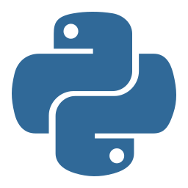
Python Training
Version History, Downloading and Installing Python
Lesson 2

Slide 2
Today's Agenda
1
Version History
2
Python 2 vs Python 3
3
Different Python Implementations
4
Downloading and Installing Python
5
Testing Python Installation

Slide 3

Python Version History
1991
0.9.0
First Release
1994
1.0
Python 1.0
2000
2.0
Python 2.0
2008
3.0
Python 3.0
2010
2.7
Python 2.7
2026
3.13
Current Era

Slide 4


Python 2 vs Python 3
Python 2
Python 3
Retired: Jan 1, 2020
Final version: 2.7.18
print "Hello"
5/2 → 2
Current standard
Latest: 3.13
print("Hello")
5/2 → 2.5
⚠ Not Backward Compatible - Python 2 code will NOT run on Python 3

Slide 5
Key Differences Between Python 2 & 3
Print Statement
print "text"
print("text")
Division
5/2 → 2
5/2 → 2.5
Integer
int and long types
Only int type
Unicode
ASCII by default
Unicode by default
Recommendation: Always use Python 3 for new projects

Slide 6
Python Implementations
1.Implementation = Tools/software used to execute Python programs
2.CPython = the Python interpreter itself is written in C.
3.The program that runs your .py file is written in C.
CPython
95%
Standard implementation (written in C)
Jython
2%
Runs on Java Virtual Machine (JVM)
IronPython
2%
Runs on .NET Framework
PyPy
1%
Just-In-Time (JIT) compiler for speed

Slide 7
Machine Code vs Bytecode
Machine Code
Bytecode (Python)
Source Code
Source Code
↓
↓
Compiler
Compiler
↓
↓
Machine Code (.exe)
Bytecode + PVM
bytecode is executed by PVM
✓ Very Fast
✗ Not Portable
Ex. c, c++
✓ Cross-Platform
✗ Slower
Ex. Python

Slide 8
CPython: Standard Implementation
Source Code
(.py file)
CPython
Compiler
Bytecode
(.pyc file)
Python VM
(PVM)
→
→
→
✓ Written in C Language | ✓ 95% of Python users | ✓ Download from python.org

Slide 9
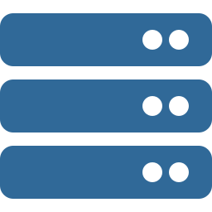
Python Virtual Machine (PVM)
Python
Bytecode
Windows
PVM
macOS
PVM
Linux
PVM
✓ Write Once, Run Anywhere - Same code runs on all platforms!

Slide 10
$ python -m py_compile main.py
$ python __pycache__/main.cpython-313.pyc

Slide 11

Downloading Python
https://www.python.org/downloads
1
Visit python.org/downloads
2
Website auto-detects your OS (Windows/Mac/Linux)
3
Click 'Download Python 3.x' button
4
For 64-bit: Select 'Windows x86-64 executable installer'
5
For 32-bit: Select 'Windows x86 executable installer'

Slide 12
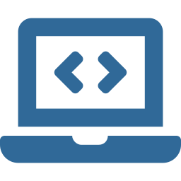
Installing Python on Windows
1
Run the installer (python-3.x-amd64.exe)
2
✓ Check 'Add Python to PATH' (VERY IMPORTANT!)
3
Click 'Install Now'
4
Wait for installation to complete
5
Click 'Close' when finished

Slide 13
Installation Complete!
Setup was successful
You are now ready to start coding in Python!
Next step: Verify installation →

Slide 14
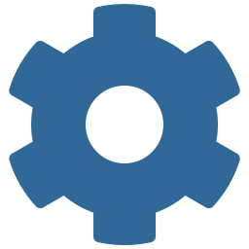
Testing Python Installation
Open Command Prompt (cmd) or Terminal
$ python --version
Python 3.13.x
If you see the version number, Python is correctly installed!

Slide 15
Troubleshooting Installation
'python' is not recognized
Add Python to PATH (re-run installer)
Wrong version showing
Multiple Python versions installed - use 'python3'
Permission denied
Run command prompt as Administrator
Installation fails
Disable antivirus temporarily

Slide 16
Lesson 2 Summary
✓ Python 2 is retired (2020) - Always use Python 3
✓ CPython is the standard implementation (95% usage)
✓ Python uses bytecode + PVM for cross-platform support
✓ Download from python.org/downloads
✓ Always check 'Add Python to PATH' during installation
✓ Verify with: python --version

Slide 17
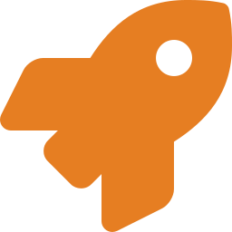
Ready to Code!
Next: Writing Your First Python Program

