Slide 1
ETL Project
Scraping the Pokémon Center website

Slide 2

ETL
-Extract: Source data was extracted from (PokémonCenter.com)
-Transform: Change the data into something that can be manipulated (Data into lists)
-Load: Export data (MongoDB)

Slide 3

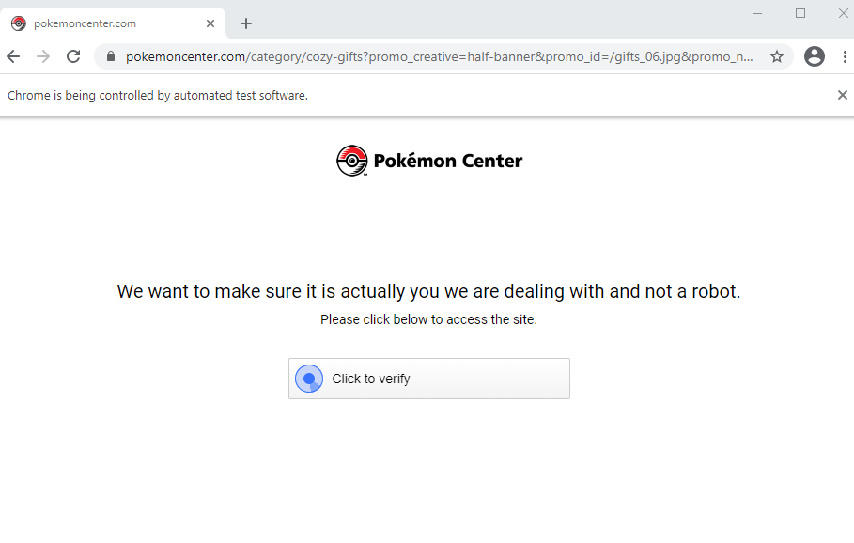
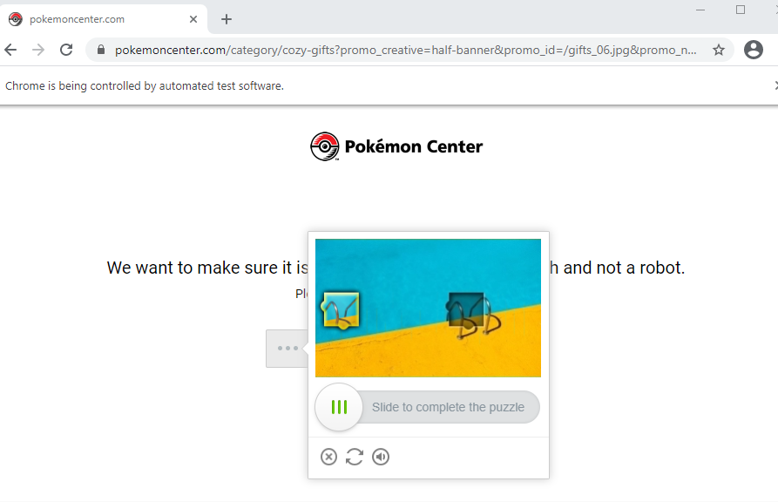
Issue ran into
Initial verification and Verification test caused code not to run until the verification test was completed.

Slide 4

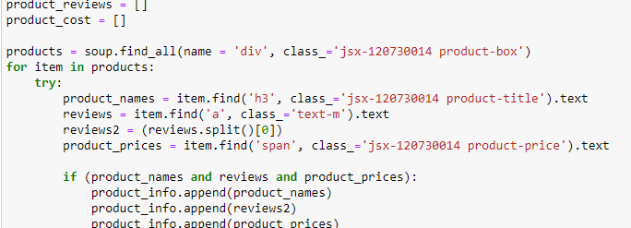
Extract section
The code shows the lists that were created and appended as the website was being scraped for data.

Slide 5

Transform
The code shows the lists of the data being changed into a dictionary.

Slide 6
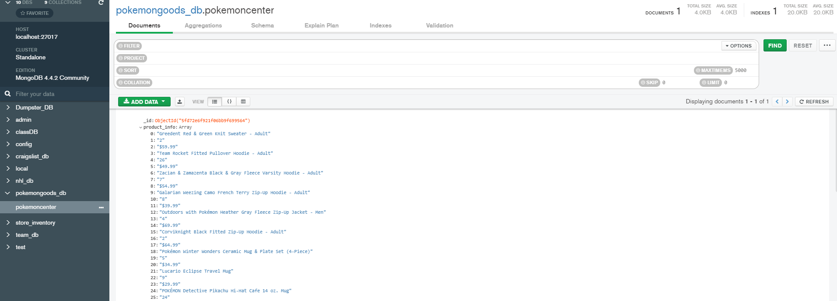
Load
The image shows the data that was loaded into Mongodb

Slide 7
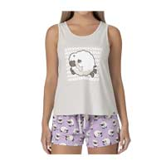
Conclusion
Major issue was determining the name and class to use
Item with highest reviews : Wooloo Gray Tank Top & Lavender Jersey Shorts - Women with 48 reviews

