Slide 1

Fort Collins water quality analysis
Ashley Dixon

Slide 2
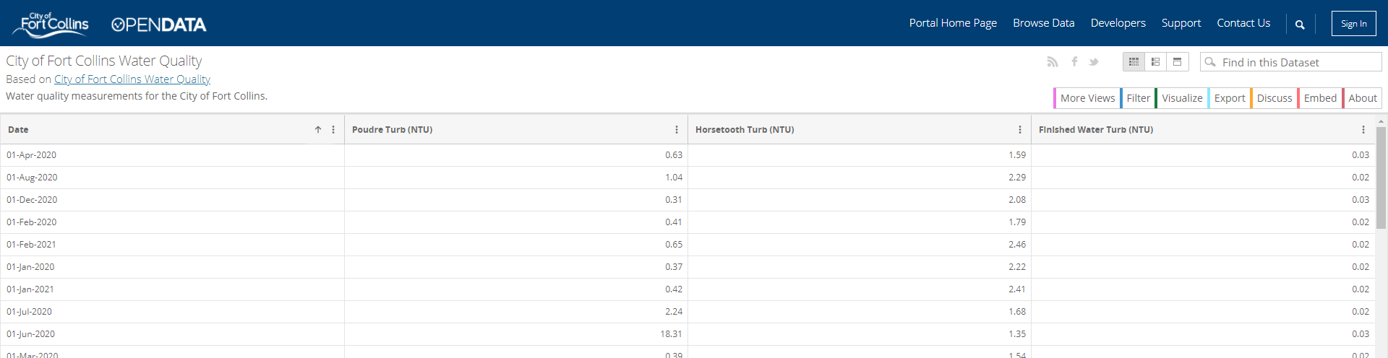
Data source

Slide 3
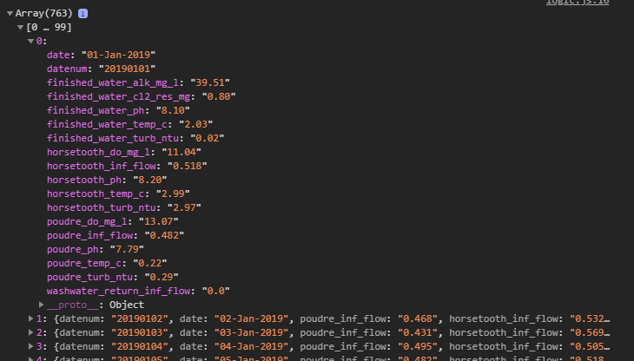




Dive into the data
What is turbidity
What was extracted

Slide 4
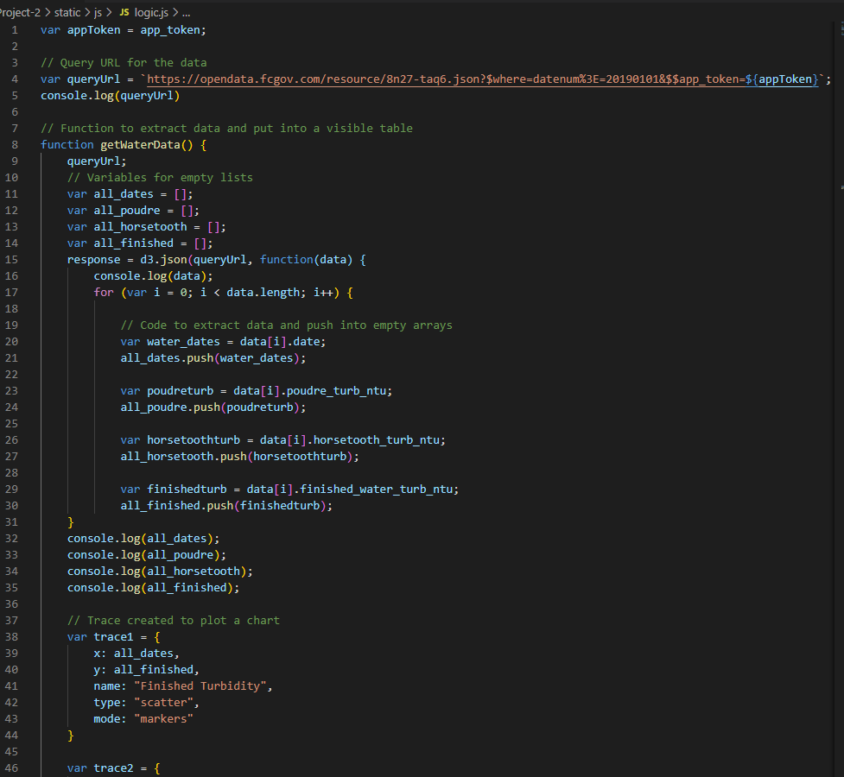
Brief look into the code

Slide 5
https://aidixon.github.io/Project-2/
Deployed html

Slide 6

Conclusion
Since the finished water had low turbidity,
Fort Collins has high water quality

