Slide 1

Fort Collins water quality analysis
Ashley Dixon

Slide 2
Overview
Brief Background
Turbidity
Chart(s) Overview
Explanation
Conclusion
Results Explained
Data Explanation
Data Source
Code
Quick Look

Slide 3
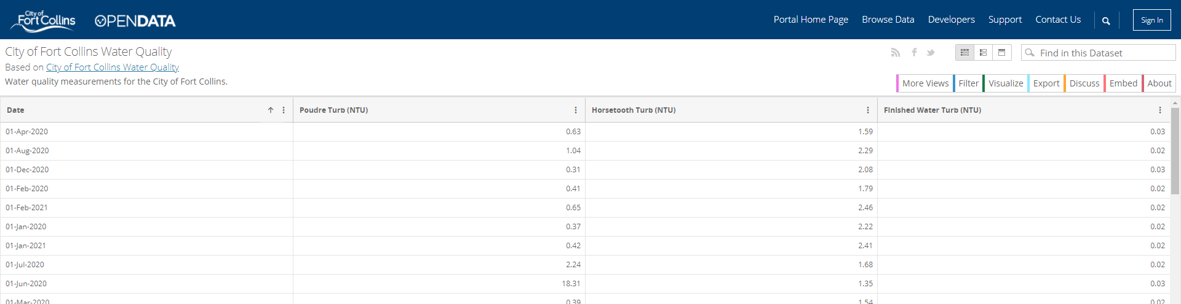
Data source

Slide 4
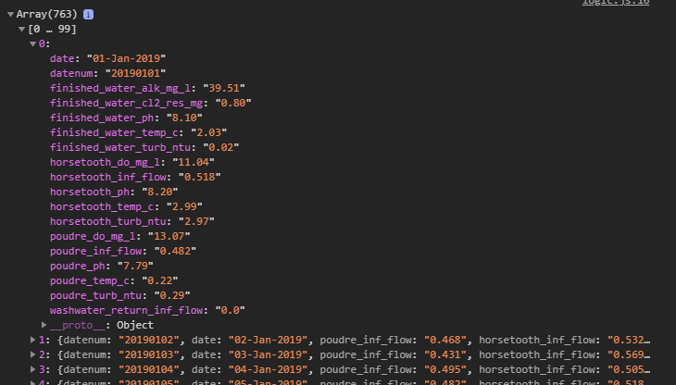




Dive into the data
What is turbidity
What was extracted

Slide 5
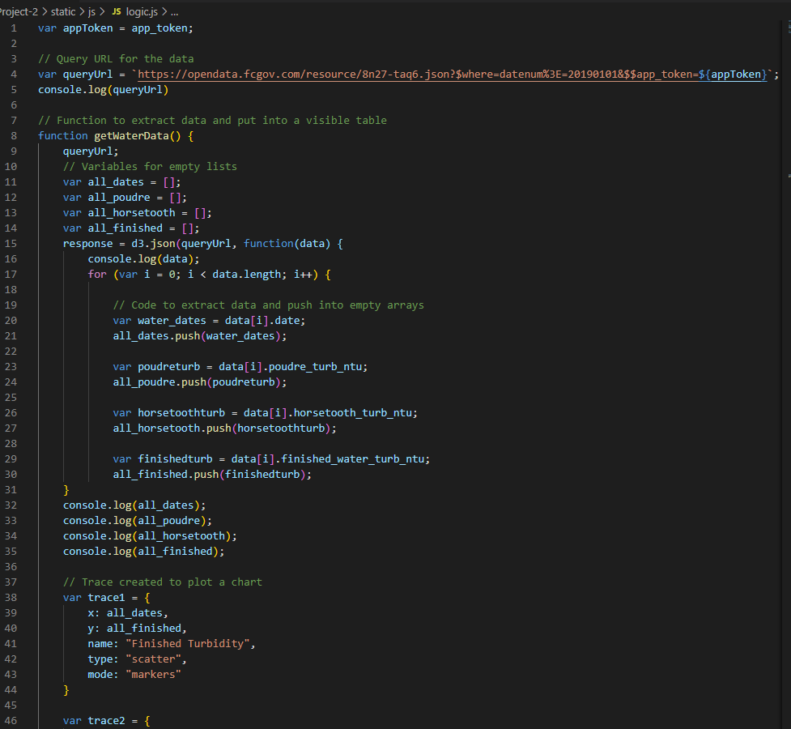
Brief look into the code

Slide 6
https://aidixon.github.io/Project-2/
Deployed html

Slide 7

Conclusion
Since the finished water had low turbidity,
Fort Collins has high water quality

