Slide 1

CS1231S Discrete Structures
AY2019/20 Semester 1

Slide 2
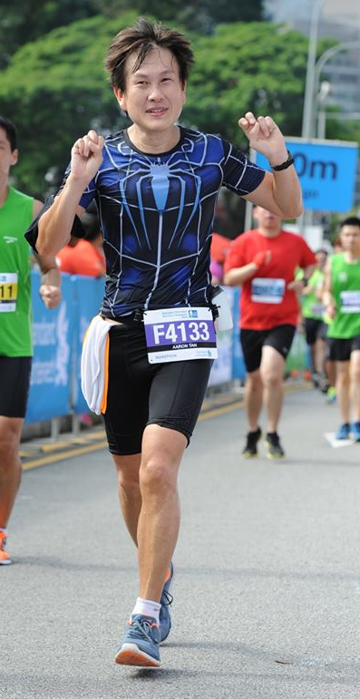
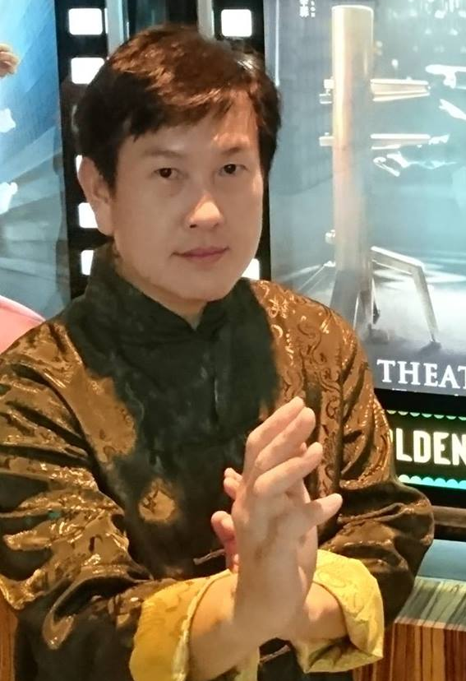
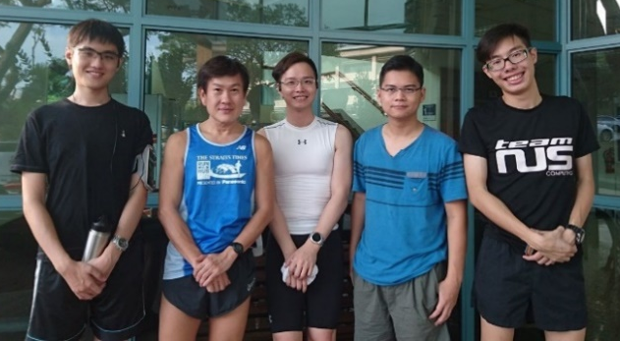
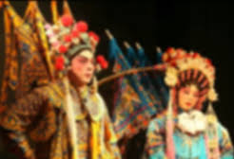
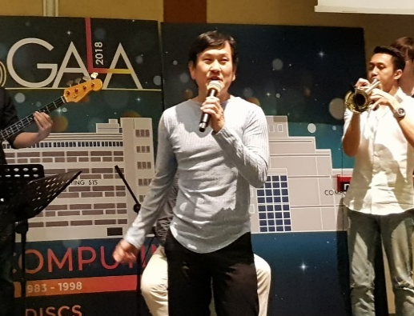
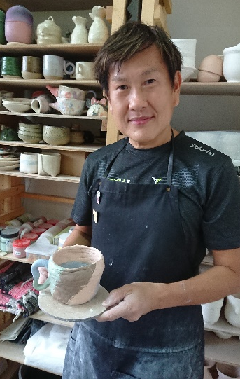
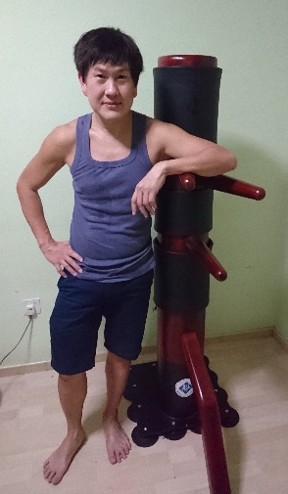
Welcome to CS1231S
1. Lecturers (1/2)
Running
Cantonese opera
Weekly group run with students. You’re welcome to join us!
Check out facebook.
A/P Tan Tuck Choy, Aaron
Office: COM1-03-12
Email: tantc@comp.nus.edu.sg
Singing
Pottery
Wing Chun
Admin appointment:
Assistant Dean (Undergraduate Studies)
SoC Gala Dinner 2018

Slide 3
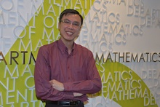
Welcome to CS1231S
1. Lecturers (2/2)
A/P Tan Kai Meng
Mathematics Department, Faculty of Science
Office: S17-07-10
Email: tankm@nus.edu.sg

Slide 4
Welcome to CS1231S
2. Description
CS1231S and CS1231 have the same contents.
The modules introduce mathematical tools required in the study of computer science. Topics include:
Logic and proof techniques
Number theory
Sequences and Mathematical Induction
Set theory, Functions and Relations
Counting and Probability
Graphs and Trees

Slide 5
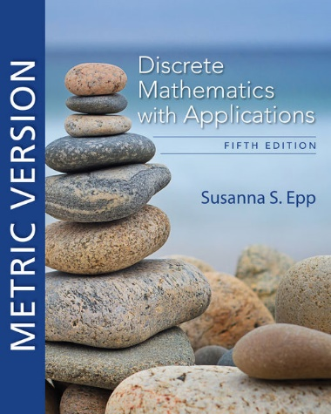
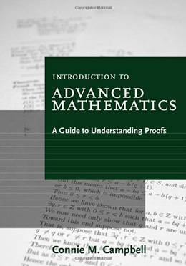
Welcome to CS1231S
3. Textbook and Reference Book
Discrete Mathematics
An Introduction to Mathematical Reasoning
5th Edition
Author: Susanna S. Epp
Publisher: Cengage Asia
ISBN-13: 9780357114087 ISBN-10: 0357114086 Online resource
Introduction to Advanced Mathematics:
A Guide to Understanding Proofs
Author: Connie M. Campbell Publisher: Cengage Asia ISBN-13: 9780547165387 ISBN-10: 0547165382
It’s ok if you get the 4th edition.

Slide 6
Welcome to CS1231S
4. Lecture Plan (May subject to change)
Week | Lecture topics | Tutorial
1 (12/8 – 16/8) | Lecture 1 Speaking Mathematically
2 (19/8 – 23/8) | Lecture 2 The Logic of Compound Statements
3 (26/8 – 30/8) | Lecture 3 The Logic of Quantified Statements | 1
4 (2/9 – 6/9) | Sets | 2
5 (9/9 – 13/9) | Functions, Bijections and Cardinality | 3
6 (16/9 – 20/9) | Mathematical Induction and Recursion | 4
Recess (21/9 – 29/9)
7 (30/9 – 4/10) | Divisibility, Primes and Base Expansion | 5
8 (7/10 – 11/10) | Euclidean Algorithm, Fundamental Theorem of Arithmetic and Modular Arithmetic | 6
9 (14/10 – 18/10) | Relations, Equivalence Relations and Partitions, and Partial Orders | 7
10 (21/10 – 25/10) | Counting and Probability | 8
11 (28/10 – 1/11) | Counting and Probability (continue) | 9
12 (4/11 – 8/11) | Graphs and Trees | 10
13 (11/11 – 15/11) | Graphs and Trees (continue) | 11

Slide 7
Welcome to CS1231S
5. Assessments and Important Dates
CA component | Date | Weightage
Tutorial attendance | - | 5%
Assignments (2) | Check out announcement later | 20%
Mid-term test * | 5 October, Saturday, 11am-1pm (tentative) | 25%
Final exam * | 30 November, Saturday, 1-3pm | 50%
* Open book. No laptop, electronic devices.

Slide 8
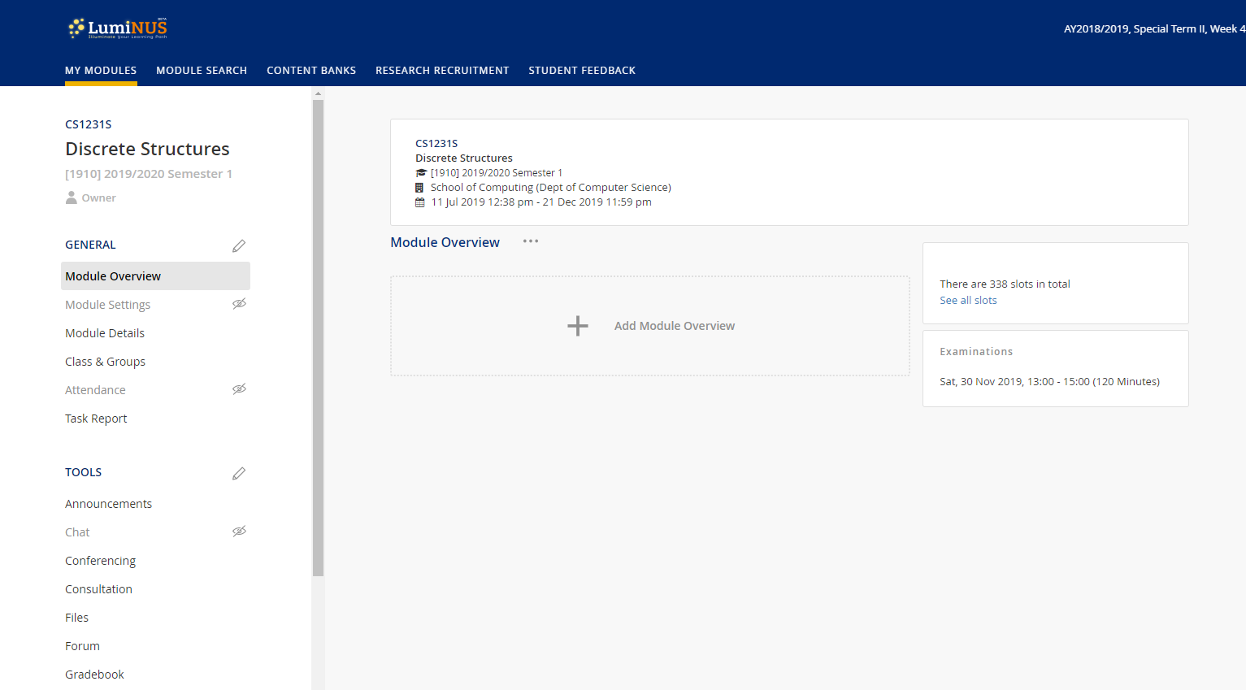
Welcome to CS1231S
6. Online Resources (1/2)
Webcast
Announcements
Forum
Files
etc.
LumiNUS: https://luminus.nus.edu.sg

Slide 9
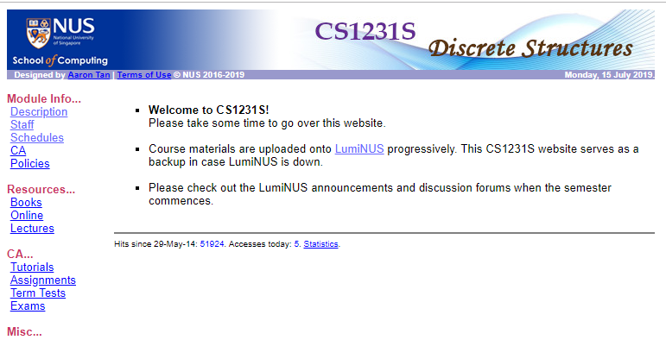
Welcome to CS1231S
6. Online Resources (2/2)
CS1231S module website: https://www.comp.nus.edu.sg/~cs1231s
As backup in case LumiNUS is down.

Slide 10
Welcome to CS1231S
7. Why is Discrete Mathematics Important?
Discrete Math (DM) is important, especially for Computer Science.
Every field in CS is related to discrete objects – databases, neural networks, automata, etc.
It is the backbone of CS.
Concepts and notations from DM are useful in studying the describing objects and problems in all branches of CS, such as algorithms, programming languages, theorem proving and software development
Modeling with DM is an extremely important problem solving skill.
Useful for algorithms modules:
CS2040 (Data Structures and Algorithms), CS3230 (Design and Analysis of Algorithms), etc.
Logic part is useful in CS2100 (Computer Organisation).

Slide 11



Welcome to CS1231S
8. CS1231S Tagline

Slide 12
END OF FILE

