Slide 1
Lecture #12: Graphs and Trees 1 Summary
Aaron Tan
4 – 8 November 2019

Slide 2
Summary
11. Graphs and Trees 1
10.1 Graphs: Definitions and Basic Properties
Vertices, edges, directed graph, simple graph, complete graph, complete bipartite graph, subgraph, degree
10.2 Trails, Paths, and Circuits
Walk, trail, path, closed walk, circuit, simple circuit
10.3 Matrix Representations of Graphs
Adjacency matrix, matrices and connected components
10.4 Planar Graphs
Connectedness, connected component
The Handshake theorem
Euler circuit, Hamiltonian circuit
Matrix multiplication, identity matrix, power of a matrix, walks of length N
Isomorphisms of graphs
Euler’s Formula

Slide 3
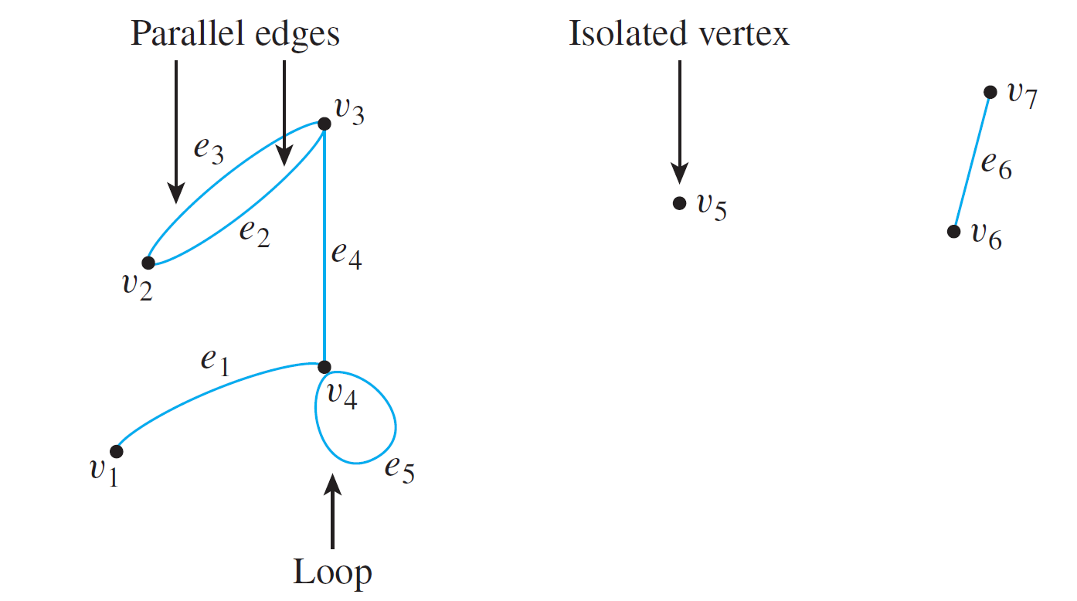
Summary
10.1 Definitions and Basic Properties
A graph G consists of
a set of vertices V(G), and
a set of edges E(G).
We also write G = {V, E}.
V = {v₁, v₂, v₃, v₄, v₅, v₆, v₇}
E = {e₁, e₂, e₃, e₄, e₅, e₆}
e₁ = {v₁, v₄}
e₂ = e₃ = {v₂, v₃}
e₄ = {v₃, v₄}
e₅ = {v₄, v₄}
e₆ = {v₆, v₇}
Edges incident on v₄: e₁, e₄ and e₅
Vertices adjacent to v₄: v₁, v₃ and v₄
Edges adjacent to e₂: e₃ and e₄

Slide 4
Summary
10.1 Definitions and Basic Properties
Definition: Directed Graph
A directed graph, or digraph, G, consists of 2 finite sets: a nonempty set V(G) of vertices and a set D(G) of directed edges, where each edge is associated with an ordered pair of vertices called its endpoints.
If edge e is associated with the pair (v, w) of vertices, then e is said to be the (directed) edge from v to w. We write e = (v, w).
Definition: Simple Graph
A simple graph is an undirected graph that does not have any loops or parallel edges.
Definition: Complete Graph
A complete graph on n vertices, n > 0, denoted K_{n}, is a simple graph with n vertices and exactly one edge connecting each pair of distinct vertices.

Slide 5
Summary
10.1 Definitions and Basic Properties
Definition: Complete Bipartite Graph
A complete bipartite graph on (m, n) vertices, where m, n > 0, denoted K_{m,n}, is a simple graph with distinct vertices v₁, v₂,…, v_{m}, and w₁, w₂,…, w_{n} that satisfies the following properties:
For all i, k = 1, 2, …, m and for all j, l = 1, 2, …, n,
There is an edge from each vertex v_{i} to each vertex w_{j}.
There is no edge from any vertex v_{i} to any other vertex v_{k}.
There is no edge from any vertex w_{j} to any other vertex w_{l}.
Definition: Subgraph of a Graph
A graph H is said to be a subgraph of graph G iff every vertex in H is also a vertex in H, every edge in H is also an edge in G, and every edge in H has the same endpoints as it has in G.

Slide 6
Summary
10.1 Definitions and Basic Properties
Definition: Degree of a Vertex and Total Degree of a Graph
Let G be a graph and v a vertex of G. The degree of v, denoted deg(v), equals the number of edges that are incident on v, with an edge that is a loop counted twice.
The total degree of G is the sum of the degrees of all the vertices of G.
Theorem 10.1.1 The Handshake Theorem
If the vertices of G are v₁, v₂, …, v_{n}, where n ≥ 0, then the total degree of G
= deg(v₁) + deg(v₂) + … + deg(v_{n}) = 2 × (the number of edges of G).
Corollary 10.1.2
The total degree of a graph is even.
Proposition 10.1.3
In any graph there are an even number of vertices of odd degree.

Slide 7
Summary
10.2 Trails, Paths, and Circuits
Definitions
Let G be a graph, and let v and w be vertices of G.
A walk from v to w is a finite alternating sequence of adjacent vertices and edges of G. Thus a walk has the form
v₀ e₁ v₁ e₂ … v_{n-1} e_{n} v_{n} ,
where the v’s represent vertices, the e’s represent edges, v₀=v, v_{n}=w, and for all i ∈ {1, 2, …, n}, v_{i-1} and v_{i} are the endpoints of e_{i}.
The trivial walk from v to v consists of the single vertex v.
A trail from v to w is a walk from v to w that does not contain a repeated edge.
A path from v to w is a trail that does not contain a repeated vertex.
A closed walk is a walk that starts and ends at the same vertex.
A circuit (or cycle) is a closed walk that contains at least one edge and does not contain a repeated edge.
A simple circuit (or simple cycle) is a circuit that does not have any other repeated vertex except the first and last.

Slide 8
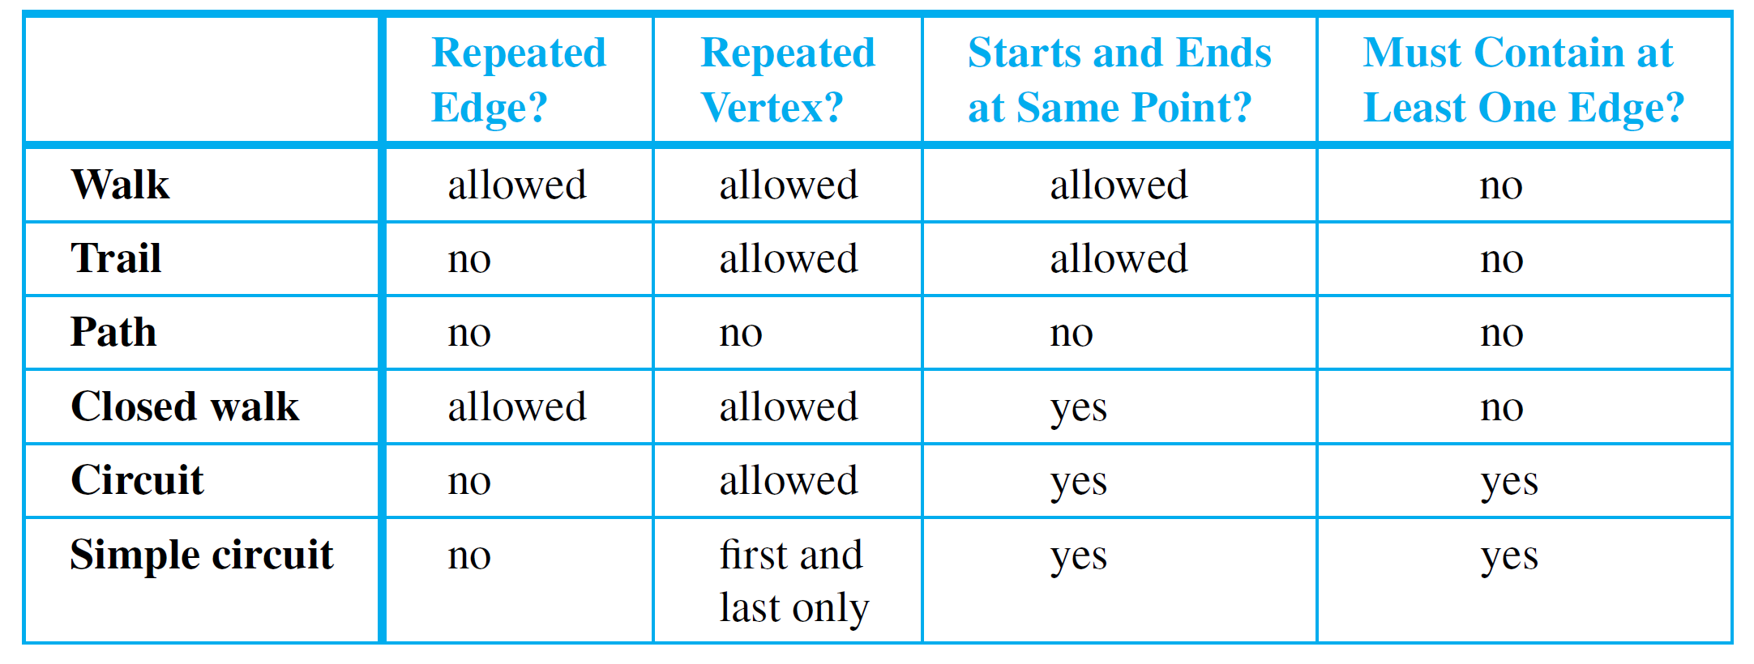
Summary
10.2 Trails, Paths, and Circuits

Slide 9
Summary
10.2 Trails, Paths, and Circuits
Definition: Connectedness
Two vertices v and w of a graph G are connected iff there is a walk from v to w.
The graph G is connected iff given any two vertices v and w in G, there is a walk from v to w. Symbolically, G is connected iff ∀ vertices v, w ∈V(G), ∃ a walk from v to w.
Definition: Connected Component
A graph H is a connected component of a graph G iff
The graph H is a subgraph of G;
The graph H is connected; and
No connected subgraph of G has H as a subgraph and contains vertices or edges that are not in H.

Slide 10
Summary
10.2 Trails, Paths, and Circuits
Definitions: Euler Circuit and Eulerian Graph
Let G be a graph. An Euler circuit for G is a circuit that contains every vertex and every edge of G.
That is, an Euler circuit for G is a sequence of adjacent vertices and edges in G that has at least one edge, starts and ends at the same vertex, uses every vertex of G at least once, and uses every edge of G exactly once.
An Eulerian graph is a graph that contains an Euler circuit.
Theorem 10.2.2
If a graph has an Euler circuit, then every vertex of the graph has positive even degree.
Contrapositive Version of Theorem 10.2.2
If some vertex of a graph has odd degree, then the graph does not have an Euler circuit.

Slide 11
Summary
10.2 Trails, Paths, and Circuits
Theorem 10.2.3
If a graph G is connected and the degree of every vertex of G is a positive even integer, then G has an Euler circuit.
Theorem 10.2.4
A graph G has an Euler circuit iff G is connected and every vertex of G has positive even degree.
Definition: Euler Trail
Let G be a graph, and let v and w be two distinct vertices of G. An Euler trail/path from v to w is a sequence of adjacent edges and vertices that starts at v, ends at w, passes through every vertex of G at least once, and traverses every edge of G exactly once.
Corollary 10.2.5
Let G be a graph, and let v and w be two distinct vertices of G. There is an Euler trail from v to w iff G is connected, v and w have odd degree, and all other vertices of G have positive even degree.

Slide 12
Summary
10.2 Trails, Paths, and Circuits
Definitions: Hamiltonian Circuit and Hamiltonian Graph
Given a graph G, a Hamiltonian circuit for G is a simple circuit that includes every vertex of G.
That is, a Hamiltonian circuit for G is a sequence of adjacent vertices and distinct edges in which every vertex of G appears exactly once, except for the first and the last, which are the same.
A Hamiltonian graph (also called Hamilton graph) is a graph that contains a Hamiltonian circuit.
Proposition 10.2.6
If a graph G has a Hamiltonian circuit, then G has a subgraph H with the following properties:
H contains every vertex of G.
H is connected.
H has the same number of edges as vertices.
Every vertex of H has degree 2.

Slide 13
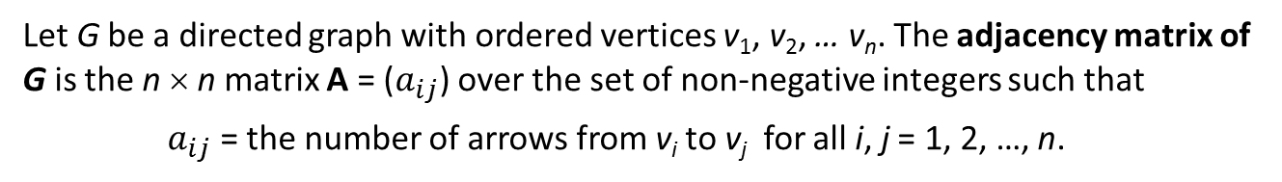
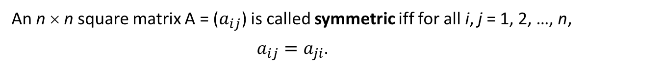
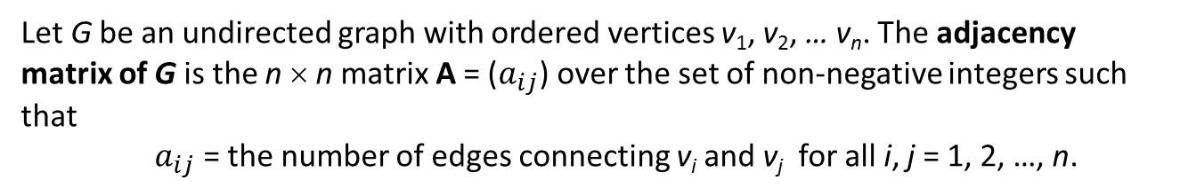
Summary
10.3 Matrix Representations of Graphs
Definition: Adjacency Matrix of a Directed Graph
Let G be a directed graph with ordered vertices v₁, v₂, … v_{n}. The adjacency matrix of G is the n × n matrix A = ($a_{ij}$) over the set of non-negative integers such that
$a_{ij}$ = the number of arrows from v_{i} to v_{j} for all i, j = 1, 2, …, n.
Definition: Adjacency Matrix of an Undirected Graph
Let G be an undirected graph with ordered vertices v₁, v₂, … v_{n}. The adjacency matrix of G is the n × n matrix A = ($a_{ij}$) over the set of non-negative integers such that
$a_{ij}$ = the number of edges connecting v_{i} and v_{j} for all i, j = 1, 2, …, n.
Definition: Symmetric Matrix
An n × n square matrix A = ($a_{ij}$) is called symmetric iff for all i, j = 1, 2, …, n,
$a_{ij}=a_{ji}$.

Slide 14
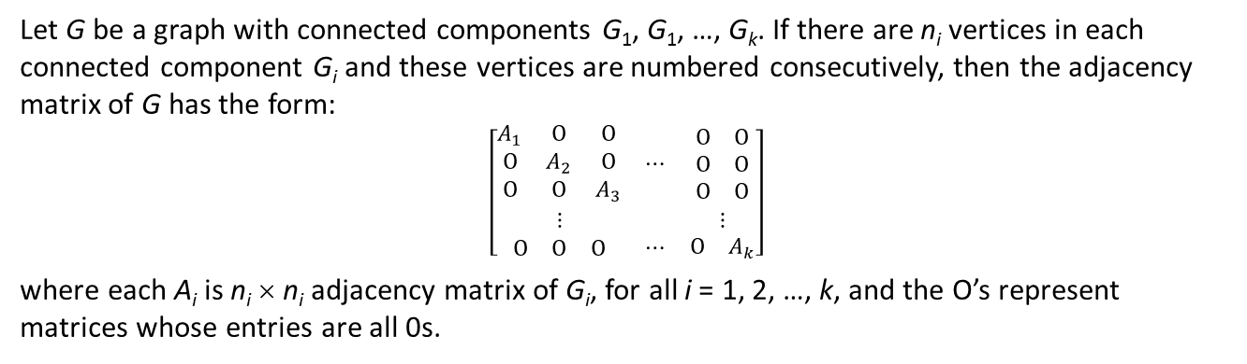
Summary
10.3 Matrix Representations of Graphs
Theorem 10.3.1
Let G be a graph with connected components G₁, G₁, …, G_{k}. If there are n_{i} vertices in each connected component G_{i} and these vertices are numbered consecutively, then the adjacency matrix of G has the form:
$$\left[\begin{matrix}\begin{matrix}A_{1} & O & O \\ O & A_{2} & O \\ O & O & A_{3}\end{matrix} & ⋯ & \begin{matrix}O & O \\ O & O \\ O & O\end{matrix} \\ ⋮ & & ⋮ \\ \begin{matrix}O & O & O\end{matrix} & ⋯ & \begin{matrix}O & A_{k}\end{matrix}\end{matrix}\right]$$
where each A_{i} is n_{i} × n_{i} adjacency matrix of G_{i}, for all i = 1, 2, …, k, and the O’s represent matrices whose entries are all 0s.
Definition: n^{th} Power of a Matrix
For any n × n matrix A, the powers of A are defined as follows:
A⁰ = I where I is the n × n identity matrix
A^{n} = A A^{n – 1} for all integers n ≥ 1
Theorem 10.3.2
If G is a graph with vertices v₁, v₂, …, v_{m} and A is the adjacency matrix of G, then for each positive integer n and for all integers i, j = 1, 2, …, m, the ij-th entry of A^{n} = the number of walks of length n from v_{i} to v_{j}.

Slide 15
Summary
10.4 Planar Graphs
Definition: Isomorphic Graph
Let G and G' be graphs with vertex sets V(G) and V(G') and edge sets E(G) and E(G') respectively. G is isomorphic to G' iff there exist one-to-one correspondences g: V(G) → V(G') and h: E(G) → E(G') that preserve the edge-endpoint functions of G and G' in the sense that for all v ∈ V(G) and e ∈ E(G),
v is an endpoint of e ⇔ g(v) is an endpoint of h(e).
Theorem 10.4.1 Graph Isomorphism is an Equivalence Relation
Let S be a set of graphs and let R be the relation of graph isomorphism on S. Then R is an equivalence relation on S.

Slide 16
Summary
10.4 Planar Graphs
Definition: Planar Graph
A planar graph is a graph that can be drawn on a (two-dimensional) plane without edges crossing.
Euler’s Formula
For a connected planar simple graph G = (V, E) with e = |E| and v = |V|, if we let f be the number of faces, then
f = e – v + 2

Slide 17
END OF FILE

