Slide 1
Lecture #13: Graphs and Trees 2
Trees Rooted Trees Spanning trees and Shortest Paths
Aaron Tan
4 – 8 November 2019

Slide 2

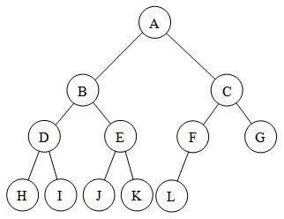
Trees Rooted Trees Spanning trees and Shortest Paths
10.5 Trees

Slide 3
Trees Rooted Trees Spanning trees and Shortest Paths
Definition
Definition
Definition: Tree
A graph is said to be circuit-free if, and only if, it has no circuits.
A graph is called a tree if, and only if, it is circuit-free and connected.
A trivial tree is a graph that consists of a single vertex.
A graph is called a forest if, and only if, it is circuit-free and not connected.

Slide 4
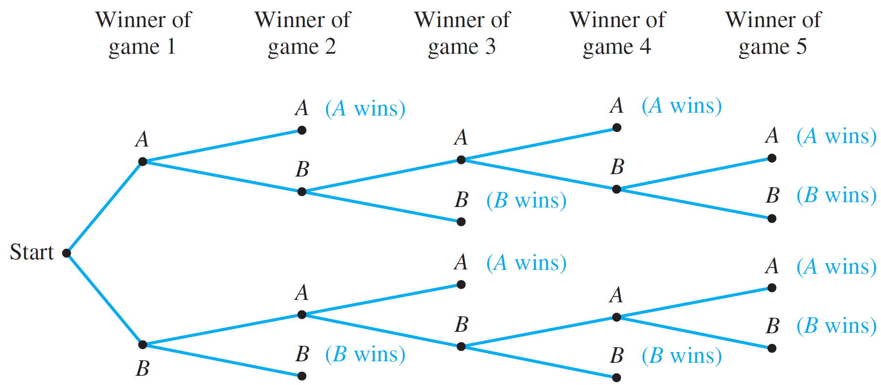
Trees Rooted Trees Spanning trees and Shortest Paths
Examples
Possibility Tree
As discussed in week 9, a possibility tree is used to keep systematic track of all possibilities in which events happen in order. For example:
Figure 9.2.1 The Outcomes of a Tournament

Slide 5
Trees Rooted Trees Spanning trees and Shortest Paths
Examples
Parse Tree
In the last 30 years, Noam Chomsky and others have developed new ways to describe the syntax (or grammatical structure) of natural languages such as English.
In the study of grammars, trees are often used to show the derivation of grammatically correct sentences from certain basic rules. Such trees are called syntactic derivation trees or parse trees.

Slide 6
Trees Rooted Trees Spanning trees and Shortest Paths
Examples
Parse Tree
A very small subset of English grammar, for example, specifies that:
a sentence can be produced by writing first a noun phrase and then a verb phrase;
a noun phrase can be produced by writing an article and then a noun;
a noun phrase can also be produced by writing an article, then an adjective, and then a noun;
a verb phrase can be produced by writing a verb and then a noun phrase;
one article is “the”;
one adjective is “young”;
one verb is “caught”;
one noun is “man”;
one (other) noun is “ball.”

Slide 7
Trees Rooted Trees Spanning trees and Shortest Paths
Examples
Parse Tree
The rules of a grammar are called productions. It is customary to express them using the shorthand notation illustrated below, in Backus-Naur notation:
<sentence> → <noun phrase> <verb phrase>
2,3. <noun phrase> → <article> <noun> | <article> <adjective> <noun>
<verb phrase> → <verb> <noun phrase>
<article> → the
<adjective> → young
<verb> → caught
8,9. <noun> → man | ball
The symbol | represents or, and <> are used to enclose terms to be defined.

Slide 8
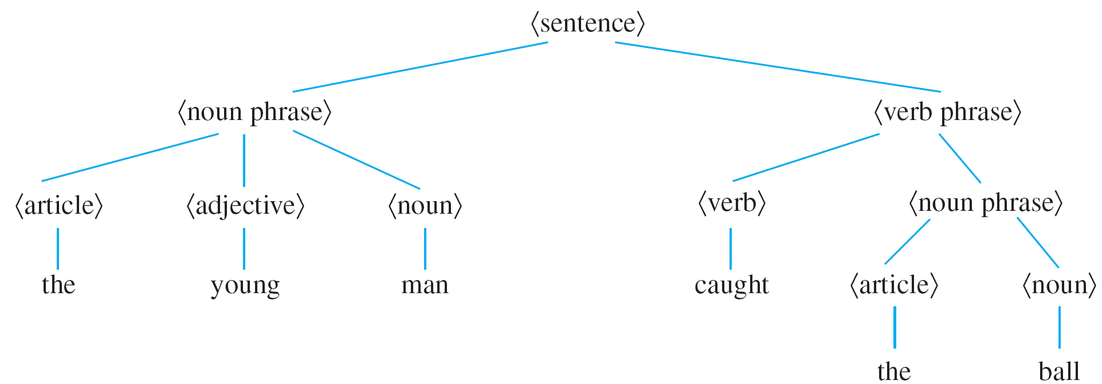
Trees Rooted Trees Spanning trees and Shortest Paths
Examples
Parse Tree
The derivation of the sentence “The young man caught the ball” from the mentioned rules is described by the tree shown below:

Slide 9
Trees Rooted Trees Spanning trees and Shortest Paths
Characterizing Trees
Lemma 10.5.1
Any non-trivial tree has at least one vertex of degree 1.
Proof: Let T be a particular but arbitrarily chosen non-trivial tree.
Step 1: Pick a vertex v of T and let e be an edge incident on v.
Step 2: While deg(v) > 1, repeat steps 2a, 2b and 2c:
2a: Choose e' to be an edge incident on v such that e' ≠ e.
2b: Let v' be the vertex at the other end of e' from v.
2c: Let e = e' and v = v'.
The algorithm must eventually terminate because the set of vertices of the tree T is finite and T is circuit-free. When it does, a vertex v of degree 1 will have been found.

Slide 10
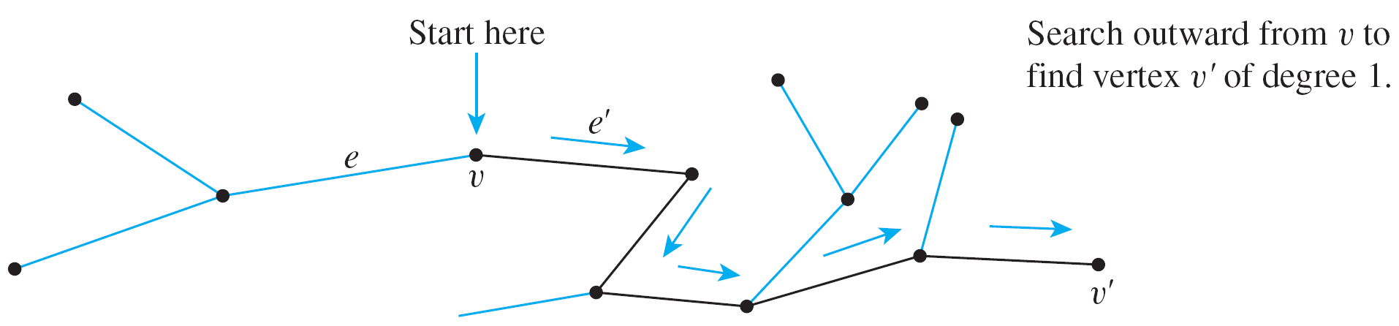
Trees Rooted Trees Spanning trees and Shortest Paths
Characterizing Trees
Lemma 10.5.1
Any non-trivial tree has at least one vertex of degree 1.
Using Lemma 10.5.1 it is not difficult to show that, in fact, any tree that has more than one vertex has at least two vertices of degree 1.

Slide 11
Trees Rooted Trees Spanning trees and Shortest Paths
Characterizing Trees
Definitions: Terminal vertex (leaf) and internal vertex
Let T be a tree. If T has only one or two vertices, then each is called a terminal vertex (or leaf). If T has at least three vertices, then a vertex of degree 1 in T is called a terminal vertex (or leaf), and a vertex of degree greater than 1 in T is called an internal vertex.

Slide 12
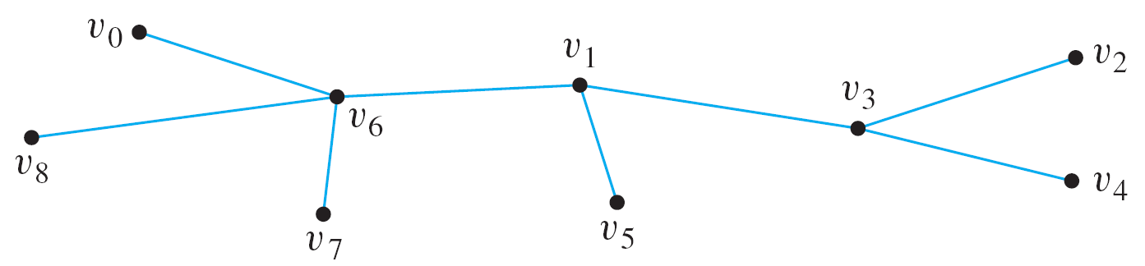
Trees Rooted Trees Spanning trees and Shortest Paths
Characterizing Trees
Example: Find all terminal vertices and all internal vertices in the following tree:
Terminal vertices: v₀, v₂, v₄, v₅, v₇ and v₈.
Internal vertices: v₆, v₁ and v₃.

Slide 13
Trees Rooted Trees Spanning trees and Shortest Paths
Characterizing Trees
Theorem 10.5.2
Any tree with n vertices (n > 0) has n – 1 edges.
Proof: By mathematical induction.
Let the property P(n) be “any tree with n vertices has n – 1 edges”.
P(1): Let T be any tree with one vertex. Then T has no edges. So P(1) is true.
Show that for all integers k ≥ 1, if P(k) is true then P(k+1) is true.
Suppose P(k) is true.
Let T be a particular but arbitrarily chosen tree with k + 1 vertices.
Since k is positive, (k + 1) ≥ 2, and so T has more than one vertex.
Hence, by Lemma 10.5.1, T has a vertex v of degree 1, and has at least another vertex in T besides v.

Slide 14
Trees Rooted Trees Spanning trees and Shortest Paths
Characterizing Trees
Proof: (continued…)
Hence, by Lemma 10.5.1, T has a vertex v of degree 1, and has at least another vertex in T besides v.
Thus, there is an edge e connecting v to the rest of T.
Define a subgraph T' of T so that V(T') = V(T) – {v} and E(T') = E(T) – {e}.
The number of vertices of T' is (k + 1) – 1 = k.
T' is circuit-free.
T' is connected.
Hence by definition, T' is a tree.
Since T' has k vertices, by inductive hypothesis, number of edges of T' = (number of vertices of T') – 1 = k – 1.
But number of edges of T = (number of edges of T') + 1 = k.
Hence P(k+1) is true.
e
T'
v
…

Slide 15
Trees Rooted Trees Spanning trees and Shortest Paths
Characterizing Trees
Example: Find all non-isomorphic trees with four vertices.
By Theorem 10.5.2, any tree with four vertices has three edges. So by Theorem 10.1.1, the tree has a total degree of six.
Also, every non-trivial tree has at least two vertices of degree 1.

Slide 16
Trees Rooted Trees Spanning trees and Shortest Paths
Characterizing Trees
Example: Find all non-isomorphic trees with four vertices.
The only possible combinations of degrees for the vertices:
and


Slide 17
Trees Rooted Trees Spanning trees and Shortest Paths
Characterizing Trees
Lemma 10.5.3
If G is any connected graph, C is any circuit in G, and one of the edges of C is removed from G, then the graph that remains is still connected.
Essentially, the reason why Lemma 10.5.3 is true is that any two vertices in a circuit are connected by two distinct paths.
It is possible to draw the graph so that one of these goes “clockwise” and the other goes “counter-clockwise” around the circuit.

Slide 18
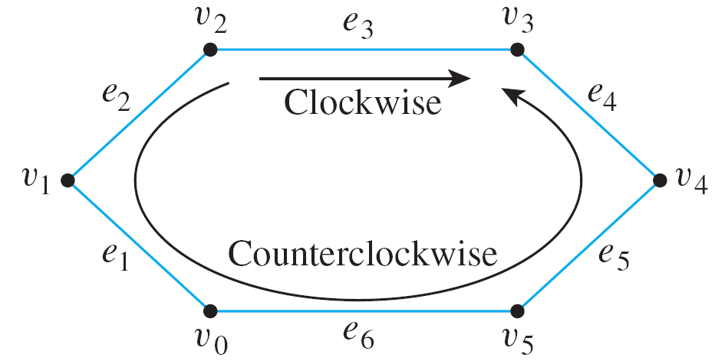
Trees Rooted Trees Spanning trees and Shortest Paths
Characterizing Trees
For example, in the circuit shown below:
The clockwise path from v₂ to v₃ is
v₂ e₃ v₃
and the counter-clockwise path from v₂ to v₃ is
v₂ e₂ v₁ e₁ v₀ e₆ v₅ e₅ v₄ e₄ v₃

Slide 19
Trees Rooted Trees Spanning trees and Shortest Paths
Characterizing Trees
Theorem 10.5.4
If G is a connected graph with n vertices and n – 1 edges, then G is a tree.
Proof:
Suppose G is a particular but arbitrarily chosen graph that is connected and n vertices and n – 1 edges.
Since G is connected, it suffices to show that G is circuit-free.
Suppose G is not circuit free
Let C be the circuit in G.
By Lemma 10.5.3, an edge of C can be removed from G to obtain a graph G' that is connected.
If G' has a circuit, then repeat this process: Remove an edge of the circuit from G' to form a new connected graph.
Continue the process of removing edges from the circuits until eventually a graph G'' is obtained that is connected and is circuit-free.

Slide 20
Trees Rooted Trees Spanning trees and Shortest Paths
Characterizing Trees
Proof: (continued…)
Continue the process of removing edges from the circuits until eventually a graph G'' is obtained that is connected and is circuit-free.
By definition, G'' is a tree.
Since no vertices were removed from G to form G'', G'' has n vertices.
Thus, by Theorem 10.5.2, G'' has n – 1 edges.
But the supposition that G has a circuit implies that at least one edge of G is removed to form G''.
Hence G'' has no more than (n – 1) – 1 = n – 2 edges, which contradicts its having n – 1 edges.
So the supposition is false.
Hence G is circuit-free, and therefore G is a tree.

Slide 21
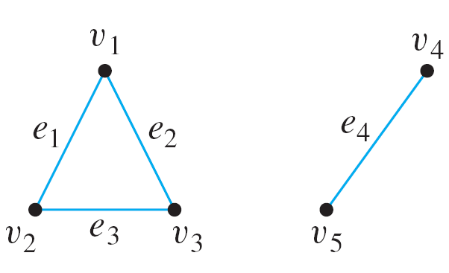
Trees Rooted Trees Spanning trees and Shortest Paths
Characterizing Trees
Note that although it is true that every connected graph with n vertices and n – 1 edges is a tree, it is not true that every graph with n vertices and n – 1 edges is a tree.
Example: Give an example of a graph with five vertices and four edges that is not a tree.
By Theorem 10.5.4, such a graph cannot be connected. One example of such an unconnected graph is shown below.

Slide 22
Trees Rooted Trees Spanning trees and Shortest Paths
10.6 Rooted Trees

Slide 23
Trees Rooted Trees Spanning trees and Shortest Paths
Definitions
A rooted tree is a tree in which one vertex has been distinguished from the others and is designated the root.
Definitions: Rooted Tree, Level, Height
A rooted tree is a tree in which there is one vertex that is distinguished from the others and is called the root.
The level of a vertex is the number of edges along the unique path between it and the root.
The height of a rooted tree is the maximum level of any vertex of the tree.

Slide 24
Trees Rooted Trees Spanning trees and Shortest Paths
Definitions
Definitions: Child, Parent, Sibling, Ancestor, Descendant
Given the root or any internal vertex v of a rooted tree, the children of v are all those vertices that are adjacent to v and are one level farther away from the root than v.
If w is a child of v, then v is called the parent of w, and two distinct vertices that are both children of the same parent are called siblings.
Given two distinct vertices v and w, if v lies on the unique path between w and the root, then v is an ancestor of w, and w is a descendant of v.

Slide 25
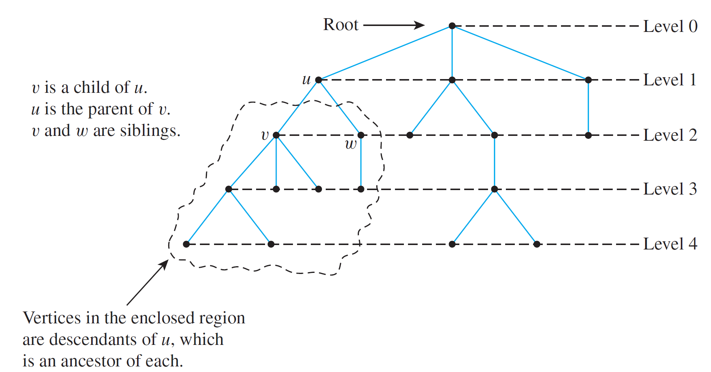
Trees Rooted Trees Spanning trees and Shortest Paths
Definitions
Figure 10.6.1 A Rooted Tree

Slide 26
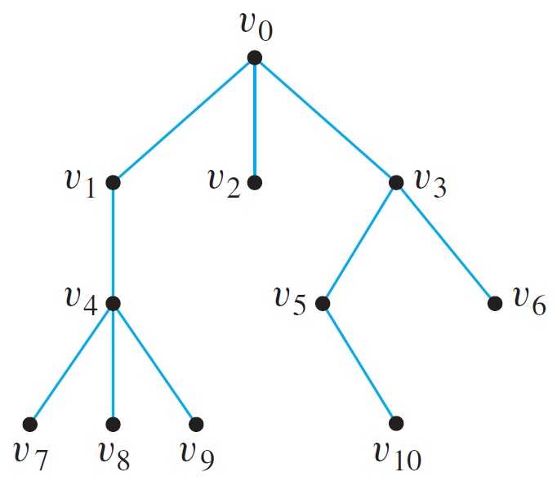
Trees Rooted Trees Spanning trees and Shortest Paths
Example
Example: Consider the tree with root v₀ shown below.
What is the level of v₅?
What is the level of v₀?
What is the height of this rooted tree?
What are the children of v₃?
What is the parent of v₂?
What are the siblings of v₈?
What are the descendants of v₃?
2
0


Slide 27
Trees Rooted Trees Spanning trees and Shortest Paths
Binary Trees
Binary Trees
Definitions: Binary Tree, Full Binary Tree
A binary tree is a rooted tree in which every parent has at most two children. Each child is designated either a left child or a right child (but not both), and every parent has at most one left child and one right child.
A full binary tree is a binary tree in which each parent has exactly two children.

Slide 28
Trees Rooted Trees Spanning trees and Shortest Paths
Binary Trees
Binary Trees
Definitions: Left Subtree, Right Subtree
Given any parent v in a binary tree T, if v has a left child, then the left subtree of v is the binary tree whose root is the left child of v, whose vertices consist of the left child of v and all its descendants, and whose edges consist of all those edges of T that connect the vertices of the left subtree.
The right subtree of v is defined analogously.

Slide 29
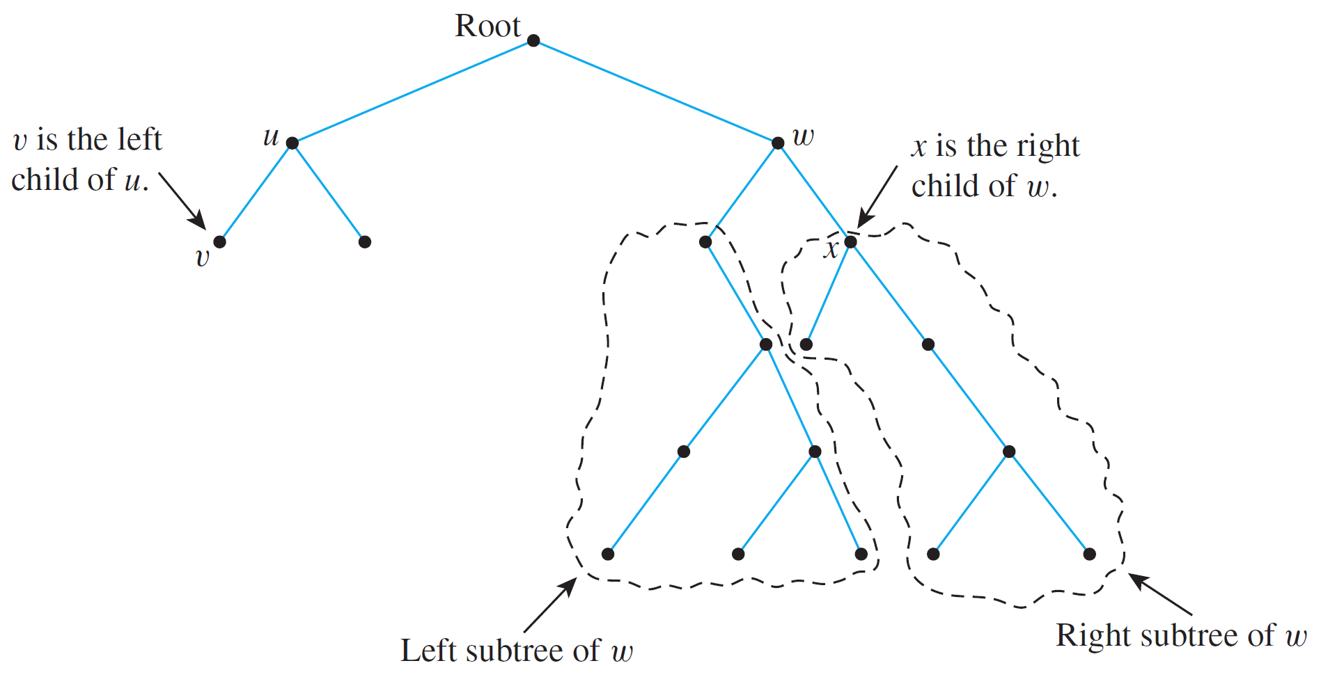
Trees Rooted Trees Spanning trees and Shortest Paths
Binary Trees
Binary Trees
Figure 10.6.2 A Binary Tree

Slide 30
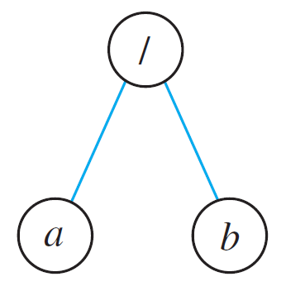
Trees Rooted Trees Spanning trees and Shortest Paths
Example – Representation of Algebraic Expressions
Example – Representation of Algebraic Expressions
Binary trees are used in many ways in computer science. One use is to represent algebraic expressions with arbitrary nesting of balanced parentheses.
For instance, the following (labeled) binary tree represents the expression a/b: The operator is at the root and acts on the left and right children of the root in left-right order.

Slide 31
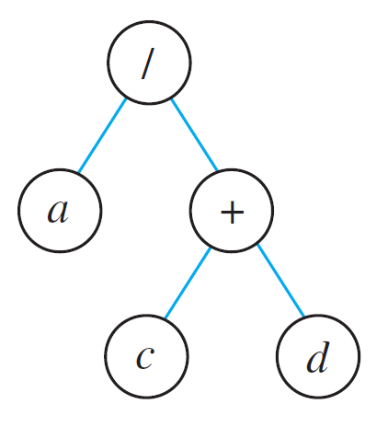
Trees Rooted Trees Spanning trees and Shortest Paths
Example – Representation of Algebraic Expressions
More generally, the binary tree shown below represents the expression a/(c + d). In such a representation, the internal vertices are arithmetic operators, the terminal vertices are variables, and the operator at each vertex acts on its left and right subtrees in left-right order.

Slide 32
Trees Rooted Trees Spanning trees and Shortest Paths
Example – Representation of Algebraic Expressions
Draw a binary tree to represent the expression ((a – b)  c) + (d/e).


Slide 33
Trees Rooted Trees Spanning trees and Shortest Paths
Full Binary Tree
An interesting theorem about binary trees says that if you know the number of internal vertices of a full binary tree, then you can calculate both the total number of vertices and the number of terminal vertices (leaves), and conversely.
Theorem 10.6.1: Full Binary Tree Theorem
If T is a full binary tree with k internal vertices, then T has a total of 2k + 1 vertices and has k + 1 terminal vertices (leaves).

Slide 34
Trees Rooted Trees Spanning trees and Shortest Paths
Full Binary Tree
Proof:
Every vertex, except the root, has a parent.
Since every internal vertex of a full binary tree has exactly two children, the number of vertices that have a parent is twice the number of parents, or 2k.
#vertices of T = #vertices that have a parent +
#vertices that do not have a parent
= 2k + 1
#terminal vertices = #vertices – #internal vertices = 2k + 1 – k = k + 1
Therefore T has a total of 2k + 1 vertices and has k + 1 terminal vertices.

Slide 35
Trees Rooted Trees Spanning trees and Shortest Paths
Full Binary Tree
Q: Is there a full binary tree that has 10 internal vertices and 13 terminal vertices?
No, by Theorem 10.6.1, a full binary tree with 10 internal vertices has 10 + 1 = 11 terminal vertices.

Slide 36
Trees Rooted Trees Spanning trees and Shortest Paths
Height and Terminal Vertices of a Binary Tree
Height and Terminal Vertices of a Binary Tree
Theorem 10.6.2
For non-negative integers h, if T is any binary tree with height h and t terminal vertices (leaves), then
t ≤ 2^{h}
Equivalently,
log₂ t ≤ h
This theorem says that the maximum number of terminal vertices (leaves) of a binary tree of height h is 2^{h}. Alternatively, a binary tree with t terminal vertices (leaves) has height of at least log₂t.

Slide 37
Trees Rooted Trees Spanning trees and Shortest Paths
Height and Terminal Vertices of a Binary Tree
Proof: By mathematical induction
Let P(h) be “If T is any binary tree of height h, then the number of leaves of T is at most 2^{h}.
P(0): T consists of one vertex, which is a terminal vertex. Hence t = 1 = 2⁰.
Show that for all integers k ≥ 0, if P(i) is true for all integers i from 0 through k, then P(k+1) is true.
Let T be a binary tree of height k + 1, root v, and t leaves.
Since k ≥ 0, hence k + 1 ≥ 1 and so v has at least one child.
We consider two cases: If v has only one child, or if v has two children.

Slide 38
Trees Rooted Trees Spanning trees and Shortest Paths
Height and Terminal Vertices of a Binary Tree
Proof: (continued…)
Case 1 (v has only one child):
v
Level 0
v_{L}
Level 1
Level 2
Level 3
Left subtree T_{L}

Slide 39
Trees Rooted Trees Spanning trees and Shortest Paths
Height and Terminal Vertices of a Binary Tree
Proof: (continued…)
Case 1 (v has only one child):
Without loss of generality, assume that v’s child is a left child and denote it by v_{L}. Let T_{L} be the left subtree of v.
Because v has only one child, v is a leaf, so the total number of leaves in T equals the number of leaves in T_{L} + 1. Thus, if t_{L} is the number of leaves in T_{L} , then t = t_{L} + 1.
By inductive hypothesis, t_{L} ≤ 2^{k} because the height of T_{L} is k, one less than the height of T.
Also, because v has a child, k+1 ≥ 1 and so 2^{k} ≥ 2⁰ = 1.
Therefore, t = t_{L} + 1 ≤ 2^{k} + 1 ≤ 2^{k} + 2^{k} = 2^{k+1}
v
Level 0
v_{L}
Level 1
Level 2
Level 3
Left subtree T_{L}

Slide 40
Trees Rooted Trees Spanning trees and Shortest Paths
Height and Terminal Vertices of a Binary Tree
Proof: (continued…)
Case 2 (v has two children):
v
Level 0
v_{L}
Level 1
v_{R}
Level 2
Level 3
Level 4
Left subtree T_{L}
Right subtree T_{R}

Slide 41
Trees Rooted Trees Spanning trees and Shortest Paths
Height and Terminal Vertices of a Binary Tree
Proof: (continued…)
Case 2 (v has two children):
Now v has a left child v_{L} and a right child v_{R} , and they are the roots of a left subtree T_{L} and a right subtree T_{R} respectively.
Let h_{L} and h_{R} be the heights of T_{L} and T_{R} respectively.
Then h_{L} ≤ k and h_{R} ≤ k since T is obtained by joining T_{L} and T_{R} and adding a level.
Let t_{L} and t_{R} be the number of leaves of T_{L} and T_{R} respectively.
Then, since both T_{L} and T_{R} have heights less than k + 1, by inductive hypothesis, t_{L} ≤ 2^{hL} and t_{R} ≤ 2^{hR}.
Therefore, t = t_{L} + t_{R} ≤ 2^{hL} + 2^{hR} ≤ 2^{k} + 2^{k} ≤ 2^{k+1}
We proved both cases that P(k+1) is true.
Hence if T is any binary tree with height h and t terminal vertices (leaves), then t ≤ 2^{h}.

Slide 42
Trees Rooted Trees Spanning trees and Shortest Paths
Height and Terminal Vertices of a Binary Tree
Q: Is there a binary tree that has height 5 and 38 terminal vertices?
No, by Theorem 10.6.2, any binary tree T with height 5 has at most 2⁵ = 32 terminal vertices, so such a tree cannot have 38 terminal vertices.

Slide 43
Trees Rooted Trees Spanning trees and Shortest Paths
Binary Tree Traversal
Binary Tree Traversal
Tree traversal (also known as tree search) is the process of visiting each node in a tree data structure exactly once in a systematic manner.
There are two types of traversal: breadth-first search (BFS) or depth-first search (DFS).
The following sections describe BFS and DFS on binary trees, but in general they can be applied on any type of trees, or even graphs.

Slide 44
Trees Rooted Trees Spanning trees and Shortest Paths
Binary Tree Traversal
Breadth-First Search
In breadth-first search (by E.F. Moore), it starts at the root and visits its adjacent vertices, and then moves to the next level.
1
The figure shows the order of the vertices visited.
2
3
4
5
6
7
8
9

Slide 45
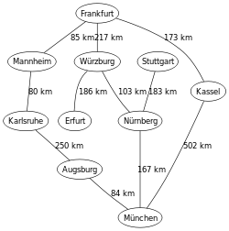
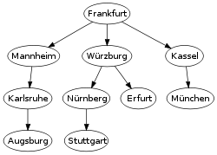
Trees Rooted Trees Spanning trees and Shortest Paths
Binary Tree Traversal
Breadth-First Search
The figure on the left shows a graph representing cities in Germany. The figure on the right shows the breadth-first traversal on the graph.
Acknowledgement: Wikipedia https://en.wikipedia.org/wiki/Breadth-first_search

Slide 46
Trees Rooted Trees Spanning trees and Shortest Paths
Binary Tree Traversal
Depth-First Search
There are three types of depth-first traversal:
Pre-order
Print the data of the root (or current vertex)
Traverse the left subtree by recursively calling the pre-order function
Traverse the right subtree by recursively calling the pre-order function
In-order
Traverse the left subtree by recursively calling the in-order function
Print the data of the root (or current vertex)
Traverse the right subtree by recursively calling the in-order function
Post-order
Traverse the left subtree by recursively calling the post-order function
Traverse the right subtree by recursively calling the post-order function
Print the data of the root (or current vertex)

Slide 47
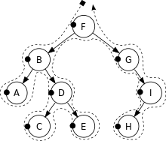
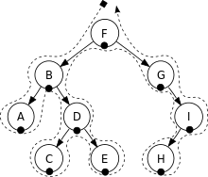

Trees Rooted Trees Spanning trees and Shortest Paths
Binary Tree Traversal
Depth-First Search
Pre-order:
F, B, A, D, C, E, G, I, H
In-order:
Post-order:
Acknowledgement: Wikipedia https://en.wikipedia.org/wiki/Tree_traversal


Slide 48
Trees Rooted Trees Spanning trees and Shortest Paths
10.7 Spanning Trees and Shortest Paths

Slide 49
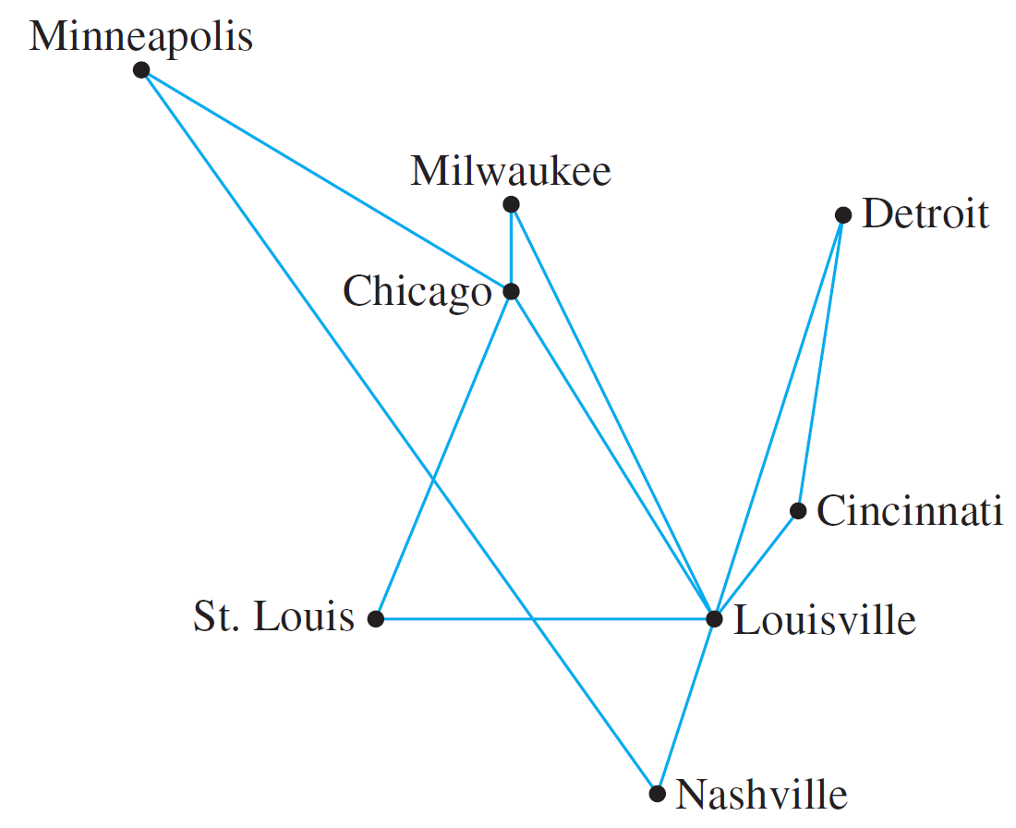
Trees Rooted Trees Spanning trees and Shortest Paths
Definitions
An East Coast airline company wants to expand service to the Midwest and has received permission from the Federal Aviation Authority to fly any of the routes shown in Figure 10.7.1.
Figure 10.7.1

Slide 50
Trees Rooted Trees Spanning trees and Shortest Paths
Definitions
The company wishes to legitimately advertise service to all the cities shown but, for reasons of economy, wants to use the least possible number of individual routes to connect them. One possible route system is given in Figure 10.7.2, where the chosen routes are in red.
Figure 10.7.1
Figure 10.7.2

Slide 51
Trees Rooted Trees Spanning trees and Shortest Paths
Definitions
Lemma 10.5.3
Is the number of individual routes minimal?
The fact is that the graph of any system of routes that satisfies the company’s wishes is a tree, because if the graph were to contain a circuit, then one of the routes in the circuit could be removed without disconnecting the graph (by Lemma 10.5.3), and that would give a smaller total number of routes.
If G is any connected graph, C is any circuit in G, and one of the edges of C is removed from G, then the graph that remains is still connected.
Figure 10.7.2

Slide 52
Trees Rooted Trees Spanning trees and Shortest Paths
Definitions
What you have seen is a spanning tree.
Definition: Spanning Tree
A spanning tree for a graph G is a subgraph of G that contains every vertex of G and is a tree.
Proposition 10.7.1
Every connected graph has a spanning tree.
Any two spanning trees for a graph have the same number of edges.

Slide 53
Trees Rooted Trees Spanning trees and Shortest Paths
Definitions
Example: Find all spanning trees for the graph G below.
The graph G has one circuit v₂v₁v₄v₂ and removal of any edge of the circuit gives a tree. Hence there are three spanning trees for G.

Slide 54
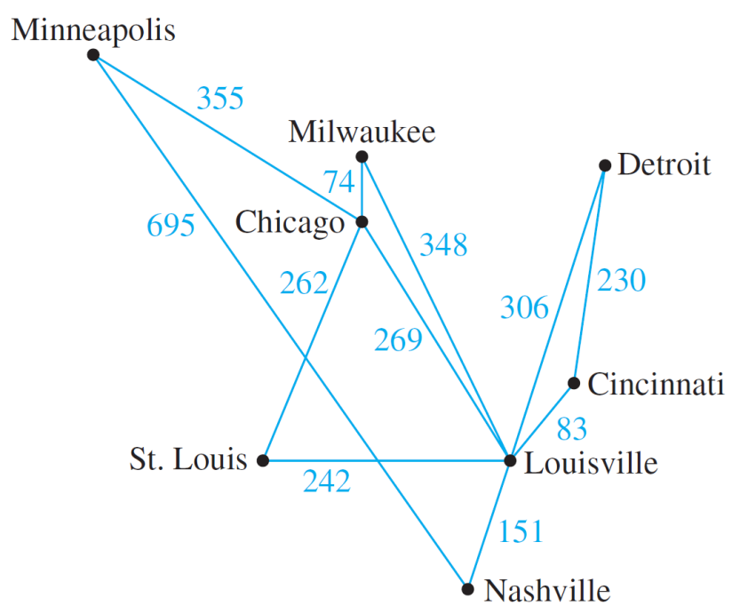
Trees Rooted Trees Spanning trees and Shortest Paths
Minimum Spanning Trees
Minimum Spanning Trees
The graph of the routes allowed by the Federal Aviation Authority shown in Figure 10.7.1 can be annotated by adding the distances (in miles) between each pair of cities.
Now suppose the airline company wants to serve all the cities shown, but with a route system that minimizes the total mileage.
Figure 10.7.3

Slide 55
Trees Rooted Trees Spanning trees and Shortest Paths
Minimum Spanning Trees
Minimum Spanning Trees
Definitions: Weighted Graph, Minimum Spanning Tree
A weighted graph is a graph for which each edge has an associated positive real number weight . The sum of the weights of all the edges is the total weight of the graph.
A minimum spanning tree for a connected weighted graph is a spanning tree that has the least possible total weight compared to all other spanning trees for the graph.
If G is a weighted graph and e is an edge of G, then w(e) denotes the weight of e and w(G) denotes the total weight of G.

Slide 56
Trees Rooted Trees Spanning trees and Shortest Paths
Kruskal’s Algorithm
Kruskal’s Algorithm (Joseph B. Kruskal, 1956)
In Kruskal’s algorithm, the edges of a connected weighted graph are examined one by one in order of increasing weight.
At each stage the edge being examined is added to what will become the minimum spanning tree, provided that this addition does not create a circuit.
After n – 1 edges have been added (where n is the number of vertices of the graph), these edges, together with the vertices of the graph, form a minimum spanning tree for the graph.

Slide 57
Trees Rooted Trees Spanning trees and Shortest Paths
Kruskal’s Algorithm
Algorithm 10.7.1 Kruskal
Input: G [a connected weighted graph with n vertices]
Algorithm:
Initialize T to have all the vertices of G and no edges.
Let E be the set of all edges of G, and let m = 0.
While (m < n – 1)
3a. Find an edge e in E of least weight.
3b. Delete e from E.
3c. If addition of e to the edge set of T does not produce a circuit, then add e to the edge set of T and set m = m + 1
End while
Output: T [T is a minimum spanning tree for G]

Slide 58
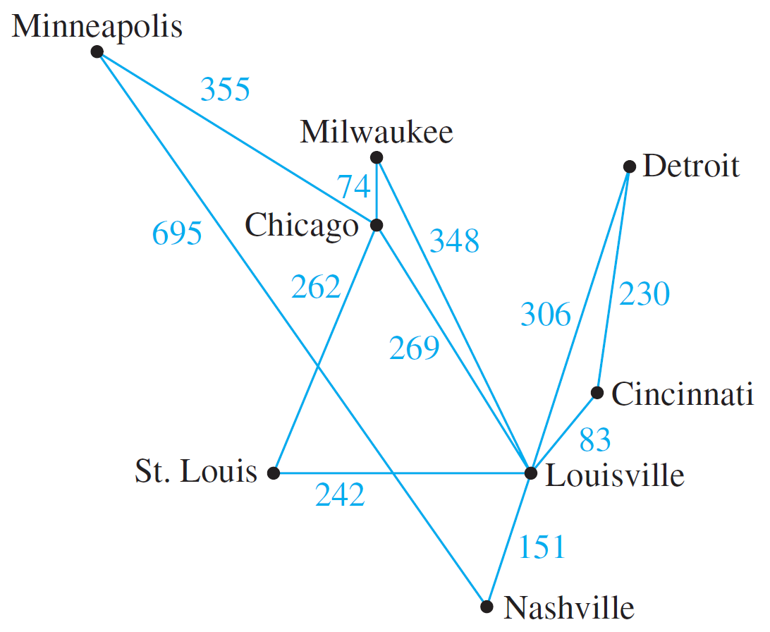
Trees Rooted Trees Spanning trees and Shortest Paths
Kruskal’s Algorithm
Example: Describe the action of Kruskal’s algorithm on the graph shown in Figure 10.7.4, where n = 8.
Figure 10.7.4

Slide 59

Trees Rooted Trees Spanning trees and Shortest Paths
Kruskal’s Algorithm
Using Kruskal’s algorithm we can formulate the following table.
 | Edge considered | Wt | Action taken
1 | Chi – Mil | 74
2 | Lou – Cin | 83
3 | Lou – Nas | 151
4 | Cin – Det | 230
5 | StL – Lou | 242
6 | StL – Chi | 262
7 | Chi – Lou | 269
8 | Lou – Det | 306
9 | Lou – Mil | 348
10 | Min – Chi | 355
added
added
added
added
added
added
not added
not added
Figure 10.7.4
not added
added

Slide 60
Trees Rooted Trees Spanning trees and Shortest Paths
Kruskal’s Algorithm
When Kruskal’s algorithm is used on a graph in which some edges have the same weight as others, more than one minimum spanning tree can occur as output.
To make the output unique, the edges of the graph can be placed in an array and edges having the same weight can be added in the order they appear in the array.

Slide 61
Trees Rooted Trees Spanning trees and Shortest Paths
Prim’s Algorithm
Prim’s Algorithm (Robert C. Prim, 1957)
Prim’s algorithm works differently from Kruskal’s. It builds a minimum spanning tree T by expanding outward in connected links from some vertex.
One edge and one vertex are added at each stage. The edge added is the one of least weight that connects the vertices already in T with those not in T, and the vertex is the endpoint of this edge that is not already in T.

Slide 62
Trees Rooted Trees Spanning trees and Shortest Paths
Prim’s Algorithm
Algorithm 10.7.2 Prim
Input: G [a connected weighted graph with n vertices]
Algorithm:
Pick a vertex v of G and let T be the graph with this vertex only.
Let V be the set of all vertices of G except v.
For i = 1 to n – 1
3a. Find an edge e of G such that (1) e connects T to one of the vertices in V, and (2) e has the least weight of all edges connecting T to a vertex in V. Let w be the endpoint of e that is in V.
3b. Add e and w to the edge and vertex sets of T, and delete w from V.
Output: T [T is a minimum spanning tree for G]

Slide 63
Trees Rooted Trees Spanning trees and Shortest Paths
Prim’s Algorithm
Example: Describe the action of Prim’s algorithm on the graph shown in Figure 10.7.6, using the Minneapolis vertex as a starting point.
Figure 10.7.6

Slide 64
Trees Rooted Trees Spanning trees and Shortest Paths
Prim’s Algorithm
Using Prim’s algorithm we can formulate the following table.
 | Vertex added | Edge added | Weight
0 | Minneapolis
1
2
3
4
5
6
7
Chicago
Min – Chi
355
Milwaukee
Chi – Mil
74
St. Louis
Chi – StL
262
Louisville
StL – Lou
242
Cincinnati
Lou – Cin
83
Nashville
Lou – Nas
151
Detroit
Cin – Det
230
Figure 10.7.6

Slide 65
Trees Rooted Trees Spanning trees and Shortest Paths
Prim’s Algorithm
Note that the tree obtained is the same as that obtained by Kruskal’s algorithm, but the edges are added in a different order.
As with Kruskal’s algorithm, in order to ensure a unique output, the edges of the graph could be placed in an array and those with the same weight could be added in the order they appear in the array.

Slide 66

Trees Rooted Trees Spanning trees and Shortest Paths
Dijkstra’s Shortest Path Algorithm
Dijkstra’s Shortest Path Algorithm
Note that Dijkstra’s Shortest Path Algorithm is taken out of the curriculum this semester.
However, the slides are retained here for your own reading.
To skip slides 67 till end.

Slide 67
Trees Rooted Trees Spanning trees and Shortest Paths
Dijkstra’s Shortest Path Algorithm
Dijkstra’s Shortest Path Algorithm
In 1959, Edsgar Dijkstra developed an algorithm to find the shortest path between a starting vertex (source) and an ending vertex (destination) in a weighted graph in which all weights are positive.
Somewhat similar to Prim’s algorithms, it works outward from the source a, adding vertices and edges one by one to construct a shortest path tree T. It differs from Prim’s algorithm in the way it chooses the next vertex to add, ensuring that for each added vertex v, the length of the shortest path from a to v has been identified.

Slide 68
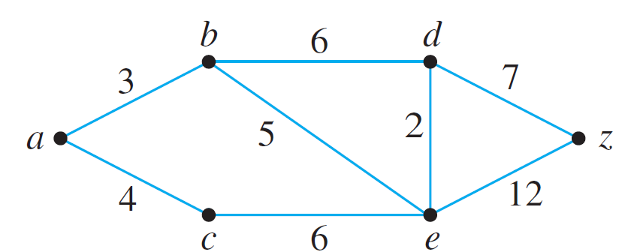
Trees Rooted Trees Spanning trees and Shortest Paths
Dijkstra’s Shortest Path Algorithm
Intuition behind Dijkstra’s algorithm:
Report the vertices in increasing order of their distance from the source vertex.
Construct the shortest path tree edge by edge; at each step adding one new edge, corresponding to construction of shortest path to the current new vertex.
Example: To find shortest part from vertex a to vertex z.
1

Slide 69
Trees Rooted Trees Spanning trees and Shortest Paths
Dijkstra’s Shortest Path Algorithm
At the start, assign every vertex u a label L(u), which is the current best estimate of the length of the shortest path from a to u.
∞
∞
L(a) is set to 0.
0
∞
∞
1
∞
L(u) of each vertex u other than a is set to ∞.

Slide 70
Trees Rooted Trees Spanning trees and Shortest Paths
Dijkstra’s Shortest Path Algorithm
As the algorithm progresses, the values of L(u) are updated, eventually becoming the actual lengths of the shortest paths from a to u.
We construct the shortest path tree T outward from a.
At each stage of the algorithm, the only vertices that are candidates to join T are those that are adjacent to at least one vertex of T. We call these candidates the set of “fringe” vertices.
The graph G can be thought of as divided into 3 parts: the tree T that is being built up, the set of “fringe” vertices, and the rest of the vertices in G.

Slide 71
Trees Rooted Trees Spanning trees and Shortest Paths
Dijkstra’s Shortest Path Algorithm
The rest of the vertices
a
Each fringe vertex is a candidate to be the next vertex added to T.
Shortest path tree T
“Fringe” vertices
All vertices in T already have their final L(u) value computed.
The one that is chosen is the one for which the length of the shortest path to it from a through T is a minimum among all the vertices in the fringe.

Slide 72
Trees Rooted Trees Spanning trees and Shortest Paths
Dijkstra’s Shortest Path Algorithm
a
If L(v) + w(v, u) < L(u), then the value of L(u) is changed to L(v) + w(v, u).
After each addition of a vertex v to T, each fringe vertex u adjacent to v is examined and two numbers are compared: the current value of L(u) and the value of L(v) + w(v, u), where L(v) is the length of the shortest path to v (in T ) and w(v, u) is the weight of the edge joining v and u.

Slide 73
Trees Rooted Trees Spanning trees and Shortest Paths
Dijkstra’s Shortest Path Algorithm
Algorithm 10.7.3 Dijkstra
Inputs:
G [a connected simple graph with positive weight for every edge]
∞ [a number greater than the sum of the weights of all the edges in G]
w(u, v) [the weight of edge {u, v}]
a [the source vertex]
z [the destination vertex]
Algorithm:
Initialize T to be the graph with vertex a and no edges. Let V(T) be the set of vertices of T, and let E(T) be the set of edges of T.
L(a) ← 0, and for all vertices u in G except a, L(u) ← ∞ . [The number L(u) is called the label of u.]
Initialize v ← a and F ← {a}. [The symbol v is used to denote the vertex most recently added to T.]

Slide 74
Trees Rooted Trees Spanning trees and Shortest Paths
Dijkstra’s Shortest Path Algorithm
Algorithm 10.7.3 Dijkstra (continued…)
Let Adj(x) denote the set of vertices adjacent to vertex x.
while (z ∉V(T))
F ← (F – {v}) ∪ {vertices ∈ Adj(v) and ∉ V(T)} [The set F is the set of fringe vertices.]
For each vertex u ∈ Adj(v) and ∉ V(T), if L(v) + w(v, u) < L(u) then L(u) ← L(v) + w(v, u) D(u) ← v
Find a vertex x in F with the smallest label. Add vertex x to V(T), and add edge {D(x), x} to E(T). v ← x
Output: L(z) [this is the length of the shortest path from a to z.]
[The notation D(u) is introduced to keep track of which vertex in T gave rise to the smaller value.]

Slide 75
Trees Rooted Trees Spanning trees and Shortest Paths
Dijkstra’s Shortest Path Algorithm
Example: Show the steps in the execution of Dijkstra’s shortest path algorithm for the graph shown below with starting vertex a and ending vertex z.
1

Slide 76
Trees Rooted Trees Spanning trees and Shortest Paths
Dijkstra’s Shortest Path Algorithm
∞
∞
3
Step 1: Going into the while loop: V(T ) = {a}, E(T ) = Ø, and F = {a}
0
∞
∞
1
∞
During iteration:
F = {b, c}, L(b) = 3, L(c) = 4.
Since L(b) < L(c), b is added to V(T) and {a, b} is added to E(T).

Slide 77
Trees Rooted Trees Spanning trees and Shortest Paths
Dijkstra’s Shortest Path Algorithm
3
∞
Step 2: Going into the while loop: V(T ) = {a, b}, E(T ) = {{a, b}}
0
∞
4
∞
∞
1
During iteration:
F = {c, d, e}, L(c) = 4, L(d) = 9, L(e) = 8.
Since L(c) < L(d) and L(c) < L(e), c is added to V(T) and {a, c} is added to E(T).

Slide 78
Trees Rooted Trees Spanning trees and Shortest Paths
Dijkstra’s Shortest Path Algorithm
3
∞
Step 3: Going into the while loop: V(T ) = {a, b, c},
E(T ) = {{a, b}, {a, c}}
0
∞
∞
4
1
5
During iteration:
F = {d, e}, L(d) = 9, L(e) = 5.
L(e) becomes 5 because ace, which has length 5, is a shorter path to e than abe, which has length 8. Since L(e) < L(d), e is added to V(T ) and {c, e} is added to E(T ).

Slide 79
Trees Rooted Trees Spanning trees and Shortest Paths
Dijkstra’s Shortest Path Algorithm
∞
3
7
Step 4: Going into the while loop: V(T ) = {a, b, c, e},
E(T ) = {{a, b}, {a, c}, {c, e}}
0
∞
4
1
5
During iteration:
F = {d, z}, L(d) = 7, L(z) = 17. L(d) becomes 7 because aced, which has length 7, is a shorter path to d than abd, which has length 9. Since L(d) < L(z), d is added to V(T ) and {e, d} is added to E(T ).

Slide 80
Trees Rooted Trees Spanning trees and Shortest Paths
Dijkstra’s Shortest Path Algorithm
3
7
Step 5: Going into the while loop: V(T ) = {a, b, c, e , d},
E(T ) = {{a, b}, {a, c}, {c, e}, {e, d}}
0
∞
14
4
1
5
During iteration:
F = {z}, L(z) = 14. L(z) becomes 14 because acedz, which has length 14, is a shorter path to z than acez, which has length 17. Since z is the only vertex in F, its label is a minimum, and so z is added to V(T ) and {d, z} is added to E(T ).
Algorithm terminates at this point because z ∈ V(T).
The shortest path from a to z has length L(z) = 14.

Slide 81
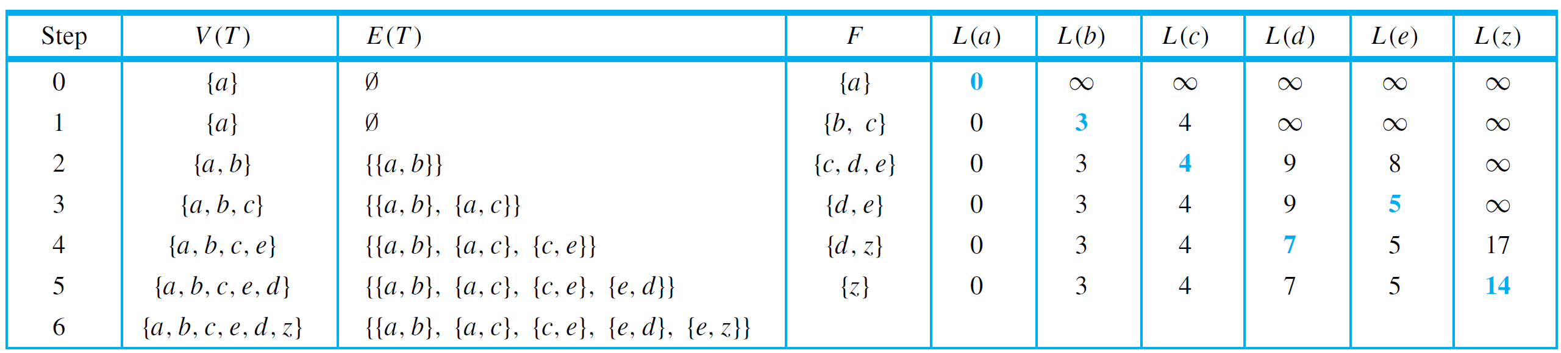
Trees Rooted Trees Spanning trees and Shortest Paths
Dijkstra’s Shortest Path Algorithm
Keeping track of the steps in a table is a convenient way to show the action of Dijkstra’s algorithm. Table 10.7.1 does this for the graph in the previous example.
{d, z}}
Table 10.7.1

Slide 82
END OF FILE

