Slide 1
Folding & Faulting
Folding
When Earth’s crust bends, folds occur
Folding occurs under compression when forces act towards each other, such as when plates collide.

Slide 2
Folding & Faulting
Definitions
Compression
    Is a process of forcing something into smaller compass, reducing it in volume by pressing it together
Tension
    Is a pulling force, tending to stretch, to cause an extension of a body or to restore the shape of an extended elastic object

Slide 3
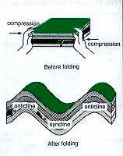

A fold is a bend in the rock strata.
Folding: Is a type of earth movement resulting from the horizontal compression of rock layers by internal forces of the earth along plate boundaries.
Folding

Slide 4
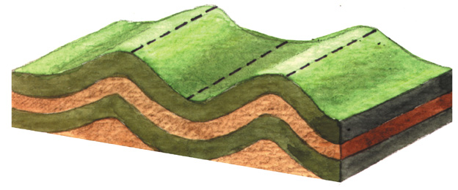
Folding
The downfolds are termed synclines
A upfold are termed as anticlines

Slide 5
Folding & Faulting
Parts of a fold :
layers of rocks of continental crust bent in upfolds called anticlines & downfolds called synclines.
2 sides of a fold are called the limbs.
Generally, anticlines form fold mountains & synclines form valleys

Slide 6
Folding & Faulting
There are 2 main fold mountains systems in the world:
Old and young fold mountains, based on their geological age.
A) The old Caledonian fold mountains (formed 400 million years ago)
B) The Circum-Pacific Region surrounding the pacific ocean (formed within the last 100 million years)

Slide 7
Folding & Faulting

Slide 8
Folding & Faulting
amount of folding depends on force used by movement of the plates.
When folding is very complex, there is little relationship between anticlines & mountains & between synclines & valleys.

Slide 9
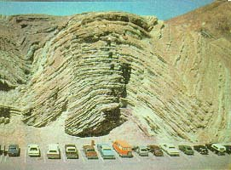

Slide 10
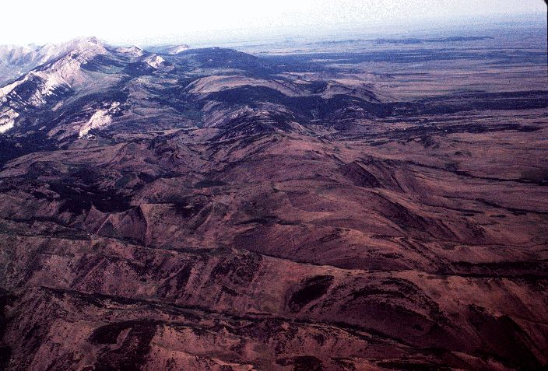
Anticline in Utah

Slide 11
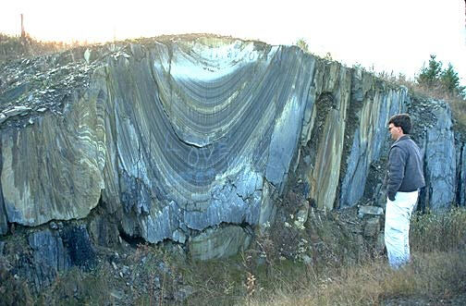
Syncline

Slide 12
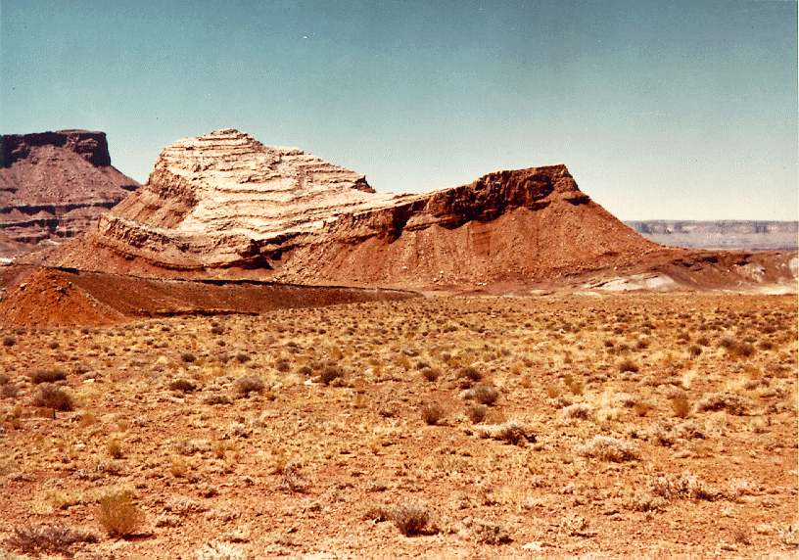
Syncline

Slide 13
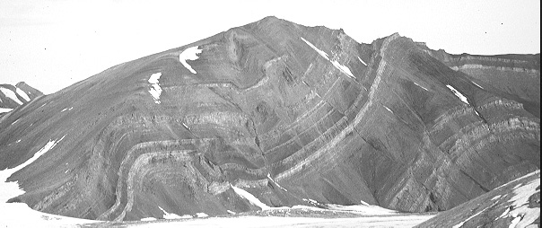
Folding

Slide 14
Folding & Faulting
Faulting
Faulting occurs when Earth’s crust cracks:
  1. under tension ( when forces are acting opposite each other ) causing layers of rocks to stretch & crack ; a normal fault develops & one block moves down relative to other block in direction of fault to form an escarpment

Slide 15
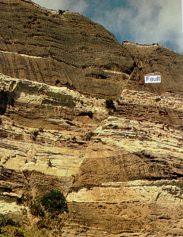
Faulting
The process by which rocks break and move or are displaced along a fracture

Slide 16
Folding & Faulting
Types of faults
http://www.geog.ouc.bc.ca/physgeog/home.html
About Geography
Animated graphics on different types of faults

Slide 17
Folding & Faulting
Block Mountain or horst
block that is raised between 2 parallel faults forms a block mountain or horst if the surface is horizontal or tilted plateau if block mountain is tilted eg : Deccan Plateau in India.
A horst can also be formed by sinking of blocks on either side of parallel faults, leaving central block standing high as mountain

Slide 18
Folding & Faulting
Rift valley or Graben
is formed when block between 2 parallel faults sinks or when block on either side of 2 parallel faults are thrust up over central block .
Egs are the Rhine Rift Valley (between the Black Forest of Germany & the Vosges of France) & the East African Rift Valley.

Slide 19
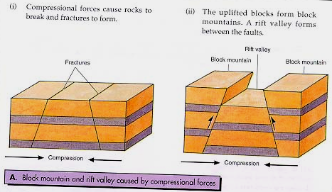
Block Mountain and rift valley caused by compressional forces

Slide 20
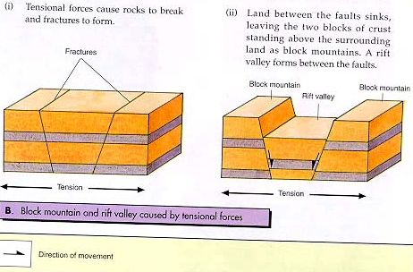
Block Mountains and rift valley formed
due to tensional forces

