Slide 1
x
(7,2)
y
(5,4)
(9,6)
(2,3)
(4,7)
(8,1)
x

Slide 2
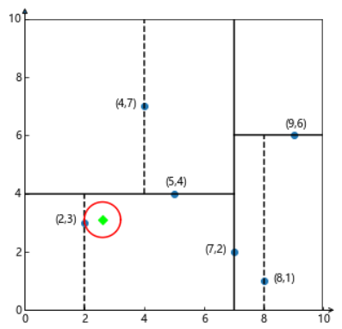
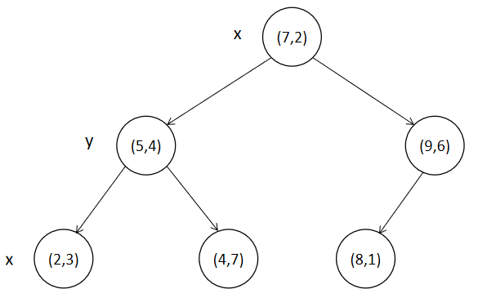

Slide 3
