Slide 1
Age | WOE | COE | B | Score=WOE * COE * B
(21, 35] | -0.54 | -0.51 | 29 | 4 = -0.25*(-0.51)*29
(35, 42] | -0.30
(42, 47] | -0.25
(47, 52] | -0.17
(52, 57] | 0.00
(57, 63] | 0.38
(63, 70] | 0.86
(70, 99] | 1.08
评分
Age = 45

Slide 2
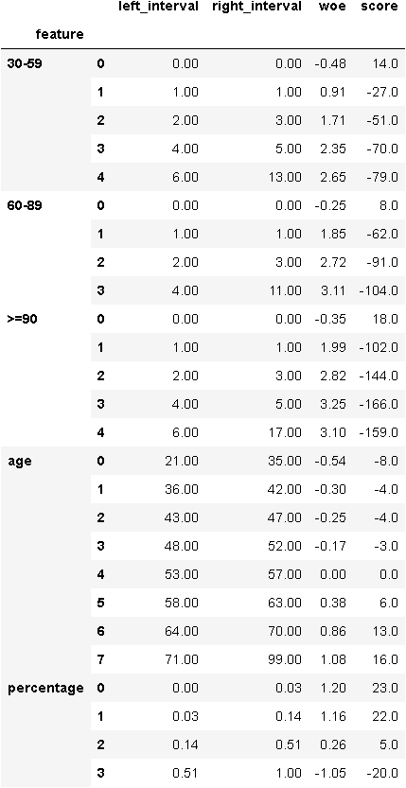
1 评分卡
评分计算示例
Age | WOE | COE | B | Score=WOE * COE * B
(21, 35] | -0.54 | -0.51 | 29 | 4 = -0.25*(-0.51)*29
(35, 42] | -0.30
(42, 47] | -0.25
(47, 52] | -0.17
(52, 57] | 0.00
(57, 63] | 0.38
(63, 70] | 0.86
(70, 99] | 1.08
评分
Age = 45
申请评分卡

