Slide 1
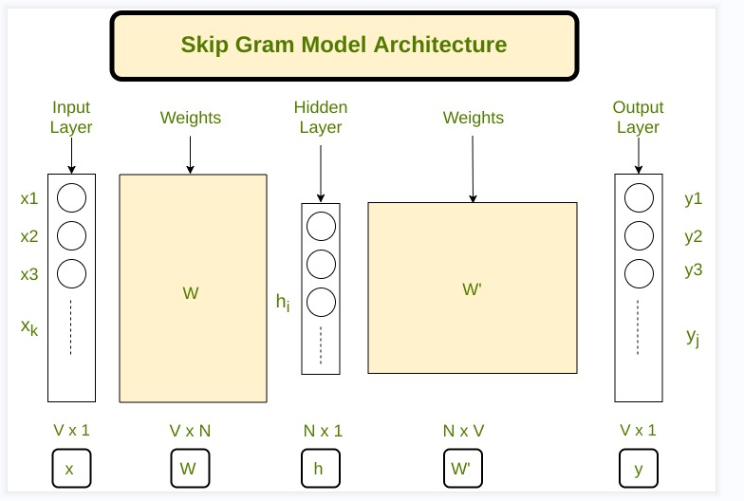

Slide 2


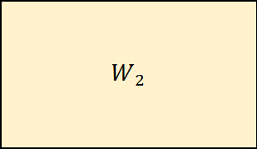







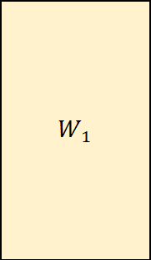
Skip Gram Model Architecture
Input Layer
Weights
Hidden Layer
Weights
Output Layer
$$x_{1}$$
$$W_{1}$$
$$y_{1}$$
$$x_{2}$$
$$W_{2}$$
$$y_{2}$$
$$h_{j}$$
.........
.........
.......
$$x_{v}$$
$$y_{v}$$
V×1
V×N
N×1
N×V
V×1
X
$$W_{1}$$
h
$$W_{2}$$
y

