Slide 1

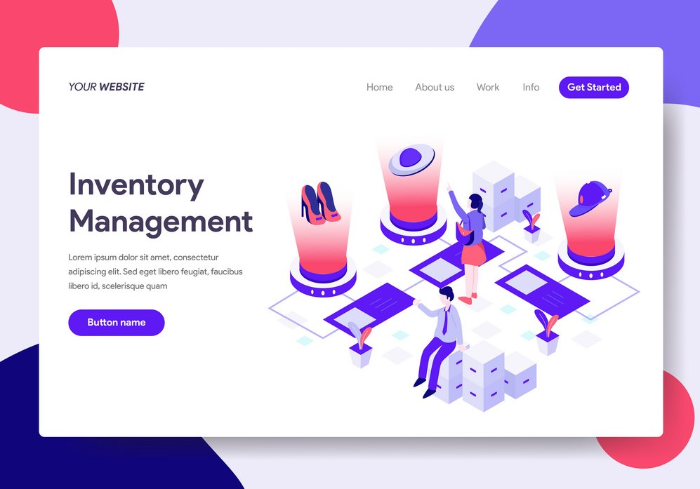

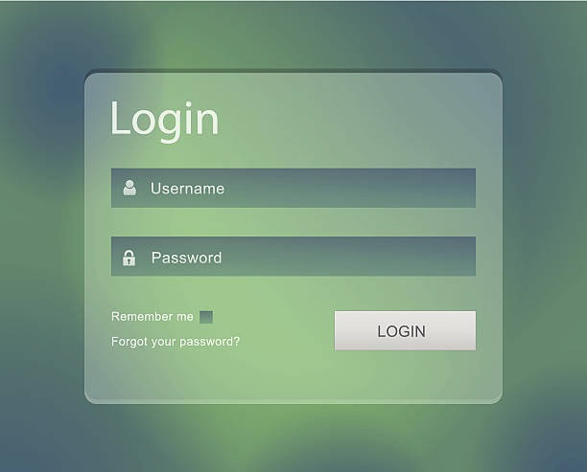
Interactive Achievements’ Inventory with AI-based Staff Assistant and Résumé Builder
Aarohi Rathore,Aieshah Nasir,Abhishek Rawat
Introduction
Objectives
Outcome
Conclusion
Professors across colleges need to collect certificates and other data at the end of every semester to keep students’ details and achievements updated in the college records and for internal evaluation. This is a time-consuming and tedious task. Students are bound to misplace their certificates or fail to submit them on the scheduled time. Traditionally this process is done with the word-of-mouth accompanied by submission of hard copies. However, in recent years, this task has been facilitated by the usage of technology like Google Forms, monday WorkForms, Google Classroom, Microsoft Forms etc where students can upload their documents. Although these solutions are appealing to the general public, access to them is unrestricted & insecure. Thus, we intend to develop a secure web application for data collection of students to ensure on-demand availability of their achievements to the concerned staff
To design & develop a web-based software solution for data collection from students
To build an engaging and interactive website for securely storing personal information & achievements and perform data analytics for visualization
To present collected data, sorted as per the categories specified, to the concerned staff
To ensure on-demand availability of & ease-of-accessibility to students’ academic and extra - curricular achievements
To provide an inventory for students to store their certificates digitally
To provide the professors with analytics of students’ data in the form of interactive graphs and plots
To help students build a resume using the data uploaded by them
No specific system exists for the described problem statement and the proposed system is unique in its essence because on the proposed platform the students can simultaneously generate resume with their uploaded data, add them to their LinkedIn profile and the concerned staff can analyze the collected data as per the required categories, generate reports of students skilled in the specified domain, and generate posts on LinkedIn on-the-go.
This project will be the best platform for student and mentor interaction. The resume-builder functionality is easy and efficient for quickly building their resume. Students can upload their respective data accordingly. It will easily find out which kind of job domain is well-suited to their profile and report to the faculty on priority based on their skills.
Reference
[1] “Google Classroom” Available at: [https://en.wikipedia.org/wiki/Google_Classroom]
[2] Sun H-L, Sun T, Sha F-Y, Gu X-Y, Hou X-R, Zhu F-Y and Fang P-T (2022) The Influence of Teacher–Student Interaction on the Effects of Online Learning: Based on a Serial Mediating Model. Front. Psychol. 13:779217. doi: 10.3389/fpsyg.2022.779217
[3] Wang L (2022) Student Intrinsic Motivation for Online Creative Idea Generation: Mediating Effects of Student Online Learning Engagement and Moderating Effects of Teacher Emotional Support. Front. Psychol. 13:954216. doi: 10.3389/fpsyg.2022.954216
[4]Sen, Kristen. “Importance of teacher-student interaction” Reference: [https://www.primescholarslibrary.org/articles/importance-of-teacherstudent-interaction-72269.html].
[5]"RESUME BUILDER APPLICATION", International Journal of Emerging Technologies and Innovative Research (www.jetir.org | UGC and issn Approved), ISSN:2349-5162, Vol.8, Issue 3, page no. pp18-20, March-2021, Available at : http://www.jetir.org/papers/JETIREN06004.pdf
Methods
We will use some tools in order to store the user data and also to perform some operations on them.some of them are commonly used nowadays and have a huge community.
Students will upload their achievements and all of their data will be automatically stored in our AWS(S3), because we are using AWS so we have a large amount of storage capacity as well as the database will always be active.
Now when students want to make their Resume and they want their stored information so this will be done through Flask (a Python framework). After using Flask, the student's data will be fetched from the AWS database and he can choose which achievement to add in his resume.
When a student decides finally which data is to be added to a resume, he just gives that information to the AI and then the AI will automatically build the resume according to the information given by the student.
When a student uploads his achievement then its achievement automatically will be posted in LinkedIn by college/Institute and this all will be done through Apache Airflow
All the students will be able to store all of their important data and information into a secured place and they can extract them whenever they want to use them. Students now don’t have to spend a lot of time building a resume from scratch and now they can just fill in their information , useful skills and achievements and that's it their resume will be ready just after they fill all these requirements this will save their time. Teachers can now easily find out by themselves how many students have done a particular task and how to identify the correct percentage and amount of students who actually did a particular task. According to the information of students, teachers can easily classify students in a particular company according to their interests and then they can just allow those students for placement in a particular company.Not only students but any working person can also use this application as it is useful for every section of society either student, teacher or any working professional.
Technologies Used
Python
Flask
PostgreSQL
HTML
CSS
React
Javascript
AWS S3
Contact
Aarohi Rathore 9926631729
Abhishek Rawat 99816 55308
Aieshah Nasir 89899 41066

