Slide 1

IoT Workshop
Day 2: Data Storage and Dashboard
Suparerk Manitpornsut
Department of Computer Engineering
UTCC

Slide 2
Topics
Introduction
Fundamentals of Database Systems
ESP8266 and MySQL
Simple Web Application
Simple Dashboard
Beyond the Basic

Slide 3
Introduction

Slide 4
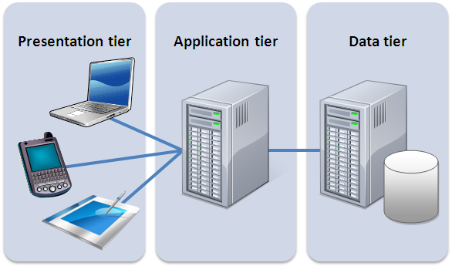
Introduction
Three-Tier Application

Slide 5
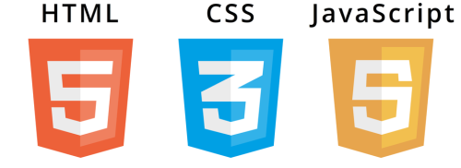


Today Sample:
Presentation
Application
Data

Slide 6
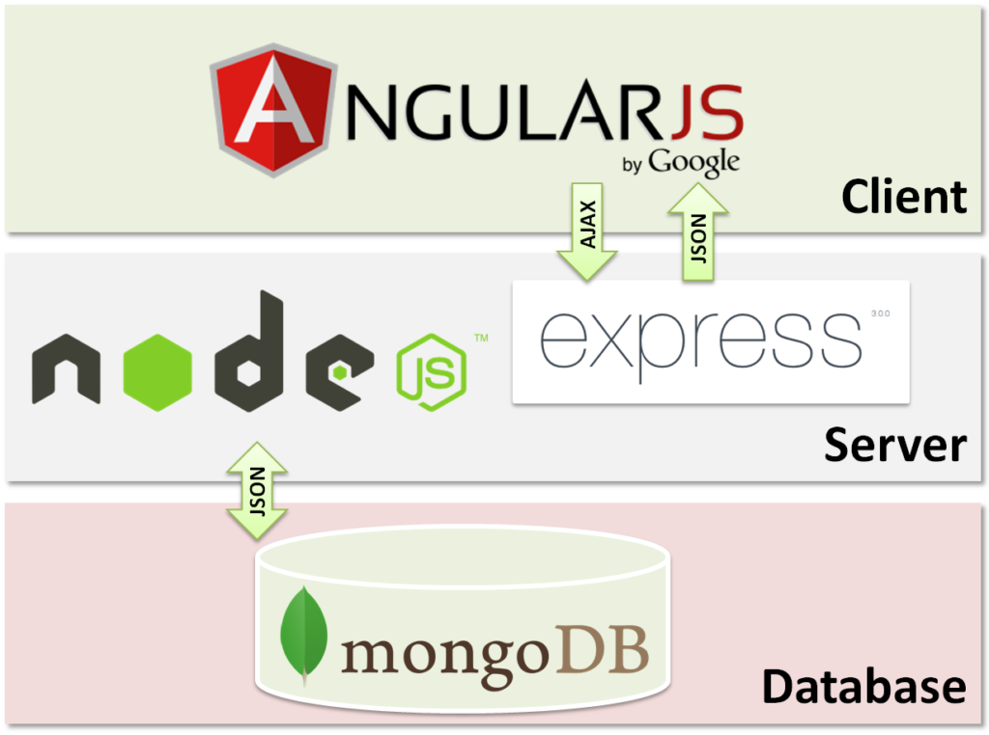
Modern Sample: MEAN Stack
Presentation
Application
Data

Slide 7
Fundamentals of Database Systems

Slide 8
Fundamentals of Database Systems
A database (DB) is a collection of data that lives for a long time. Many systems fit this definition, for example, a paper-based file system, a notebook, or even a string with knobs for counting.
A Database Management System (DBMS) is a system (software) that provides an interface to database for information storage and retrieval.
From https://en.wikibooks.org

Slide 9
RDBMS
RDBMS is the majority of DBMS in the market.
A relational database management system (RDBMS) is a database management system (DBMS) that is based on the relational model. (from tutorialspoint.com)
Entity
Relationship

Slide 10
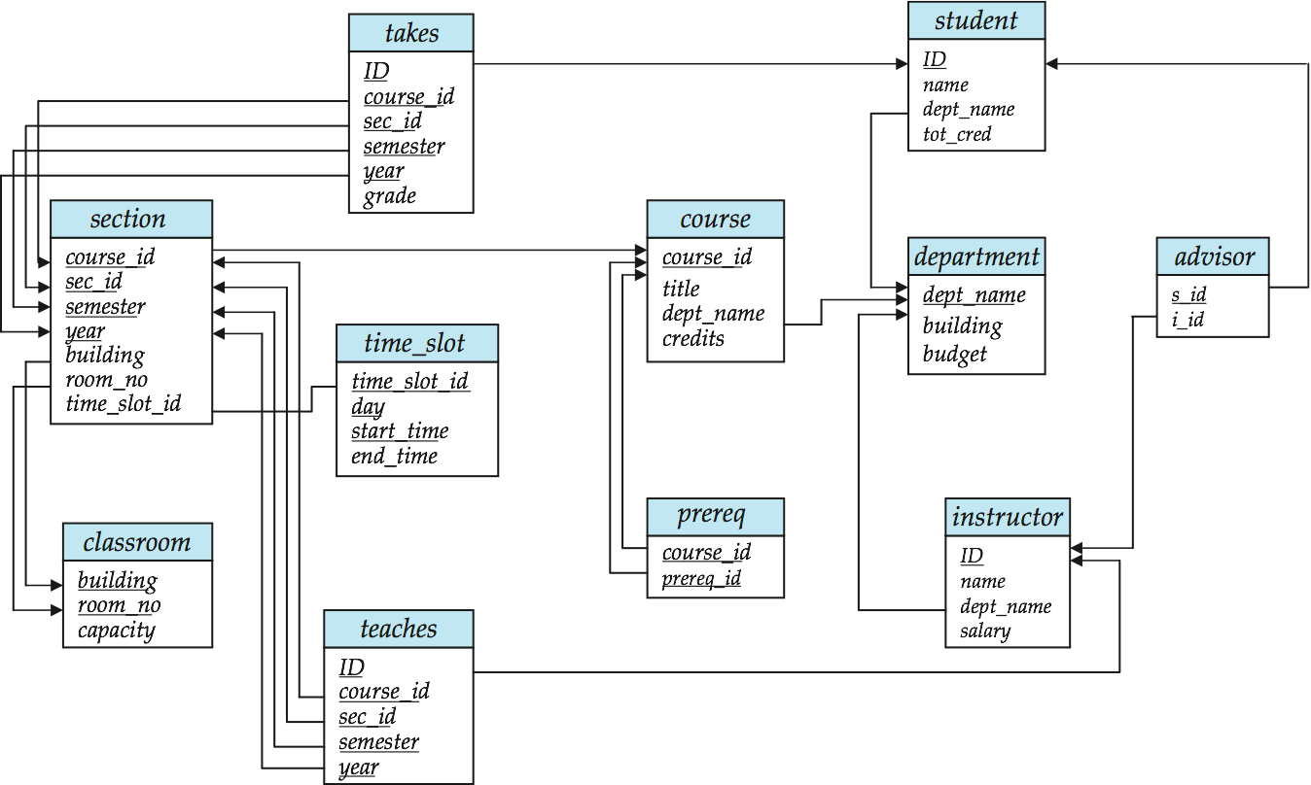
Sample: Entity – Relationship

Slide 11
RDBMS: Sample
Open-Source:
MariaDB
MySQL
Proprietaries:
Oracle Database
IBM DB2
MS SQL Server

Slide 12
RDBMS: SQL Commands
Basic operations: Create/Retrieve/Update/Delete (CRUD).
Create: e.g.
insert into my_data values (null,1,25,80,null);
Retrieve: e.g.
select temperature from my_data;
Update: e.g.
update my_data set humidity = 85 where id = 1;
Delete: e.g.
delete my_data where id = 2;

Slide 13
NoSQL
NoSQL (originally referring to “non SQL” or “non relational”) database provides a mechanism for storage and retrieval of data that is modeled in means other than the tabular relations used in relational databases.
NoSQL systems are also sometimes called “Not only SQL”.
May support SQL-like query languages, or sit alongside SQL database
From https://en.wikipedia.org/wiki/NoSQL

Slide 14


NoSQL: Samples
MongDB
Elasticsearch

Slide 15
Workshop #1: Database Preparation

Slide 16
ESP8266 & MySQL

Slide 17
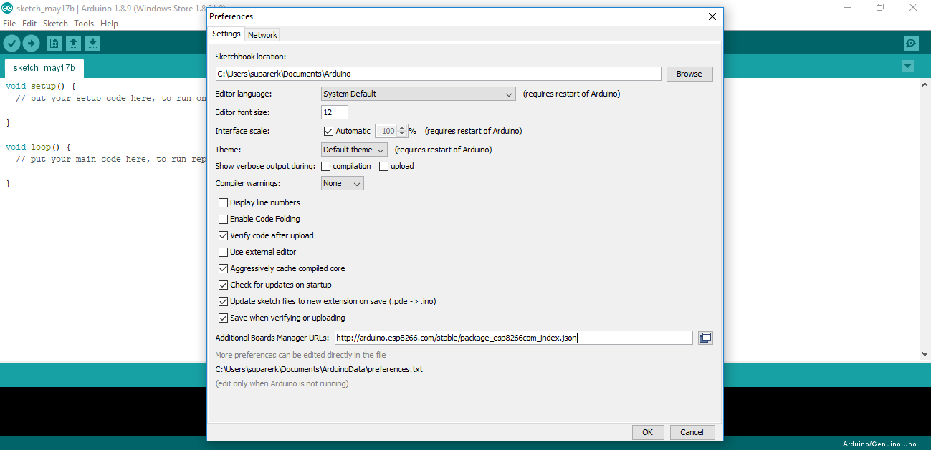
Adding ESP8266 Board

Slide 18
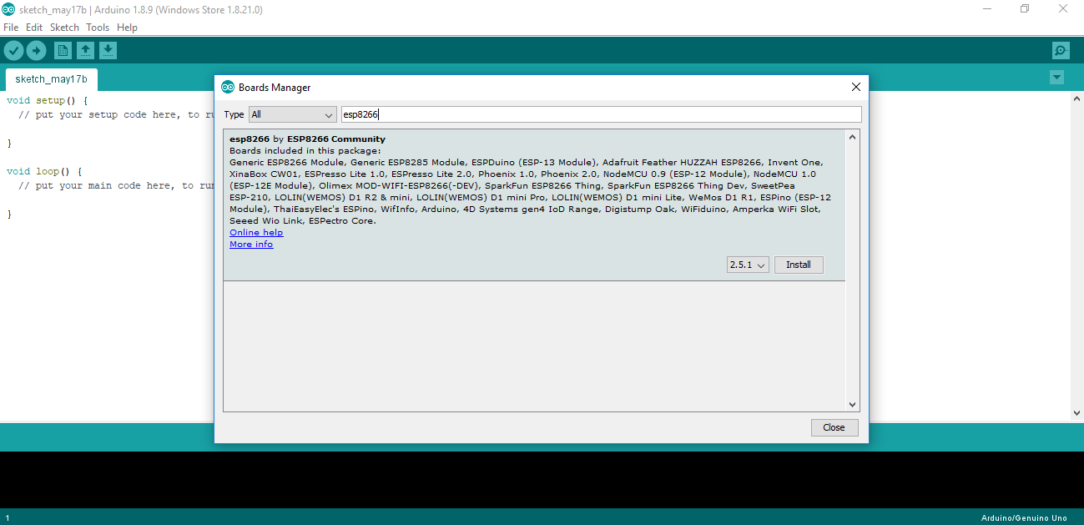

Slide 19
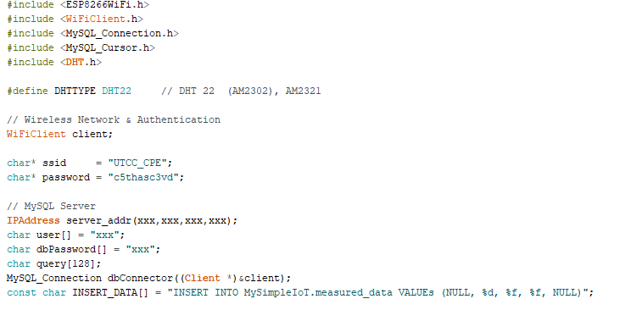
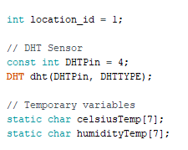
Preprocessing & Global Variables

Slide 20
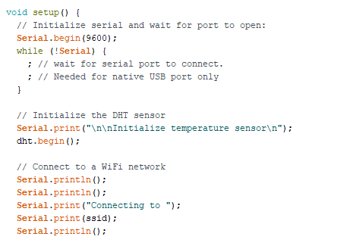
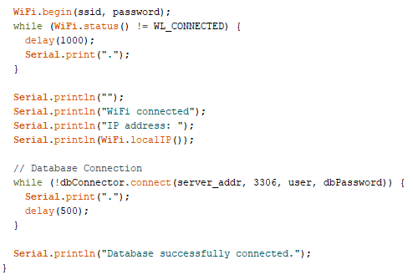
setup

Slide 21
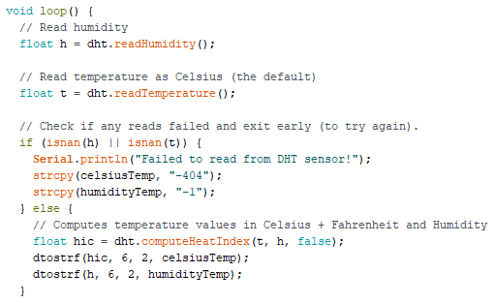
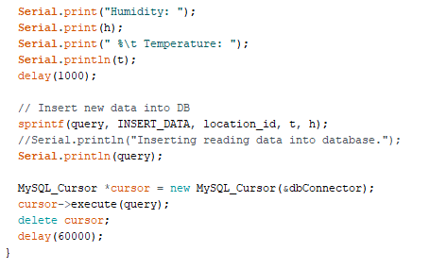
loop

Slide 22
Workshop #2: ESP8266 & MySQL

Slide 23
Simple Web Application

Slide 24
Simple Web Application
XAMPP:
A: Apache Web Server
M: MySQL Database Server
P: PHP Engine
P: phpMyAdmin
Web Root: e.g. C:\xampp\htdocs

Slide 25
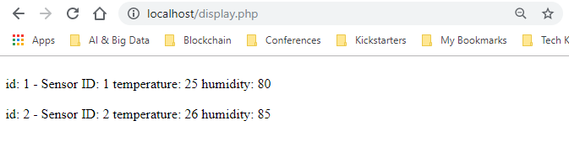
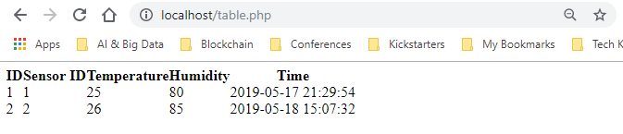
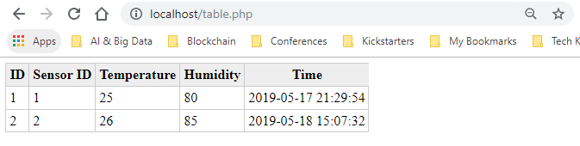
Possible Output
Simple Text
Simple Table
Table with CSS

Slide 26
Workshop #3: Simple Web Application

Slide 27
Simple Dashboard

Slide 28
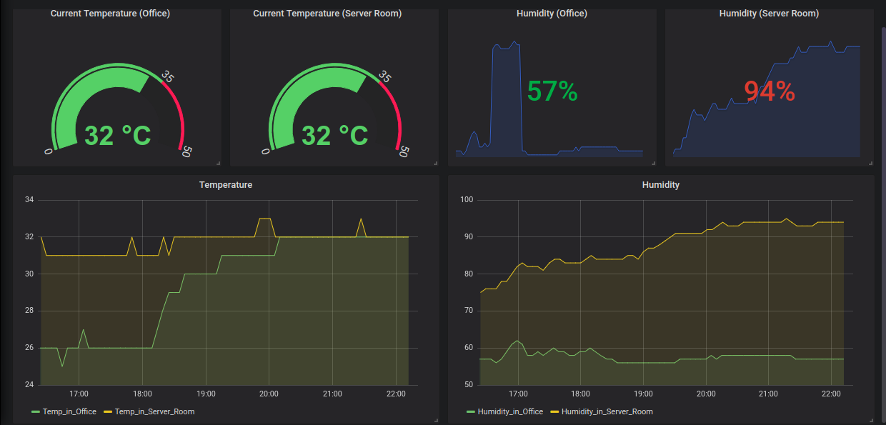
Simple Dashboard

Slide 29
Possible Tools
Possible Tools:
Tableau
Oracle DV
MS Power BI
Kibana
Grafana
Etc.

Slide 30
Workshop #4: Simple Dashboard

Slide 31
Beyond the Basic

Slide 32
Advanced Topics
Protocols:
Message Queue: e.g. MQTT.
Routing: e.g. AODV.
Data Streaming:
Apache Storm/Kafka
Apache Nifi
Big Data Integration & Analytics:
Apache Spark

