Slide 1
Question Answering System
: JARDIS
WEEK 6
8th Aug, 2017

Slide 2
Previously
Training
Implementation
 | week1 | week2 | week3 | week4 | week5 | week6 | week7 | week8
Word embedding
Sequence embedding
Question Answering
Memory Network
Goal setting
Dataset
Implementation

Slide 3
Previously
Training
Implementation
 | week1 | week2 | week3 | week4 | week5 | week6 | week7 | week8
Word embedding
Sequence embedding
Question Answering
Memory Network
Goal setting
Dataset
Implementation
Background research & Problem Setup

Slide 4


Previously
“What is the baseline?”
“Check the baseline score and just start implementation.”

Slide 5
Outline
Fix the dataset: SQuAD
Check the “Baseline” and “Human Performance” scores
Check the current leaderboard
Select and run the working algorithm: BiDAF
Future work

Slide 6

SQuAD
A pair of passage and question is given
: Answer is found inside the given passage.

Slide 7
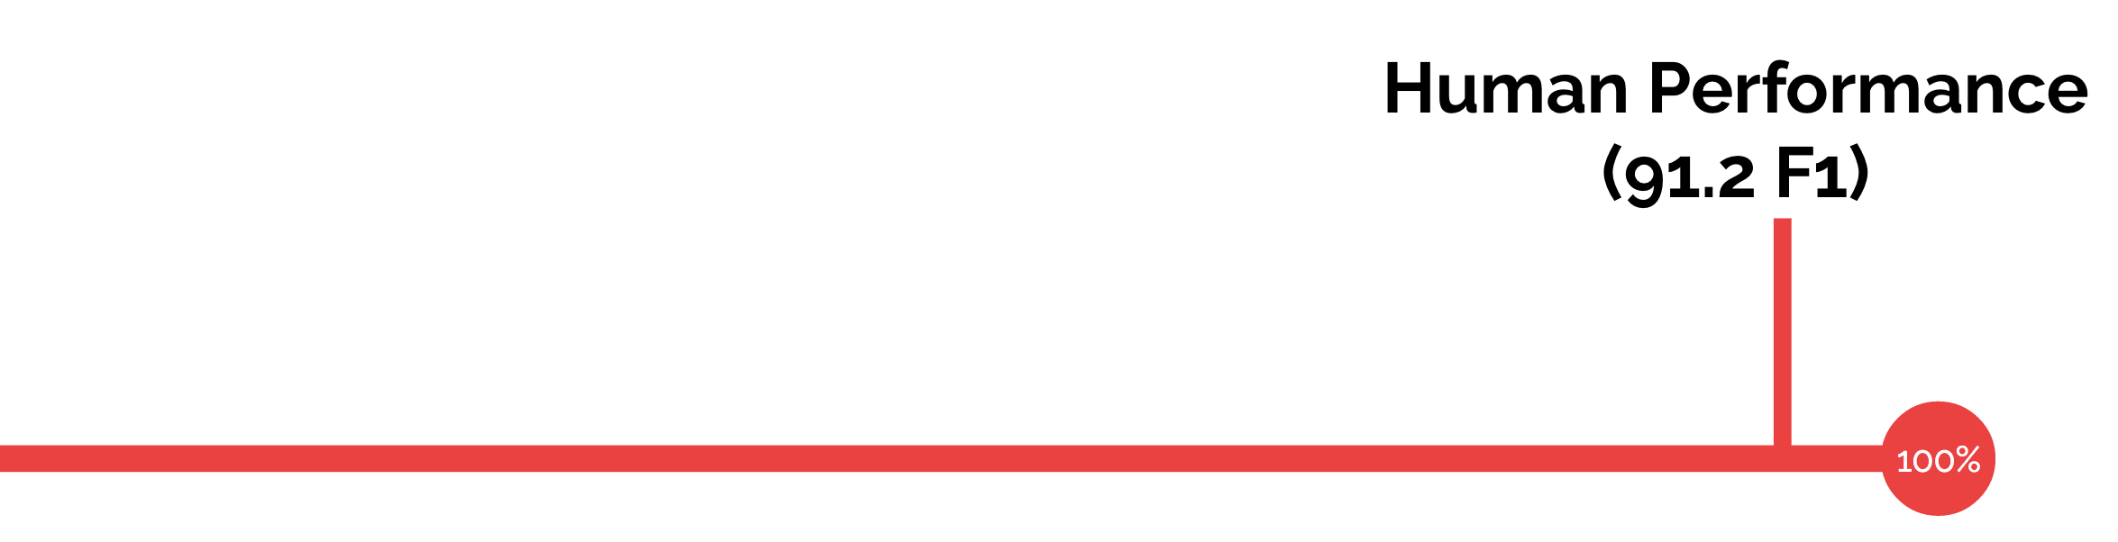
SQuAD
Metric
EM: Exact Match
F1: Average overlap between prediction and ground truth

Slide 8
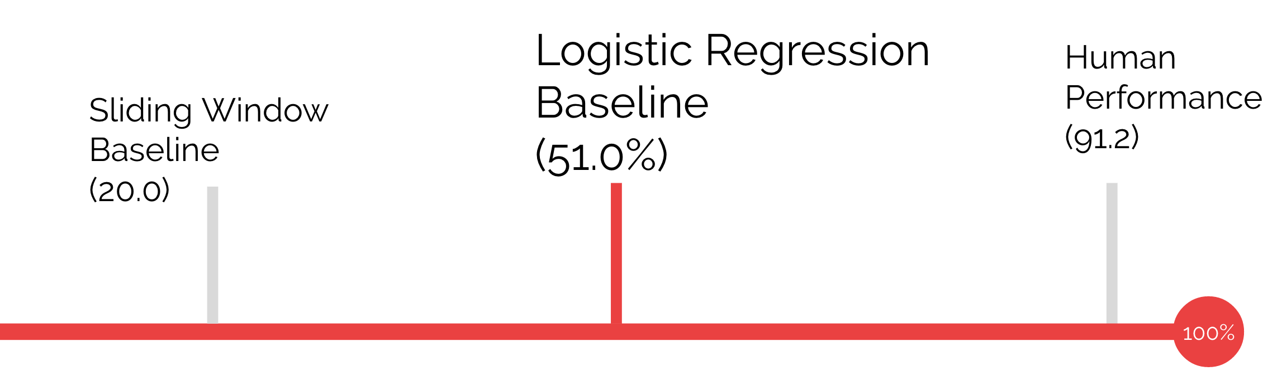
SQuAD
Metric
EM: Exact Match
F1: Average overlap between prediction and ground truth

Slide 9
Outline
Fix the dataset: SQuAD
Check the “Baseline” and “Human Performance” scores
Check the current leaderboard
Select and run the working algorithm: BiDAF
Future work

Slide 10
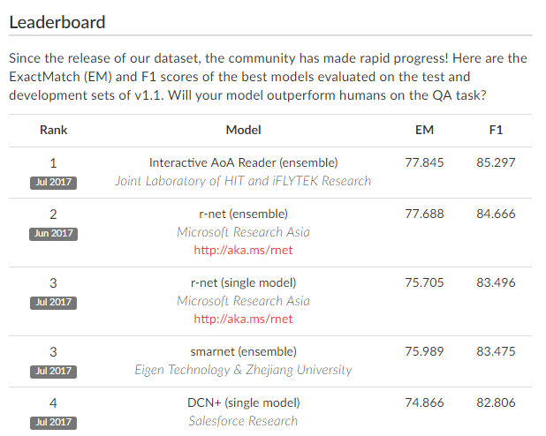
SQuAD

Slide 11

BiDAF
Bi-Directional Attention Flow
for Machine Comprehension

Slide 12
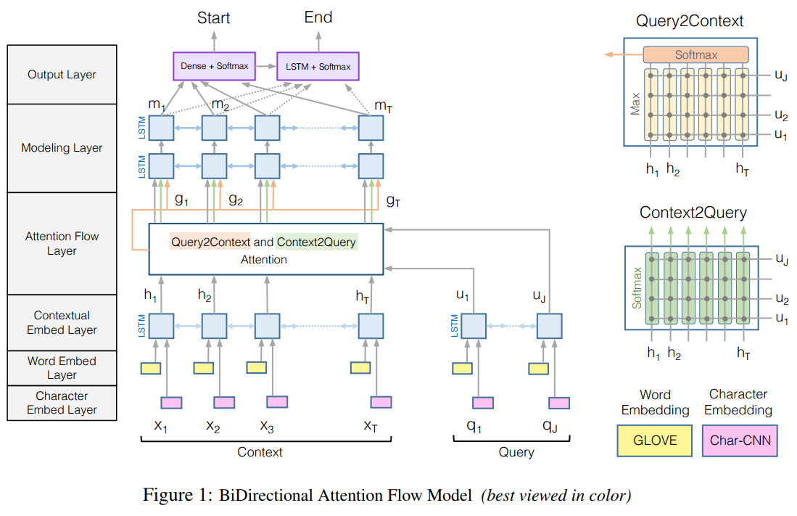
BiDAF
Bi-Directional Attention Flow
for Machine Comprehension

Slide 13


BiDAF
Bi-Directional Attention Flow
for Machine Comprehension
$$↑H∈ℝ^{2d×T}$$
$$↑U∈ℝ^{2d×J}$$
Embedding layers

Slide 14

BiDAF
Bi-Directional Attention Flow
for Machine Comprehension
$↑G=β(H_{:t},\tilde{U_{:t}}$, $\tilde{H_{:t}})$
Bi-Directional
Attention

Slide 15

BiDAF
Bi-Directional Attention Flow
for Machine Comprehension
$$↑M∈ℝ^{2d×T}$$

Slide 16
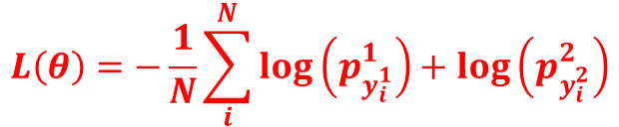
BiDAF
Bi-Directional Attention Flow
for Machine Comprehension
$$L\left(θ\right)=−\frac{1}{N}\sum_{i}^{N}{\log\left(p_{y_{i}^{1}}^{1}\right)+\log\left(p_{y_{i}^{2}}^{2}\right)}$$

Slide 17


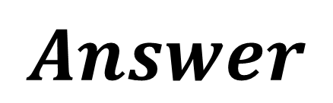
BiDAF
Bi-Directional Attention Flow
for Machine Comprehension
BiDAF
$$Answer$$
$$\left\{P,Q\right\}:A?$$

Slide 18
BiDAF
Bi-Directional Attention Flow
for Machine Comprehension
BiDAF
$$Answer$$
Now we know how to tackle this problem given {P, Q}
$$\left\{P,Q\right\}:A?$$

Slide 19
BiDAF
Bi-Directional Attention Flow
for Machine Comprehension
BiDAF
$$Answer$$
Now we know how to tackle this problem given {P, Q}
BUT there are bunch of others which already do better.
(Remember that BiDAF is only rank 9th in the current leaderboard!)
$$\left\{P,Q\right\}:A?$$

Slide 20
BiDAF
Bi-Directional Attention Flow
for Machine Comprehension
BiDAF
$$Answer$$
LET’S SOLVE DIFFERENT PROBLEM
BY SLIGHTLY TWEAKING THE ORIGINAL ONE!
Now we know how to tackle this problem given {P, Q}
BUT there are bunch of others which does better.
(Remember that BiDAF is only rank 9th in the current leaderboard!)
$$\left\{P,Q\right\}:A?$$

Slide 21


BiDAF $+ α$
Bi-Directional Attention Flow
for Machine Comprehension
BiDAF
$$Answer$$
?
What if we have a question without passage?
$$\left\{P,Q\right\}:A?$$

Slide 22
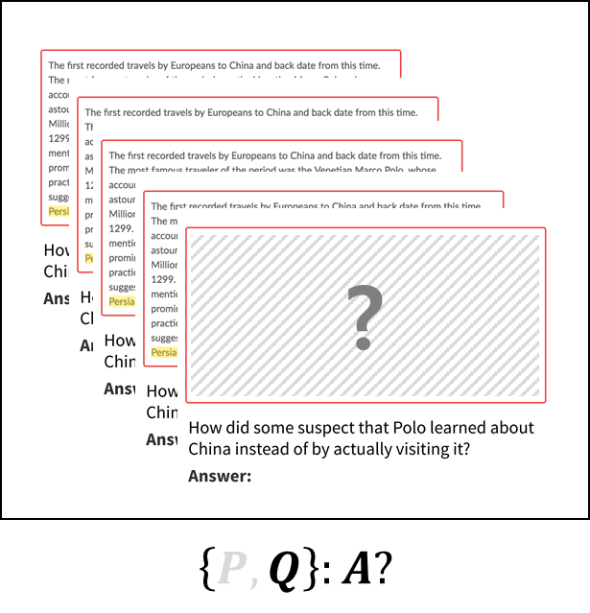
BiDAF $+ α$
Bi-Directional Attention Flow
for Machine Comprehension
BiDAF
$$Answer$$

Slide 23

BiDAF $+ α$
Bi-Directional Attention Flow
for Machine Comprehension
BiDAF
$$Answer$$
Parse $Q$and find its keyword

Slide 24
BiDAF $+ α$
Bi-Directional Attention Flow
for Machine Comprehension
BiDAF
$$Answer$$
Parse $Q$and find its keyword
Search Wiki &
Crawl the abstract passage

Slide 25


BiDAF $+ α$
Bi-Directional Attention Flow
for Machine Comprehension
BiDAF
$$Answer$$
Parse $Q$and find its keyword
Search Wiki &
Crawl the abstract passage
$$P′$$

Slide 26

BiDAF $+ α$
Bi-Directional Attention Flow
for Machine Comprehension
BiDAF
$$Answer$$
$$\left\{P′,Q\right\}$$
Parse $Q$and find its keyword
Search Wiki &
Crawl the abstract passage
$$P′$$

Slide 27
Five Advantages
Define a new problem

Slide 28

Five Advantages
Define a new problem
Do not have to compete with the existing tasks! $+ α$ !

Slide 29

Five Advantages
Define a new problem
Do not have to compete with the existing tasks! $+ α$ !
Creativity $+ α$ !

Slide 30

Five Advantages
Define a new problem
Do not have to compete with the existing tasks! $+ α$ !
Creativity $+ α$ !
Plug & Play $+ α$ !

Slide 31
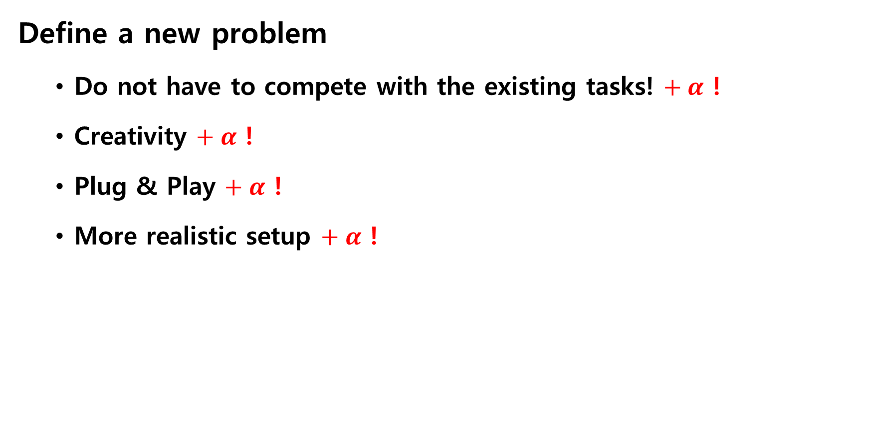
Five Advantages
Define a new problem
Do not have to compete with the existing tasks! $+ α$ !
Creativity $+ α$ !
Plug & Play $+ α$ !
More realistic setup $+ α$ !

Slide 32
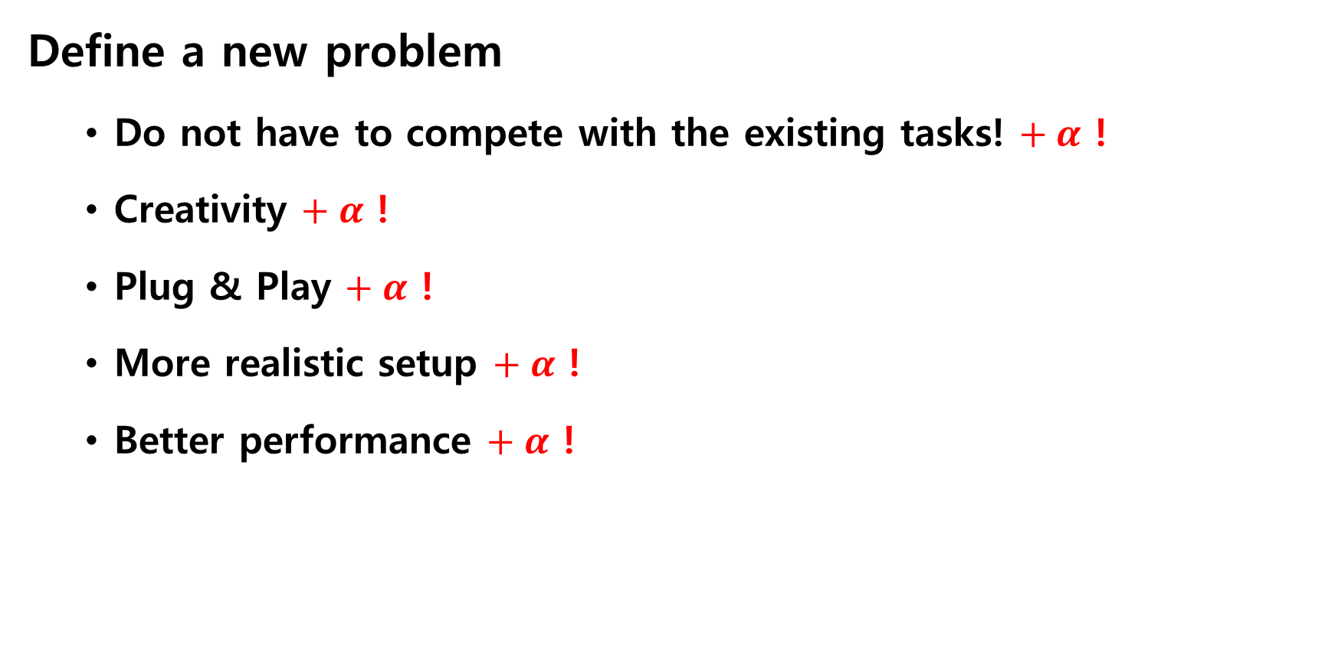
Five Advantages
Define a new problem
Do not have to compete with the existing tasks! $+ α$ !
Creativity $+ α$ !
Plug & Play $+ α$ !
More realistic setup $+ α$ !
Better performance $+ α$ !

