Slide 1
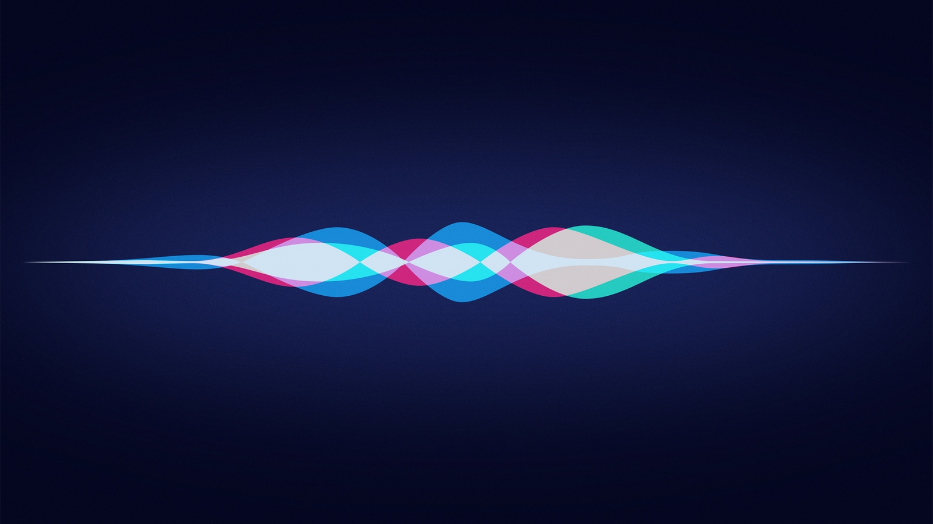
Question Answering System: JARDIS
Week3

Slide 2

Prerequisites for QA system
Basics of neural network
Word embedding
Sequence embedding
Question answering system
Set the goal
Understand the dataset
Start implementation!

Slide 3
Schedule
Training
Implementation
 | week1 | week2 | week3 | week4 | week5 | week6 | week7 | week8
Word embedding
Sequence embedding
Question Answering
Goal setting
Dataset
Implementation

Slide 4
Contents
Word embedding
Sequence embedding
Question Answering
Goal setting
Dataset
QA Implementation
Word2vec: Skip-gram, CBOW, GloVe
RNN, GRU, LSTM, seq2seq
Baseline(GRU,LSTM,seq2seq), end to end memory network, subgraph embedding, dynamic memory network
On going
Not Yet
Not Yet

Slide 5
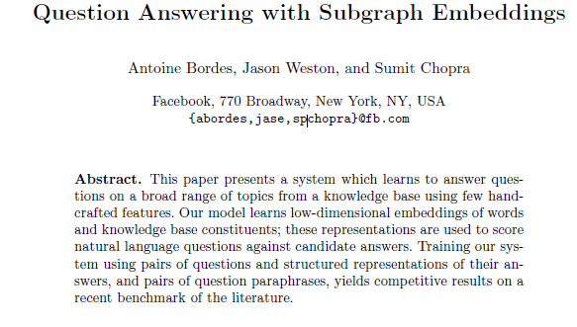
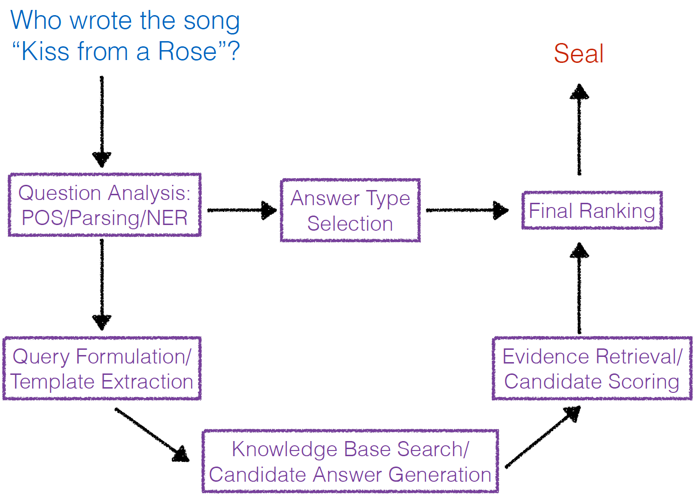
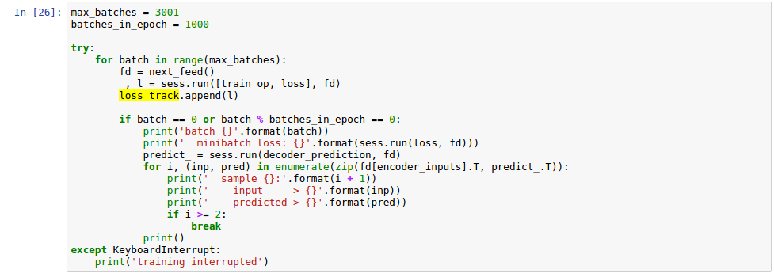
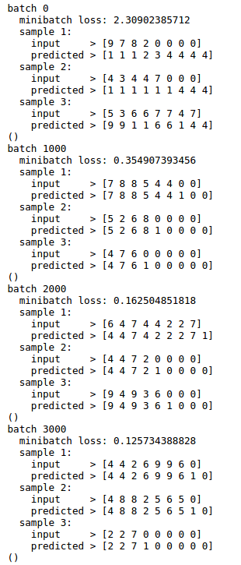
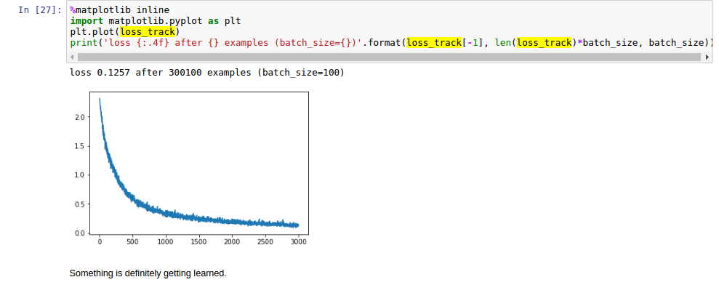
Contents: week3
Study 1 paper, 1 video lecture
Deep learning for question answering
Code level implementation: seq2seq, word2vec optimization

Slide 6
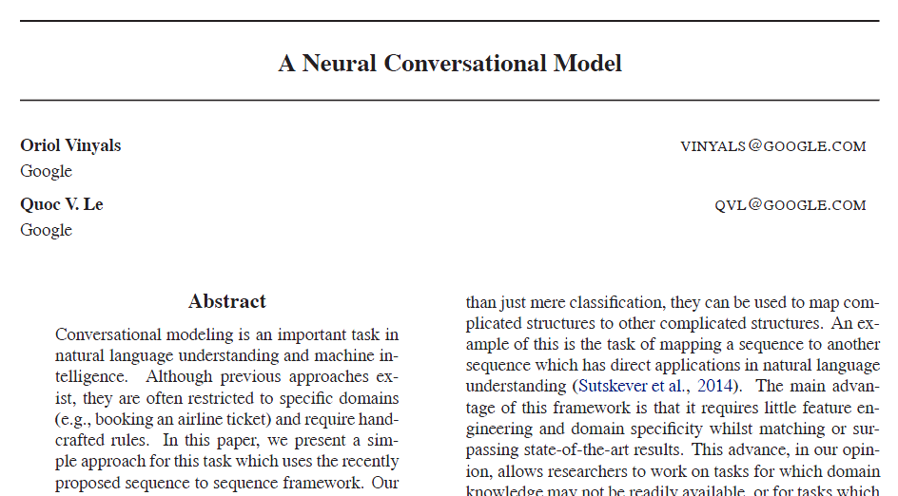
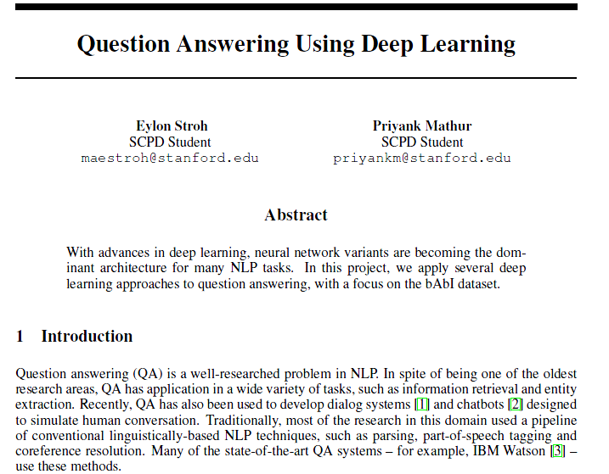
Plan: week4 ?
Study basic QA systems
Consolidate ideas for QA system
Find and get to know about proper datasets
Try basic QA systems on code level

Slide 7
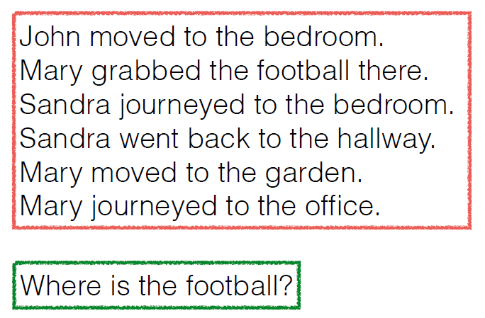
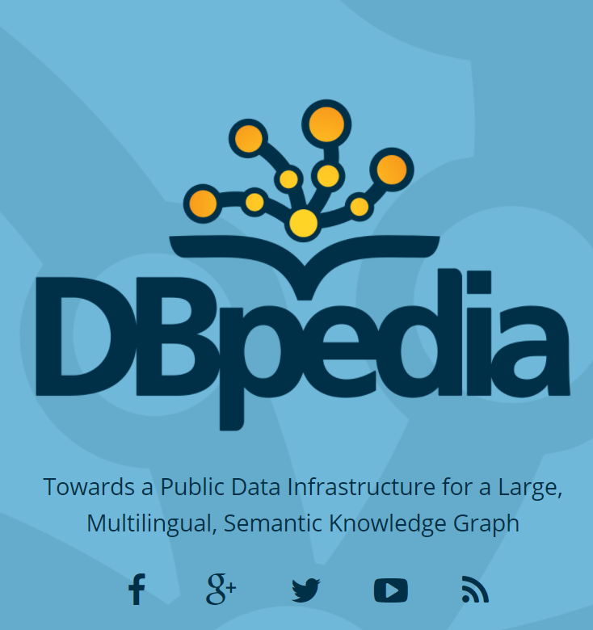
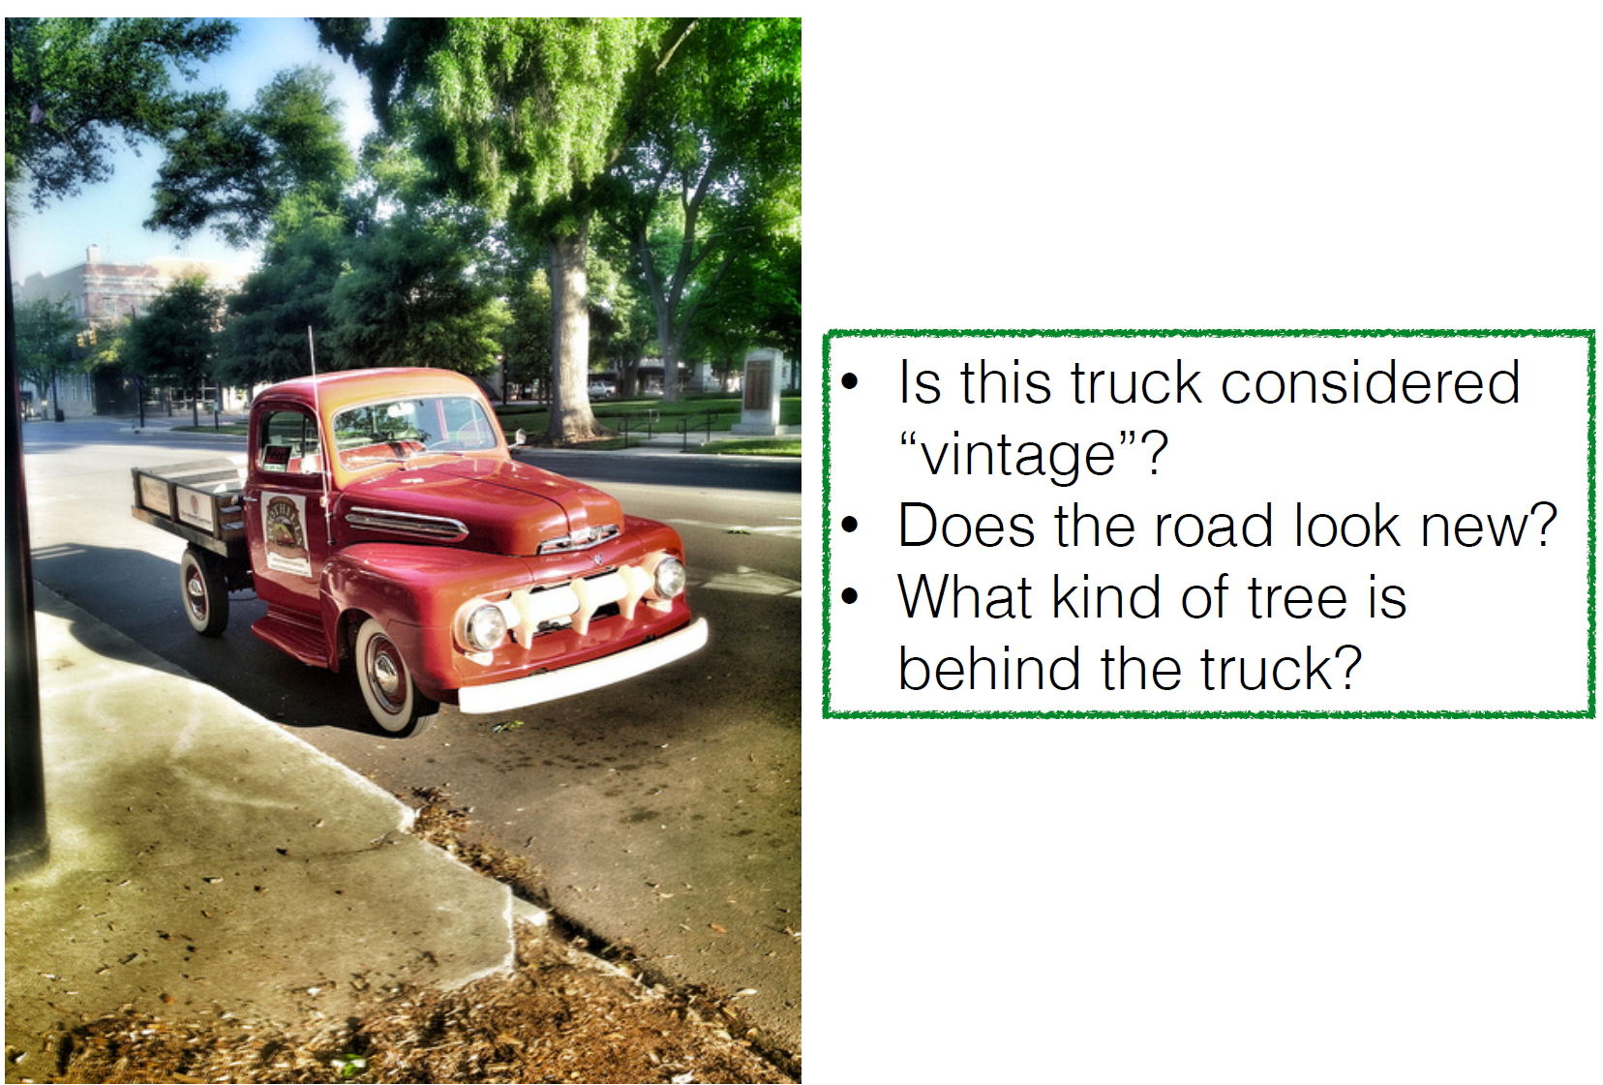
Brainstorming
What is the name of Barack Obama’s wife?
When did the Great Depression happen?
Story
Answer
Knowledge Base
Answer
Image
Answer
Question
Question
Question
Closed QA problems
Open QA problems
Visual QA problems

Slide 8
Thank you

