Slide 1
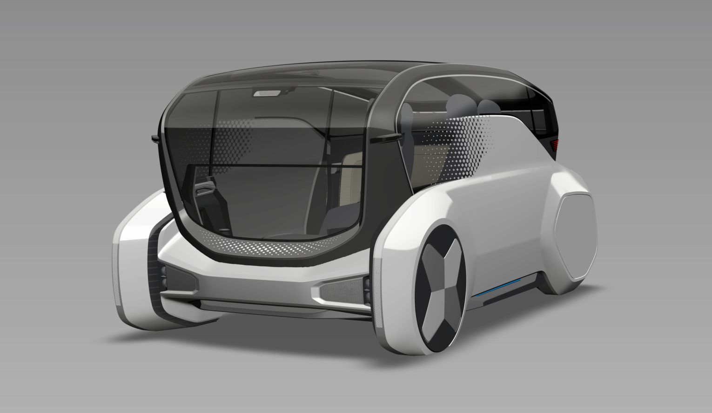
Concept FQ
Roof lighting guide (LED)
Side Communication Lighting
(RGB LED)
Front Communication (LED)
Mood light (LED)
Head lamp (LED low/High)
Mood light (LED)

Slide 2
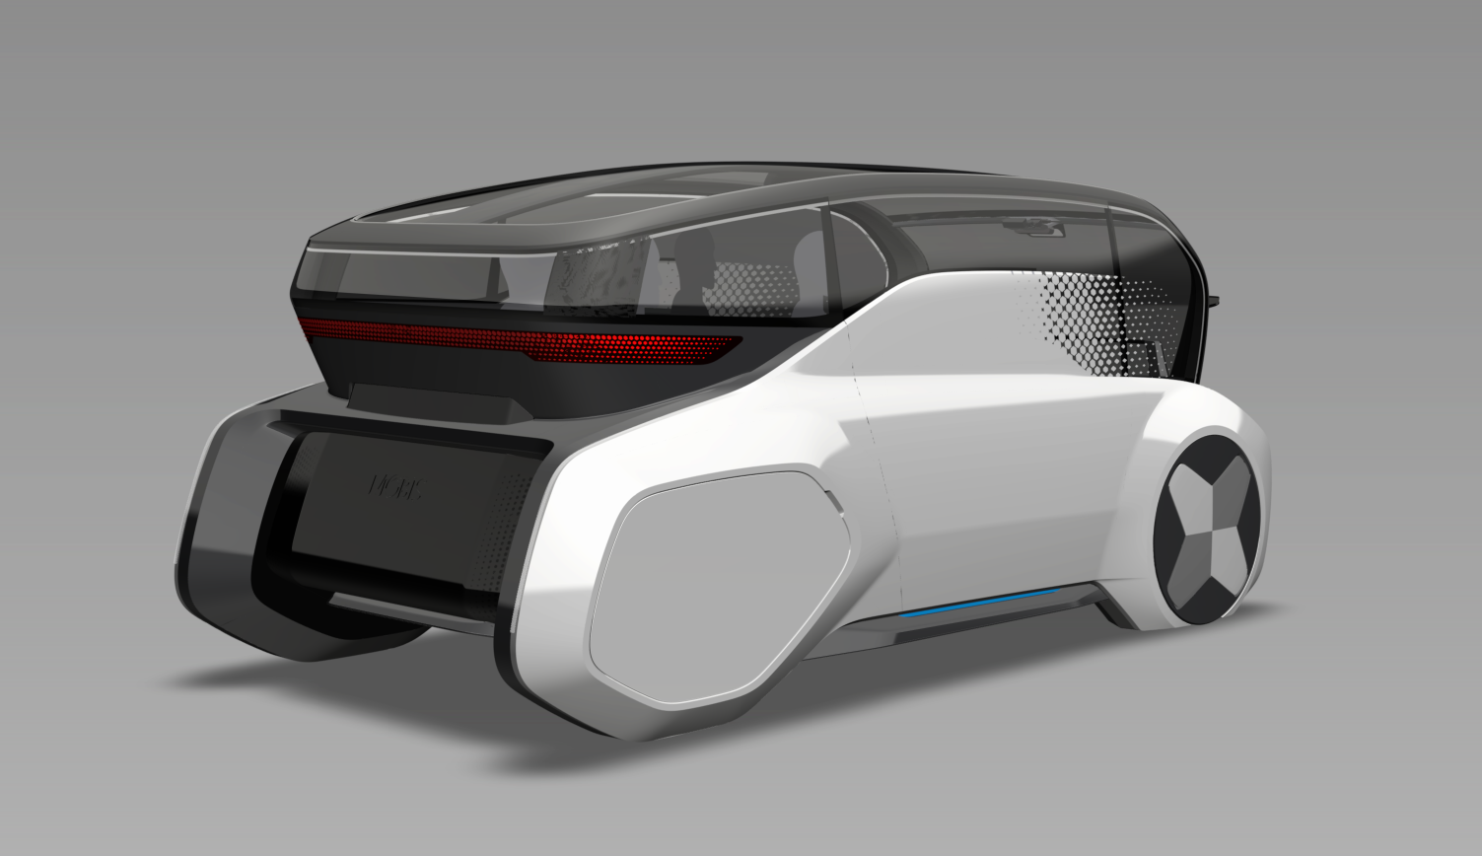
Concept RQ
Roof lighting guide (LED)
Rear Communication Lamp (Lenticular)
Battery Indicator (LED)
Mood light (LED)

