Slide 1
Principles of AI Engineering Chapter 1: Introduction
Prof. Dr. Steffen Herbold
Credit:
Based on contents from Christian Kästner (https://github.com/ckaestne/seai)

Slide 2
Contents
Why is AI Engineering Important? A small case study.
Skills required for AI Engineering
What makes software with ML challenging?

Slide 3
Why is AI Engineering important?
A small case study
Notes:
(8 min)

Slide 4

Case study
Take audio or video files and produce text
Used by academics to analyze interview text
For podcast show notes
Generation of subtitles for videos
State of the art: Manual transcription, often mechanical turk
https://gotranscript.com/

Slide 5
Idea: Let‘s use AI!
Deep Neural Network (DNN) trained on publicly available and transcribed interviews
For example, from a public news channel
Use transfer learning to support domain-specific terminology
Requires smaller corpus from the domain (e.g., medicine, engineering, etc.)
Research shows that this works really well!
→ Let‘s commercialize this and sell this as a tool called transcrAIbe

Slide 6
Live exercise: Challenges for creating transcrAIbe
One challenge for …
… the machine learning
… the engineering for building the product
… operating and updating the product
… for the team and the management
… the business side
… safety and ethics
Without this slide, how many of these aspects would you have considered?!

Slide 7
Possible components of transcrAIbe
System: transcrAIbe
User Interface
User Accounts
Audio Upload
Payment
Speech Recognition
Database
Cloud Processing
Logging
Monitoring
Only one AI component!

Slide 8
A closer look at ML part of the components
End-User Interface
Internal Data Labeling Interface
telemetry
data collection
User Accounts
Audio Upload
Feature Server
share
Model Inference:
Speech Recognition
learns &
deploys
observes
Payment
Training Data
ML Pipeline
Model Monitoring
uses
triggers
scales by
observes
Database
Cloud Processing
Logging
Monitoring

Slide 9
Terminology
No standard term for referring to building systems with AI components
ML-enabled systems
Production systems with ML components
AI-enabled systems
ML-infused systems
Software engineering for AI (SE4AI)
Software engineering for ML (SE4ML)
AI Engineering
Related terms
MLOps: technical infrastructure for automating ML pipelines
ML systems engineering: building distributed, scalable ML and data storage platforms
My personal favorites

Slide 10
Skills required for AI Engineering
Notes:
(8 min)

Slide 11
Data Scientists vs. Software Engineers
Data Scientist
Software Engineer
Often fixed datasets for training and testing
Focused on accuracy
Expert in data modelling and feature engineering
Code often prototypical and hacky (e.g., Jupyter Notebook)
Model size, updateability, implementation stability usually ignored
Builds a product
Concerned about cost, performance, stability, release time
Measures quality through user satisfaction
Detects and handles mistakes
Maintains, evolves, and extends product
Considers non-functional requirements such as security and fairness

Slide 12
Different focus
End-User Interface
Internal Data Labeling Interface
telemetry
data collection
User Accounts
Audio Upload
Feature Server
share
Model Inference:
Speech Recognition
Legend
Software Engineering Focus
learns &
deploys
Data Science Focus
observes
Payment
Training Data
ML Pipeline
Model Monitoring
uses
triggers
scales by
observes
Database
Cloud Processing
Logging
Monitoring

Slide 13
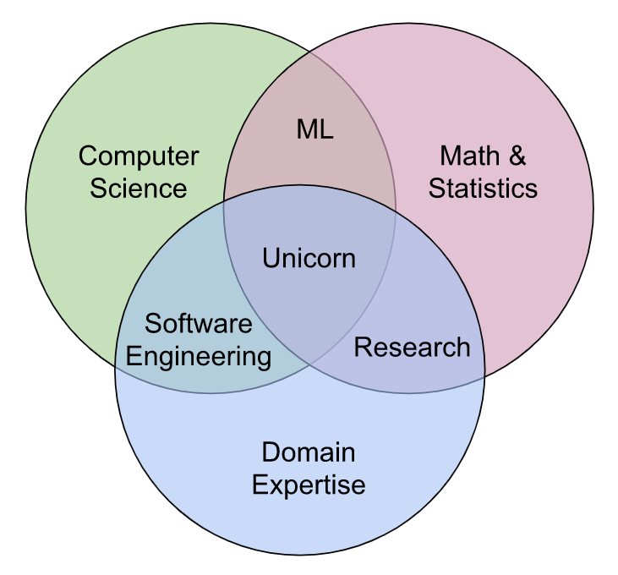
Extremely rare skillset required!
By Steven Geringer, via Ryan Orban. Bridging the Gap Between Data Science & Engineer: Building High-Performance Teams. 2016

Slide 14
T-shaped people
I-shaped
Generalist
T-shaped
Expert at one thing
Capable of a lot of things but not expert in any
Capable of a lot of things and expert in one of them

Slide 15
Example of T-shaped skill set
T-shaped
Basic skills in software engineering, distributed computing, and communication
Expert in deep neural networks for computer vision (technique expertise) and their use in the automotive domain (domain expertise)

Slide 16
What makes software with ML challenging?
Notes:
(8 min)

Slide 17
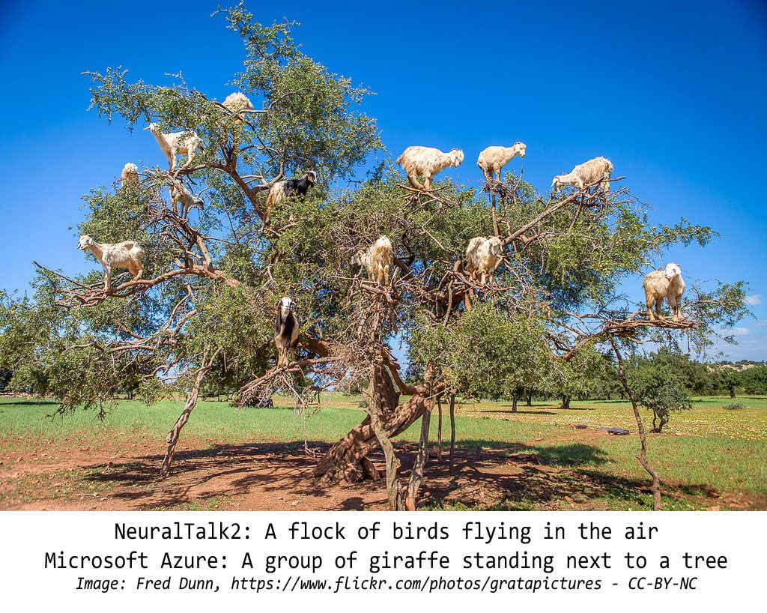
ML models make mistakes

Slide 18
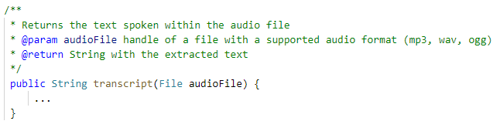
Usually no clear specification that can be tested
How would you write a software test for the correctness this function!?

Slide 19





Scaling and Concept Drift
“Normal” up-scaling of applications, e.g., through load balancing
→ Common SE problem
More Users
Better Product
More Data
How can this data be used to detect when the model must/should be updated?
→ Requires SE and ML considerations
Same model with new training data? New Model? How to ensure quality?
→ Requires SE and ML considerations
Better Models

Slide 20


Interactions with the Environment
System: transcrAIbe
User Interface
User Accounts
Audio Upload
Payment
Speech Recognition
Environment
Database
Cloud Processing
Logging
Monitoring

Slide 21
Not everything needs to be re-invented!
Software can be safe, with unreliable components
E.g., through redundancy
Cyberphysical systems often have similar properties
Many data and scaling issues also present without ML
Big data, cloud computing
ML only needs to be “good enough” and “fit for the purpose”, not “correct”
→ ML is just one more challenge for software engineering!

Slide 22

Questions?

