Slide 1
Principles of AI Engineering Chapter 4: Goals
Prof. Dr. Steffen Herbold
Credit:
Based on contents from Christian Kästner (https://github.com/ckaestne/seai)

Slide 2
Contents
When to use machine learning
System goals
Measurement
Risk of measurements

Slide 3
When to use machine learning
Notes:
(8 min)

Slide 4
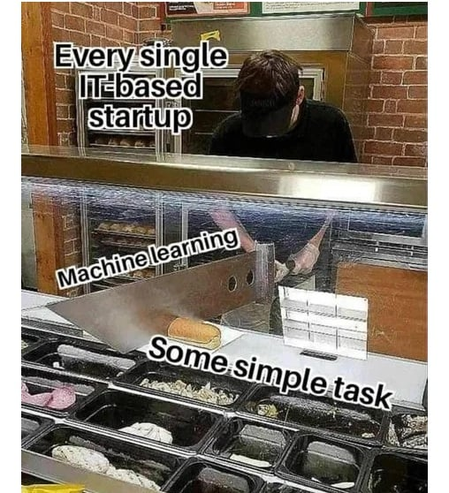
ML as universal solution
But is it really always the best tool?
https://www.facebook.com/ProgrammersCreateLife/photos/a.241809332534619/4417862111595966/

Slide 5

When not to use ML
Clear specification available
Implement the specification directly! Learning adds risk.
Simple heuristics are good enough
No need to spend the additional effort
Cost of building and maintaining the ML system outweighs the benefits
ML components are complex and hard to maintain, simpler solutions or human effort may be cheaper
Correctness is of utmost importance
That is still the issue with ML for safety critical systems!
ML is only used for the hype
Marketing should not affect the system design

Slide 6
Consider non-ML baselines
How far can simple heuristics get you?
What are the costs and benefits of a semi-automated approach with human supervision?
What would the system look like without the ML features?

Slide 7

When to use ML
Big problems
Many inputs
Massive scale
Open-ended problems
No single final solution
No fixed specification
Incremental improvements and growth over time
Time-changing problems
Adapting to constant changes
Learning with and from the users
Intrinsically hard problems
Unclear rules
Heuristics perform poorly

Slide 8
Live exercise: ML or not?
Recommending products in a huge webshop
Recommending products in a small webshop
Filtering hate speech or profanity in public forums
Credit card fraud detection
Controlling water use in a washing machine

Slide 9
Additional consideration for ML
Check if partial solutions are acceptable
Requires that mistakes are acceptable or can be mitigated
Data for continuous improvement should be available
Predictions can have an influence on the system objectives
Ensure that they contribute to the organizations objectives
Cost effectiveness also affects ML model choice
Should use a ML approach that is clearly cheaper and has a better cost/benefit ratio than non-ML approaches

Slide 10
System goals
Notes:
(8 min)

Slide 11
Layers of success measures
Organizational objectives
Innate/overall goals of the organization
Leading indicators
Measures correlating with future success, from the business perspective
User outcomes
How well the system is serving its users, from the users’ perspective
Model properties
Quality of the model used in a system, from the model’s perspective

Slide 12



Organizational Objectives
Businesses
Current revenue, profit
Future revenue, profit
Reduce business risks
Non-profits
Quality of life (e.g., lives saved, animal welfare increased, higher convenience in daily life)
Public policy goals (e.g., social justice improved, CO2 reduced, catastrophes averted)
Research
Knowledge gained
(any of the above, depending on type of research)
Implication: Accurate models are often not themselves the goals!
It follows that ML usually only indirectly influences the organizational objectives → Hard to quantify

Slide 13
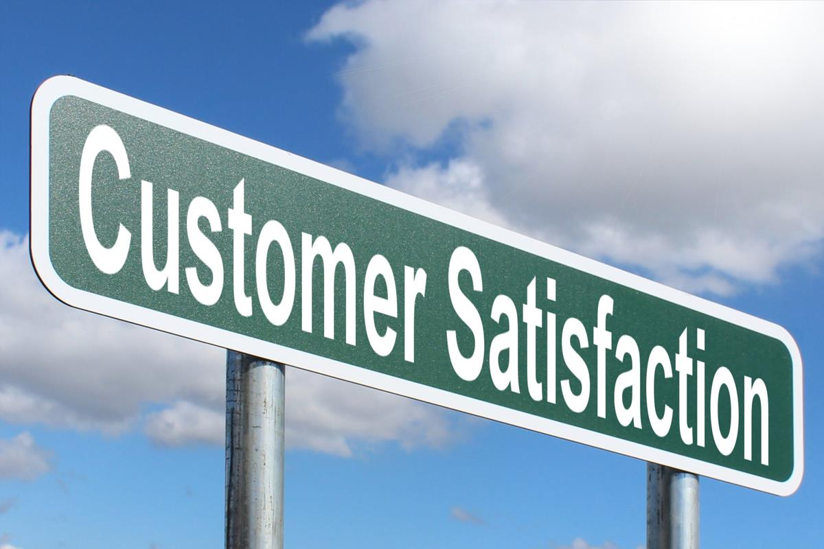
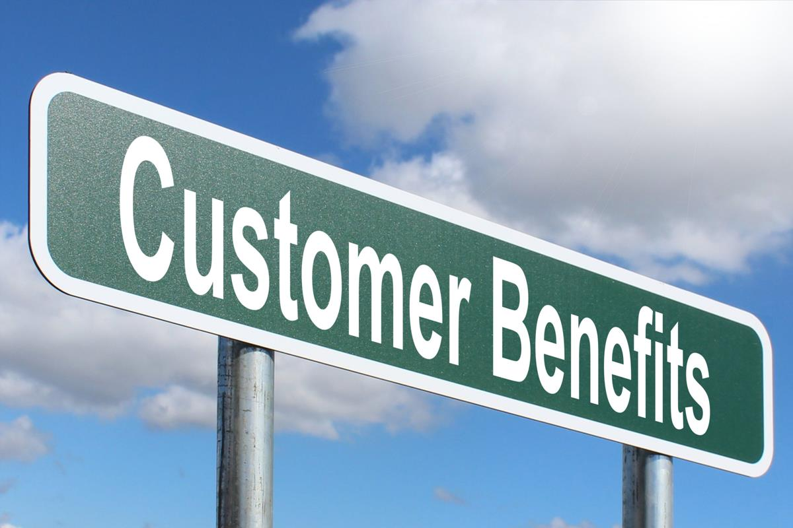
Leading indicators
Key factors related to organizational objectives
Examples
Customer sentiment: do they like the product?
Customer engagement: how often do they use the product?
Time spent using product
Changes in customer base (growth, steady, decline)
Changes in reviews and ratings
…
Often indirect proxy measures
Can be misleading
Example: more users does not automatically mean higher profits

Slide 14

User outcomes
Measure how the system is serving the users
Examples
Users choose recommended items
Users make better decisions
Users save time
Users achieve their goals
…
Easier to measure than leading indicators
Can often be automated
Only indirect relation to organizational objectives

Slide 15
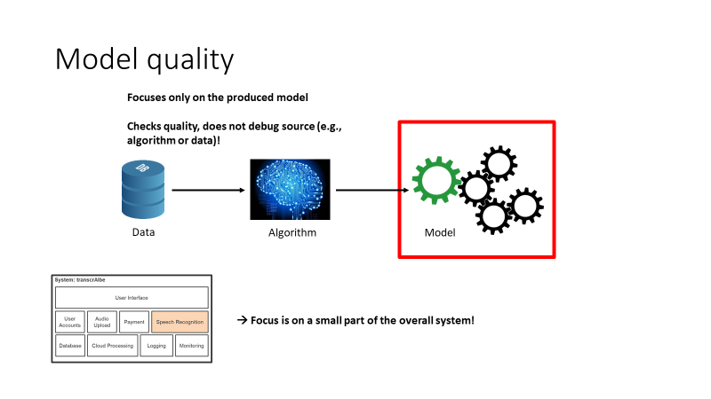
Model properties
Directly related to model quality
Examples
Accuracy
Rate and kinds of mistakes
User interactions
Inference time
Training costs
…
No direct link to organizational objectives
Only indirect through user outcomes

Slide 16

Live exercise
Consider a movie stream service
One of your customer promises is to suggest good movies
What are relevant …
organizational objectives
leading indicators
user outcomes
Model properties

Slide 17
Measurement
Notes:
(8 min)

Slide 18
Defining measurements
Measurement is the empirical, objective assignment of numbers, according to a derived rule from a model or theory, to attributes of objects or events with the intent of describing them.
(Craner, Bond. Software Engineering Metrics: What Do They Measure and How Do We Know?)
A quantitatively expressed reduction of uncertainty based on one or more observations.
(Hubbard. How to Measure Anything: finding the value of intangibles in business)

Slide 19



Everything is measurable
If we care about something, it must be detectable!
Quality, risk, security, public image, …
Detection may not be easy!
If something is detectable, then it must be quantifiable
Number of bugs, deviation from project plan, positive/negative statements on social media
Often only partial aspects
If we can observe it, we can use this to define measures
… but the measures may be imprecise

Slide 20
Measurement terminology
Quantification is turning observations into numbers
Metric and measure refer to a method or standard format for measuring something
We use both terms synonymously, which is not always the case!
Operationalization is identifying and implementing a method to measure some factors

Slide 21
Measurements
Software Engineering
Data Science
Which project to fund
Need for more testing
Need for more training
Execution speed
Code quality
Importance of features
Time and cost estimation
…
Model accuracy
Generalization
Noise in data
Fairness of models
Robustness of models
…

Slide 22
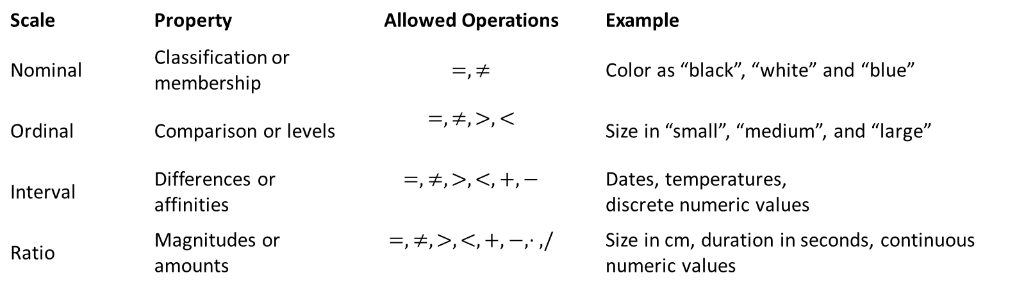
Measurement scales
Scale | Property | Allowed Operations | Example
Nominal | Classification or membership | $$=, ≠$$ | Color as “black”, “white” and “blue”
Ordinal | Comparison or levels | $$=, ≠, >, <$$ | Size in “small”, “medium”, and “large”
Interval | Differences or affinities | $$=, ≠, >, <, +, −$$ | Dates, temperatures, discrete numeric values
Ratio | Magnitudes or amounts | $$=, ≠, >,<, +, −, ⋅ ,/$$ | Size in cm, duration in seconds, continuous numeric values
Categorial
Numeric
Not only relevant for features for ML, but for any measurement!
S. S. Stevens: On the Theory of Scales of Measurement, Science, 103(2684):677-680

Slide 23
Decomposition of measures
Number of interactions per month
Customer engagement
Average duration of interactions
Customer churn
Usability
Business risk
Customer sentiments
…
…
…
Higher-level measure often composed from lower level measures
Clear trace from specific low-level measurements to high-level metrics
Use, e.g., Goal-Question-Metric approach to define the measures

Slide 24
Specifying metrics
measure accuracy
evaluate accuracy with MAPE
evalute test quality
measure branch coverage of Java code with Jacoco
VS
measure execution time
average and 90%-quantile response time of REST-API under normal load
measure customer happiness
report response rate and average customer rating on survey shown to 2% of all customers (randomly selected)
Independent party should be able to set up infrastructure and measure outcomes

Slide 25
Live exercise
What are measures you could define for the movie recommendation service goals?

Slide 26
Risk of measurements
Notes:
(8 min)

Slide 27
Measurement validity
Construct validity
Are we measuring what we intent to measure?
Does the abstract concept match the specific scale/measurement?
Example:
What is concept IQ actually measuring? Is the scale meaningful?
Are the questions in a usability assessment suitable?
External validity
Generalization of the findings to context and environments, other than the one studied
Example:
Do the results of a usability assessment on a sample generalize to the target population?
Bad constructs lead to invalid measurements and conclusions

Slide 28
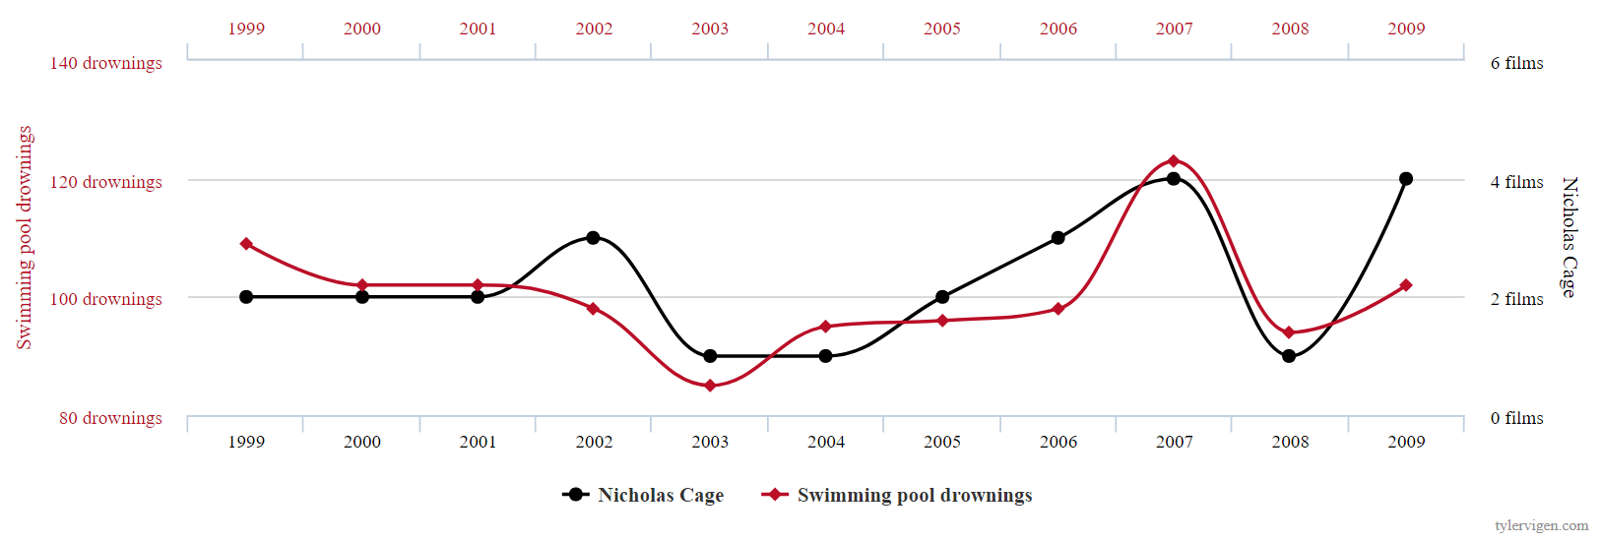
Correlation vs. causation
Did Nicholos Cage sign a contract when he read about drownings!?
Did people really jump into pools because of Nicholas Cage movies!?
Spurious correlation!
https://www.tylervigen.com/spurious-correlations

Slide 29
ML (usually) learns correlations!
ML exploits correlations between inputs (features) and output to build a model
Notable exceptions: Bayesian networks, some symbolic AI methods
Be careful about interpretation & intervention based on correlations
Does a positive correlation between exercise and skin cancer mean, we should exercise less to reduce our chance of skin cancer?
To establish causality you need to
develop a theory (X causes Y) based on domain knowledge and independent data
indentify relevant variables suitable to measure the predictions of the theory
design a controlled experiment with a suitable construct that shows the predicted correlations
That is why checking model quality is important (and difficult)!

Slide 30
Confounding variables
Confounding
variable
Sunshine
causal
causal
Independent
variable
causal
Ice cream
consumption
causal
spurious
correlation
spurious
correlation
Dependent
variable
Number of sunburns

Slide 31
Controlling for confounding variables
Identify confounding variables
Control for those variables during measurement
Randomize, fix, or measure+account for during analysis
Example
Want to study relation between coffee consumption and lung cancer
Use knowledge that coffee consumption is correlated with smoking → smoking as confounding variable
Ask study participants if they are smokers, consider this during analysis

Slide 32
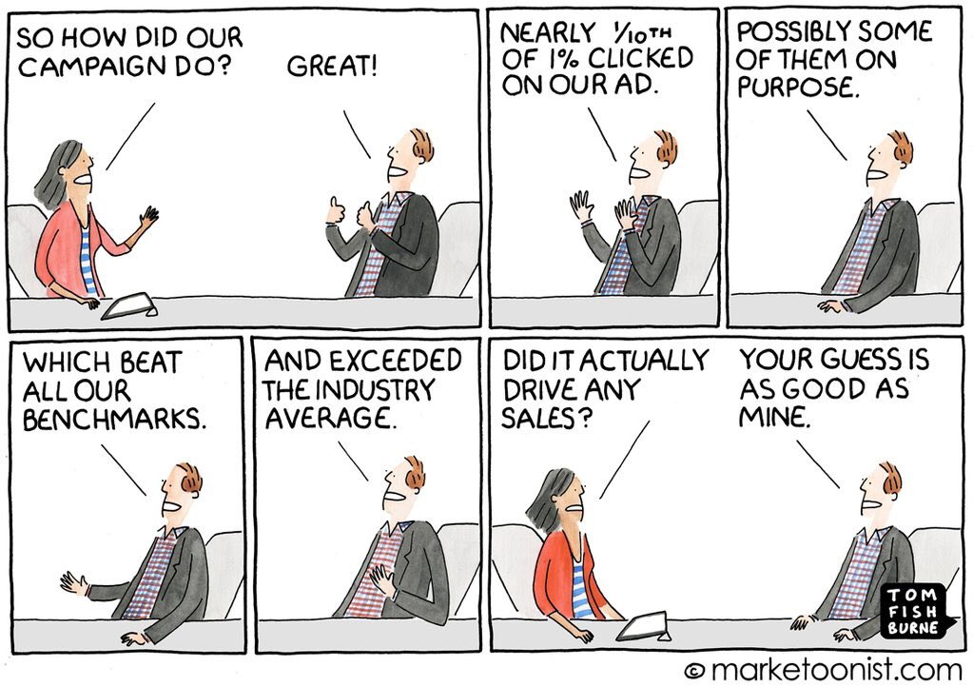
Streetlight effect
Danger to avoid: focus on bad and easy to measure metrics in favor of good metrics

Slide 33
Goodhart‘s law
Example
Number of visits is used as proxy for revenue
No problem: revenue is still the target and regularly considered to make decisions
Problem: the number of visits are increased, without checking if this is good or bad for the revenue
When a measure becomes a target, it ceases to be a good measure.

Slide 34

Questions?

