Slide 1
Principles of AI Engineering Chapter 5: Requirements and risk
Prof. Dr. Steffen Herbold
Credit:
Based on contents from Christian Kästner (https://github.com/ckaestne/seai)

Slide 2
Contents
Software requirements
Risk analysis
Strategies for handling faults in ML-based systems
Constraints and trade-offs

Slide 3
Software requirements
Notes:
(8 min)

Slide 4
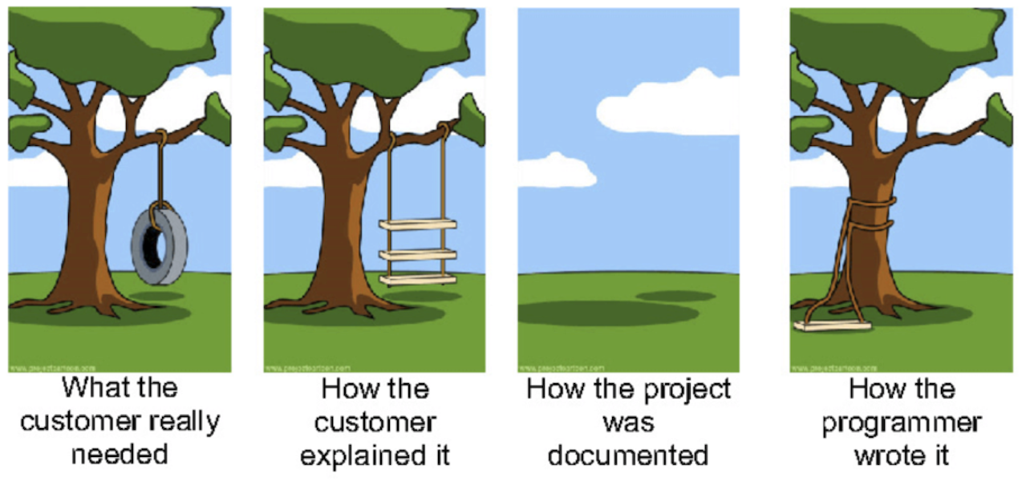
Software requirements
Describe what the system should do, in terms of the services that it provides and their qualities (safety, reliability, performance)
Gathered through requirements elicitations from stakeholders, standards, systems in use, …

Slide 5

Importance of requirements
The hardest single part of building a software system is deciding precisely what to build.
No other parth of the work so cripples the resulting system if done wrong.
Fred Brooks, The Mythical Man Month (1975)

Slide 6
Reasons for project failure
Source: Standish Group 1995 (www.standishgroup.com)
… there are also newer studies with similar results

Slide 7
Software does not live in a vacuum
Input devices
(e.g., sensor, camera, mouse, keyboard)
monitored variables
input data
Environment
Machine
controlled variables
Output devices
(e.g., actuator, monitor)
output results
Requirements describe desired states of the world
Software/machine is designed to sense and manipulate state of the world

Slide 8

Shared phenomena
Phenomenom
World phenomena
Machine phenomena
Shared phenomena
Shared phenomena = interface between environment and software
Example: software for cars
engineCtrl = On
Engine running
daysSinceLastInspection = 154
Handbrake released
handBrakeCtrl = Off
World
Machine
Software can influence environment only through the shared interface!
Unshared parts beyond control, we can only assume behavior!

Slide 9

Environment, specification, and requirements
Environment
ENV
Machine
REQ
SPEC
ENV
Requirement fulfilled if the specification is implemented and the assumptions about the environment are correct
SPEC $∧$ ENV $⊨$ REQ
Requirement (REQ): What the system must ensure, in terms of desired effects on the environment
Specification (SPEC): What the software must implement, expressed over shared phenomena
Environment (ENV): What‘s assumed about the behavior/properties of the environment. Bridges the gap between SPEC and REQ
Software cannot satisfy requirements on its own and must rely on environment!

Slide 10

Example: Lane keeping assistance system with lane departure warning
REQ:
The vehicle must be prevented from veering of the lane.
SPEC:
Lane detector accurately identifies lane markings in the input image.
The controller generates correct steering commands.
ENV:
Sensors provide accurate information about the environment.
Driver responds when given warning.
Steering wheel is functional.

Slide 11
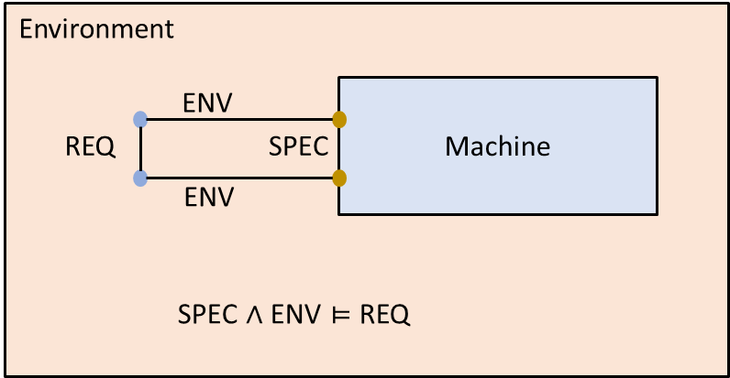

What could go wrong?
REQ: Wrong, inconsistent or infeasible requirements
ENV: Missing or incorrect assumptions about the environment
SPEC: Wrong or violated specifications
SPEC $∧$ ENV: Inconsistency between specification and assumptions about the environment

Slide 12
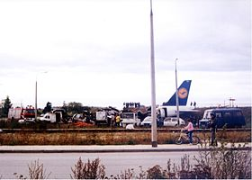
Lufthansa 2904 Crash
REQ: Reverse thrust is enabled if and only if the plane is on the ground
SPEC: Reverse thrust is enabled if and only if the wheel is turning
ENV: Wheel is turning if and only if the plane is one the ground. Wheel is turning when plane moves on the ground.
What happened?
The wheels did not start moving immediately when the plane touched the ground due to a wet runway
Reverse trust could not be used because because the assumption about the environment was wrong
The plane failed to brake in time and two people died.

Slide 13
Assumption violations in ML-based system
Unrealistic or missing assumptions
Poorly understood impact of wheather condition on sensor accuracy, missing pedestrian behavior, assumptions about how users interact with a user interface, …
Concept drift
Environment evolves over time and the underlying distributions change
Adversaries intentionally cause concept drift by poisoning data
A malicious actor deliberately tries to violate or invalidate assumptions on the environment
Placing fake traffic signs or manipulating traffic signs
Initiating feedback loops
System itself may change environment over time and invalidate assumptions
System interacts with environment and can change behavior

Slide 14
Example: Lane keeping assistance system with lane departure warning
Live exercise: What could go wrong?

Slide 15
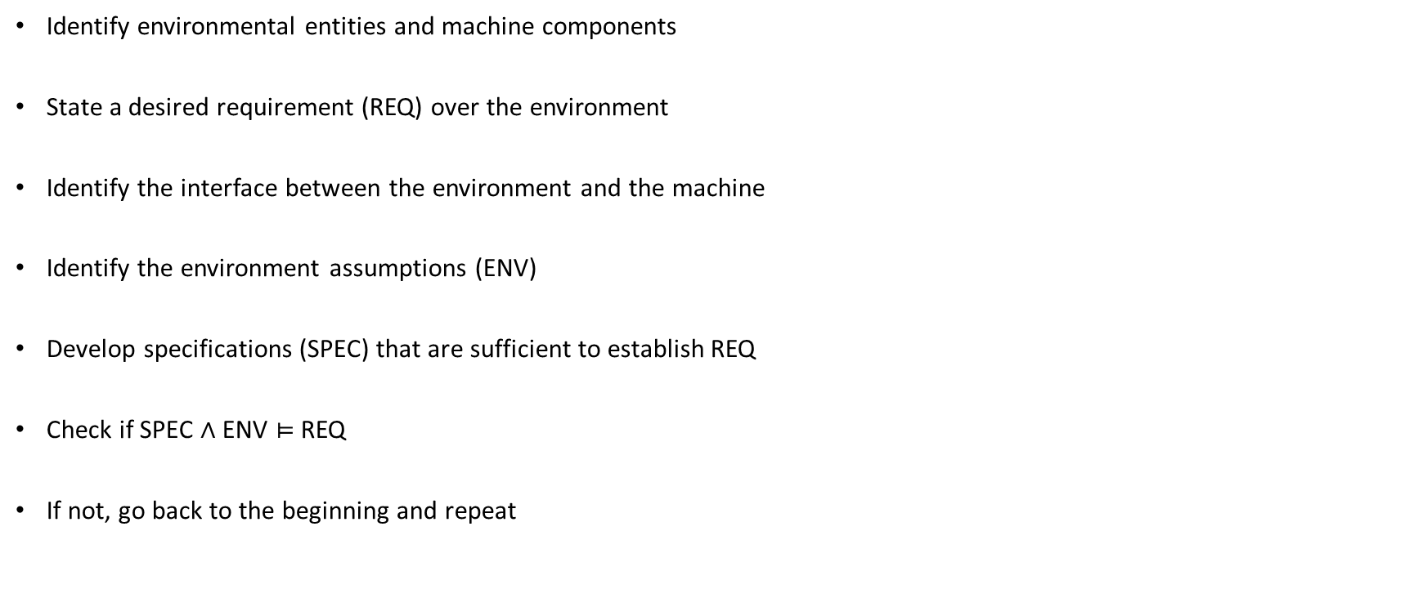
Generic process to establish requirements
Identify environmental entities and machine components
State a desired requirement (REQ) over the environment
Identify the interface between the environment and the machine
Identify the environment assumptions (ENV)
Develop specifications (SPEC) that are sufficient to establish REQ
Check if SPEC $∧$ ENV $⊨$ REQ
If not, go back to the beginning and repeat

Slide 16
Risk analysis
Notes:
(8 min)

Slide 17
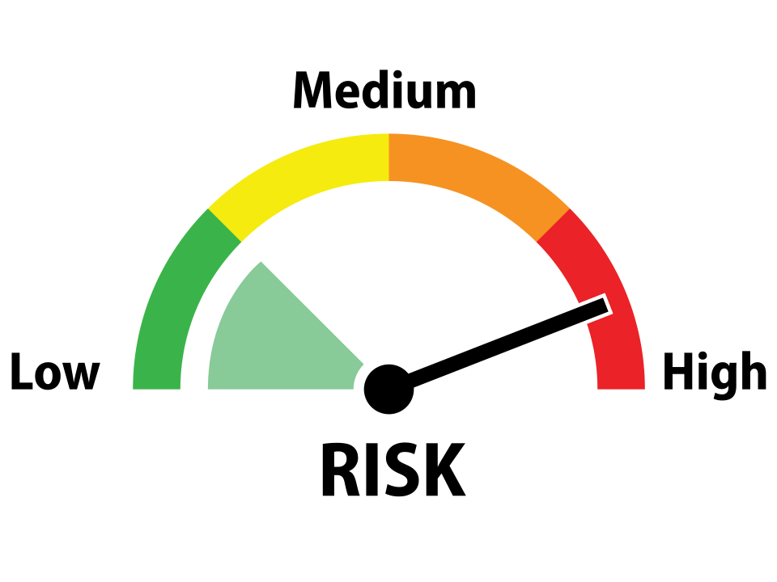

What is risk analysis
What can possibly go wrong in my system and what are potential impacts on the requirements?
Risk = Likelihood $⋅$ Impact
Methods for risk analysis
Failure mode & effects analysis (FMEA)
Hazard analysis
Why-because analysis
Fault tree analysis (FTA)
We focus on FTA

Slide 18
Fault tree analysis (FTA)
Top-down diagram of the relationship between a system failure (= requirement violation) and its potential causes
Can be used to identify sequences of events that result in a failure
Allows prioritization of contributors leading to failures
Informs decisions about how to design the system to be fault tolerant and/or fail safely
Allows investigation of accidents and the identification of the root causes
Often used for safety and reliability analysis, but can be used for other requirements as well

Slide 19
Fault tree analysis & ML
ML is increasingly used in safety critical domains
Automotive, aeronautics, industrial control systems, …
ML models are part of a larger system
ML models will eventually make mistakes
Output wrong predictions/values
Fail to adapt to the changing environment
Confuse users
…
Fault trees can help to understand how mistakes by ML contribute to system failures
Prerequesite to ensure that mistakes do not result in catastrophic outcomes

Slide 20
Basic building blocks of fault trees
E
Event: an occurrence of a fault or an undesirable action
B.E.
Basic event: no further development or breakdown (leaves of the tree)
AND
AND: all of the sub-events must take place
Gates
OR
OR: any of the sub-events may result in the parent event

Slide 21
Fault tree example
TOP EVENT
No light in the room
Every tree begins with a top event
This is typically requirement violation
OR
Switch
failed
All lightbulbs broken
No voltage at input
AND
OR
Every branch must terminate in a basic event
Bulb
lamp 1
broken
Bulb
lamp 2
broken
Power
outage
Fuse
burned
Figure from Fault Tree Analysis and Reliability Block Diagram (2016), Jaroslav Menčík.

Slide 22


Anaysis of fault trees
Qualitative analysis
Determine potential root causes of failure through minimal cut analysis
Quantitative analysis
Compute probability of failure

Slide 23
Minimal cut set analysis
TOP EVENT
No light in the room
Cut set
A set of basic events whose simultaneous occurence is sufficient to guarantee that the top event occurs
Minimal cut set
A cut set from which a smaller cut set cannot be obtained by removing basic events
Minimal cut sets for the example
Bulb lamp 1 broken, bulb lamp 2 broken
Switch failed
Power outage
Fuse burned
OR
Switch
failed
All lightbulbs broken
No voltage at input
AND
OR
Bulb
lamp 1
broken
Bulb
lamp 2
broken
Power
outage
Fuse
burned

Slide 24







Failure probability analysis
$$p\left(no light\right)≈0.0015005$$
TOP EVENT
No light in the room
Goal: compute the probability of the top event
Assign probabilities to basic event
Based on domain knowledge
If possible, use measurements
Apply probability theory to compute probalities of intermediate events through AND and OR gates
Simplified but less accurate approach:
Compute probability as the sum as the probabilities of the minimal cut sets
OR
$$p\left(all bulbs broken\right)=0.000001$$
$$p\left(no voltage\right)=0.0014995$$
Switch
failed
All lightbulbs broken
No voltage at input
$$p\left(switch failed\right)=0.001$$
AND
OR
Bulb
lamp 1
broken
Bulb
lamp 2
broken
Power
outage
Fuse
burned
$$p\left(bulb broken\right)=0.001$$
$$p\left(power outage\right)=0.0005$$
$$p\left(fuse burned\right)=0.001$$

Slide 25
Fault tree analysis process
Specify the system structure
Environment entities and machine components
Assumptions (ENV) and specifications (SPEC)
Identify the top even as a requirements violation (REQ)
Construct the fault tree
Derive intermediate events from a violation of ENV or SPEC
Decompose intermediate events further down based on the knowledge of the domain or components
Analyze the tree
Identify all possible minimal cut sets
Consider design modifications
Try to elimate cut sets or
Elimates risk factor
Increase the size of cut sets
Makes the event less likely
Repeat (possibly with new requirement)

Slide 26
Example: FTA for Lane assistant
Vehicle fails to stay
within lane
REQ
OR
Vehicle fails to
detect lane
Vehicle fails to
steer
OR
AND
Incorrect lane data
received by vehicle
Lane detection ML fails
to produce markings
Driver fails to
steer in time
Contoller fails to generate
steering command
ENV
SPEC
…
SPEC
OR
OR
OR
Camera
failure
Inclement
weather
Classifi-
cation
error
Slow
inference
time
No driver
response
No lane assist
warning produced
…
SPEC
ENV

Slide 27
FTA caveats
In general, building a complete fault tree is impossible
There are probably some faulty events missed (unknown unknowns)
Domain knowledge is crucial for improving coverage
Talk to domain experts
Augment the tree as you learn more
FTA is still very valuable for risk reduction!
Forces you to think about and explicitly document possible failure scenarios
A good starting point for designing mitigations

Slide 28
Strategies for handling faults in ML-based systems
Notes:
(8 min)

Slide 29
Elements of fault-tolerant design
Assume that …
software/ML components will make mistakes at some point
the environment evolves, violating some of its assumptions
Goal: minimize the impact of mistakes/violations on the overall system
Approaches:
Detection
Redundancy
Response
Containment

Slide 30
Detection: Monitoring
Goal: detect when a component failure occurs
Monitor: periodically checks the output of a component for errors
Challenge: recognizing errors
E.g., corrupt sensor data, slow or missing responses, low ML confidence, …
Doer-Checker pattern
Perform primary functions
Untrusted and potentially faulty
Doer
Output
Input
corrective action
check
Checker
If doer output is faulty, perform a corrective action.
Should be trustworthy!

Slide 31
Doer-Checker for an autonomous vehicle
Generate commands to steer vehicle
E.g., complex neural network
Vehicle controller
ML-based controller
(Doer)
Checks commands from ML controller.
Overrides commands with a safe default if the action is deemed risky
Simpler, based on transparent and verifiable logic. Conservative behavior.
Control action
Safety controller
(Checker)
Safe control action
Sensor data
about environment
Sensor
Environment
Actuator

Slide 32
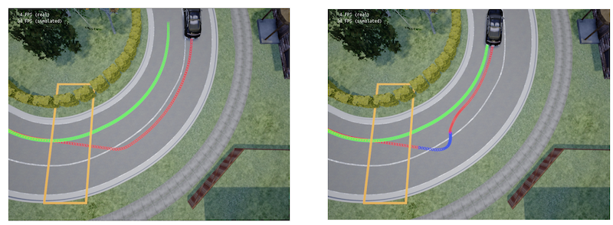
The example in action
Green: optimal behavior
Red: generated by ML controller
Blue: correction by safety controller
Safe actions directly generated by ML controller.
No action by safety controller required.
Unsafe steering in wrong direction by ML controller.
Safety controller overrides commands to achieve safe trajectory
Weichao Zhou, Ruihan Gao, BaekGyu Kim, Eunsuk Kang, Wenchao Li. Runtime-Safety-Guided Policy Repair, Intl. Conference on Runtime Verification (2020)

Slide 33
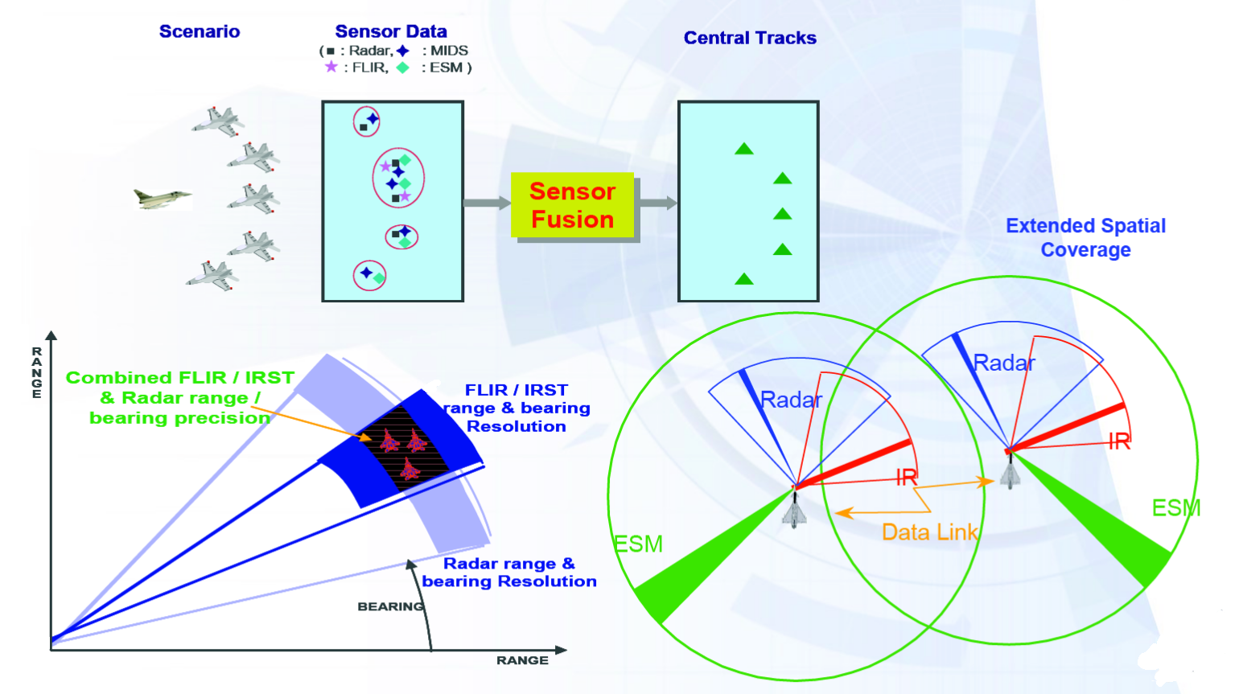
Redundancy: Sensor data fusion
Combine data from a wide range of sensors
Provides partial information even when (some) sensors are faulty
Common approach for all modern tracking technology
https://en.wikipedia.org/wiki/Sensor_fusion#/media/File:Eurofighter_sensor_fusion.png

Slide 34

Redundancy: Ensemble learning
?
New instance
Multiple predictors
1
1
2
1
Predictions
1
Ensemple prediction (e.g., majority vote)
Only fails if multiple predictors are failing.

Slide 35
Response: Graceful degradation (fail-safe)
Goal: when a component failure occurs, achieve system safety by reducing functionality and performance
Relies on a monitor to detect failures!
Example: computer vision failures
Failure: one lidar sensor fails, making position estimates less reliable
Response: switch to lower-quality detection and give more conservative estimations of positions and required minimal distances.

Slide 36
Response: Human in the loop
Use less forceful interaction, make suggestions, or ask for confirmation
AI for prediction, human for judgement
AI good at statistics at scale with many factors
Human good at understanding context and data generation process
Several risks involved
Notification fatigue
Complacency and just following predictions
Lots of UI design and Human-Computer-Interaction (HCI) problems

Slide 37
Response: Undoable action
Design the system to reduce the consequences of wrong predictions, allowing humans to override or undo
Similar to human in the loop
No asking for confirmation
Instead allowing to undo already performed actions

Slide 38
Containment: Decoupling and isolation
Faults in low-critical (LC) components should not impact high-critical (HC) components
A broken car radio software should not interfere with the engine!
Apply principle of least privilege
LC components should be allowed access to the minimum of necessary functions
Limits interaction across critical boundaries
Build barriers between LC and HC components
E.g., deploy in different networks
Add monitors/checks at interfaces
Determine if ML component is performing LC or HC tasks
If HC: check if this can be degraded into LC tasks or be replaced with non-ML components
Experimental Security Analysis of a Modern Automobile, Koscher et al., IEEE Symposium on Security and Privacy, 2010

Slide 39
Example: Lane keeping assistance system with lane departure warning
Live exercise: How could we mitigate the risk?
… monitoring?
… redundancy?
… response?
… containment?

Slide 40
Constraints and trade-offs
Notes:
(8 min)

Slide 41
Constraints
Define the space of attributes for valid design solutions
Compliance with standards and regulations
Capability constraints
Policies and governance
Solution space: designs that are allowed given the constraints
Technology constraints
Values and ethics
Existing commitments
Resource contraints including schedule
Copyright, patents, trademarks

Slide 42
Types of Constraints
Problem constraints
Minimal required quality assurance for an acceptable product
E.g., to guarantee safety or fairness
Project constraints
Deadlines
Project budget
Team skills
Design constraints
Type of ML task (e.g., clustering, classification, regression)
Available data
Available resources for training
Available resources for inference

Slide 43
Trade-offs between ML models
Assume multiple ML methods satisfy the constraints: which one should be used?
Different ML qualities may be in conflict with each other
E.g., accuracy vs. interpretability
Requires trade-offs between these qualities
Decision between models requires
Understanding the impact of different ML models on the trade-offs
Understanding the importance of the different qualities: which one(s) do you care about most?

Slide 44
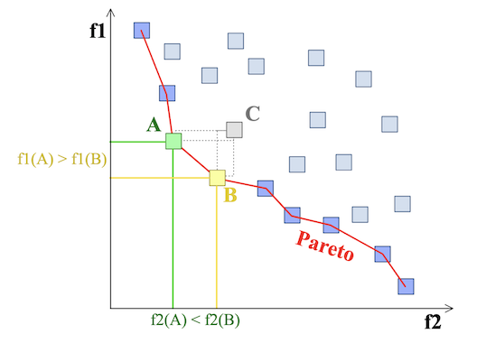
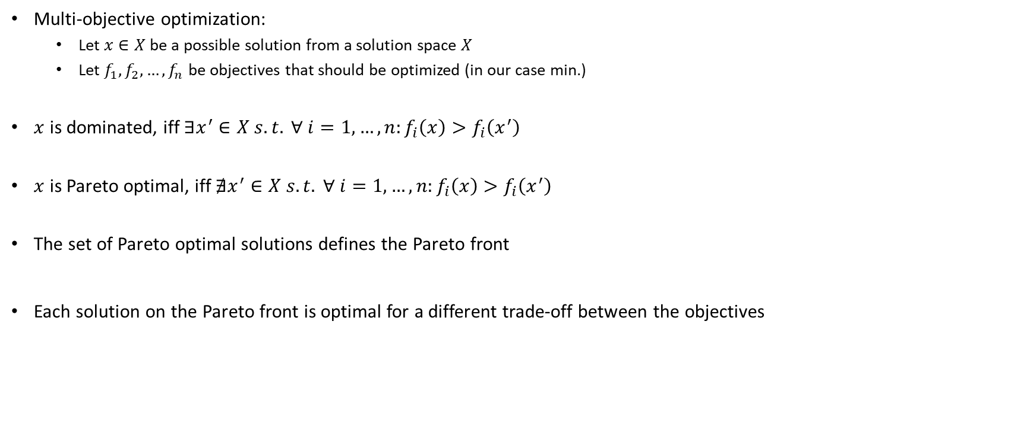
Pareto Fronts
Multi-objective optimization:
Let $x∈X$ be a possible solution from a solution space $X$
Let $f_{1},f_{2},…, f_{n}$ be objectives that should be optimized (in our case min.)
$x$ is dominated, iff $∃x^{′}∈X s.t. ∀ i=1,…,n:f_{i}\left(x\right)>f_{i}\left(x^{′}\right)$
$x$ is Pareto optimal, iff $∄x^{′}∈X s.t. ∀ i=1,…,n:f_{i}\left(x\right)>f_{i}\left(x^{′}\right)$
The set of Pareto optimal solutions defines the Pareto front
Each solution on the Pareto front is optimal for a different trade-off between the objectives
https://en.wikipedia.org/wiki/Multi-objective_optimization#/media/File:Front_pareto.svg

Slide 45
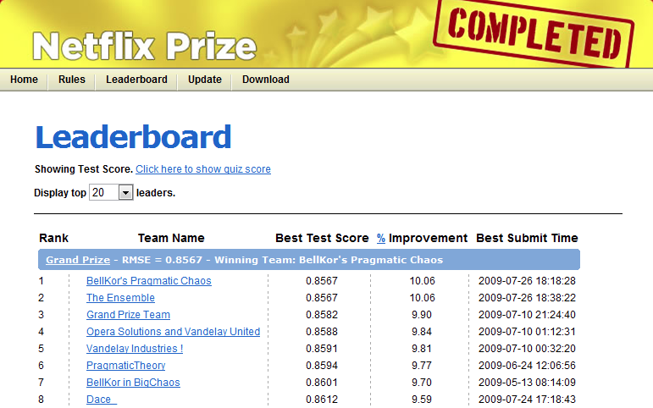
Examples for trade-offs: Cost vs. accuracy
“We evaluated some of the new methods offline but the additional accuracy gains that we measured did not seem to justify the engineering effort needed to bring them into a production environment.”
https://netflixtechblog.com/netflix-recommendations-beyond-the-5-stars-part-1-55838468f429

Slide 46
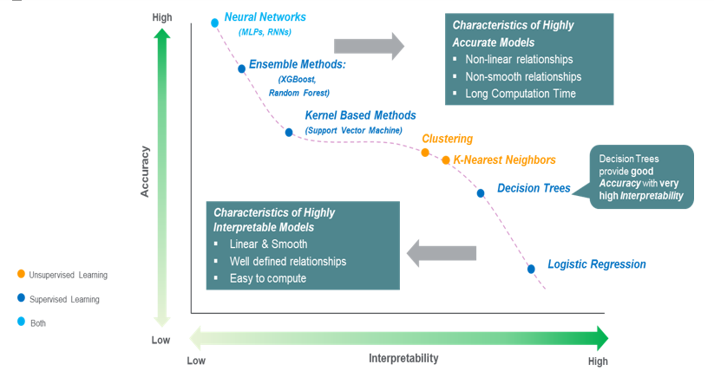
Examples for trade-offs: Accuracy vs. interpretability
https://towardsdatascience.com/the-balance-accuracy-vs-interpretability-1b3861408062

Slide 47
More trade-offs
Accuracy vs. model size (memory footprint)
Accuracy vs. inference time
Dedicated hardware vs. standard hardware
Fairness vs. costs
Online vs. offline model
Model update vs. accuracy loss
…

Slide 48
Finding the right qualities for a product
Interview stakeholders (customers, operators, developers, business experts, …)
Understand the problem, the kind of prediction needed
Understand the scope (target domain, frequency of change, …)
Broadly understand quality needs from different views
Model view: direct expectation on the model
Data view: availability, quantity, and quality of the data
System view: system goals and the role of the ML model and interactions with the environment
Infrastructure view: training costs, reproducibility needs, serving infrastructure needs, monitoring needs, …
Environment/user view: external expectations on the system by users and society (fairness, safety, privacy, …)
Collect and document needs, resolve conflicts, discuss and prioritize
Siebert, Julien, Lisa Joeckel, Jens Heidrich, Koji Nakamichi, Kyoko Ohashi, Isao Namba, Rieko Yamamoto, and Mikio Aoyama. "Towards Guidelines for Assessing Qualities of Machine Learning Systems." In International Conference on the Quality of Information and Communications Technology, pp. 17-31. Springer, Cham, 2020.

Slide 49
Formulating goals
Set minimum accuracy expectations (functional requirement)
Identify runtime needs
Number of predictions, latency requirements, cost budget, local vs. cloud deployment
Identify evolution needs
Update and retraining frequency, expected concept drift, …
Identify explainability needs
Identify protected characteristics and possible fairness concerns
Identify security and privacy requirements (both ethical and legal)
Understand data availability and need
Quality, quantity, diversity, formats, provenance
Map to system goals
Vogelsang, Andreas, and Markus Borg. "Requirements Engineering for Machine Learning: Perspectives from Data Scientists." In Proc. of the 6th International Workshop on Artificial Intelligence for Requirements Engineering (AIRE), 2019.

Slide 50

Questions?

