Slide 1
Principles of AI Engineering Chapter 6: Model deployment and software architecture
Prof. Dr. Steffen Herbold
Credit:
Based on contents from Christian Kästner (https://github.com/ckaestne/seai)

Slide 2
Contents
Simple deployments
Software architecture
Design decisions
Design pattern for systems with ML components
Documenting model inference interfaces

Slide 3
Simple deployments
Notes:
(8 min)

Slide 4
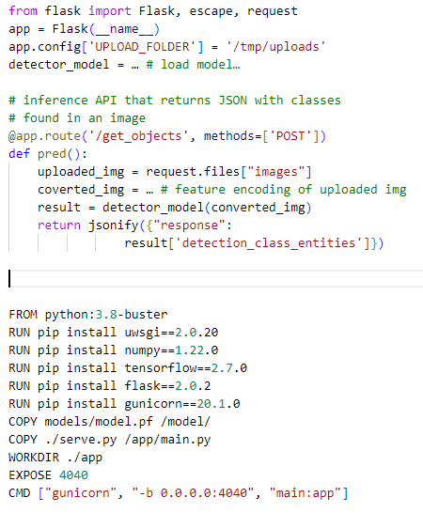
Deploying a model is easy!
1. Define a REST API
2. Deploy in Docker Container
3. Put container on a cloud and use auto-scaling
There are dedicated solutions to this (e.g., BentoML, Cortex, TFX model serving, Seldon, …)

Slide 5
… but is it really easy?
Offline use?
Deployment at scale?
Hardware needs and operating costs?
Frequent updates?
Integration of the model into a system?
Meeting system requirements?
Every system is different! Not everything is a web service!
Personalized music recommendations → Playlists created online only, privacy important
Transcription service → Transcription online only, works with large amounts of data
Self-driving car → Many different ML components (vision, steering, …) that interact locally
Smart keyboard for a mobile device → Very limited compute resources (and storage?)

Slide 6
Software architecture
Notes:
(8 min)

Slide 7

So far: Requirements
Identify goals, define success metrics
Understand the requirements, specifications, and assumptions
Consider risks, plan mitigations
Understand quality requirements and constraints for models and learning algorithms
Requirements
???
Implementation
Architecture
a) Miracle performed by
a genius developer
b) Focused reasoning about trade-offs and desired qualities

Slide 8

Software architecture
The software architecture of a program or computing system is the structure or structures of the system, which comprise software elements, the externally visible properties of those elements, and the relationships among them.
Rick Kazman, Paul Clements, and Len Bass. Software architecture in practice. Addison-Wesley Professional

Slide 9
Importance of architecture
Represents earliest design decisions
Aids in communication with stakeholders
Shows them how at a level they can understand, raising questions whether it meets their needs
Defines constraints on the implementation
Design decision form a load-bearing wall of application (e.g., interfaces and how scaling is achieved)
Dictates organizational structure
Teams work on different components
Inhibits or enables quality attributes
Similar to design patterns
Supports predicting costs, quality, and schedule
Typically by predicting information for each component → breaks down complexity
Aids in software evolution
Breaking down complexity aids change analysis
Aids in prototyping
Can implement architectural skeleton early

Slide 10

Example: Twitter redesign
https://blog.twitter.com/engineering/en_us/a/2013/new-tweets-per-second-record-and-how

Slide 11
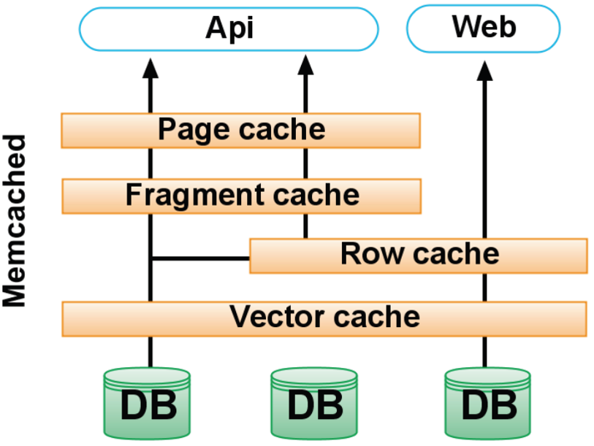
Old architecture
One of the world‘s larges Ruby on Rails installations
200 engineers working on a monolithic architecture
Manages raw database
Memcached + multiple dedicated caches
Public Twitter API
Rendering the Website
Increasingly difficult to understand the system
Organizational challenge to distribute and parallelize tasks
Reached limit of throughput of the storage system (MySQL)
Increasing number of machines only limited potential
Low throughput per machine (CPU+RAM limited, network not saturated)
Potential for optimization: trade of readability vs. performance
https://www.slideshare.net/Eweaver/improving-running-components-at-twitter
https://blog.twitter.com/engineering/en_us/a/2013/new-tweets-per-second-record-and-how

Slide 12
Redesign goals
Performance
Improve median latency, reduce outliers
Reduce number of machine by a factor of ten
Reliability
Isolate failures
Maintainability
Encapsulation and modularity at the system level (rather than at the class, module, or package level): “We wanted cleaner boundaries with related logic being in one place”
Modifiability
Quicker release of new features: “run small and empowered engineering teams that could make local decisions and ship user-facing changes, independent of other teams”
https://blog.twitter.com/engineering/en_us/a/2013/new-tweets-per-second-record-and-how

Slide 13
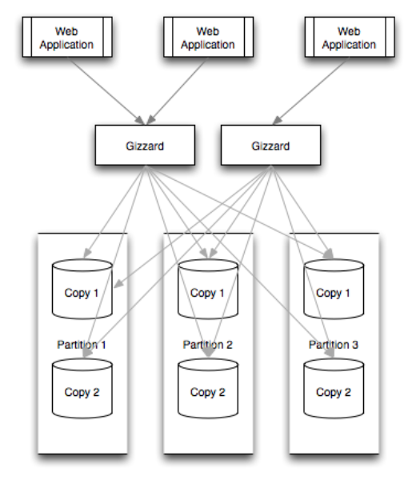
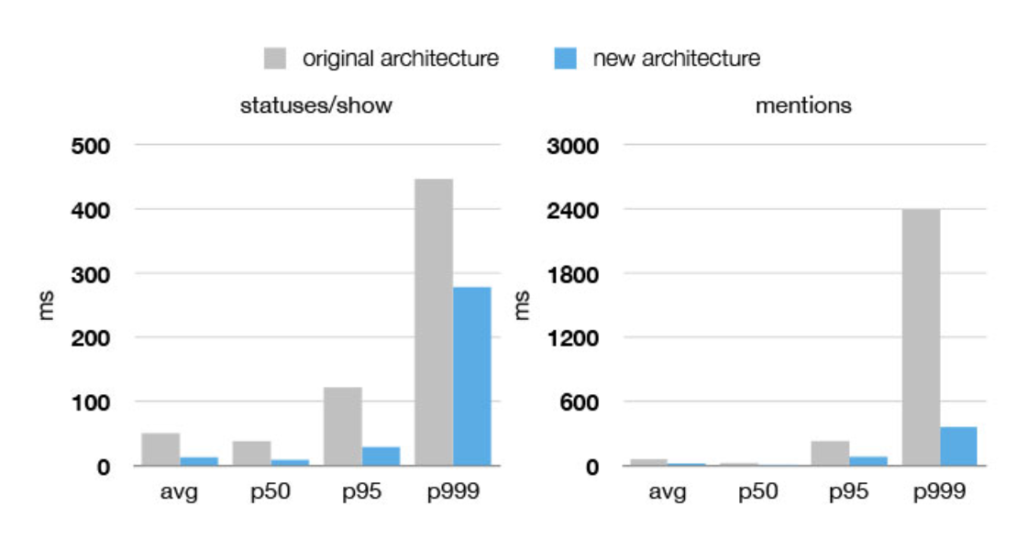
New architecture
JVM/Scala instead of Ruby on Rails
Microservices instead of a monolith: one service for tweets, one service for the timeline, …
RPC framework with built-in monitoring, connection pooling, failover strategies, load balancing, …
Gizzard as new storage solution with temporal clustering and roughly sortable Ids
https://blog.twitter.com/engineering/en_us/a/2013/new-tweets-per-second-record-and-how
https://blog.twitter.com/engineering/en_us/a/2010/introducing-gizzard-a-framework-for-creating-distributed-datastores

Slide 14
Insights from Twitter Redesign
Architectural decision have a huge impact on the entire system
Good decision require early reasoning about quality attributes
Architectural decision should be made explicit and documented
Live exercise: Did the original architects make poor decisions?

Slide 15
Reasoning about architecture: Use cases and interfaces

Slide 16
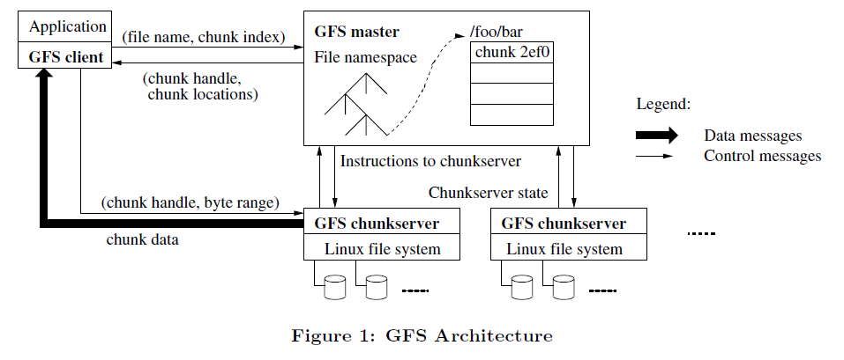
Reasoning about architecture: Data flow and storage components
Scalability through redundancy and replication, no single points of failures
Ghemawat, Sanjay, Howard Gobioff, and Shun-Tak Leung. "The Google file system." ACM SIGOPS operating systems review. Vol. 37. No. 5. ACM, 2003.

Slide 17
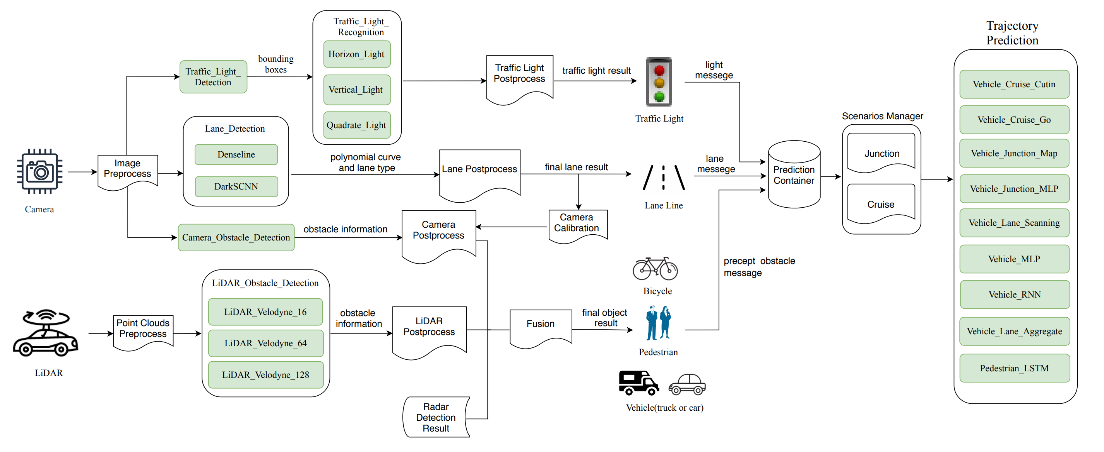
Reasoning about architecture: ML pipeline
Peng, Zi, Jinqiu Yang, Tse-Hsun Chen, and Lei Ma. "A first look at the integration of machine learning models in complex autonomous driving systems: a case study on Apollo." In Proceedings of the 28th ACM Joint Meeting on European Software Engineering Conference and Symposium on the Foundations of Software Engineering, pp. 1240-1250. 2020.

Slide 18
Graphical Notations for Architecture
Notation should be suitable for the analysis
No single best solution!
Meaning of elements (boxes, edges, colors, …) should be documented
Ideally with a legend
Graphical notation and text are both okay
Can be combined, e.g., graphical overview with details as text
Formal notations available
Allow verification of architecture constraints

Slide 19

Live exercise
Consider a translation service running embedded in glasses as augmented reality service.
What are architectural considerations and qualities of interest?
https://www.tecnoneo.com/2020/02/las-gafas-ar-glass-2-de-google-estan.html

Slide 20
Design decisions

Slide 21
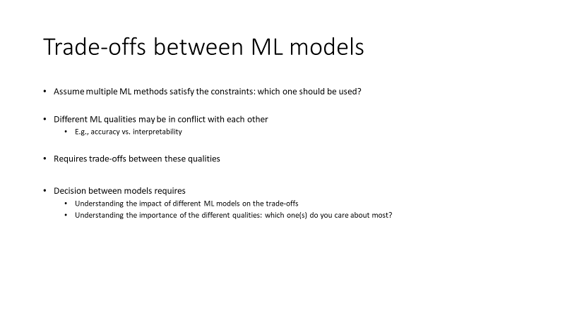
Which ML algorithm should be used?
See previous chapter

Slide 22
Deployment architecture: Where should the model live?
OCR
Translation
???
Cloud
infrastructure
Mobile phone
Smart Glasses
Mobile data /
WIFI
Bluetooth
What qualities are relevant for the decision?

Slide 23
Considerations for deployment architecture
How much data is needed as input for the model?
How much output data is produced by the model?
How fast/energy consuming is the model execution/inference?
What latency is needed for the application?
How big is the model? How often does it need to be updated?
What is the cost of operating the model (distribution & execution)?
What are opportunities for telemetry?
What happens if users are offline?
…

Slide 24
For the AR use case
Some important data
200 ms latency is notable as a speech pause
20 ms is perceivable as video delay
10 ms as haptic delay
5 ms as cybersickness threshold for VR – 20 ms sometimes acceptable
5 megapixel camera, 640x360 pixel screen, up to 2 GB ram, 16 GB storage
Mobile data (4G)
Cloud
infrastructure
Latency: 90-160 ms
Bandwidth: 60 Mbit/s
Mobile phone
Bluetooth
Smart Glasses
WIFI + domestic cable
Latency: 40-200 ms
Bandwidth: 3 Mbit/s
Latency: 10-2000 ms
Bandwidth: 90 Mbit/s
Where to run OCR? Where to run translation?

Slide 25
Possible locations for intelligence
Static intelligence in product
Difficult to update
Offline operation, low execution latency
Cheap operation
No telemetry
Client-side intelligence
Updates costly/slow, out-of-sync problems
Complexity in clients
Offline operation, low execution latency
Server-centric intelligence
Latency in model execution (remote calls)
Easy to update and experiment
Operation costs and no offline operation
Back-end cached intelligence
Precompute common results
Fast execution, partially offline
Saves bandwidth, complicated updates
… hybrid models also possible

Slide 26
Where should feature encoding happen?
Raw inputs
Feature
vectors
Predicted
results
Feature encoding
Model inference
Server side? Client side? What are the trade-offs?

Slide 27
Reusing feature engineering code
Training
Raw training
data
Feature
vectors
Learned model
Feature encoding
Model training
Share feature encoding
implementation
Inference
Raw runtime
data
Feature
vectors
Predicted
results
Feature encoding
Model inference
Avoids training-serving skew of features

Slide 28
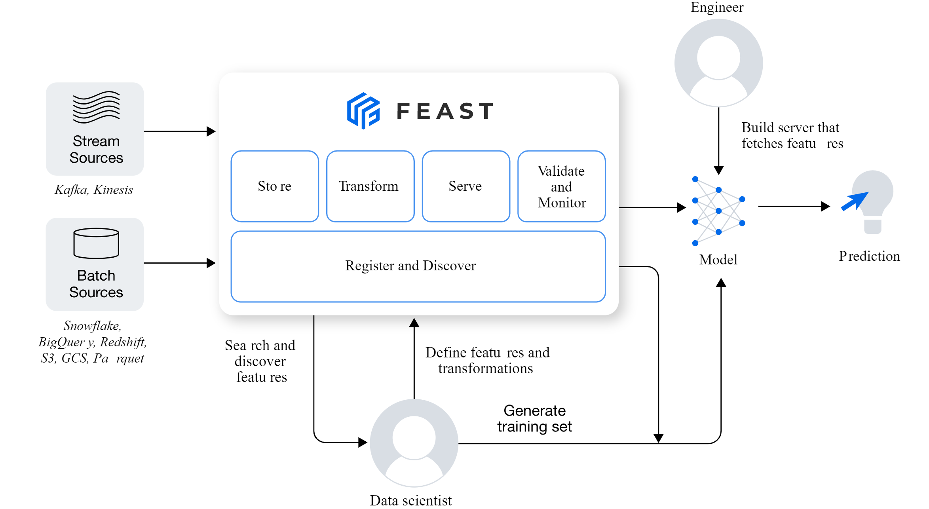
Feature store pattern
Central place to store, version, and describe feature engineering code
Can be re-used across projects
Possible caching of expensive features
Examples:
Feast, Tecton, AWS SageMaker Feature Store, …
https://feast.dev/

Slide 29
More design considerations
Coupling of ML pipeline parts
Coupling with other parts of the system
Ability for developers and analysts to collaborate
Support online experiments
Ability to monitor
Redundancy for availability
Load balancing for scalability
Isolation of mistakes for error handling
Logging and log analysis
…

Slide 30
Design pattern for systems with ML components

Slide 31
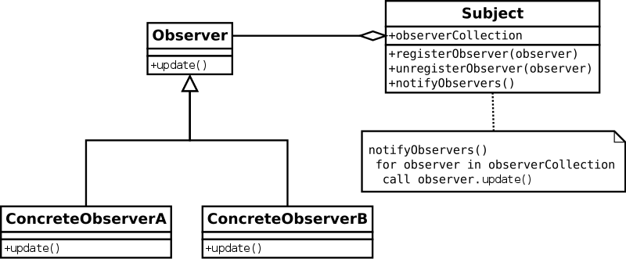
Design patterns are codified design knowledge
Example: Observer pattern to decouple observers from subjects
https://commons.wikimedia.org/wiki/File:Observer_w_update.svg
Gamma, E., Helm, R., Johnson, R., Vlissides, J., & Patterns, D. (1995). Elements of reusable object-oriented software. Design Patterns.

Slide 32
Multi-tier architecture: Separating models and business logic
Presentation Tier
Logic Tier
Data Tier
User Interface
Business Logic
Database
Business
Architectural tier
Real World
Component
Data Collection
Data Processing
Data Lake
Business data flow
Machine Learning
ML runtime data flow
Model
Inference
ML development data flow
Model Training
Based on: Yokoyama, Haruki. "Machine learning system architectural pattern for improving operational stability." In 2019 IEEE International Conference on Software Architecture Companion (ICSA-C), pp. 267-274. IEEE, 2019.

Slide 33
Advantages of separating logic
Clearly divide responsibilities
Allows (mostly) independent and parallel work
Assumes stable interfaces!
Allows planning for location of non-ML safeguards
Shows where ML processing logic is required

Slide 34
Microservices
Service
Data storage
Calls
Mobile App
(Client)
Authentication
Real World
Web App
(Client)
Content delivery
engine
Cache
Cache
Cache
Assets
Metadata
Download
service
Many small loosely coupled services
Assets
Metadata
Assets
Assets
Ownership
Activation
Stats

Slide 35
More patterns
Stateless/serverless serving function pattern
Feature store pattern
Batched/precomputed serving pattern
Two-phase prediction pattern
Batch serving pattern
Decoupling-training-from-serving pattern
…
Based on: Yokoyama, Haruki. "Machine learning system architectural pattern for improving operational stability." In 2019 IEEE International Conference on Software Architecture Companion (ICSA-C), pp. 267-274. IEEE, 2019.

Slide 36
Anti-patterns (things to avoid)
Big ass script architecture
Dead experimental code paths
Glue code
Multiple language smell
Pipeline jungles
Plain-old datatype smell
Undeclared consumers
Sculley, David, Gary Holt, Daniel Golovin, Eugene Davydov, Todd Phillips, Dietmar Ebner, Vinay Chaudhary, Michael Young, Jean-Francois Crespo, and Dan Dennison. "Hidden technical debt in machine learning systems." In Advances in neural information processing systems, pp. 2503-2511. 2015.
Yokoyama, Haruki. "Machine learning system architectural pattern for improving operational stability." In 2019 IEEE International Conference on Software Architecture Companion (ICSA-C), pp. 267-274. IEEE, 2019.

Slide 37
Documenting model inference interfaces

Slide 38
Reasons for documentation
Model interference between teams
Data scientists developing the model
Other data scientists using the model, evolving the model
Software engineers integrating the model as a component
Operators managing model deployment
Communicates required knowledge between teams

Slide 39
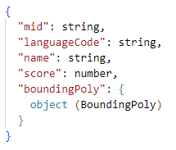
Documenting input/output types
Documentation of the output types of Google‘s public object detection API

Slide 40
Beyond input/output types
Intended use cases, model capabilities and limitations
Supported target distributions
Accuracy
Ideally various measures, including data on slices and for fairness
Latency, throughput, availability
This information is required for Service Level Agreements (SLAs) of served models
Model qualities such as explainability, robustness, calibration
Ethical considerations
Fairness, safety, security, privacy, …
Live exercise: What would you describe for an OCR model?

Slide 41
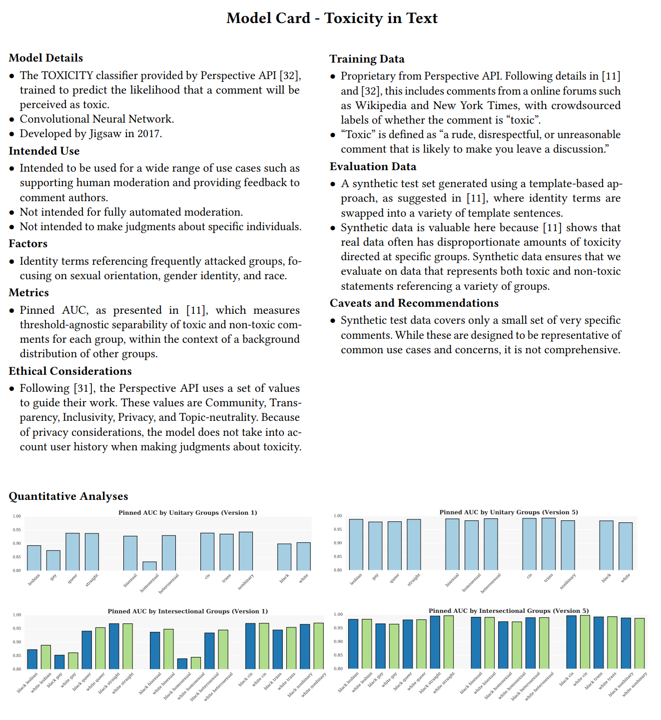
Model cards
Proposal and template for documentation from Google
1-2 page summary
Focused on fairness
Includes
Intended use and scope (incl. out of scope)
Training and evaluation data
Considered demographic factors
Accuracy evaluations
Ethical considerations
Production example
https://modelcards.withgoogle.com/object-detection
Similar approach used by Hugging Face
Mitchell, Margaret, Simone Wu, Andrew Zaldivar, Parker Barnes, Lucy Vasserman, Ben Hutchinson, Elena Spitzer, Inioluwa Deborah Raji, and Timnit Gebru. "Model cards for model reporting." In Proceedings of the conference on fairness, accountability, and transparency, pp. 220-229. 2019.

Slide 42
FactSheet
Proposal and template for documentation by IBM
Intended to communicate intended qualities and assurances
Longer list of criteria, including
Service intention
Technical description
Intended use
Target distribution
Own and third-party evaluation results
Safety and fairness considerations
Explainability
Preparation for drift and evolution
Security
Lineage and versioning
Arnold, Matthew, Rachel KE Bellamy, Michael Hind, Stephanie Houde, Sameep Mehta, Aleksandra Mojsilović, Ravi Nair, Karthikeyan Natesan Ramamurthy, Darrell Reimer, Alexandra Olteanu, David Piorkowski, Jason Tsay, and Kush R. Varshney. "FactSheets: Increasing trust in AI services through supplier's declarations of conformity." IBM Journal of Research and Development 63, no. 4/5 (2019): 6-1.

Slide 43

Questions?

