Slide 1


New Jersey Office Systems
Onboarding Kick-off Call
NEEDS: Kickoff date

Slide 2


DISCUSSION TOPICS
Agenda for Today’s Call
Your roadmap to getting up and running with Rev.io PSA - what to expect, when it's happening, and how we'll crush onboarding together.
1
1
Contract & Business Case Review
2
Training Segments & Milestones
2
3
Your Questions & How We'll Stay Connected
3

Slide 3
CLIENT OVERVIEW
Contract Review
YOUR CONTRACT SPECIFICS
Package Details
$560 MRR
Recurring Fees
Standard Licenses: NEEDS: Qty at $NEEDS: Price per seat
Field Licenses: NEEDS: Qty at $NEEDS: Price per seat
Billing Start Date
NEEDS: Start date
Notes:
Generated source context:
Package details: source field `deal.packageDetails`; context/value: $560 MRR
Standard license count: source field `(no source field found)`; context/value: (missing)
Standard license price: source field `(no source field found)`; context/value: (missing)
Field license count: source field `(no source field found)`; context/value: (missing)
Field license price: source field `(no source field found)`; context/value: (missing)
Billing start date: source field `(no source field found)`; context/value: (missing)

Slide 4
CLIENT OVERVIEW
Business Case Review
Business Issues & Current Pain Points
• E-Automate workflow friction slows service, field, billing, and collections
• Disconnected service workflows
• Limited field visibility
• Manual billing and collections follow-up
Notes:
Generated source context:
Salesforce Business Issues Details: source field `salesforce.businessIssuesDetails`; context/value: E-Automate is slowing common service workflows and forces teams to work across disconnected billing, field, and collections views.
Salesforce Business Issue Pick List: source field `salesforce.businessIssuePickList`; context/value: Disconnected service workflows; Limited field visibility; Manual billing and collections follow-up
Salesforce Problems: source field `salesforce.problems`; context/value: Service teams do not have one reliable workspace for tickets and work orders.; Field activity and back-office billing context are split across tools.; Payment and AR follow-up require manual workarounds.
Fallback motivation/pain-point context: source field `salesforce.problems`; context/value: Service teams do not have one reliable workspace for tickets and work orders.; Field activity and back-office billing context are split across tools.

Slide 5
CLIENT OVERVIEW
Business Case Review
Rev.io Value & Solutions
• Shared visibility for service, field, billing, and AR with fewer handoffs
• Centralized PSA workspace for tickets, work orders, and field activity
• Operational visibility across service, billing, payments, and follow-up
• Module path aligned to mobile field work, inventory, and projects
Notes:
Generated source context:
Salesforce Value: source field `salesforce.value`; context/value: Rev.io gives service, field, billing, and AR teams shared visibility with fewer handoffs and less manual reconciliation.
Salesforce Solutions: source field `salesforce.solutions`; context/value: Centralized PSA workspace for tickets, work orders, and field activity.; Operational visibility across service, billing context, payments, and follow-up.; Module path aligned to mobile field work, inventory, project management, and Rev.io Payments.
Fallback expected value: source field `brief.expectedValue`; context/value: Shared service, field, billing, and AR visibility
Fallback solution context: source field `brief.solutions`; context/value: Simpler ticket and work-order workspace; Centralized operations and payment visibility

Slide 6
OPTIONAL MODULE DISCOVERY
Setup Facts
Instance URL: NEEDS: Instance URL
Optional module requirements?
Quoting
✓
Inventory
✓
Project Management
✓
Mobile App
What integrations are you interested in?
QuickBooks Desktop workaround, Authorize.net, Rev.io Payments
Notes:
Generated source context:
Instance URL: source field `(no source field found)`; context/value: (missing)
Priority modules: source field `brief.priorityModules`; context/value: Mobile App; Rev.io Payments; Inventory; Project Management
Integrations: source field `brief.integrations`; context/value: QuickBooks Desktop workaround; Authorize.net; Rev.io Payments

Slide 7
Rev.io Onboarding Process
Three key onboarding categories we'll review today
Security Aligns Naturally
1
Pre-Configured Setups
Out-of-the-box configurations ready for your use
2
PSA Configuration
Client-responsible setup and customization
3
Onboarding Assist
Rev.io team support and guidance

Slide 8
PRECONFIGURED SETUP
Ready To Go From Day One
Asset Types
Roles & Permissions
Quote Templates
Billing Rules
✓
Equipment
✓
1 global admin
✓
5 preconfigured
✓
2 billing profiles
✓
License
✓
1 standard user
✓
(logo change needed)
✓
$35 return fee
✓
Other
✓
Net 15 / 3% late fee
Provider Types
Ticket Settings
Product Types
Payment Methods
✓
Vendor setup
✓
Status, Priority
✓
Serialized items
✓
Check, CC, ACH
✓
Ready to use
✓
Type, Severity
✓
Non-serialized
✓
eCheck, Cash
✓
Labor, Service

Slide 9
CUSTOMER CONFIGURATION
Where You’ll Customize Your Instance
Company Info
Data Setup
Data & Assets
Security Aligns Naturally
✓
Logo
✓
Customers*
✓
Customer Sites
✓
Contact Details
✓
Vendors*
✓
Customer Contacts
✓
Billing Address
✓
Employees*
✓
Asset Import
✓
Products/Services*
Expected timeline: 5 days
Expected timeline: 10 days
Expected timeline: 5 days
Data Import Timeline
Quotes
Time Entry
✓
Prepared Files
✓
Templates*
✓
Labor Rates
✓
QA Review
✓
Pricing Rules
✓
Overtime Rules
✓
Final Load
✓
Terms
✓
PTO Policies
Expected timeline: 10 days
Expected timeline: 3 days
Expected timeline: 3 days
* Indicates pre-configured setups available

Slide 10
ONBOARDING ASSISTED
Preparing You to be Operations Ready
Payments
Data Import
Taxation
Integrations*
✓
No token migrations
✓
Follow timeline/SLA
✓
Provide credentials
✓
Client prioritizes
✓
3 months statements
✓
Set time for QA
✓
Prepare code mapping
✓
Selection-dependent
✓
Credentials loaded
✓
Rev.io loads data
✓
Rev.io assists setup
✓
SureTax submission
Expected timeline: 10 days
Expected timeline: 5 days
Expected timeline: 3 days
Expected timeline: 5 days
* Only Rev.io supported integrations

Slide 11
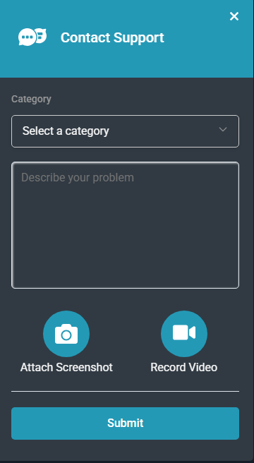
SUPPORT & COMMUNICATION
YOUR QUESTIONS ANSWERED
Documentation Center
Articles and videos in lower left corner
Get Help Button
Located in top right corner
Select "I got stuck or confused"
Submit support tickets for basic QA

Slide 12
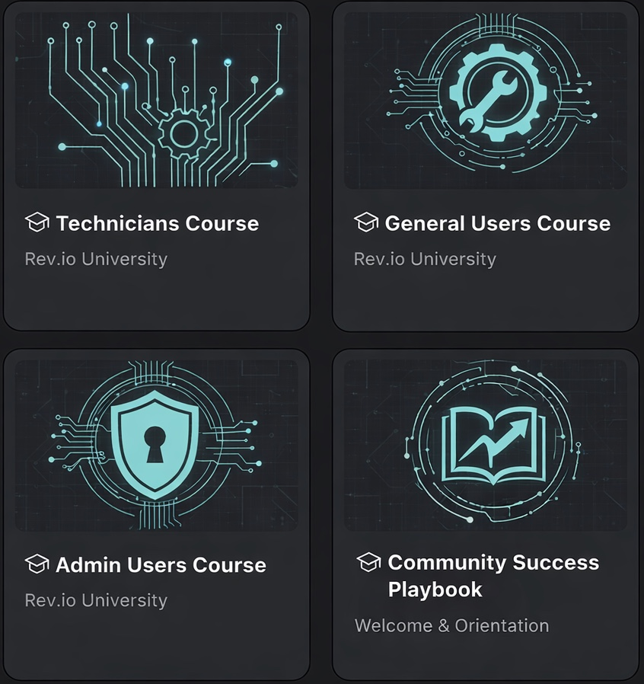
SUPPORT & COMMUNICATION
Submit Your Suggestions
Have an idea or feature suggestion? Need additional training?
1
Navigate to the Community tab
2
Sign up by clicking the link
3
Complete the form
4
Log in and submit your ideas
5
Product team reviews submissions
* Implementation is not guaranteed

Slide 13
DISCUSSION TOPICS
What’s Next?
Your action items to get started
Security Aligns Naturally
✓
Set kickoff target date and time
✓
Confirm Vanessa vs. Shawn onboarding ownership and approval authority
✓
Confirm Sue O'Keefe role
✓
Collect merchant statements for Rev.io Payments migration
✓
Confirm QuickBooks Desktop workaround and accounting plan
✓
Collect GL/chart of accounts details
✓
Confirm field mobile workflow priorities
Notes:
Generated source context:
Next steps: source field `brief.nextSteps`; context/value: Set kickoff target date and time; Confirm Vanessa vs. Shawn onboarding ownership and approval authority; Confirm Sue O'Keefe role; Collect merchant statements for Rev.io Payments migration; Confirm QuickBooks Desktop workaround and accounting plan; Collect GL/chart of accounts details; Confirm field mobile workflow priorities

Slide 14


