Slide 1
Business Recommendations and Insights
Business problem: Predicting likelihood of a customer purchasing a long term package

Slide 2
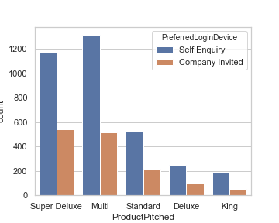
Insights
During the course of the last month, majority of customers preferred `self-enquiry` as their login devices.
Salesmen and other sales personnel pitched Multi and Super Deluxe packages the most.
Among customers received during the previous month king package was pitched the least.
Among customers preferring Company Invite, Multi package was pitched the most.

Slide 3

insights
Customers who preferred self_enquiry as their login device dominated the packages pitched by sales personnel.
During the course of the last month, majority of customers received were executives at their current organisations.
Customers who preferred `self_enquiry` as their login device dominated the packages pitched by sales personnel.
Majority of customers received in the previous month who were managers or executives preferred the `self enquiry` device.

Slide 4
Other key insights
More time was spent by salesmen in successfully pitching all package except King.
for each of the packages pitched by the salesmen an average of 4 follow ups is done by the salesman.
More singles were pitched multi packages than in any other packages combined(511).
No Unmarried individual was pitched the king package.
Married Couples dominated the purchase of all Tourist packages(Deluxe, King, multi, etc.)
company invited customers are not frequent even among the customers who hold managerial and executive positions at their current organisation.
Customers from 2nd Tier cities only purchased the Standard and Multi packages.

Slide 5
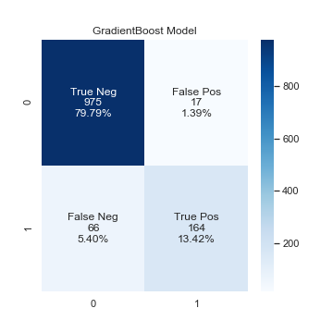
Evaluation metric and model development
The model developed uses the Gradient Boosting Classifier.
The evaluation metric used to capture model performance is called average precision score.
The model improvement parameters are aimed at improving the precision of likelihood of long term package purchased.
Model is adept at predicting likelihood of customer not purchasing long term packages

Slide 6
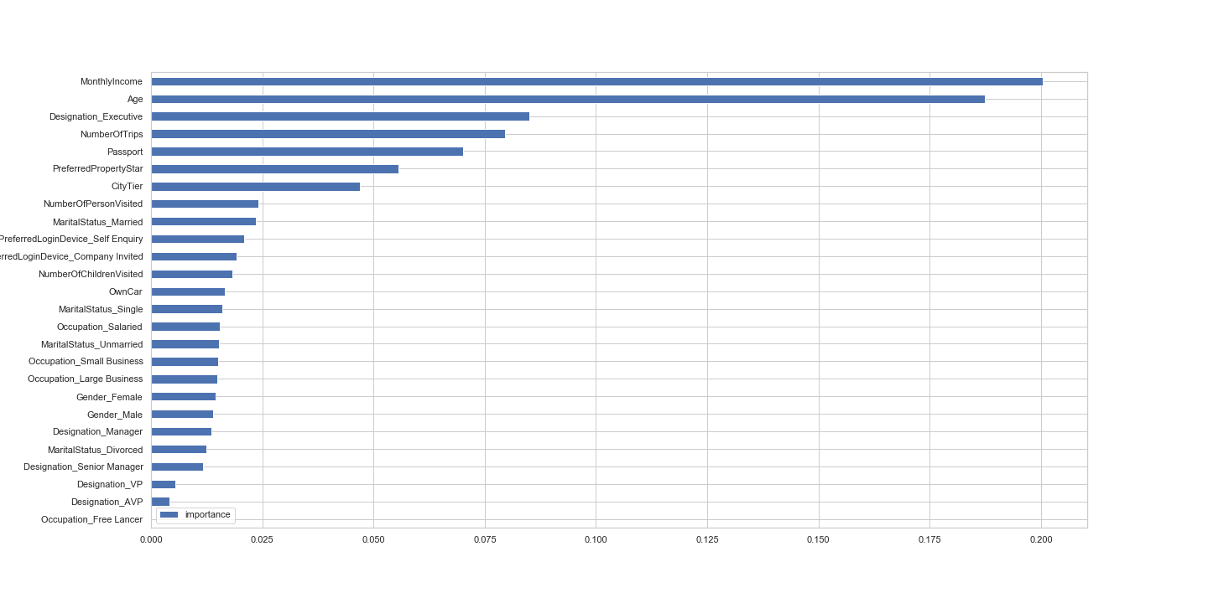
important features to machine learning solution.

Slide 7
recommendations
Adoption and promotion of techniques used by Salesmen who pitched Multi as Multi package was purchased more than any other packages(including Super Deluxe).
This may be because More singles were pitched the multi packages than in any other packages combined(511).
Sales personnel should intensify efforts in following up and pitching Multi packages as they are the most purchased by members from cities of any tier.

