Slide 1
Report Replication -Empirical Asset Pricing via Machine Learning
YANG Tianhao JIANG Xiaoyue
JIA Yaoyao HUANG Yuxuan

Slide 2
Table of contents
01
02
03
04
Introduction
Data Analysis & Processing
Model Training
Comparison & Conclusion

Slide 3
01
Introduction

Slide 4
5 types of models paper employed:
Linear models
Dimension reduction
Generalized linear model
Simple: OLS, OLS-3,
Penalized: Elastic Net
PLS, PCR
Tree models
Neural networks
Boosted regression trees, random forests
NN1-NN5

Slide 5
6 models we chose to replicate:
Linear models
Dimension reduction
Generalized linear model
Simple: OLS, OLS-3,
Penalized: Elastic Net
PLS, PCR
Tree models
Neural networks
Boosted regression trees, random forests
NN1-NN5

Slide 6
02
Data Analysis & Processing

Slide 7
Data Analysis and Processing
Data Download
Data Processing
Delete Some Data
'sic2' , 'RET' ; 'permno', 'SHROUT', 'mve0', and 'prc'
Handling Extreme Value
3-MAD；On a monthly basis
Handling Missing Value
Remove 'sic2' and 'RET'；Fill missing values using the mean of that feature; Fill missing beta and betasq using the average beta value of the industry in which the company is located; On a monthly basis
Data Normalization
One-hot Encoding
'sic2'
Industry & Market Capitalization Neutralization

Slide 8
03
Model Training

Slide 9
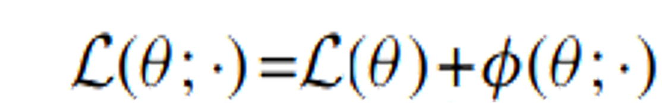
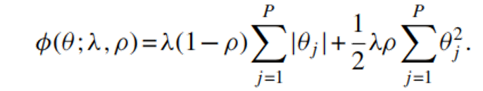
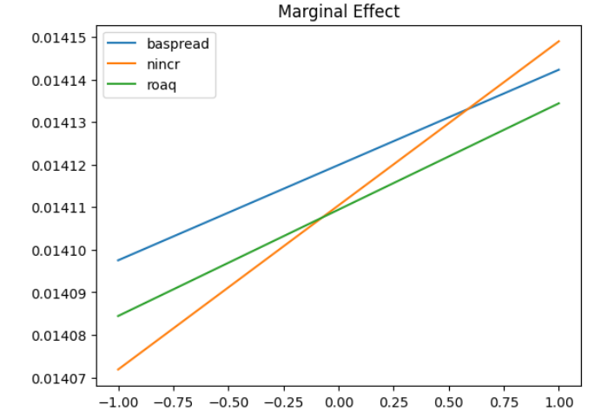
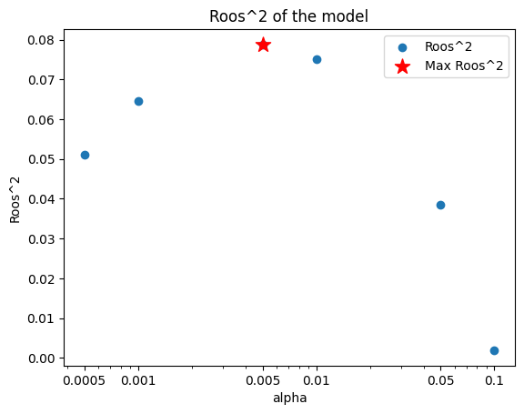
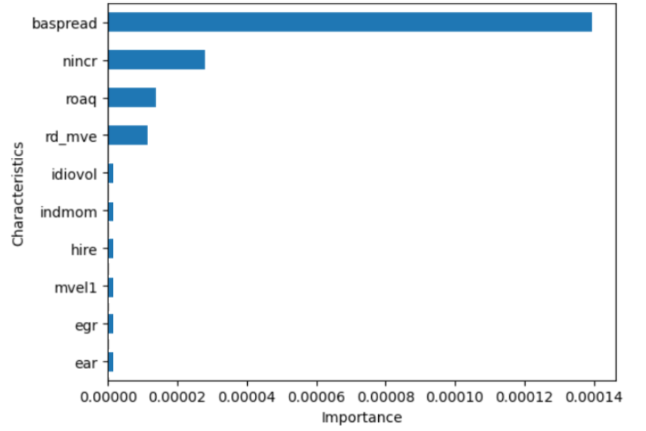
Penalized Linear-Elastic Net
Avoiding overfit ⇒ Append a penalty to the objective function
Average R_square | 0.07877
Top 1000_Roos | 0.21084
Bottom 1000_Roos | 0.03258
Elastic Net Penalty:
L1_ratio (ρ) = 0.5 (from appendix)
Alpha (λ) = [0.0005, 0.001, 0.005, 0.01, 0.05]
Features Importance
Top 3: baspread, nincr, roaq
Marginal effect

Slide 10
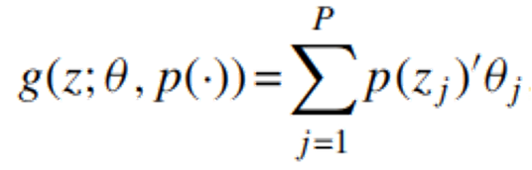

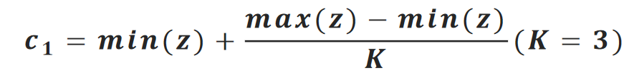
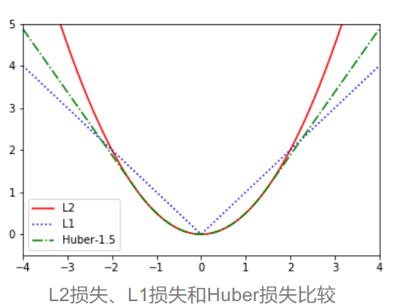
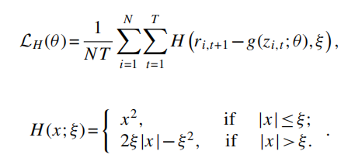
Generalized Linear
Generalized Linear model applies nonlinear transformations of the original predictors as new additive terms based on the linear model.
Adapt 3-term spline series (order 2) expansion of the predictors
Huber robust objective function was adopted.
Average R_square | 0.07905
Top 1000_Roos | 0.17840
Bottom 1000_Roos | 0.02534
epsilon = 1.35
alphas = [0.0005,0.001,0.005,0.01,0.05]

Slide 11

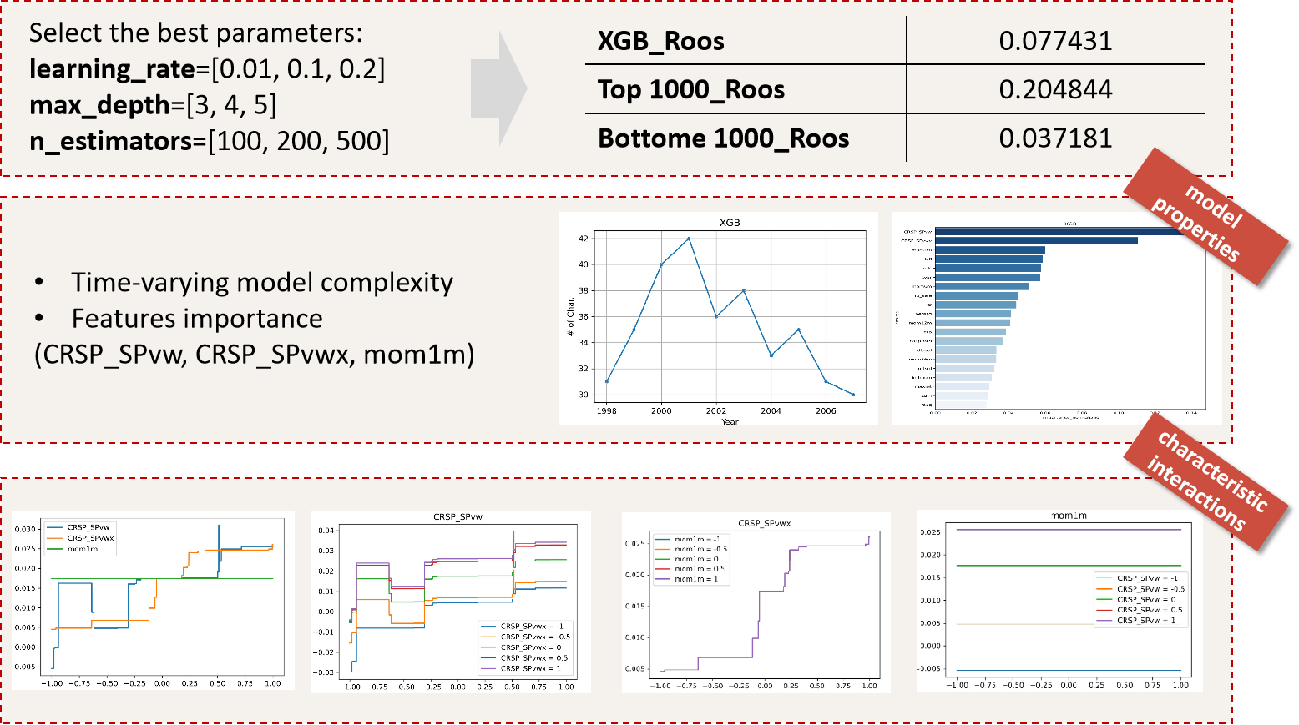
XGBoost Model
XGBoost is an efficient implementation of the Gradient Boosting method, which improves and enhances the GBDT algorithm.

Slide 12
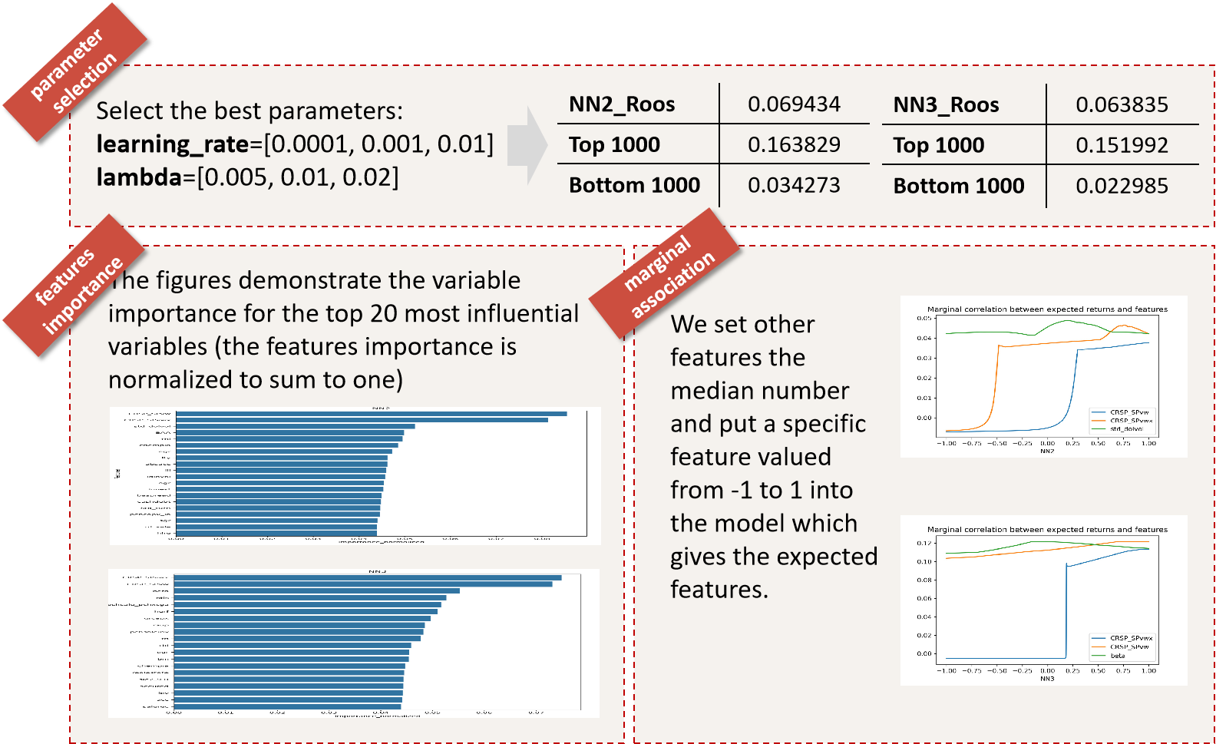
NN2 & NN3 Model

Slide 13
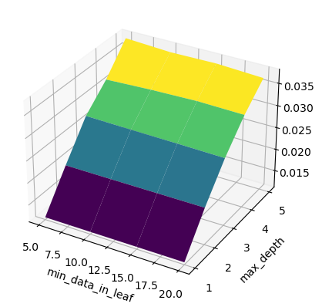
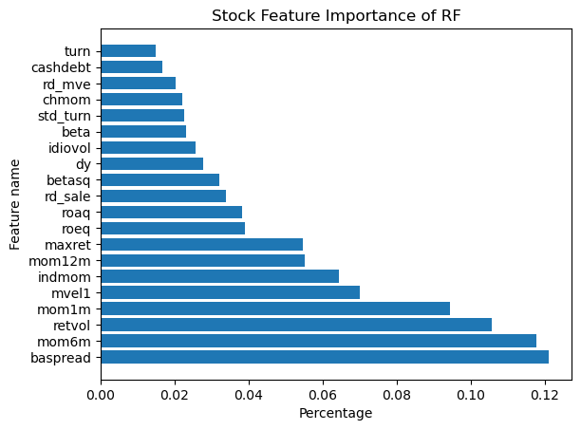
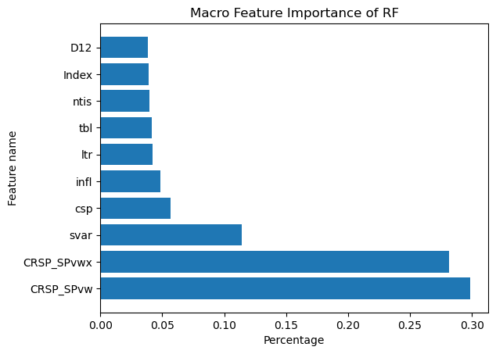
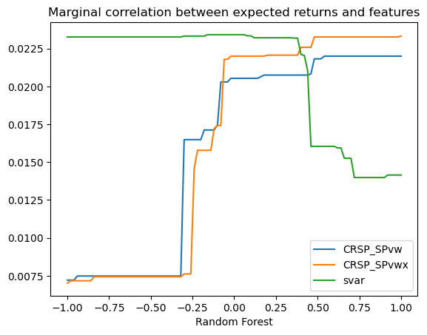
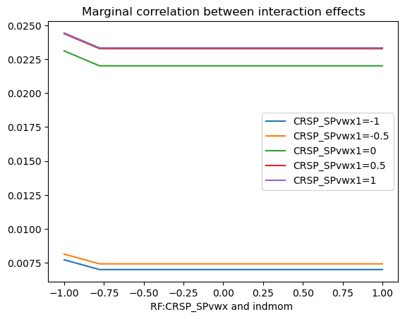
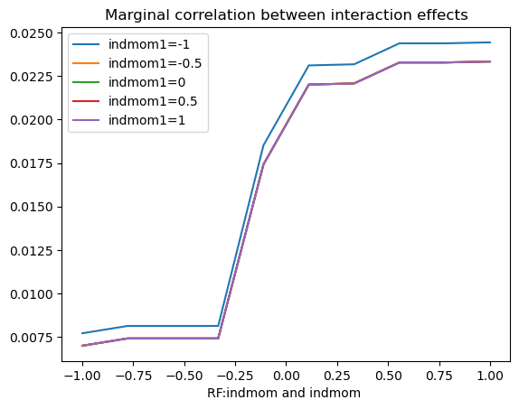
Random Forest
Parameter Selection
Best Model Roos Performance
Estimators=300 (according to supplement)
min_data_in_leaves=[5,10,15,20]
max_depths=[1,2,3,4,5] (according to supplement)
Roos | Value
Total | 0.038
Top1000 | 0.130
Bottom1000 | 0.031
Select
Parameters
Validation Roos of Different
Parameters of Random Forest
Feature
Importance
Micro
Macro
RF Marginal correlation between return & feature
RF Marginal correlation between different features (fix indmom)
RF Marginal correlation between different features (fix CRSP_SPvxx)
Interaction
of
Features

Slide 14
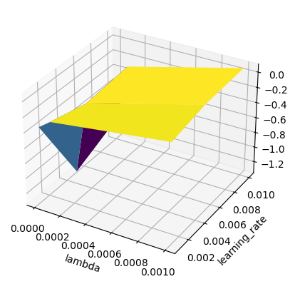
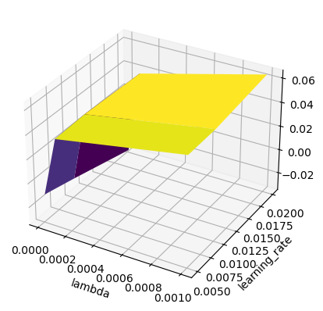
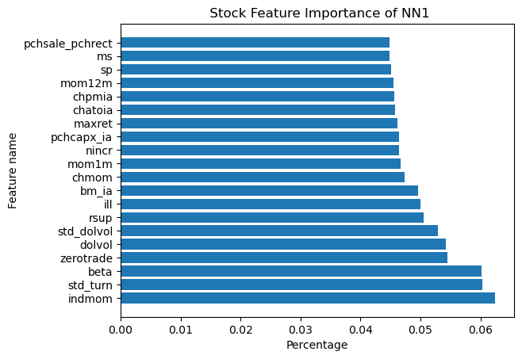
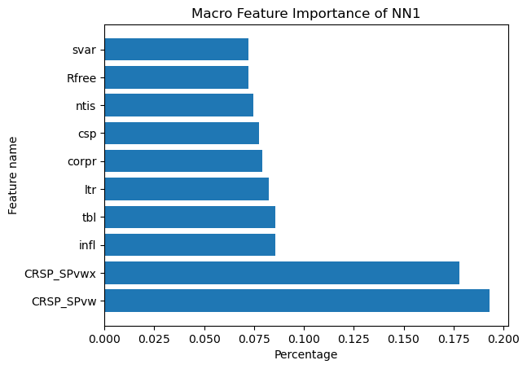
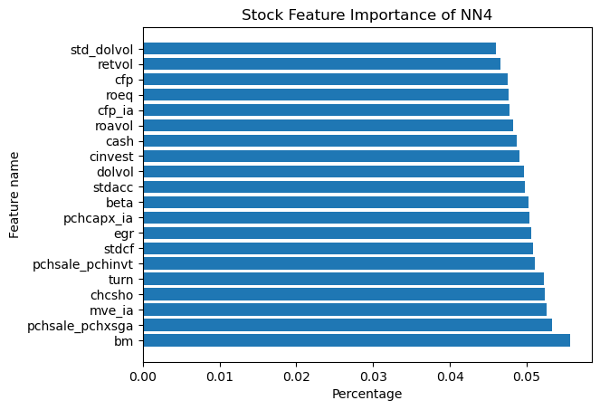
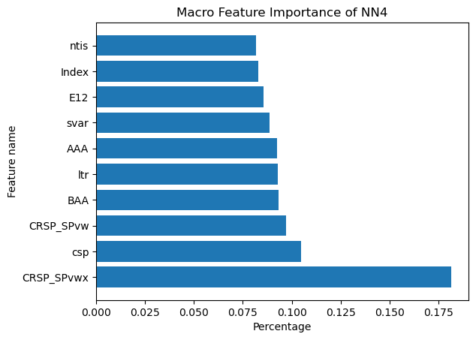
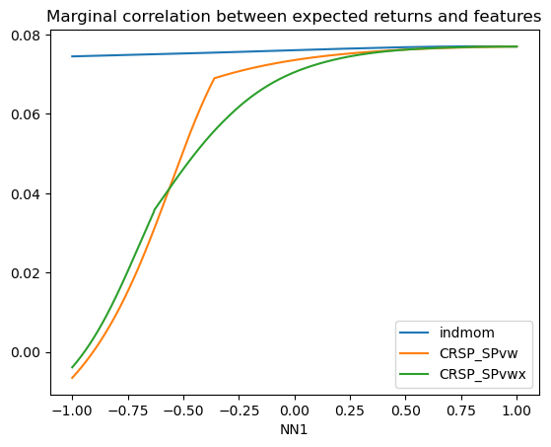
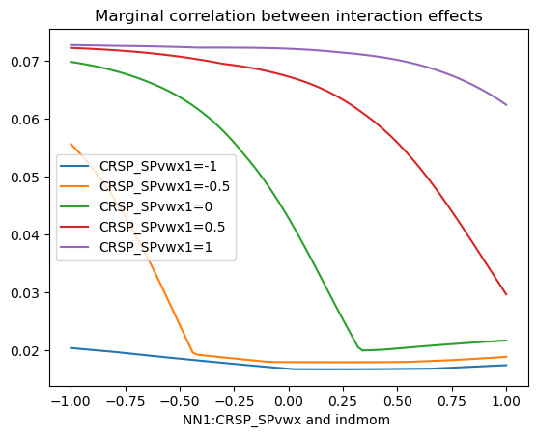
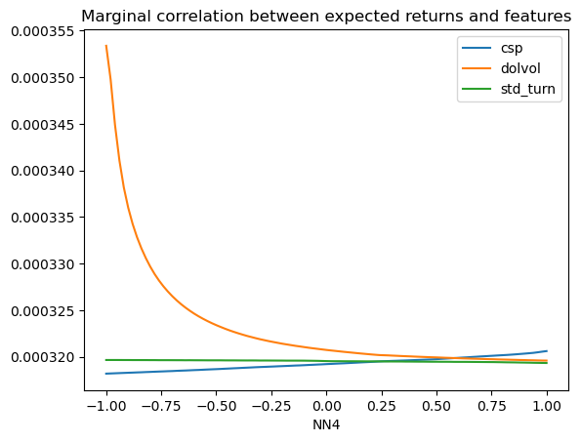
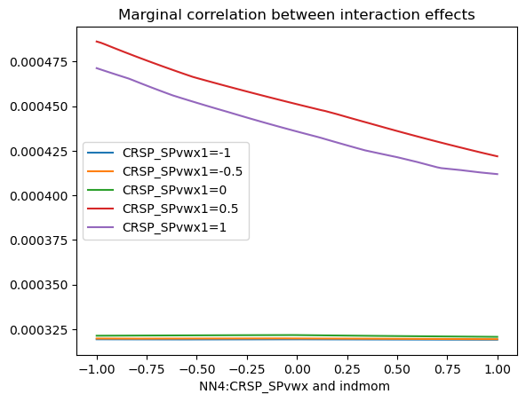
NN1 & NN4
Best Model Roos Performance
NN1 Selection
NN4 Selection
Select
Parameters
L1 lambda=[0.00001,0.0001,0.001]
learning_rate=[0.005,0.01,0.02]
Roos | NN1_value | NN4_value
Total | 0.076 | 0.064
Top1000 | 0.185 | 0.146
Bottom1000 | 0.026 | 0.019
Feature
Importance
NN1Macro
NN4Micro
NN4Macro
NN1Micro
NN1 Marginal correlation between return & feature
NN1 Marginal correlation between different features
NN4 Marginal correlation between return & feature
NN4 Marginal correlation between different features
Interaction
of
Features

Slide 15
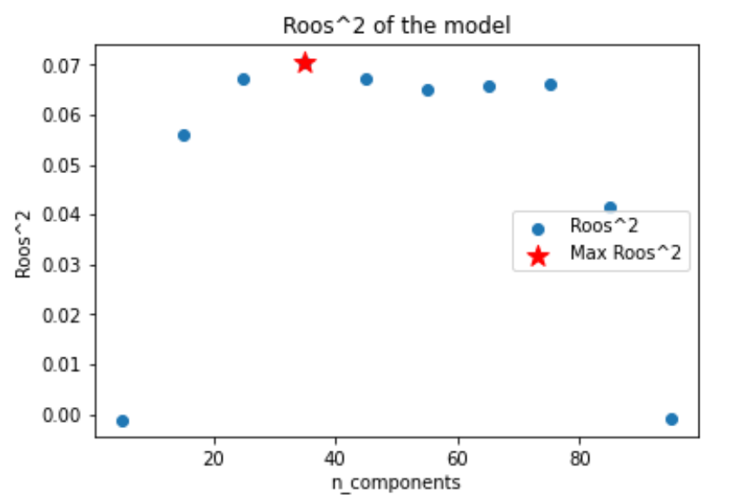
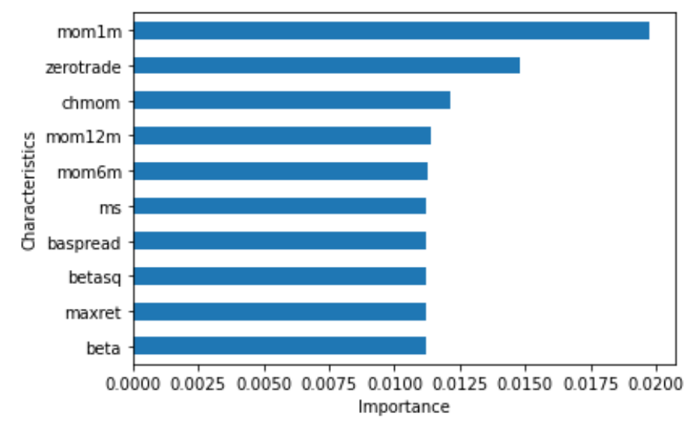
PCR
Forming linear combinations of predictors helps reduce noise, which can better isolate the signal in predictors and help decorrelate highly dependent predictors.
Using PCA.
Average R_square | 0.0773
Top 1000_Roos | 0.239
Bottom 1000_Roos | 0.0113
N_components = [5, 10, 15, 20, 25, 30, 35, 40, 45, 50, 55, 60, 65, 70, 75, 80, 85, 90, 95]
Features Importance
Top 3: mom1m, zerotrade, chmom

Slide 16
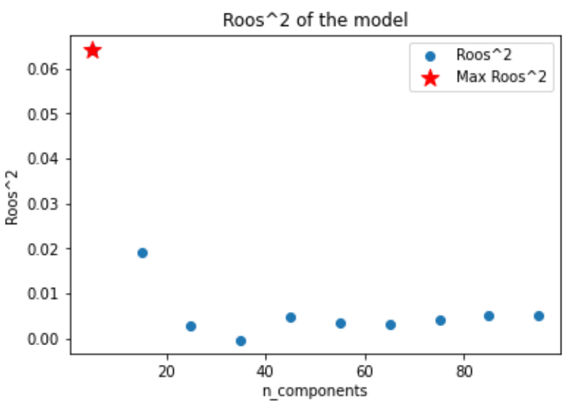
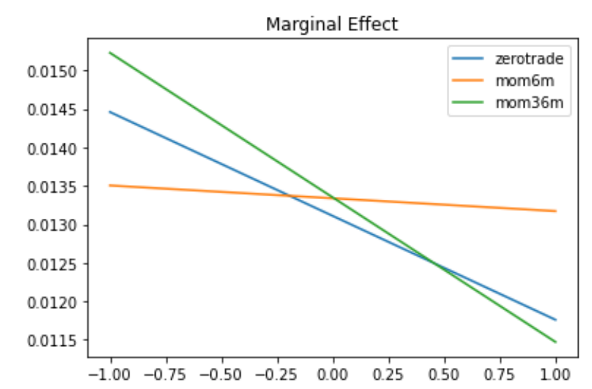
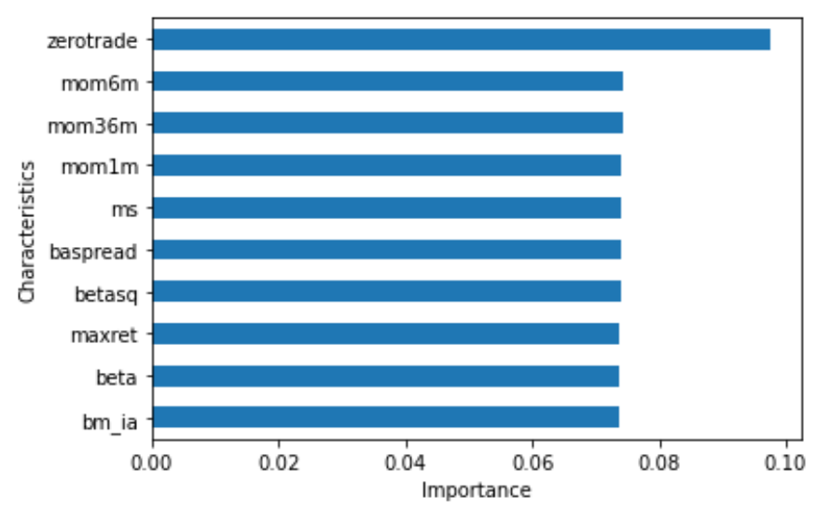
PLS
Considers the relationship between the predictor variables and the response variable simultaneously.
Decomposing the covariance matrix between the response variable and the predictor variables.
Average R_square | 0.068
Top 1000_Roos | 0.102
Bottom 1000_Roos | -0.416
Features Importance
Top 3: zerotrade, mom6m, mom36m
Marginal Effect
N_components = [5, 10, 15, 20, 25, 30, 35, 40, 45, 50, 55, 60, 65, 70, 75, 80, 85, 90, 95]

Slide 17
04
Comparison & Conclusion

Slide 18
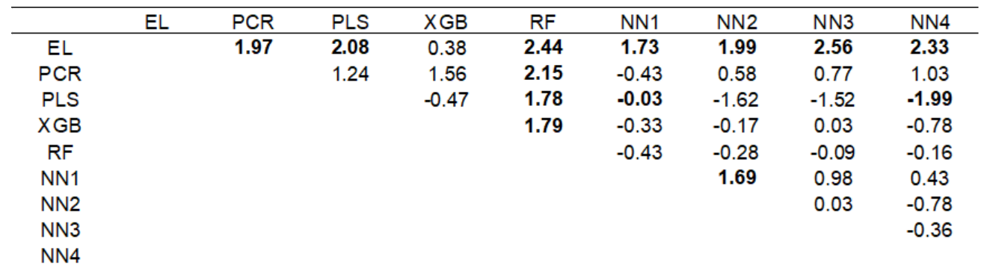
Model Comparison
Compare model prediction performance based on the Diebold-Mariano test statistic.
The elastic network model has an unexpectedly good prediction level, and the random forest performs the worst.

Slide 19
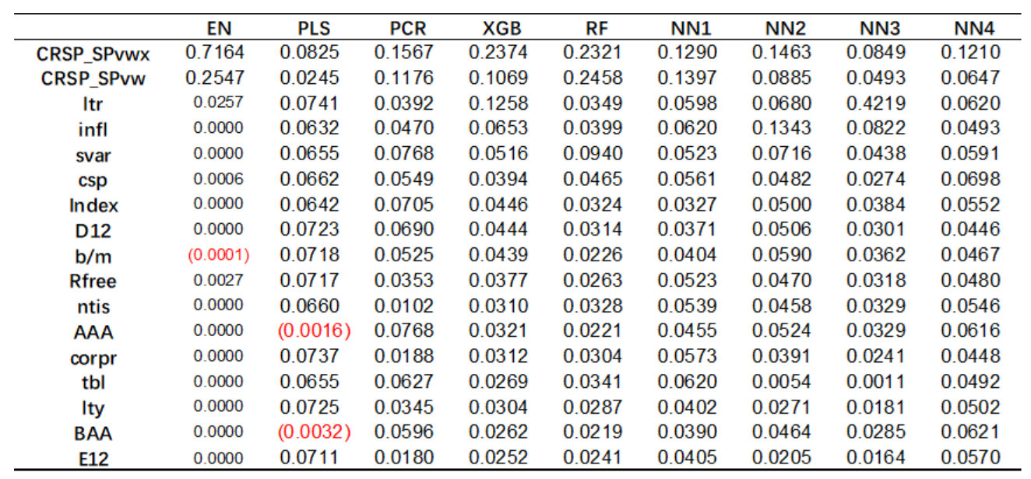
Summary of Importance

Slide 20
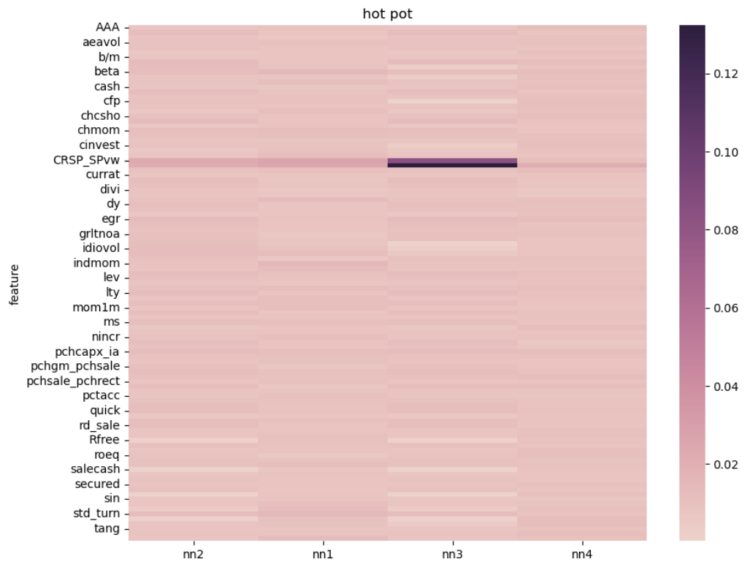
Summary of Importance

Slide 21
Thanks

