Slide 1

Paper Replication I: Empirical Asset Pricing via Machine Learning
HUANG, Yuxin; LEI, Yunxin; AN, Tianyuan; LIN, Fengshan; LIU, Zongxuan

Slide 2
Introduction
Presented: Lin Fengshan

Slide 3
Main Contributions:
A comparative analysis of machine learning methods for measuring asset risk premia of the market and individual stocks.
A demonstration of large economic gains to investors using machine learning forecasts, in some cases doubling the performance of leading regression-based strategies.
An identification of the best-performing methods (trees and neural networks) and their predictive gains due to allowing nonlinear predictor interactions.
A consensus on the dominant predictive signals, which include variations in momentum, liquidity, and volatility.

Slide 4
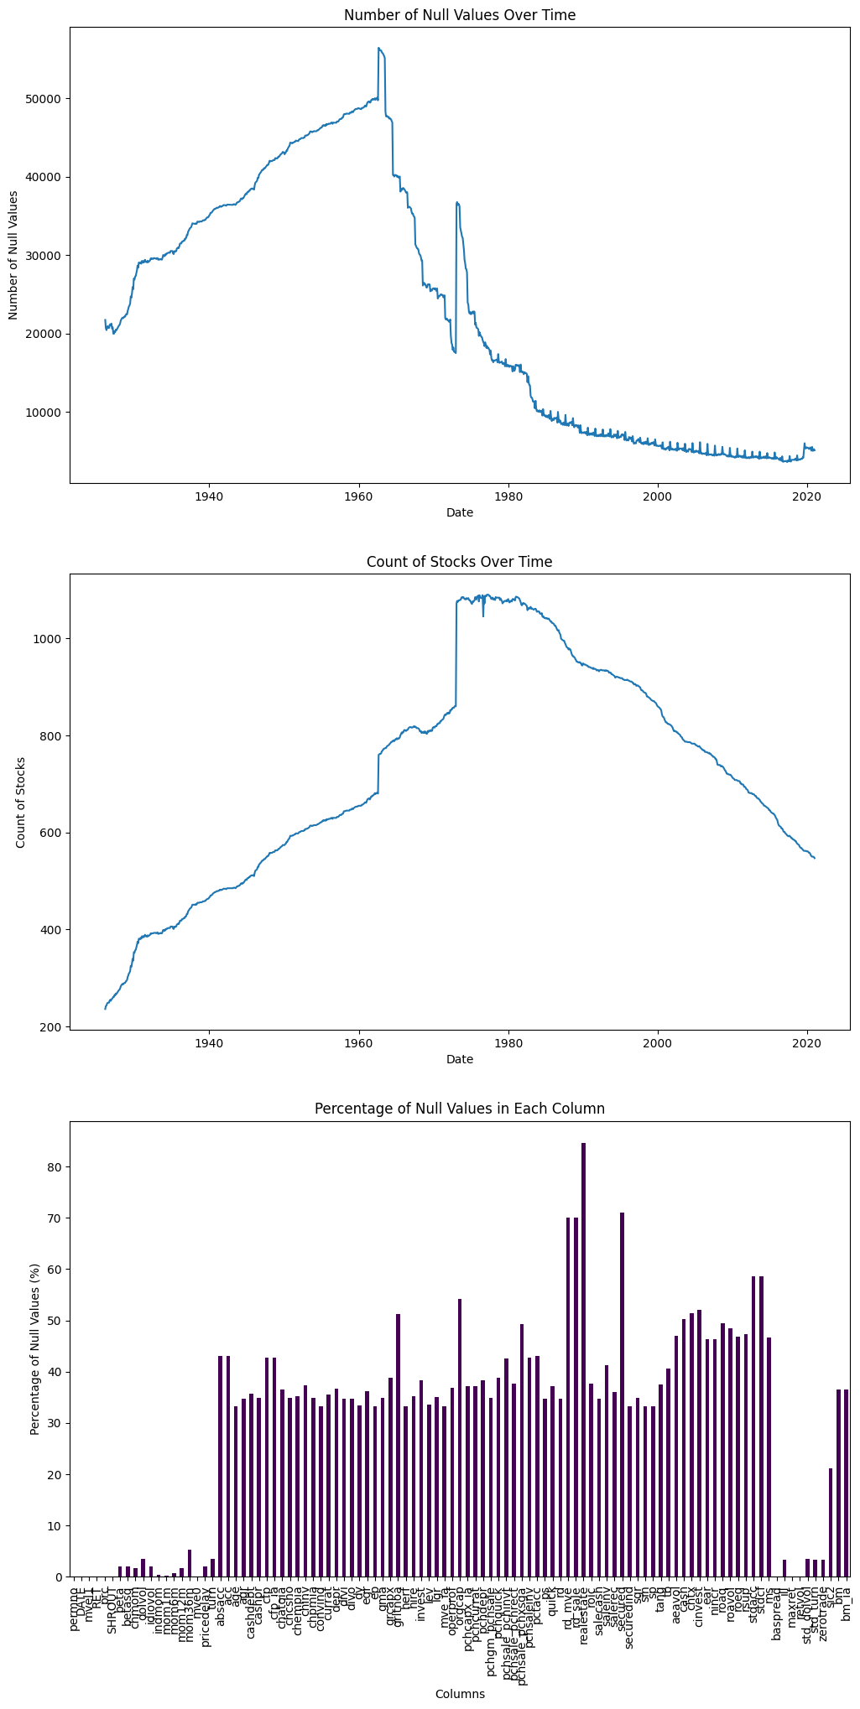
Data sampling
The data collected by TA resembles the original data. It has stock data for many US firms from 1957 to 2016.
We used a random subset of 1000 stocks to run the models on Colab, as the full dataset was too large.
We also used another subset of 1247 stocks with more than 480 months of history to test the OLS, OLS_3, PLS, and PCR models, which were less computationally intensive.

Slide 5
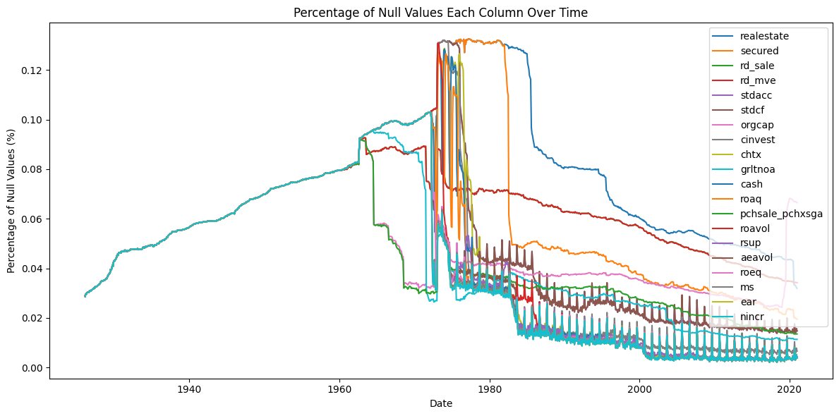
Missing data
To handle missing data, we applied a median imputation strategy for each column based on the month and year of the observation
We assumed that any remaining null values were zero and replaced them accordingly

Slide 6
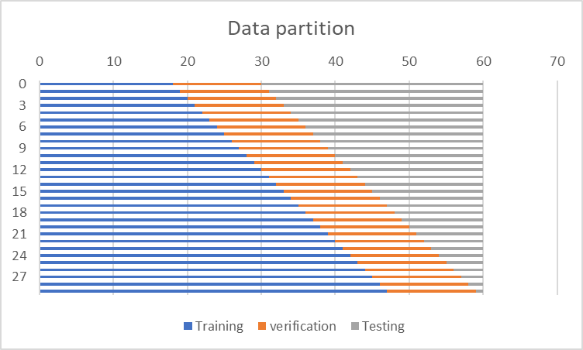
Data partition
The training set consisted of 18 years of historical data, which were divided into yearly partitions.
The verification set included 12 years of data that followed the training period.
The test set contained the remaining data after the verification period.
The model was trained incrementally by adding one year of data to the training set at each iteration.

Slide 7
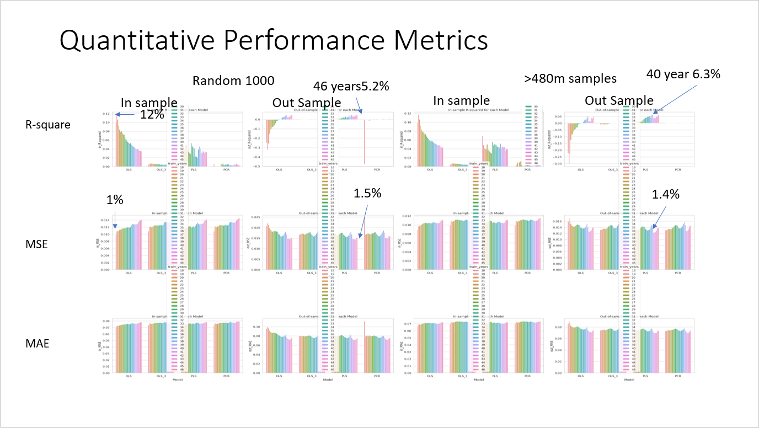
Notes:
The in sample R-Square shows the OLS and PLS model fits the training data well. However, the out sample/ cross-validation score, as it was expected, does not performed.
Higher R-squared and lower RMSE indicate better fit.
OLS - 19 has the highest in-sample R-square 12% while enjoying 1%MSE. However, it is the worst in the out sample test. Indicating that OLS does not perform well in the prediction.
PLS – 46 has the best Out sample R-square of 5.2% and a MSE of 1.5.
Over all, PLS with longer training data perform better, while the OLS is the worst.

Slide 8
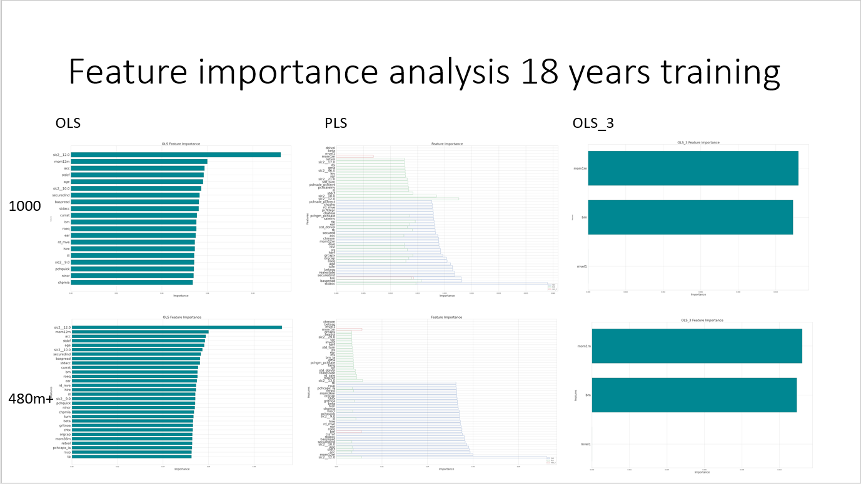
Notes:
OLS: sic2__12.0 mom12m
PLS: sic2__13 0sic2__12
OLS_3 mom1m BM

Slide 9
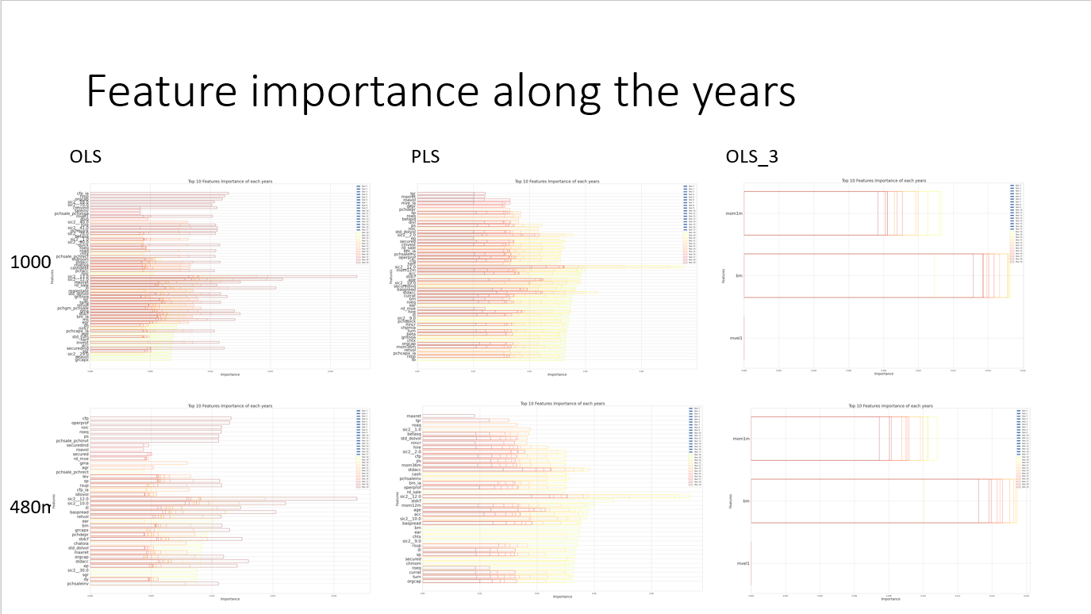
Notes:
The chart shows that the feature importance varies over time, depending on the data and the model. Some features become more or less important as the years change, while some remain stable or fluctuate slightly.
The chart also shows that there is no single feature that dominates the prediction for all years. Instead, there is a combination of different features that have different levels of importance for each year.
PLS -46 sic2__13.0 ill sic2__12.0
OLS: sic2__12.0 baspread
OLS 3: BM is more importance

Slide 10
Summary and Implications
- Both OLS and PLS models have good in-sample R-Square values, indicating a good fit to the training data.
- However, the out-sample/cross-validation scores are much lower, suggesting poor predictive performance.
- OLS - 19 has the highest in-sample R-Square of 12% and low MSE of 1%. It has the lowest out-sample R-Square of -0.2%.
- PLS - 46 has the best out-sample R-Square of 5.2%, and a reasonable MSE of 1.5%. It also has a high in-sample R-Square of 11.8%.
- In general, PLS models with longer training data perform better than OLS models in terms of prediction.
- The feature importance is not constant over time, but varies according to the data and the model used.
- Different features have different importance for each year, and there is no single feature that can explain the prediction for all years.

Slide 11
PLS, PCR, Elastic-Net
Presented: Liu Zongxuan

Slide 12
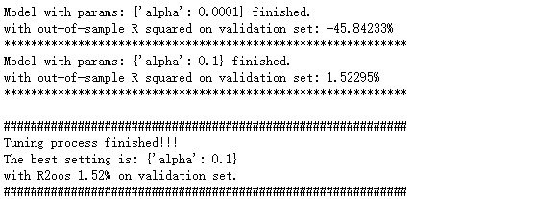
Elastic-Net
The ElasticNet model is a linear regression model that uses both L1 and L2 regularization to prevent overfitting. The alpha hyperparameter controls the strength of the regularization, with larger values of alpha leading to stronger regularization. As the result suggests, we choose α=0.1 in Elastic-Net.

Slide 13
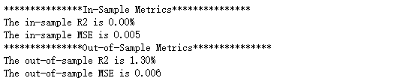
Elastic-Net
After training the model, we use it to make predictions on the training and testing data and evaluates the performance of the model using the evaluate function. The evaluate function calculates the mean squared error and R-squared score between the predicted and actual values of the target variable.
Overall, this code is performing cross-validation to select the best hyperparameters for an Elastic-Net regression model and then evaluating the performance of the model on the training and testing data.

Slide 14

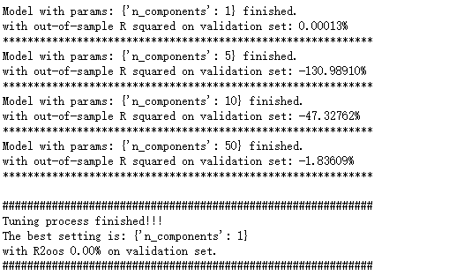
PLS
As the result suggests, we use only 1 component in PLS.

Slide 15

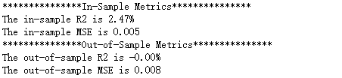
After training the model, we uses it to make predictions on the training and testing data (pls_pred_is and pls_pred_os, respectively) and evaluates the performance of the model using the evaluate function. Overall, the code is performing cross-validation to select the best hyperparameters for a PLS regression model and then evaluating the performance of the model on the training and testing data.
PLS

Slide 16


PCR
As the result suggests, we use 5 principal components in PCR.

Slide 17
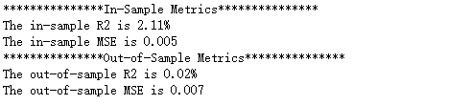
PCR
After training the model, we use it to make predictions on the training and testing data and evaluates the performance of the model using the evaluate function.
Overall, this code is performing cross-validation to select the best hyperparameters for a PCR model and then evaluating the performance of the model on the training and testing data.

Slide 18
Generalized Linear Model
Presented: Huang Yuxin

Slide 19
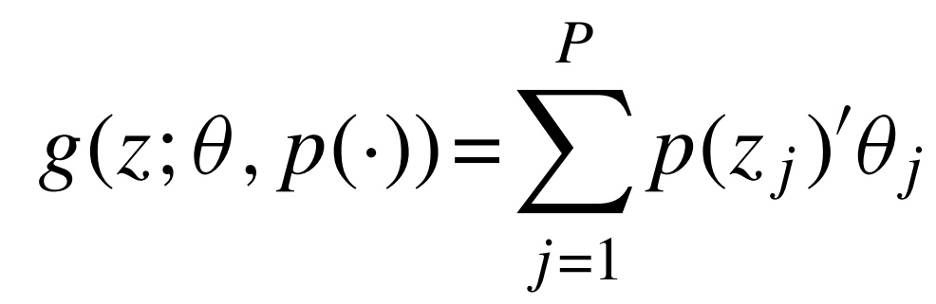

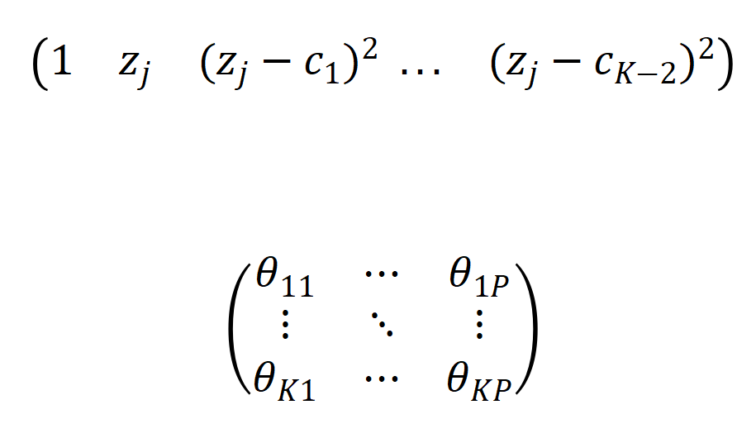

Generalized Linear Model
Compare with Simple Linear
K-term spline series expansion
knots
$k=1,…,K:$ term index
$j =1,…,P:$ character index

Slide 20
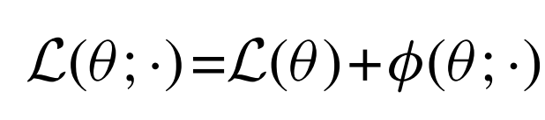
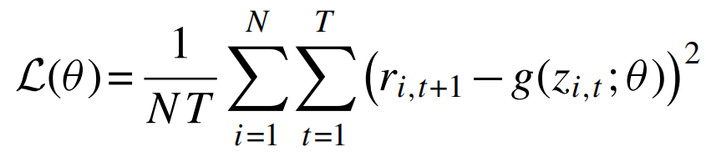
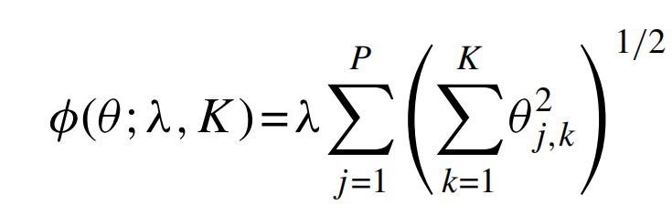
Generalized Linear Model
However, the number of model parameters multiply quickly...
Objective function
Penalization function
Group Lasso
$k=1,…,K:$ term index
$j =1,…,P:$ character index
As its name suggests, the group lasso selects either all K spline terms associated with a given characteristic or none of them.

Slide 21
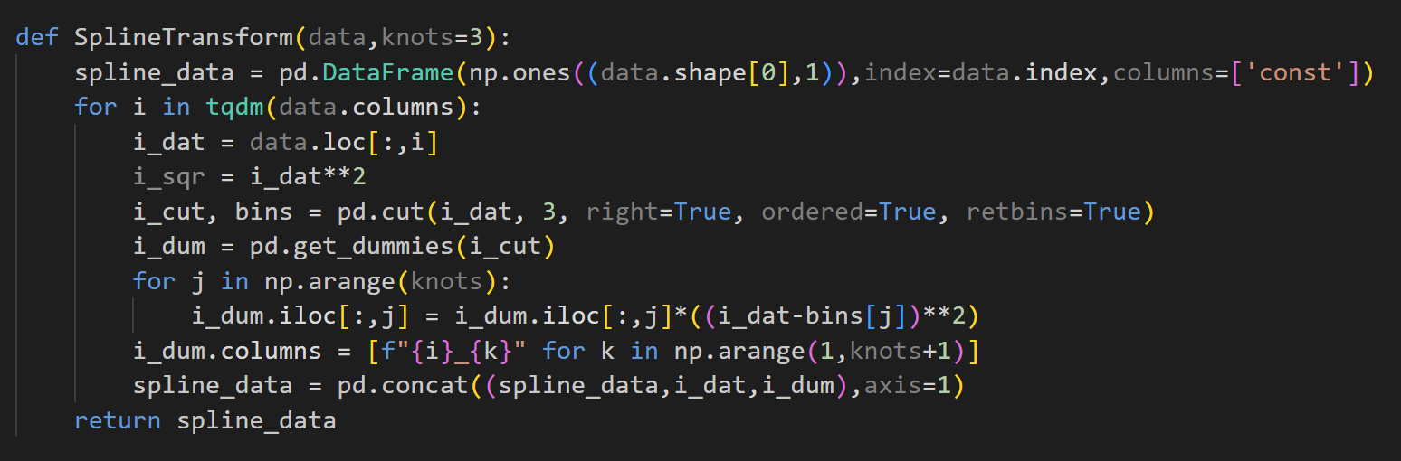
Generalized Linear Model
Code design to implement the above content

Slide 22
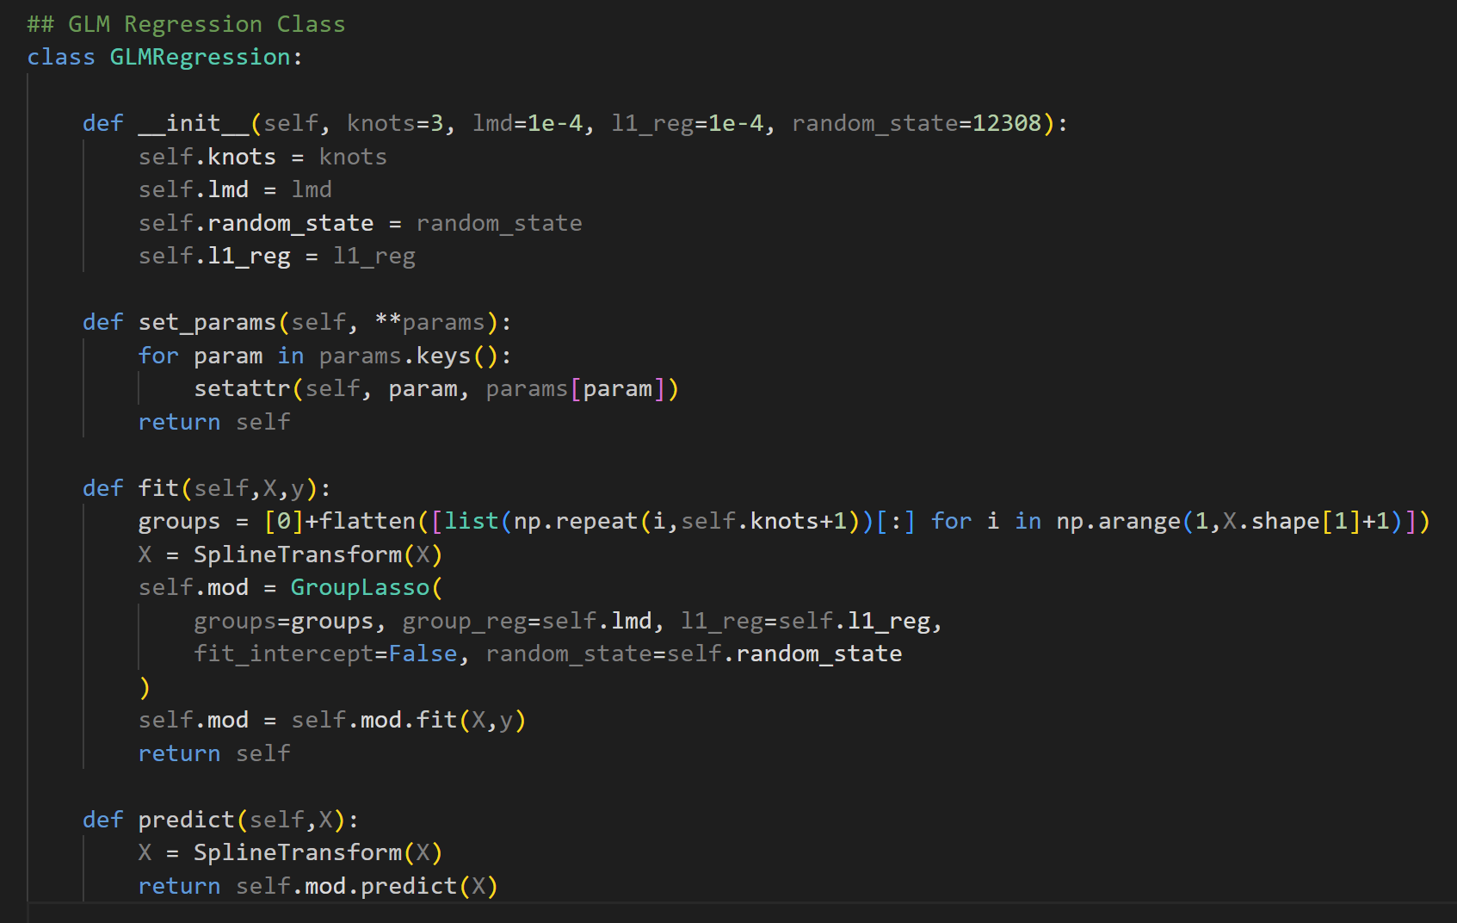
Generalized Linear Model

Slide 23
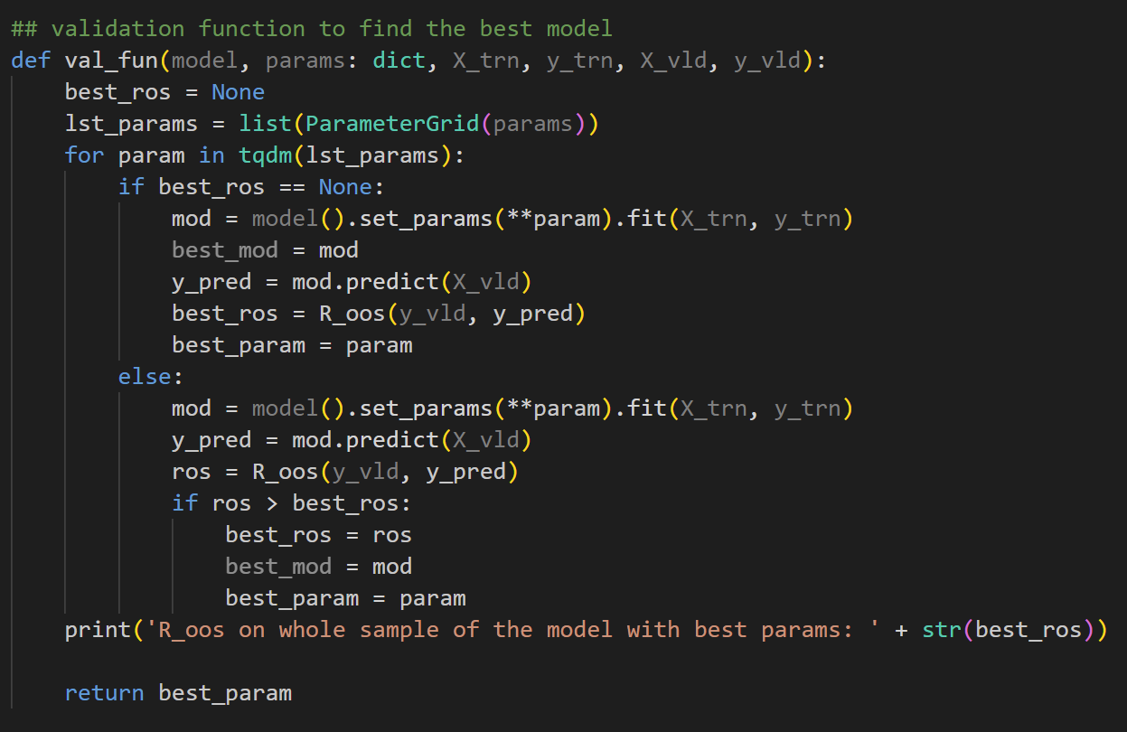
Generalized Linear Model
How to find the best parameter settings

Slide 24
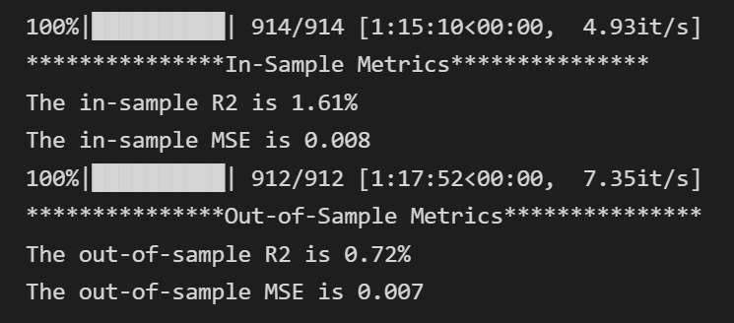
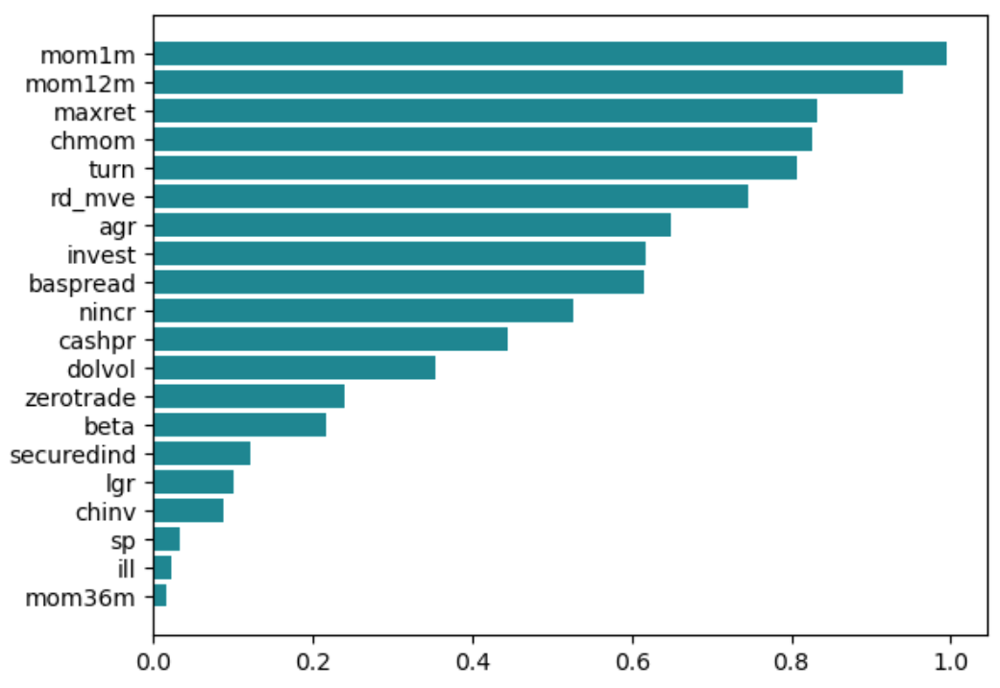
Generalized Linear Model
R-squared & Mean Square Error
Feature Importance

Slide 25
Generalized Linear Model
Summary
Best parameter settings
R-squared
K-term spline series expansion
Penalization function-Group Lasso
GLM
Regression
fixed window
expanding window
MSE
Feature Importance

Slide 26
Tree Models
Presented: An Tianyuan

Slide 27
Models
Inspired by the warm-up project, we tried two gradient-boosting tree models: LightGBM and XGB.
Random Forest is also in this part.

Slide 28
Best Parameters of Tree Models
We use the regressor from packages lightgbm, sklearn and xgboost.
Random Forest: estimator(300), max depth(6), max features(100);
LightGBM: estimator(100),max depth(2), learning rate(0.1);
XGB: estimator(500), max depth(2), learning rate(0.01) ;

Slide 29
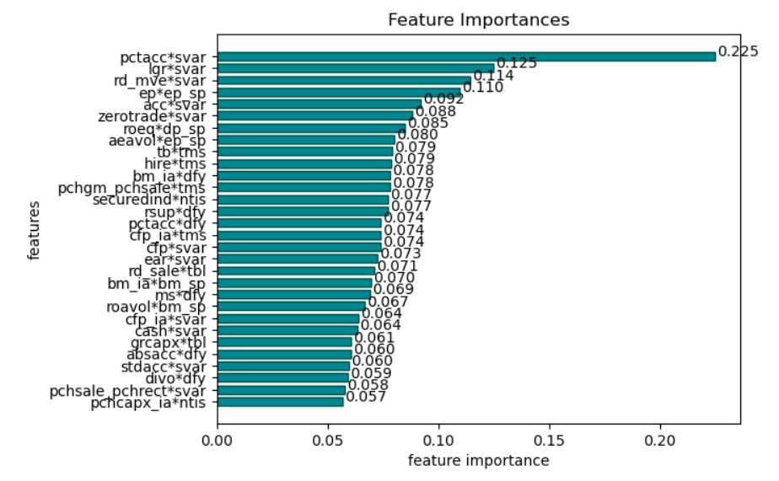

Feature Importance

Slide 30
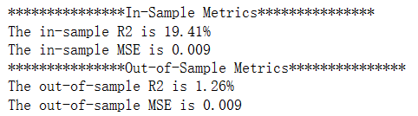
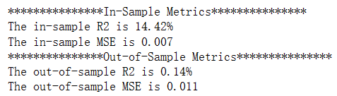
Model Performance
LightGBM
XGB

Slide 31

Neural Networks
Presented: Lei Yunxin

Slide 32
Models
NN1 – 1 hidden layer – 32 neurons
NN2 – 2 hidden layers – [32,16] neurons
NN3 – 3 hidden layers – [32,16,8] neurons
NN4 – 4 hidden layers – [32,16,8,4] neurons
NN5 – 5 hidden layers – [32,16,8,4,2] neurons

Slide 33
Details
Activation Function: ReLU
Parameter Estimation: SGD
learning rate: 'learning rate shrinkage' algorithm
early stopping: lower computational cost
batch normalization

Slide 34
Performance Evaluation
Calculation reduction in panel predictive R² from shuffling values of predictor j, while holding the remaining model estimates fixed.

Slide 35
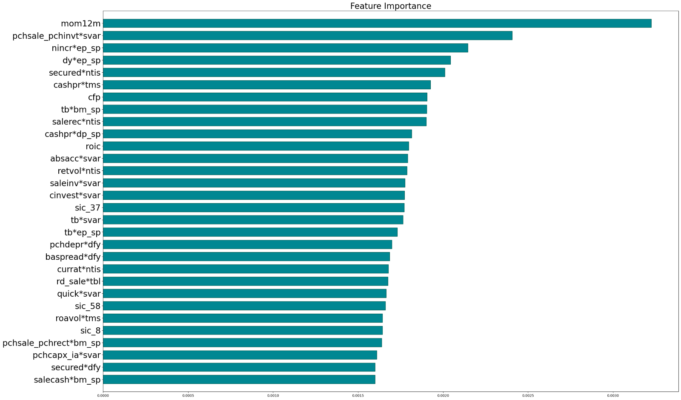
Feature Importance

Slide 36
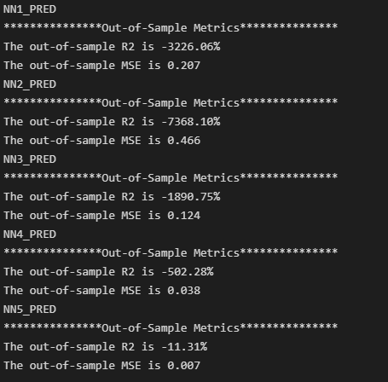
Model Performance

Slide 37
Conclusion
Model Comparison: we find that tree models the best under the recursive performance evaluation scheme. They have the highest R-squared, both in-sample and out-of-simple.

Slide 38
Conclusion
Feature importance: some variables weigh a lot among all models.
Percent accruals (pctacc) implies the company's debt position.
12-month momentum (mom12m) reflects the long-term trend of the stocks’ price.
Industry-adjusted book-to-market (bm_ia) illustrates the market's assessment of the company.

Slide 39
References
Notebooks and codes on the Website, especially Yanlin Bao, PhD in Business (Finance) student at Singapore Management University;
Shihao Gu, Bryan Kelly, Dacheng Xiu, Empirical Asset Pricing via Machine Learning, The Review of Financial Studies, Volume 33, Issue 5, May 2020, Pages 2223–2273

