Slide 1
Kaggle ——
Jane Street Real-Time Market Data Forecasting
Kaggle website: https://www.kaggle.com/competitions/jane-street-real-time-market-data-forecasting/overview
MAFS5440, Fall 2024

Slide 2
Background
Modeling problems in modern financial markets are inherently complex due to unique challenges such as fat-tailed distributions, non-stationary time series, and data that often violate assumptions of standard statistical methods. Using real-world data derived from Jane Street's production systems, you are required to develop models to forecast market actions. This project provides an opportunity to tackle a highly relevant and complex problem that mirrors the intricacies of trading in competitive financial markets.
Task: Build a predictive model to forecast trading actions using real-time market features.
Key Challenge: Extract actionable insights from complex, noisy financial data.

Slide 3
Data
Training Set:
date_id and time_id - a chronological structure to the data
symbol_id - identifies a unique financial instrument.
weight - the weighting used for calculating the scoring function.
feature_{00...78} - anonymized market data.
responder_{0...8} - anonymized responders. The responder_6 is target to predict.
Testing Set: Only a single batch served by the evaluation API.
Others:
lags.parquet - values of responder_{0...8} lagged by one date_id. All of the previous date's responders will be served at the first time step of the succeeding date.
sample_submission.csv - the format of the predictions your model should make.
features.csv - metadata pertaining to the anonymized features
responders.csv - metadata pertaining to the anonymized responders
Refer: https://www.kaggle.com/competitions/jane-street-real-time-market-data-forecasting/data
Notes:
Each row in the {train/test}.parquet dataset corresponds to a unique combination of a symbol (identified by symbol_id) and a timestamp (represented by date_id and time_id). You will be provided with multiple responders, with responder_6 being the only responder used for scoring. The date_id column is an integer which represents the day of the event, while time_id represents a time ordering. It's important to note that the real time differences between each time_id are not guaranteed to be consistent.
The symbol_id column contains encrypted identifiers. Each symbol_id is not guaranteed to appear in all time_id and date_id combinations. Additionally, new symbol_id values may appear in future test sets.

Slide 4
Your Job
Predict the 'action' variable, i.e., responder_6 , based on features to optimize trading decisions.
Key Questions:
How to handle high-dimensional, noisy data effectively?
What strategies improve prediction accuracy?
How to ensure predictions align with trading constraints?
Notes:
ordinary least squares (OLS) panel model
principal components regression (PCR)
Partial least squares (PLS),

Slide 5
Approach (Just some suggestion)
Data Preprocessing:
Handle missing data and scale features.
Analyze feature correlations.
Feature Engineering:
Explore time-series trends and interactions.
Modeling:
Base: Basic statistical or machine learning models(e.g., XGBoost).
Advanced: Neural Networks, such as LSTMs or Transformers.
Note: Freely & publicly available external data is allowed, including pre-trained models

Slide 6
Challenges
Feature Engineering Sparse Target:
Imbalanced classes derived from 'resp'.
Computational Feasibility:
CPU&GPU Notebook <= 8 hours run-time when submit to Kaggle.

Slide 7
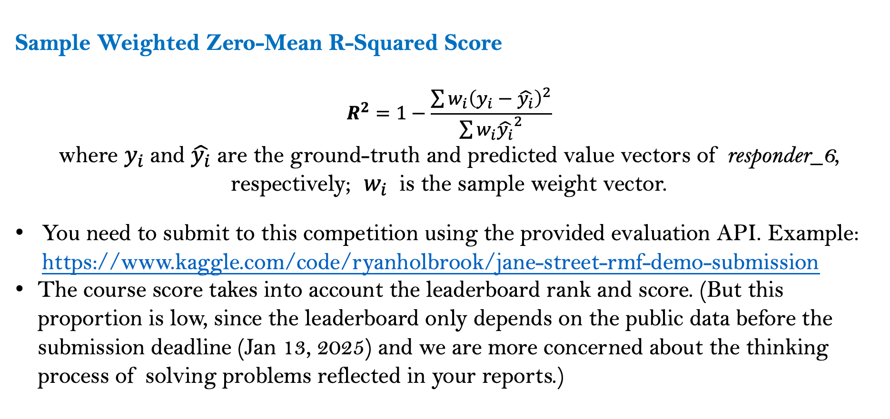
Evaluation metric
Sample Weighted Zero-Mean R-Squared Score
$$R^{2}=1−\frac{\sum{w_{i}{\left(y_{i}−\hat{y_{i}}\right)}^{2}}}{\sum{w_{i}{\hat{y_{i}}}^{2}}}$$
where $y_{i}$and $\hat{y_{i}}$ are the ground-truth and predicted value vectors of responder_6, respectively; $w_{i}$ is the sample weight vector.
You need to submit to this competition using the provided evaluation API. Example: https://www.kaggle.com/code/ryanholbrook/jane-street-rmf-demo-submission
The course score takes into account the leaderboard rank and score. (But this proportion is low, since the leaderboard only depends on the public data before the submission deadline (Jan 13, 2025) and we are more concerned about the thinking process of solving problems reflected in your reports.)

Slide 8
Enjoy the project! You can keep following after the course ends!

