Slide 1
Kaggle ——
M5 Forecasting
Kaggle website: https://www.kaggle.com/c/m5-forecasting-accuracy
https://www.kaggle.com/c/m5-forecasting-uncertainty
MAFS5440, Fall 2024

Slide 2
Background
M5 forecasting: the 5th Makridakis Competition.
Task: Forecasting (accuracy) and estimating the uncertainty distribution of the realized values of the same series
Accuracy task: Can you estimate, as precisely as possible, the point forecasts of the unit sales of various products sold in the USA by Walmart?
Uncertainty task: Can you estimate, as precisely as possible, the uncertainty distribution of the unit sales of various products sold in the USA by Walmart?
Aim:
Identifying the most appropriate method(s) for different types of situations requiring predictions and making uncertainty estimates
Comparing the accuracy/uncertainty of ML and DL methods versus those of standard statistical ones
Notes:
Aim: To identify the most appropriate method(s) for different types of situations requiring predictions (accuracy) and making uncertainty estimates.
To advance the theory of forecasting and improve its utilization by businesses and non-profit organizations. Its other goal is to compare the accuracy/uncertainty of ML and DL methods versus those of standard statistical ones, and assess possible improvements versus the extra complexity and higher costs of using the various methods.

Slide 3
Data
42,840 time series data from Walmart (sales data from 2011-01-29 to 2016-06-19).
hierarchical sales data: starting at the item level and aggregating to that of departments, product categories and stores in three geographical areas of the US: California, Texas, and Wisconsin.
explanatory variables are also included; such as price, promotions, day of the week, and special events (e.g. Super Bowl, Valentine’s Day, and Orthodox Easter) that affect sales which are used to improve forecasting accuracy.
The majority of the more than 42,840 time series display intermittency (sporadic sales including zeros).
Refer: https://mofc.unic.ac.cy/m5-competition/
Notes:
ordinary least squares (OLS) panel model
principal components regression (PCR)
Partial least squares (PLS),

Slide 4
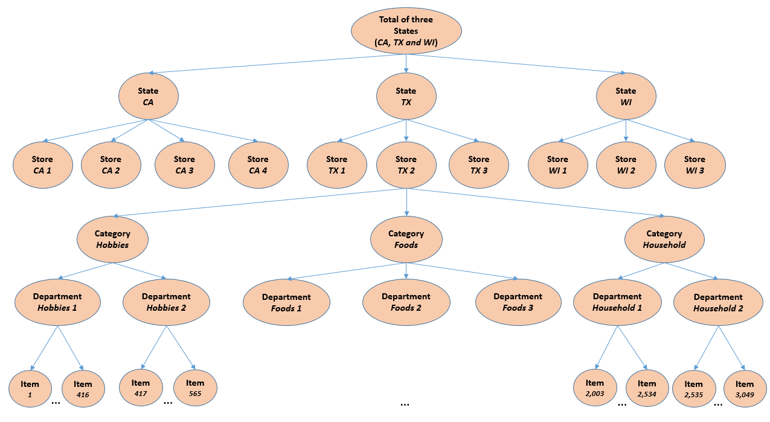
Data Organization Overview
In total:
42,840 time series
Notes:
ordinary least squares (OLS) panel model
principal components regression (PCR)
Partial least squares (PLS),

Slide 5
Your Job
Accuracy task: forecasting daily sales of each products for the next 28 days.
(m5-forecasting-accuracy)
Uncertainty task: 28 days ahead probabilistic forecasts for the median and four prediction intervals (PIs) (50%, 67%, 95%, and 99%).
(m5-forecasting-uncertainty)
The two task using the same dataset.
Notes:
ordinary least squares (OLS) panel model
principal components regression (PCR)
Partial least squares (PLS),

Slide 6
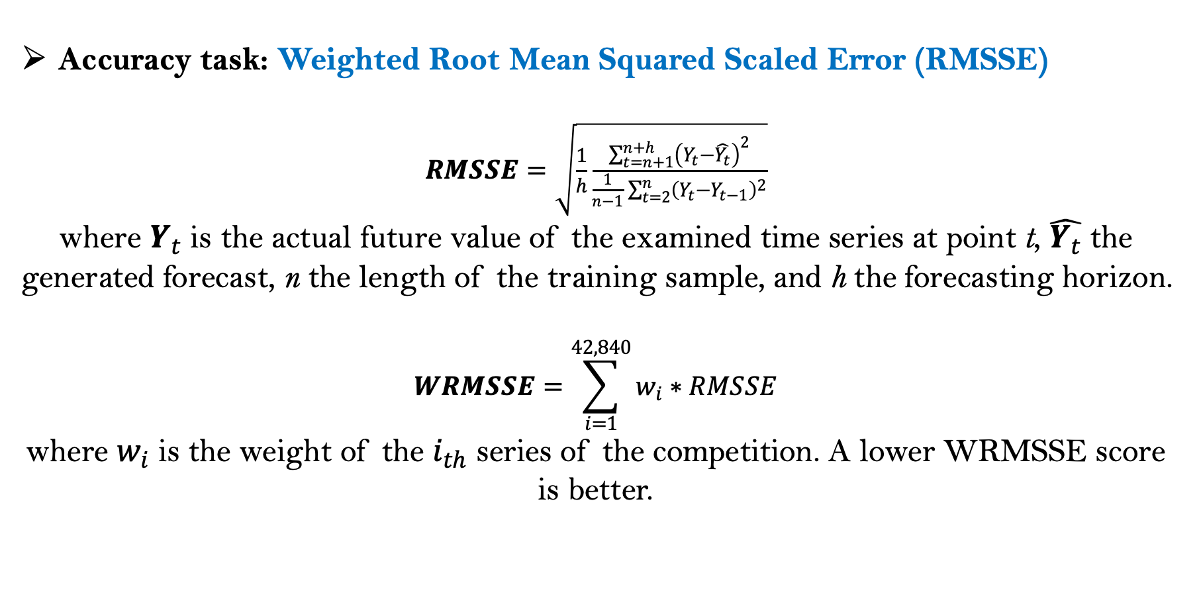
Evaluation metrics
Accuracy task: Weighted Root Mean Squared Scaled Error (RMSSE)
$RMSSE=\sqrt{\frac{1}{h}\frac{\sum_{t=n+1}^{n+h}{{\left(Y_{t}−\hat{Y_{t}}\right)}^{2}}}{\frac{1}{n−1}\sum_{t=2}^{n}{{\left(Y_{t}−Y_{t−1}\right)}^{2}}}}$
where $Y_{t}$ is the actual future value of the examined time series at point t, $\hat{Y_{t}}$ the generated forecast, n the length of the training sample, and h the forecasting horizon.
$$WRMSSE=\sum_{i=1}^{42,840}{w_{i}∗RMSSE}$$
where $w_{i}$ is the weight of the $i_{th}$ series of the competition. A lower WRMSSE score is better.
Notes:
ordinary least squares (OLS) panel model
principal components regression (PCR)
Partial least squares (PLS),

Slide 7
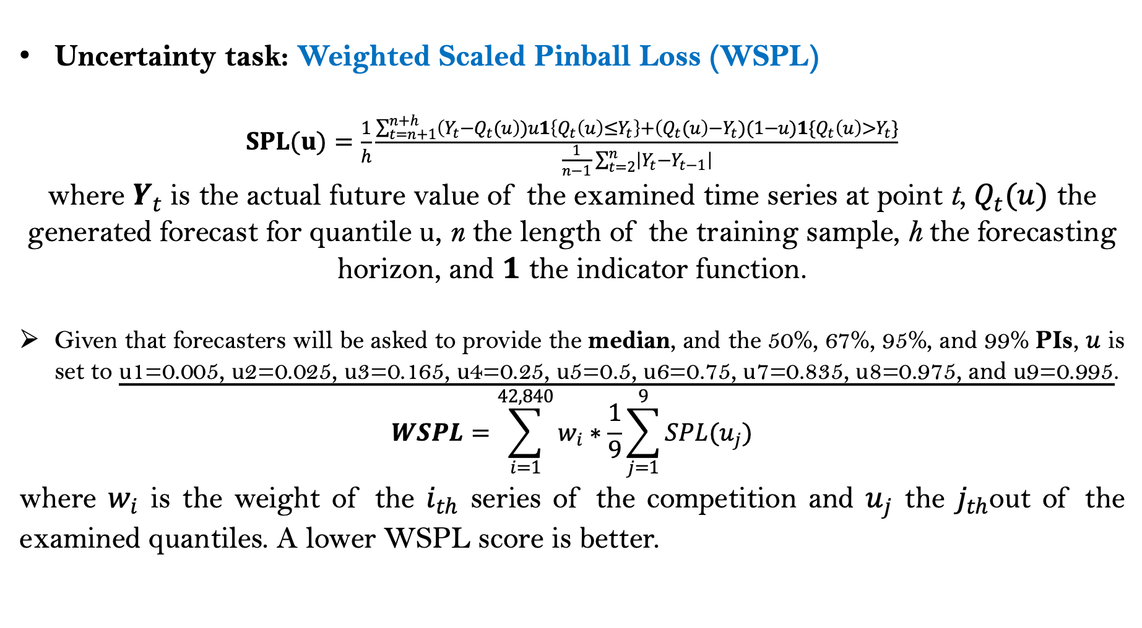
Evaluation metrics
Uncertainty task: Weighted Scaled Pinball Loss (WSPL)
$SPL(u)=\frac{1}{h}\frac{\sum_{t=n+1}^{n+h}{\left(Y_{t}−Q_{t}(u\right))u1\left\{Q_{t}\left(u\right)≤Y_{t}\right\}+\left(Q_{t}(u\right)−Y_{t})(1−u)1\{Q_{t}\left(u\right)>Y_{t}\}}}{\frac{1}{n−1}\sum_{t=2}^{n}{\left|Y_{t}−Y_{t−1}\right|}}$
where $Y_{t}$ is the actual future value of the examined time series at point t, $Q_{t}(u)$ the generated forecast for quantile u, n the length of the training sample, h the forecasting horizon, and $1$ the indicator function.
Given that forecasters will be asked to provide the median, and the 50%, 67%, 95%, and 99% PIs, $u$ is set to u1=0.005, u2=0.025, u3=0.165, u4=0.25, u5=0.5, u6=0.75, u7=0.835, u8=0.975, and u9=0.995.
$$WSPL=\sum_{i=1}^{42,840}{w_{i}∗\frac{1}{9}\sum_{j=1}^{9}{SPL(u_{j})}}$$
where $w_{i}$ is the weight of the $i_{th}$ series of the competition and $u_{j}$ the $j_{th}$out of the examined quantiles. A lower WSPL score is better.
Notes:
ordinary least squares (OLS) panel model
principal components regression (PCR)
Partial least squares (PLS),

Slide 8
Weighting
M5 involves the unit sales of various products of different selling volumes and prices that are organized in a hierarchical fashion. Therefore, you must provide accurate forecasts across all hierarchical levels, especially for series of high importance, i.e. for series that represent significant sales, measured in US dollars.
To that end, the forecasting errors computed for each participating method (both RMSSE and SPL) will be weighted across the M5 series based on their cumulative actual dollar sales, which is a good and objective proxy of their actual value for the company in monetary terms.
Refer: https://github.com/Mcompetitions

