Slide 1
Large Language Models with Financial Analysis
MAFS5440 2024Fall

Slide 2








Large language models use transformer models and are trained using massive datasets — hence, large. This enables them to recognize, translate, predict, or generate text or other content.
What LLM can do for financial analysis?
Interpreting Data
Modeling Predict
Automated Reporting
Market Analysis
Risk Assessment
Notes:
ChatGPT is an AI language model by OpenAI that uses deep learning to understand and generate human-like text in conversations.

Slide 3
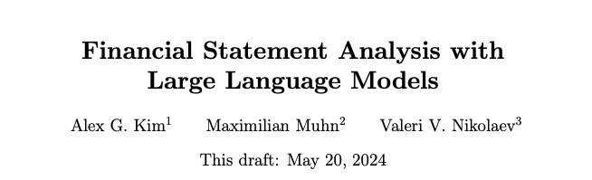

GPT-4 can outperform professional financial analysts in predicting future earnings changes, generating useful narrative insights, and resulting in superior trading strategies with higher Sharpe ratios and alphas, thereby suggesting a potential central role for LLMs in financial decision-making.
https://arxiv.org/pdf/2407.17866

Slide 4
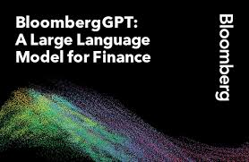


BloombergGPT
trained an LLM using a mixture of finance data and general-purpose data, which took about 53 days, at a cost of around $3M)
Improving existing financial NLP tasks, such as sentiment analysis, named entity recognition, news classification, and question answering.
Open Financial LLMs. Can be fine-tuned swiftly to incorporate new data (the cost falls significantly, less than $300 per fine-tuning).
FinGPT: Instruction Tuning Benchmark for Open-Source Large Language Models in Financial Datasets
FinGPT: Democratizing Internet-scale Data for Financial Large Language Models
https://arxiv.org/abs/2306.05443
Notes:
BloombergGPT represents the first step in the development and application of this new technology for the financial industry.

Slide 5
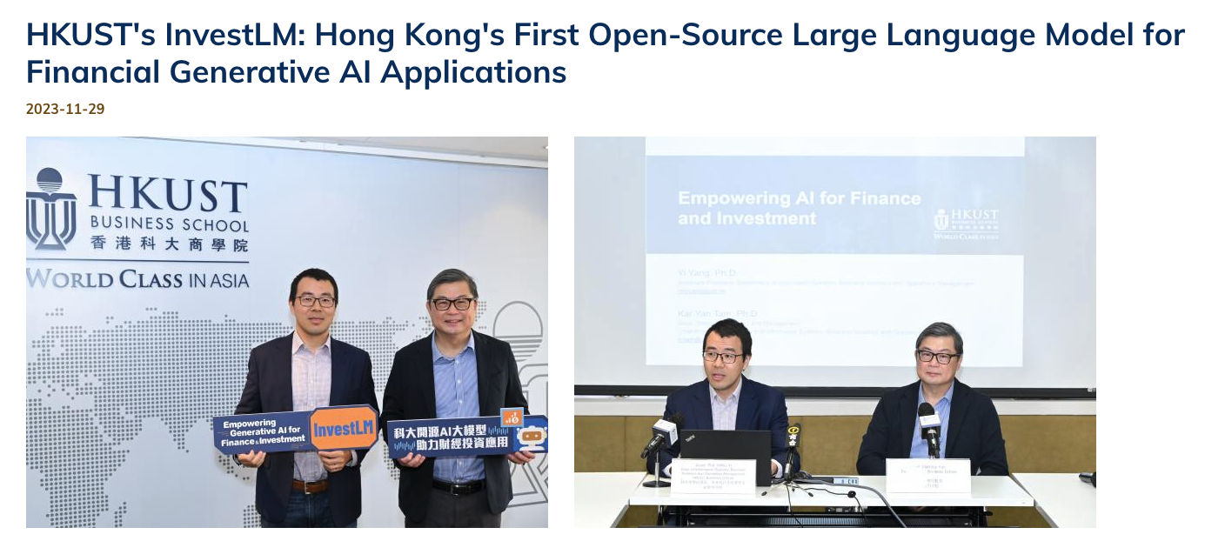
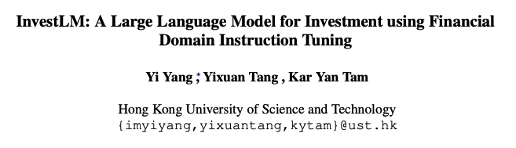


Slide 6
Example 1
Financial News Analysis with Llama Index, ChatGPT, and Streamlit

Slide 7




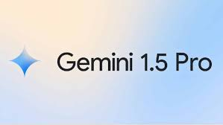


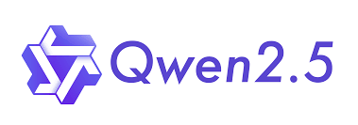
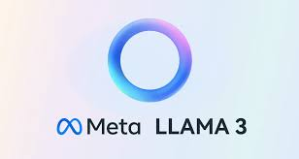
LlamaIndex: Swiftly start LLM apps, create (retrieval-augmented generation) RAG systems in minutes, access advanced data tools for customization.
A free and open-source framework to rapidly build and share beautiful machine learning and data science web apps. It is a Python-based library specifically designed for machine learning engineers.

Slide 8
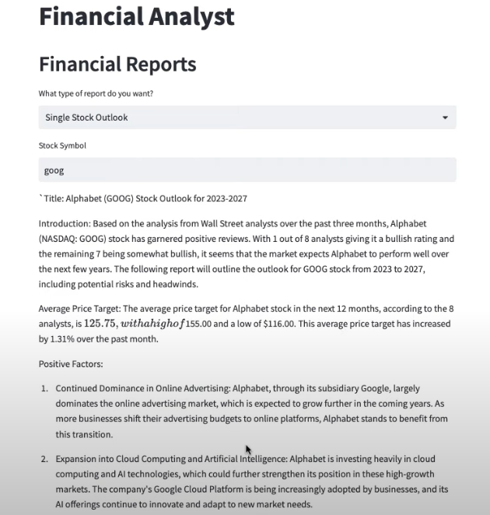
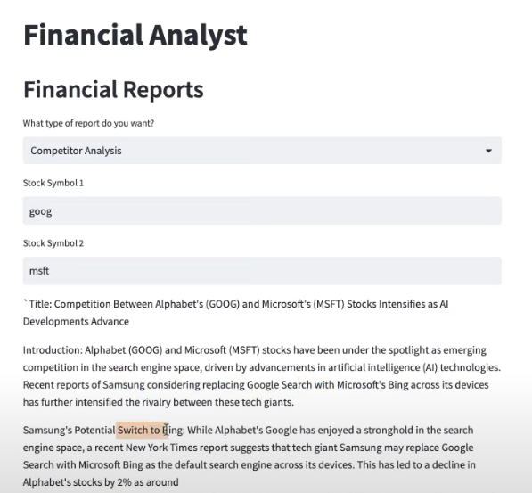
What we will build?
Single Stock Outlooks
Competitor Analysis

Slide 9
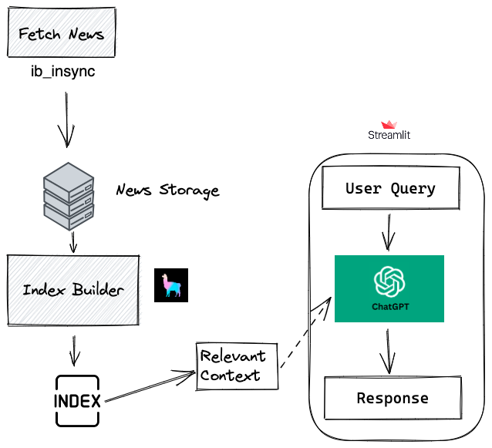
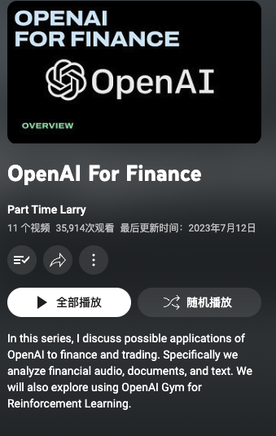
Overall Framework
Few line codes
Very clear infrastructure
Courses on Youtube
Code Example
https://github.com/hackingthemarkets/financial-news-llama-index

Slide 10
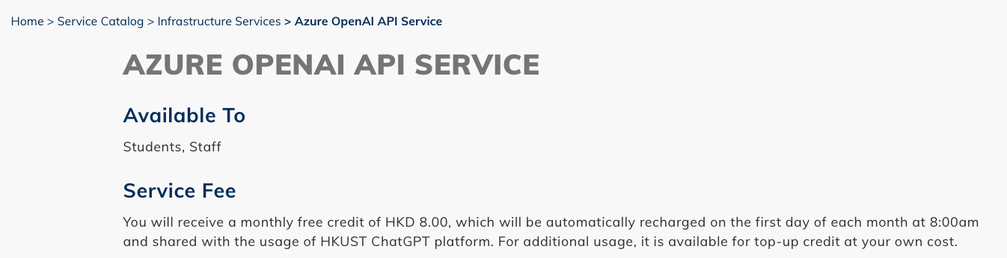

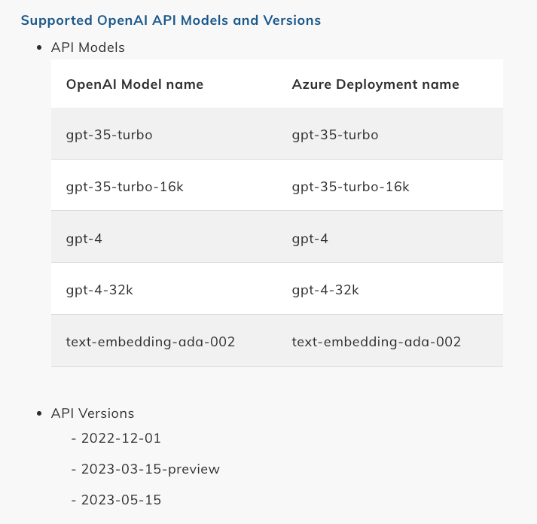
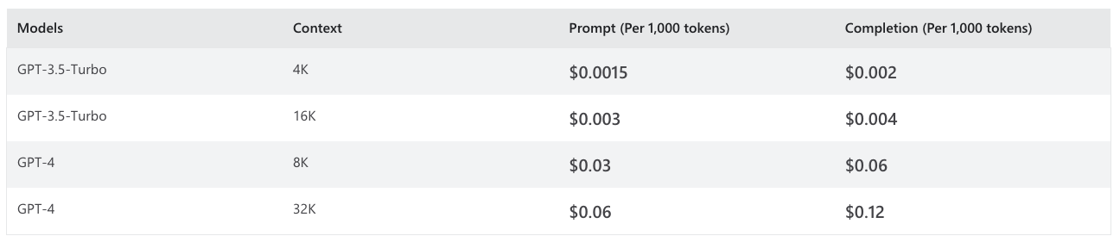

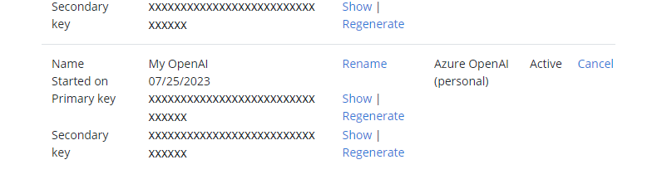
hkust azure-openai-api-service
Get the OpenAI API Key step by step

Slide 11
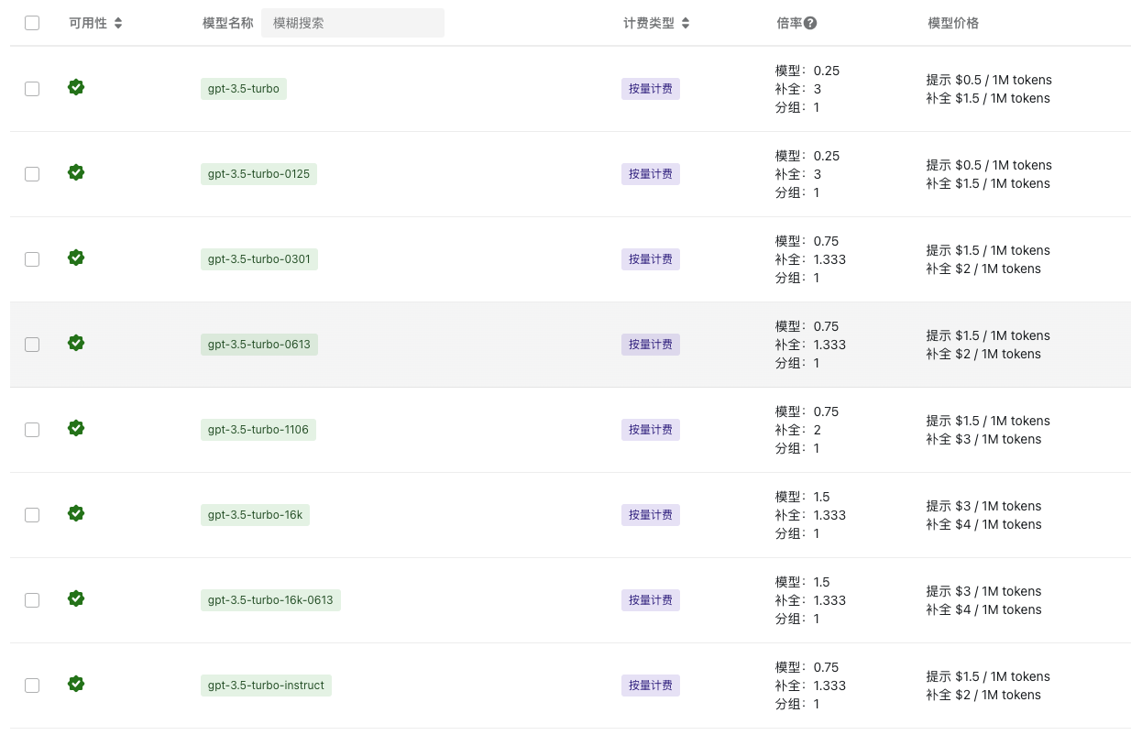

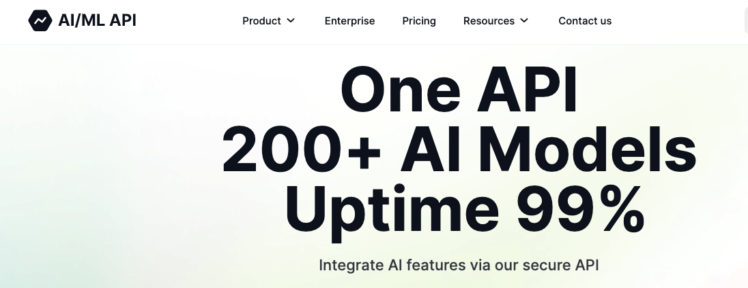
Other way to
get API tokens
https://api.bianxie.ai/
https://aimlapi.com/

Slide 12

Example 2
Local-deployed FinGPT-Forecaster

Slide 13


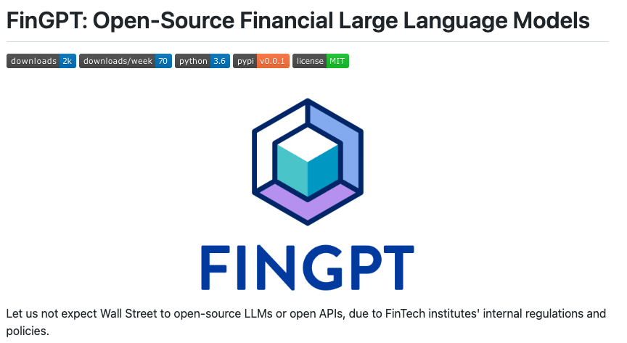

What is FinGPT-Forecaster?
An AI tool analyzing market news and optional financial data for a specific company.
Offers a stock price movement forecast for the upcoming week along with summarized analysis.
Fine-tuned on Llama-3-7b-chat-hf with LoRA using past year's DOW30 market data.
Demonstrates adaptability and generalization capabilities across various stock symbols.
GitHub link
Huggingface Demo
Build by
An open-source organization focused on advancing AI within the finance sector

Slide 14
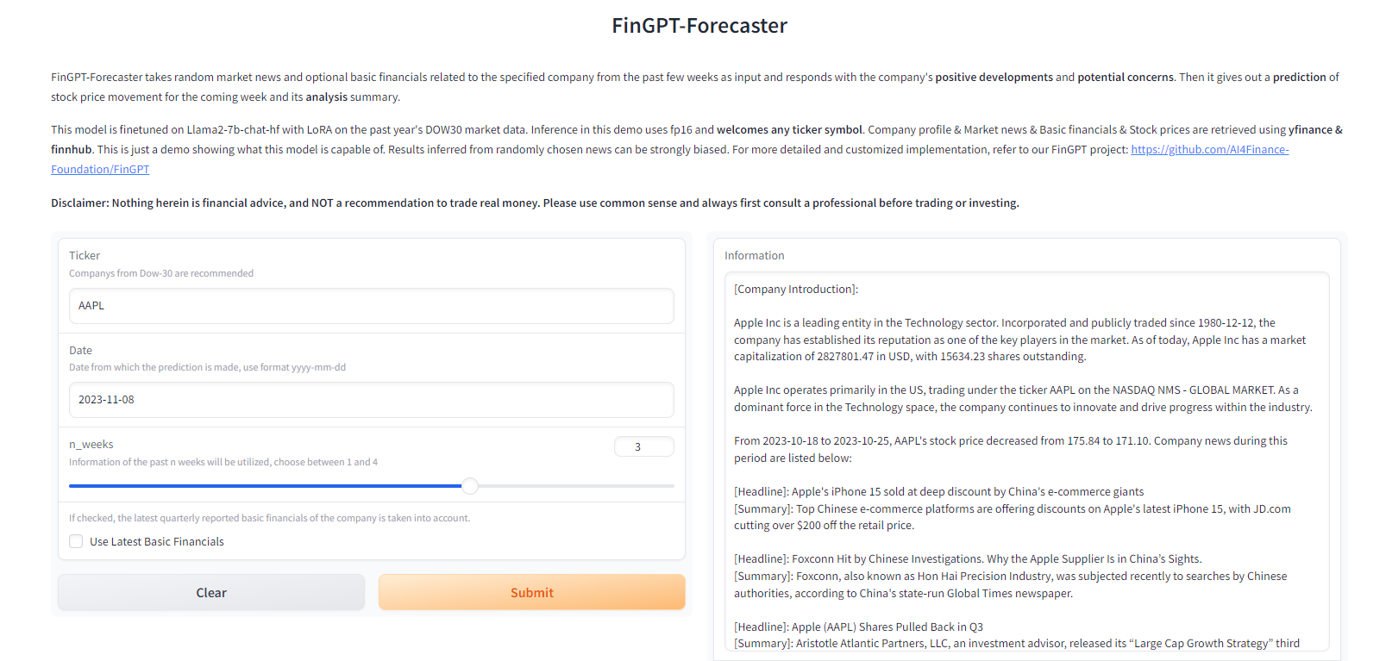

Slide 15
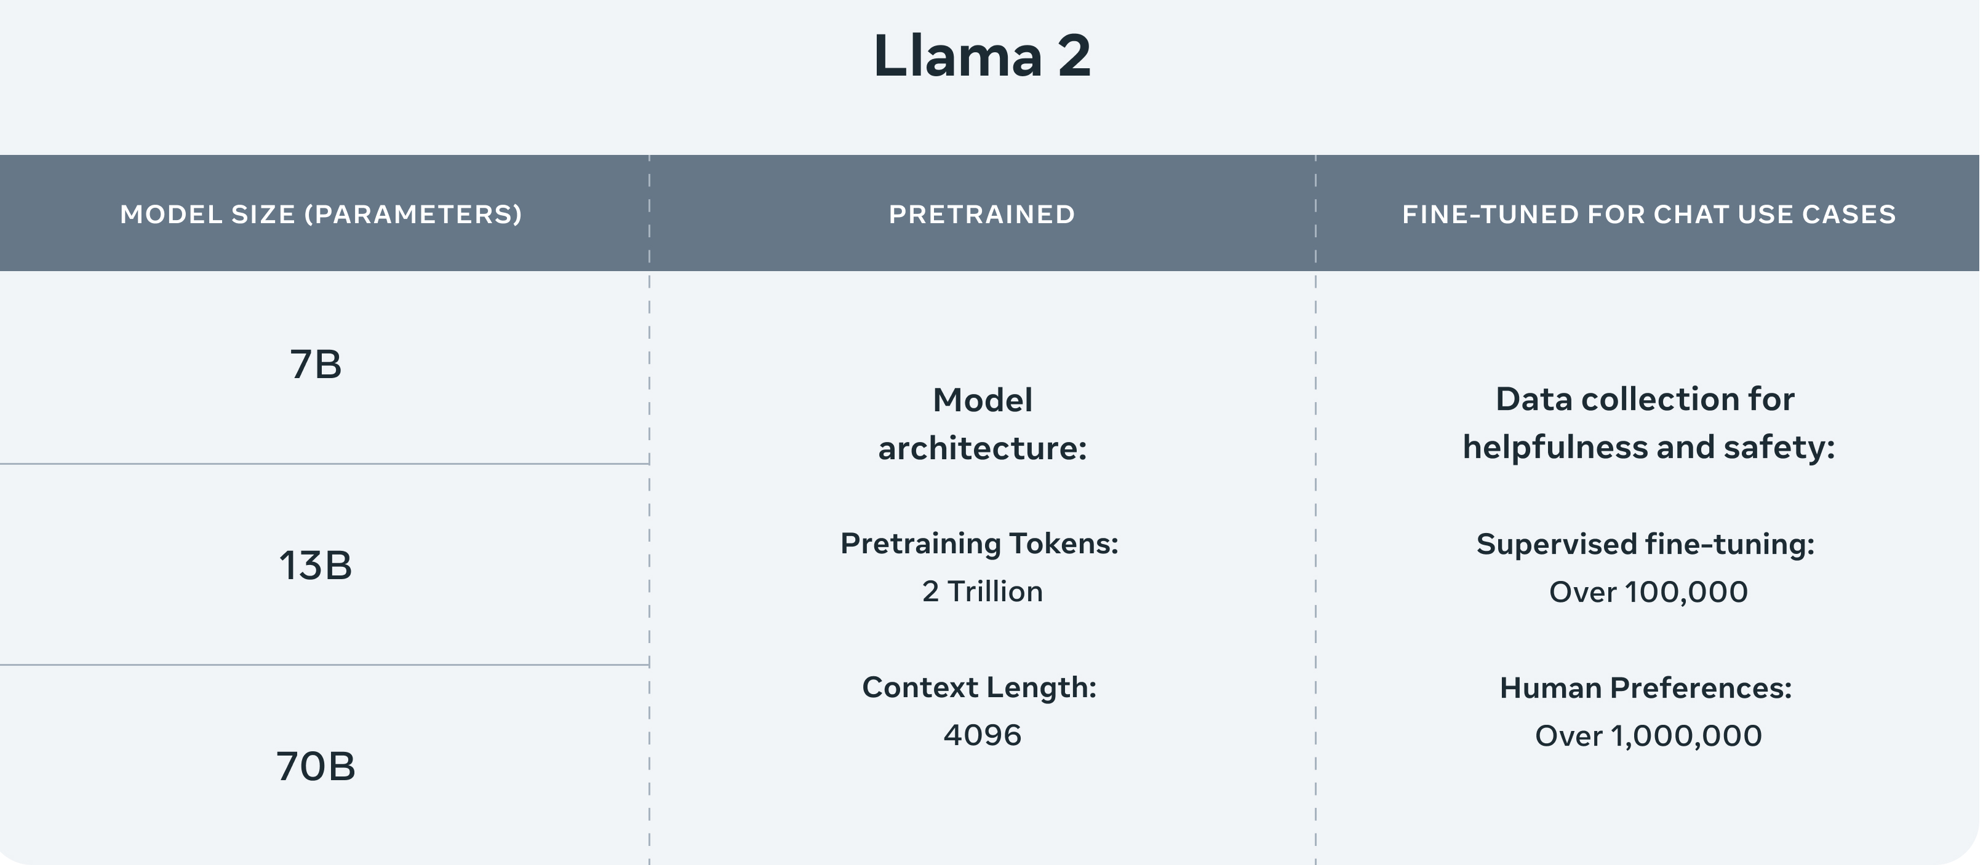
Llama 2 is Meta's open source large language model (LLM). It's freely available for almost anyone to use for research and commercial purposes. 7B model could deploy on RTX-3090(24GB)

Slide 16
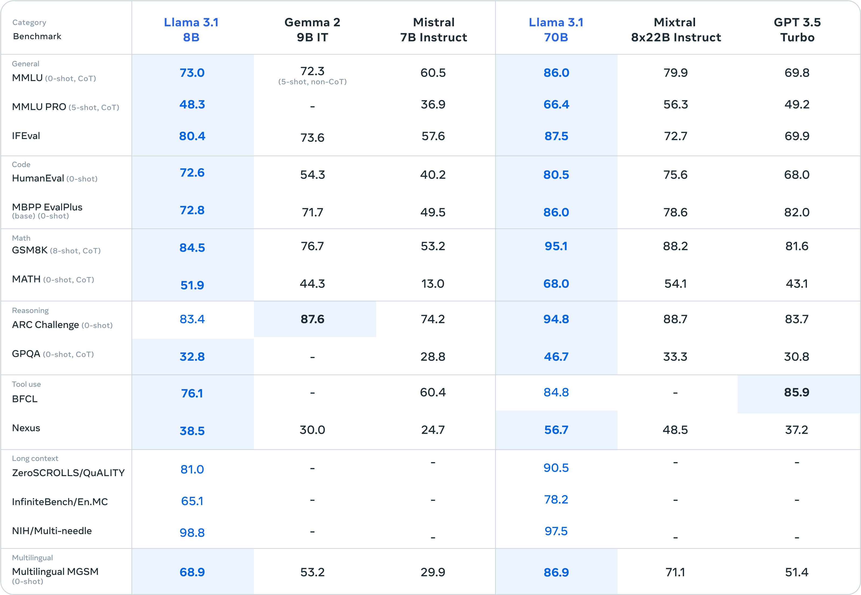
LLama3.1 series

Slide 17
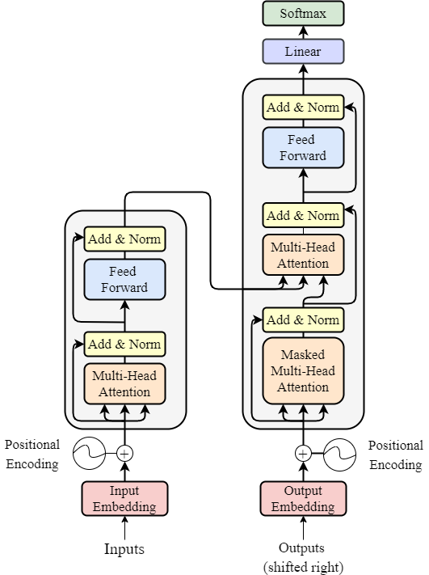
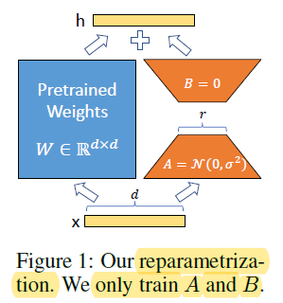
LoRA (Low-Rank Adaptation of Large Language Models) is a popular and lightweight training technique that significantly reduces the number of trainable parameters. It works by inserting a smaller number of new weights into the model and only these are trained.

Slide 18
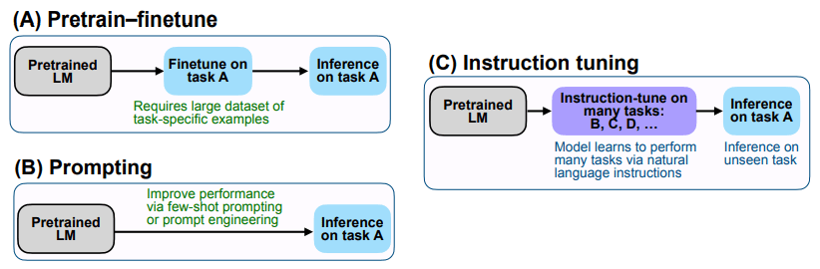


Slide 19

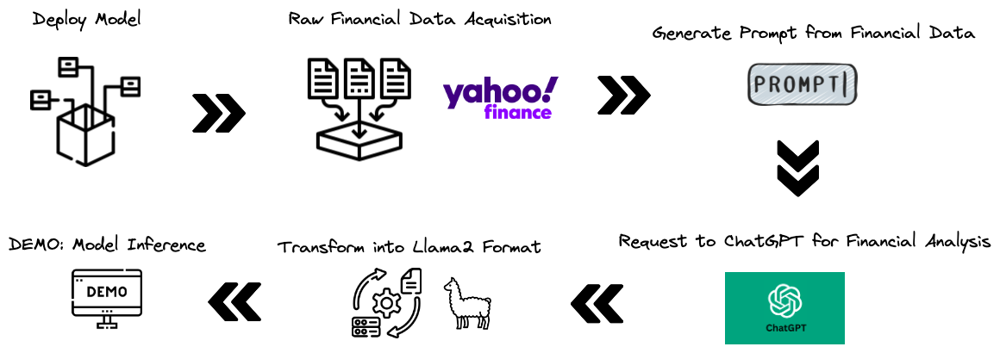
Try to deploy the FinGPT-Forecaster locally
Overall Framework

Slide 20
References
Data Preparation Reference
CODE
Demo Reference
CODE
FinGPT-forecaster Huggingface Page
Huggingface
[Optional] OpenAI API Key: see previous slides
Huggingface Tutorials:
Generation with LLMs link
NLP Course link

Slide 21
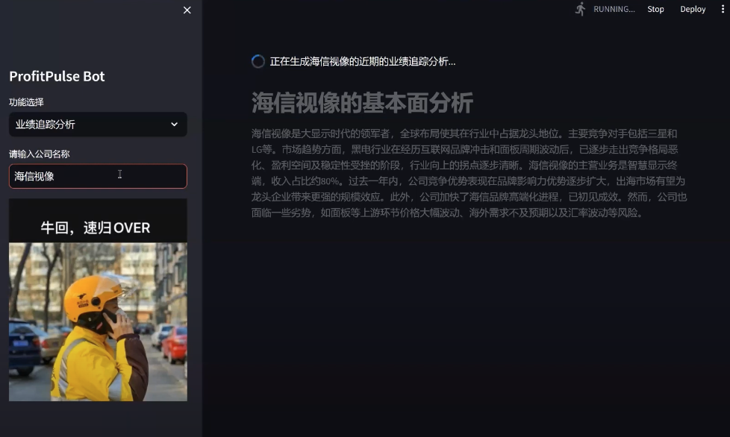
Last year students' excellent projects presentation:
https://www.youtube.com/watch?v=4nkZgyifR_s
https://youtu.be/Lk8iM29FGcI?si=Pgf9oBBw4hH_YwEd

