Slide 1
Project 3 Cryptocurrency Trading
MAFS6010Z, Fall 2023

Slide 2
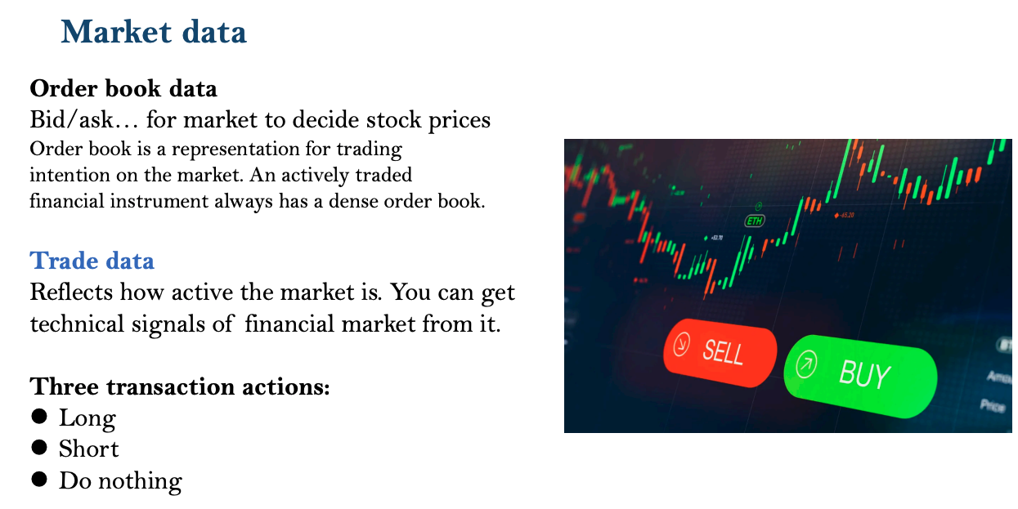

Slide 3
Data
You are provided with historical minute level data of four major cryptocurrencies ‘BTC(比特币)’, ‘EOS(柚子币)’, ‘ETH(以太坊)’, and ‘TRX(波场币)’ traverses from ‘2021-09-14 00:00:00’ to ‘2023-04-19 00:00:00’
Get preprocessed data via:
h5 format (recommend)
google driver link
Non-splitted csv format:
google driver link

Slide 4
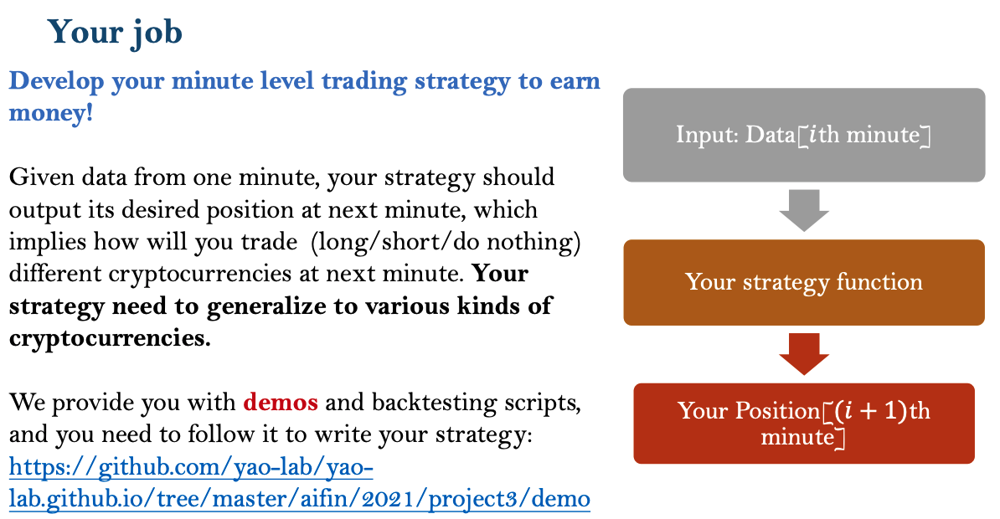

Slide 5
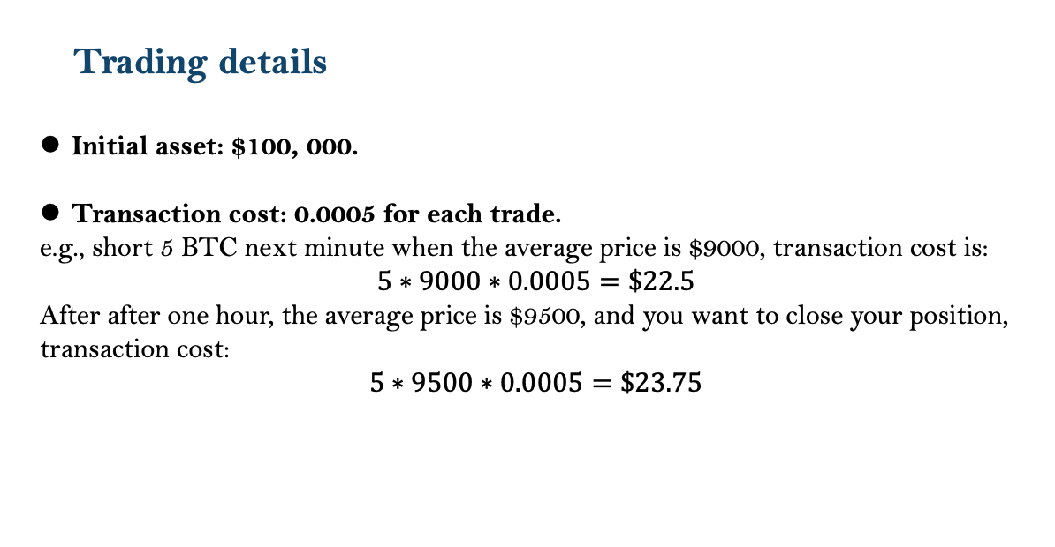

Slide 6
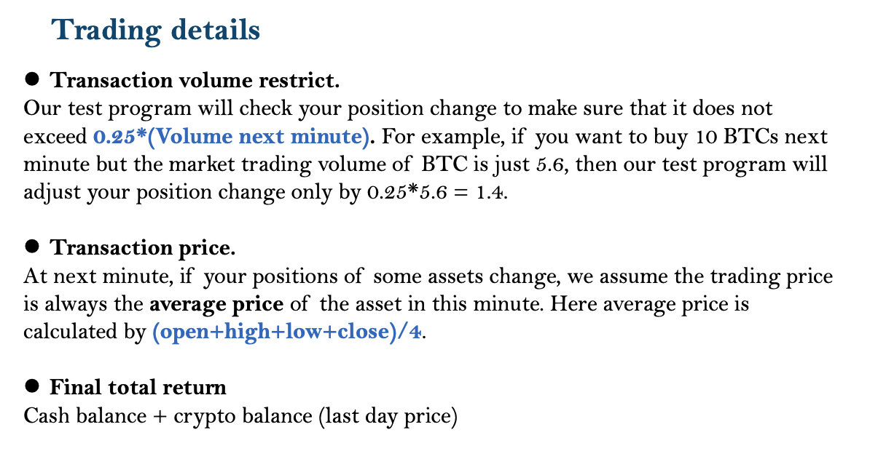

Slide 7
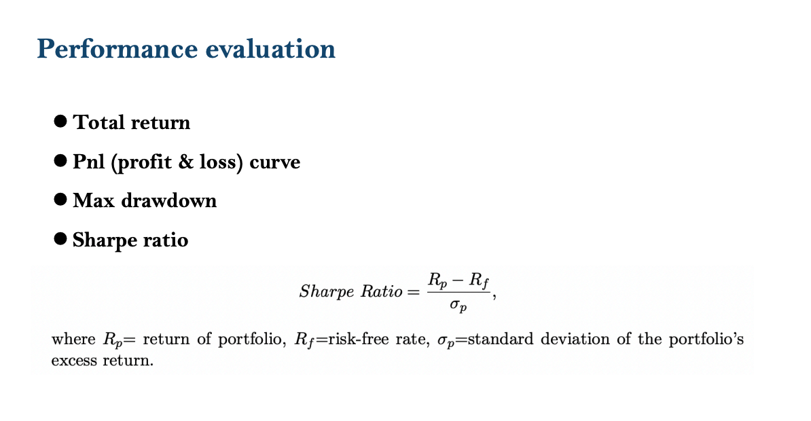

Slide 8
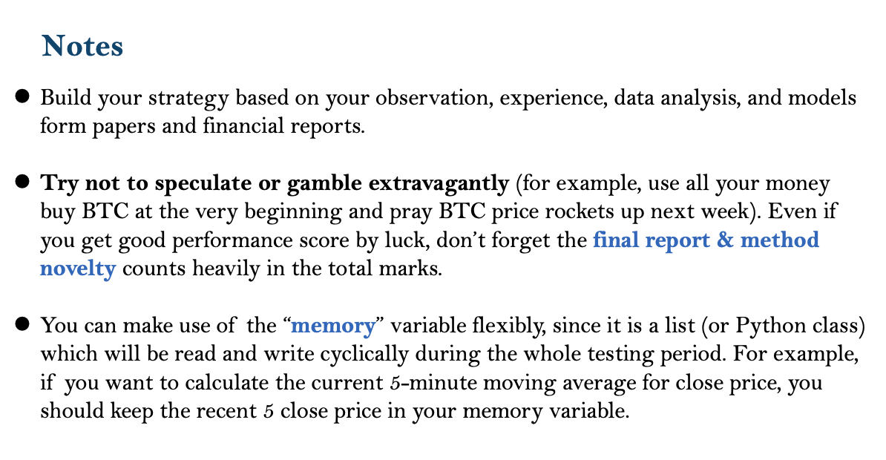

Slide 9
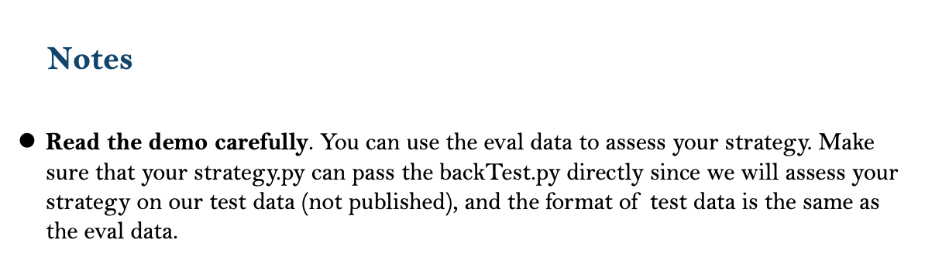

For those who wants to try more: We will provide additional historical OHLCV data with different frequencies (including ‘BTCUSD’, ‘BCHBTC’, ‘ETHUSD’, ‘LTCUSD’ transaction data in the minute /15- minute/1- hour/1-day bar). Contact with us!

Slide 10


Acknowledge to Cyril DL and Bastian Kälin for providing relevant materials and data download API.
You can get list of available books from their API https://api.bitso.com/v3/available_books/
Get historical data from Bitso (https://bitso.com) OHLC csv format.

