Slide 1
Overview of the 2nd project
Best writing award: HUANG Yuxin, LEI Yunxin, AN Tianyuan, LIN Fengshan, LIU Zongxuan (paper 1)
Best technique award: LI Aoran, MA Yijia, WENG Langting, ZHOU Tianying (paper 2)
Best overall award: YANG Tianhao, JIA Yaoyao, JIANG Xiaoyue, HUANG Yuxuan (paper1)
Best overall award: SUN Peiran, LUO Xinyang (paper 2)
Congratulations! You can gain some bonus for your grades!
By the way, the grade of the warm-up project does not count a lot for the final score; you still have the opportunity to earn a bonus during the following projects!
Besides, please submit your project reports / review / rebuttal in time, otherwise, you may lose some point.

Slide 2
Project 3:
Kaggle ——
G-Research Crypto Forecasting
MAFS6010Z, Fall 2023

Slide 3
Background
Cryptocurrencies, such as Bitcoin and Ethereum, are among the most popular assets for speculation and investment, yet have proven wildly volatile. Fast-fluctuating prices have made millionaires of a lucky few, and delivered crushing losses to others. Could some of these price movements have been predicted in advance?
Task: use your machine learning expertise to forecast short term returns in 14 popular cryptocurrencies.
Difficulty: extreme volatility of the assets, the non-stationary nature of the data, the market and meme manipulation, the correlation between assets and the very fast changing market conditions.

Slide 4
Data
Millions of rows of minute-by-minute cryptocurrency trading data dating back to 2018
Data features:
timestamp: Timestamps in this dataset are multiple of 60, indicating minute-by-minute data.
Asset_ID: The asset ID corresponding to one of the cryptocurrencies.
Count: Total number of trades in the time interval (last minute).
Open: Opening price of the time interval (in USD).
High: Highest price reached during time interval (in USD).
Low: Lowest price reached during time interval (in USD).
Close: Closing price of the time interval (in USD).
Volume: Quantity of asset bought or sold, displayed in base currency USD.
VWAP: The average price of the asset over the time interval, weighted by volume.
Target: Residual log-returns for the asset over a 15 minute horizon.
Notes:
ordinary least squares (OLS) panel model
principal components regression (PCR)
Partial least squares (PLS),

Slide 5
Your Job
Predict price returns across 14 major cryptocurrencies, in the time scale of minutes to hours.
Your predictions will be evaluated by how much they correlate with real market data collected during the future three-month evaluation period.
In advance, you are encouraged to perform additional statistical analyses to have a stronger grasp on the dataset, including autocorrelation, time-series decomposition and stationarity tests.
Notes:
ordinary least squares (OLS) panel model
principal components regression (PCR)
Partial least squares (PLS),

Slide 6

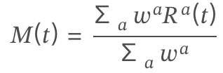

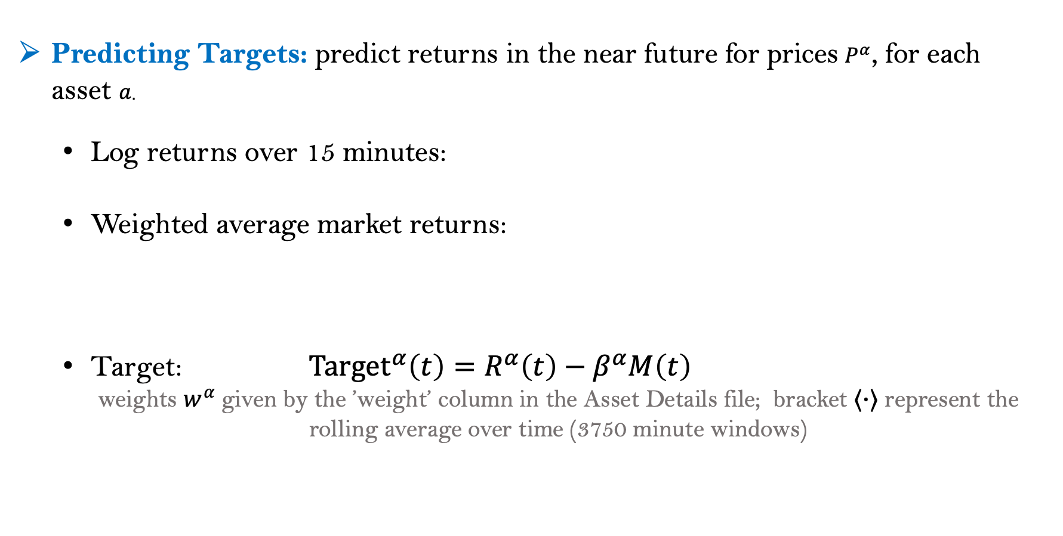
Prediction Targets and Evaluation
Predicting Targets: predict returns in the near future for prices $P^{α}$, for each asset 𝑎.
Log returns over 15 minutes:
Weighted average market returns:
Target: $Target^{α}\left(t\right)=R^{α}\left(t\right)−β^{α}M\left(t\right)$
weights $w^{α}$given by the ’weight’ column in the Asset Details file; bracket ⟨·⟩ represent the rolling average over time (3750 minute windows)
Refer: https://www.kaggle.com/code/cstein06/tutorial-to-the-g-research-crypto-competition/notebook
Notes:
ordinary least squares (OLS) panel model
principal components regression (PCR)
Partial least squares (PLS),

Slide 7
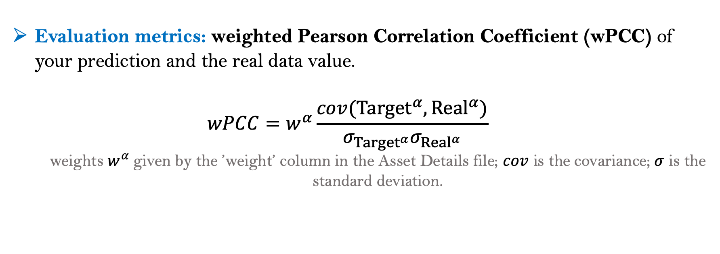
Prediction Targets and Evaluation
Evaluation metrics: weighted Pearson Correlation Coefficient (wPCC) of your prediction and the real data value.
$$wPCC=w^{α}\frac{cov(Target^{α}, {Real}^{α})}{σ_{Target^{α}}σ_{{Real}^{α}}}$$
weights $w^{α}$given by the ’weight’ column in the Asset Details file; $cov$ is the covariance; $σ$ is the standard deviation.
Refer: https://en.wikipedia.org/wiki/Pearson_correlation_coefficient
Notes:
ordinary least squares (OLS) panel model
principal components regression (PCR)
Partial least squares (PLS),

Slide 8
Notes
Be careful of the missing values. Rows with nulls in the test set ground truth are ignored for scoring purposes.
The danger of overfitting should be considerable.
The volatility and correlation structure in the data are likely to be highly non-stationary.
Changes in prices between different cryptocurrencies are highly interconnected. For example, Bitcoin has historically been a major driver of price changes across cryptocurrencies but other coins also impact the market.

Slide 9
Project 3:
Kaggle ——
M5 Forecasting
MAFS6010Z, Fall 2023

Slide 10
Background
M5 forecasting: the 5th Makridakis Competition.
Task: Forecasting (accuracy) and estimating the uncertainty distribution of the realized values of the same series
Accuracy task: Can you estimate, as precisely as possible, the point forecasts of the unit sales of various products sold in the USA by Walmart?
Uncertainty task: Can you estimate, as precisely as possible, the uncertainty distribution of the unit sales of various products sold in the USA by Walmart?
Aim:
Identifying the most appropriate method(s) for different types of situations requiring predictions and making uncertainty estimates
Comparing the accuracy/uncertainty of ML and DL methods versus those of standard statistical ones
Notes:
Aim: To identify the most appropriate method(s) for different types of situations requiring predictions (accuracy) and making uncertainty estimates.
To advance the theory of forecasting and improve its utilization by businesses and non-profit organizations. Its other goal is to compare the accuracy/uncertainty of ML and DL methods versus those of standard statistical ones, and assess possible improvements versus the extra complexity and higher costs of using the various methods.

Slide 11
Data
42,840 time series data from Walmart (sales data from 2011-01-29 to 2016-06-19).
hierarchical sales data: starting at the item level and aggregating to that of departments, product categories and stores in three geographical areas of the US: California, Texas, and Wisconsin.
explanatory variables are also included; such as price, promotions, day of the week, and special events (e.g. Super Bowl, Valentine’s Day, and Orthodox Easter) that affect sales which are used to improve forecasting accuracy.
The majority of the more than 42,840 time series display intermittency (sporadic sales including zeros).
Refer: https://mofc.unic.ac.cy/m5-competition/
Notes:
ordinary least squares (OLS) panel model
principal components regression (PCR)
Partial least squares (PLS),

Slide 12
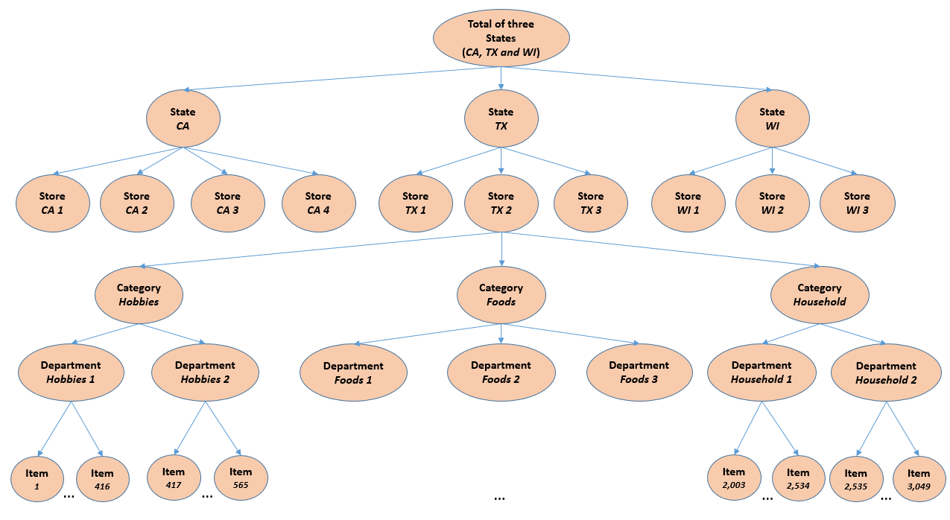
Data Organization Overview
In total:
42,840 time series
Notes:
ordinary least squares (OLS) panel model
principal components regression (PCR)
Partial least squares (PLS),

Slide 13
Your Job
Accuracy task: forecasting daily sales of each products for the next 28 days.
(m5-forecasting-accuracy)
Uncertainty task: 28 days ahead probabilistic forecasts for the median and four prediction intervals (PIs) (50%, 67%, 95%, and 99%).
(m5-forecasting-uncertainty)
The two task using the same dataset.
Notes:
ordinary least squares (OLS) panel model
principal components regression (PCR)
Partial least squares (PLS),

Slide 14
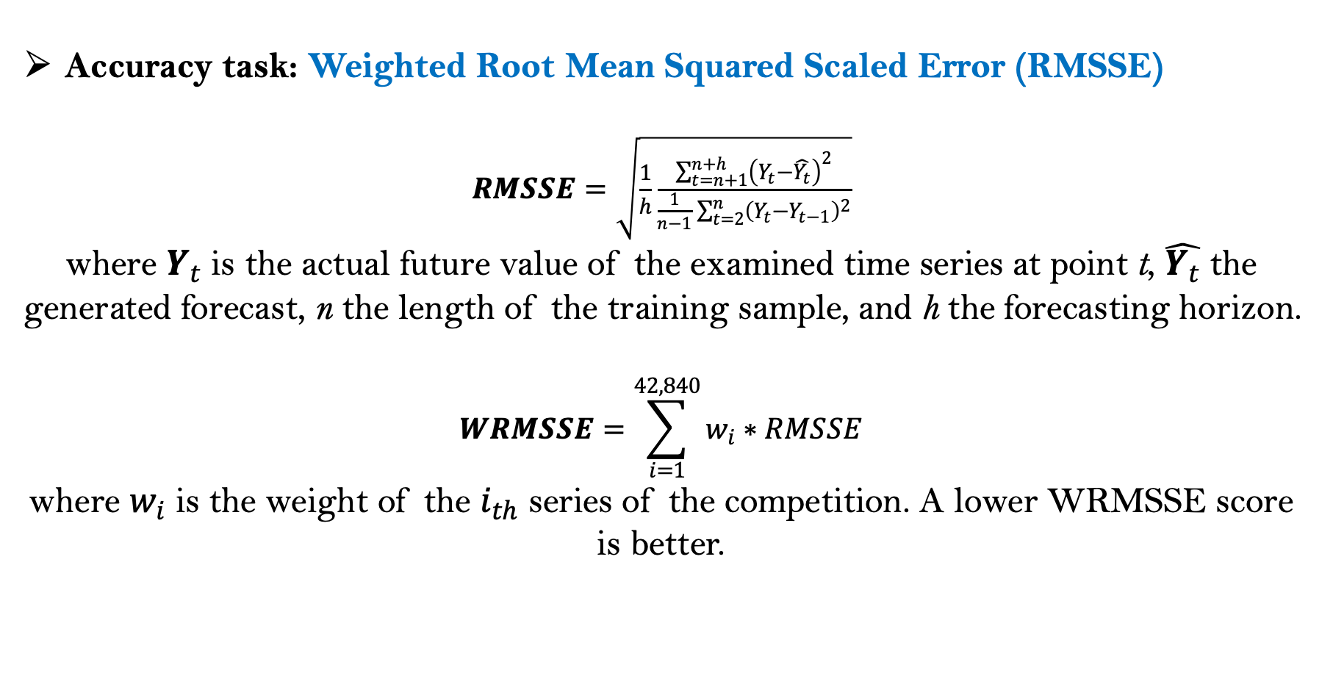
Evaluation metrics
Accuracy task: Weighted Root Mean Squared Scaled Error (RMSSE)
$RMSSE=\sqrt{\frac{1}{h}\frac{\sum_{t=n+1}^{n+h}{{\left(Y_{t}−\hat{Y_{t}}\right)}^{2}}}{\frac{1}{n−1}\sum_{t=2}^{n}{{\left(Y_{t}−Y_{t−1}\right)}^{2}}}}$
where $Y_{t}$ is the actual future value of the examined time series at point t, $\hat{Y_{t}}$ the generated forecast, n the length of the training sample, and h the forecasting horizon.
$$WRMSSE=\sum_{i=1}^{42,840}{w_{i}∗RMSSE}$$
where $w_{i}$ is the weight of the $i_{th}$ series of the competition. A lower WRMSSE score is better.
Notes:
ordinary least squares (OLS) panel model
principal components regression (PCR)
Partial least squares (PLS),

Slide 15
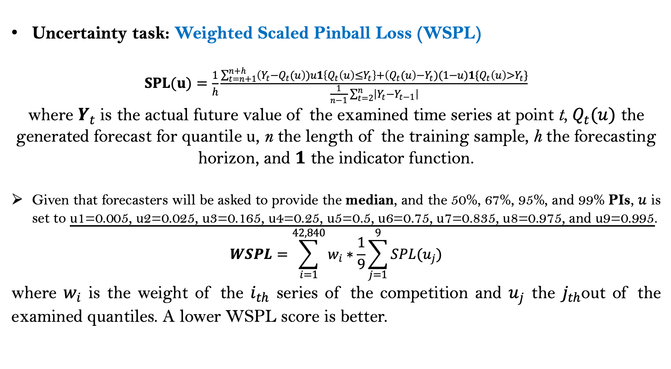
Evaluation metrics
Uncertainty task: Weighted Scaled Pinball Loss (WSPL)
$SPL(u)=\frac{1}{h}\frac{\sum_{t=n+1}^{n+h}{\left(Y_{t}−Q_{t}(u\right))u1\left\{Q_{t}\left(u\right)≤Y_{t}\right\}+\left(Q_{t}(u\right)−Y_{t})(1−u)1\{Q_{t}\left(u\right)>Y_{t}\}}}{\frac{1}{n−1}\sum_{t=2}^{n}{\left|Y_{t}−Y_{t−1}\right|}}$
where $Y_{t}$ is the actual future value of the examined time series at point t, $Q_{t}(u)$ the generated forecast for quantile u, n the length of the training sample, h the forecasting horizon, and $1$ the indicator function.
Given that forecasters will be asked to provide the median, and the 50%, 67%, 95%, and 99% PIs, $u$ is set to u1=0.005, u2=0.025, u3=0.165, u4=0.25, u5=0.5, u6=0.75, u7=0.835, u8=0.975, and u9=0.995.
$$WSPL=\sum_{i=1}^{42,840}{w_{i}∗\frac{1}{9}\sum_{j=1}^{9}{SPL(u_{j})}}$$
where $w_{i}$ is the weight of the $i_{th}$ series of the competition and $u_{j}$ the $j_{th}$out of the examined quantiles. A lower WSPL score is better.
Notes:
ordinary least squares (OLS) panel model
principal components regression (PCR)
Partial least squares (PLS),

Slide 16
Weighting
M5 involves the unit sales of various products of different selling volumes and prices that are organized in a hierarchical fashion. Therefore, you must provide accurate forecasts across all hierarchical levels, especially for series of high importance, i.e. for series that represent significant sales, measured in US dollars.
To that end, the forecasting errors computed for each participating method (both RMSSE and SPL) will be weighted across the M5 series based on their cumulative actual dollar sales, which is a good and objective proxy of their actual value for the company in monetary terms.
Refer: https://github.com/Mcompetitions

