Slide 1
Large Language Models with Financial Analysis
MAFS6010Z 2023Fall

Slide 2




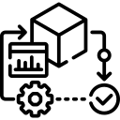



Large language models use transformer models and are trained using massive datasets — hence, large. This enables them to recognize, translate, predict, or generate text or other content.
What LLM can do for financial analysis?
Data Interpretation
Predictive Modeling
Automated Reporting
Market Analysis
Risk Assessment.
Notes:
ChatGPT is an AI language model by OpenAI that uses deep learning to understand and generate human-like text in conversations.

Slide 3
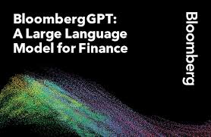
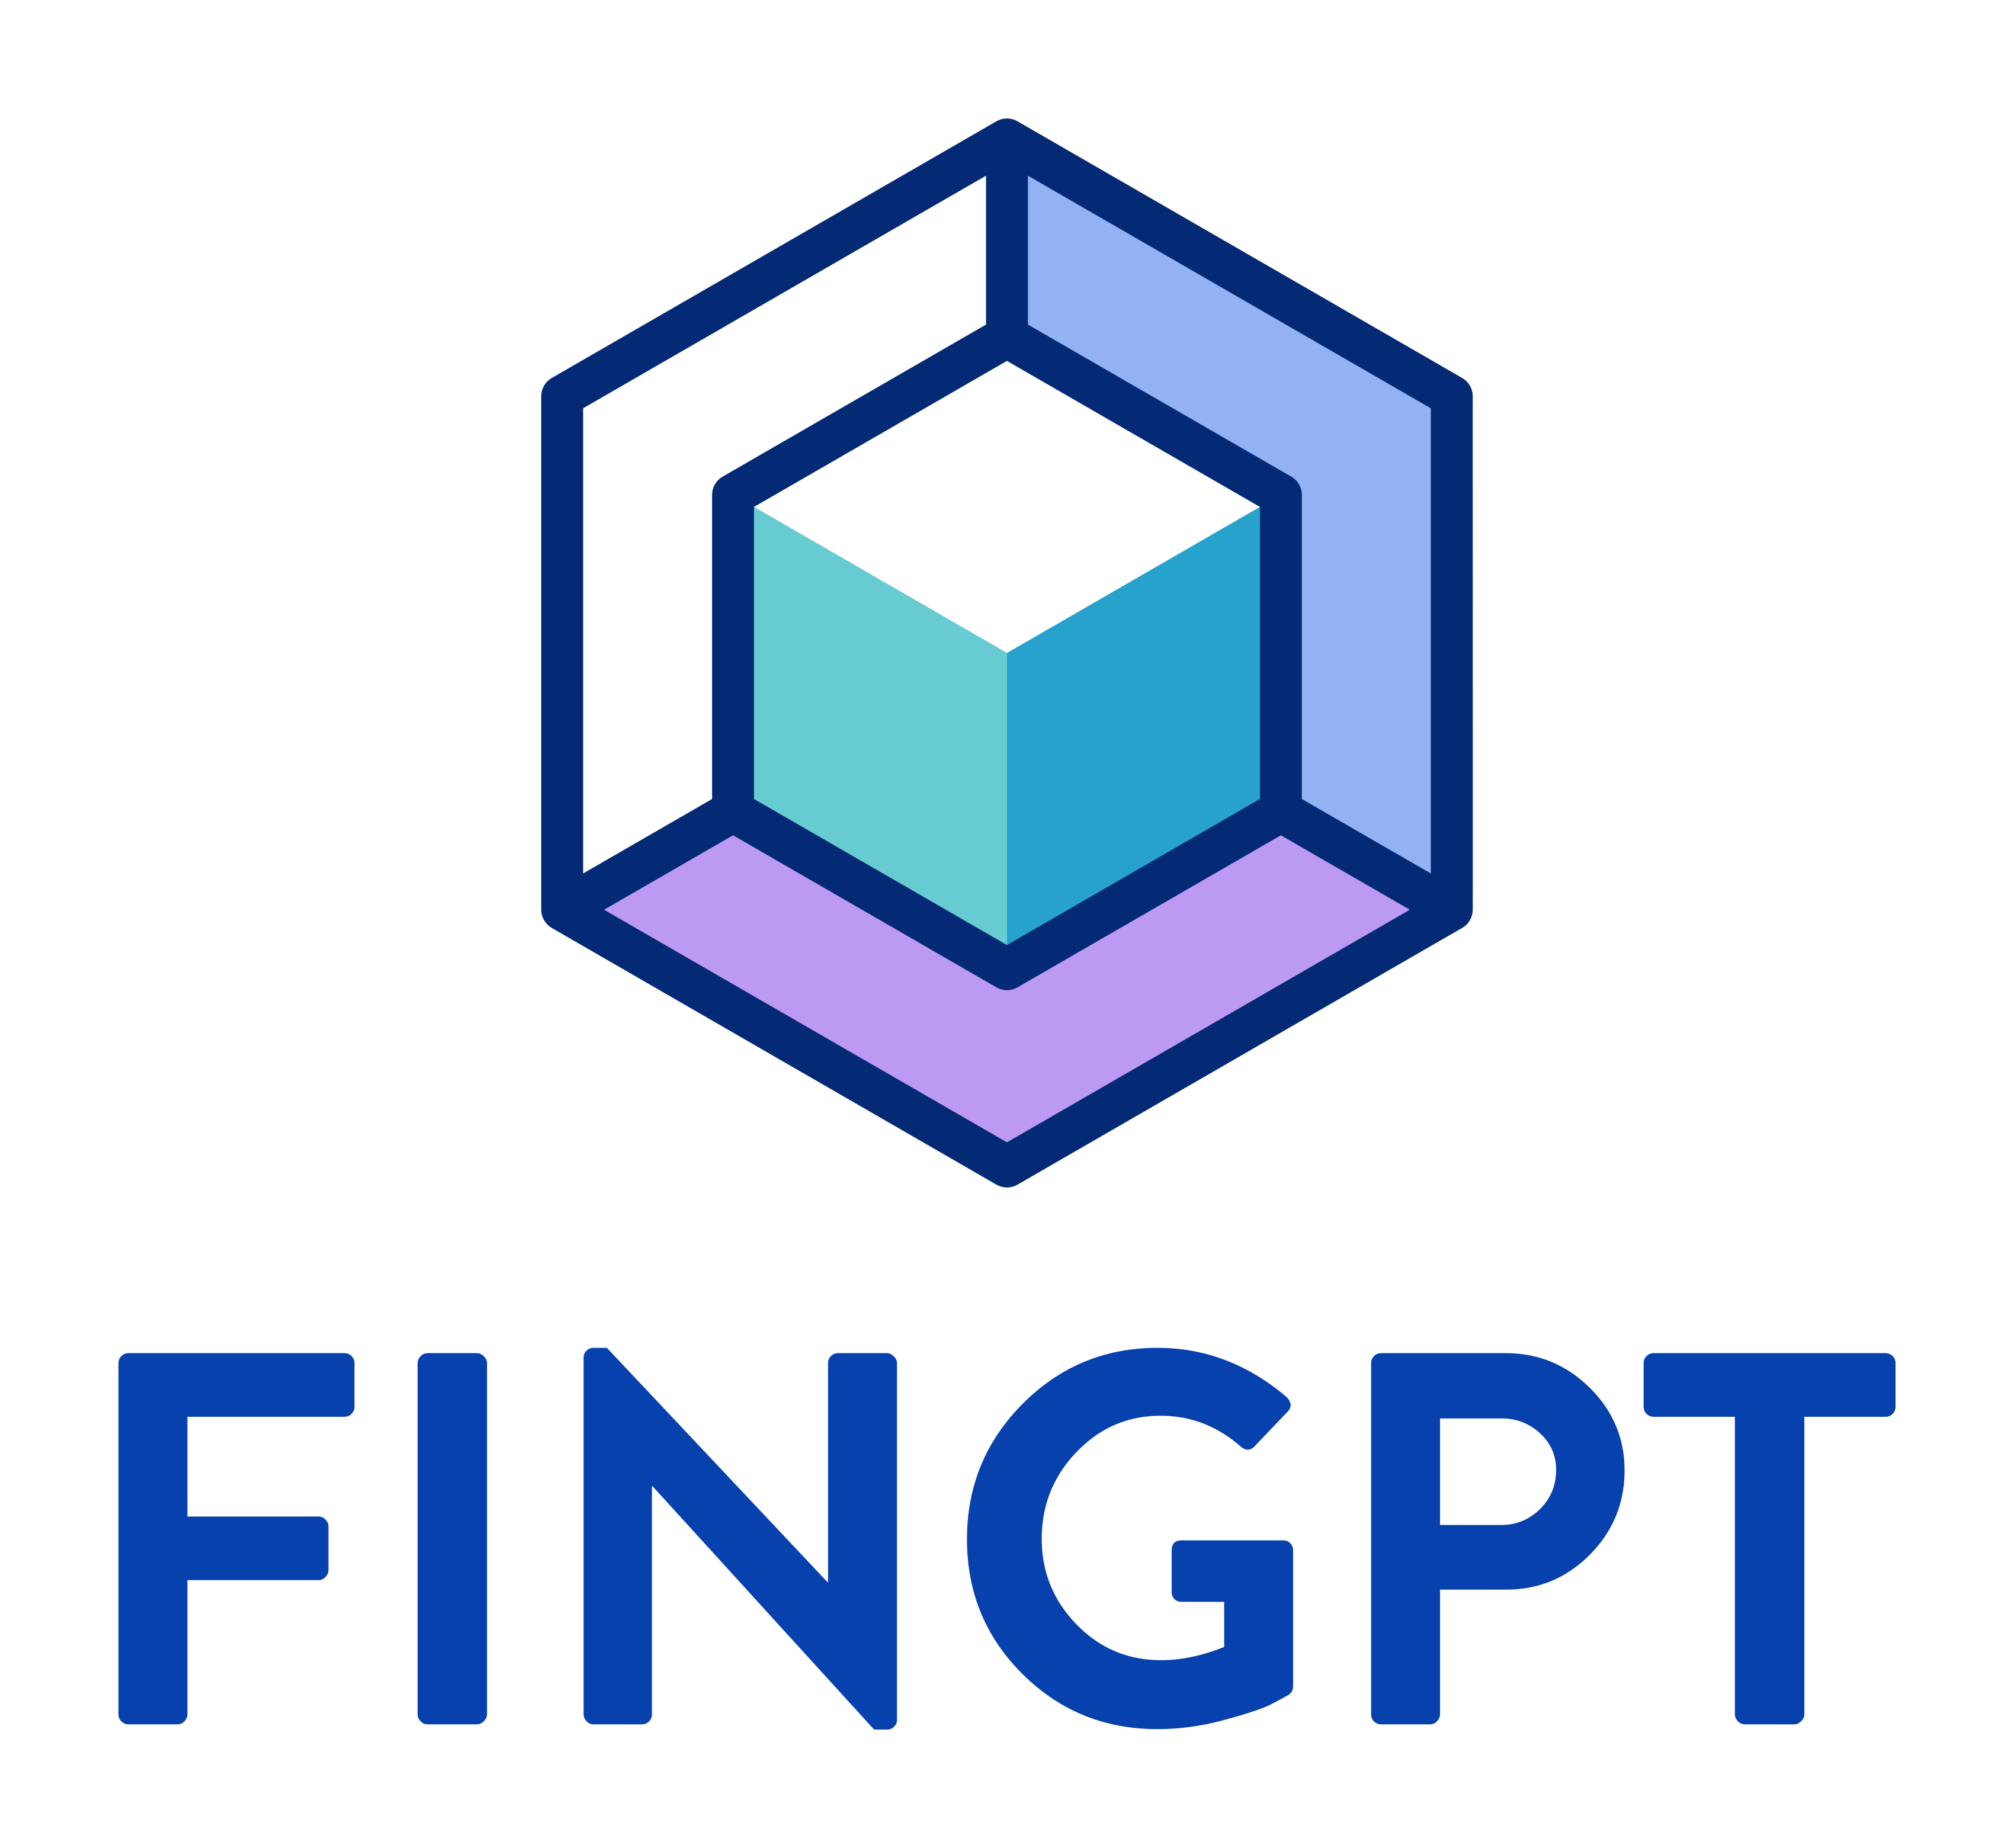
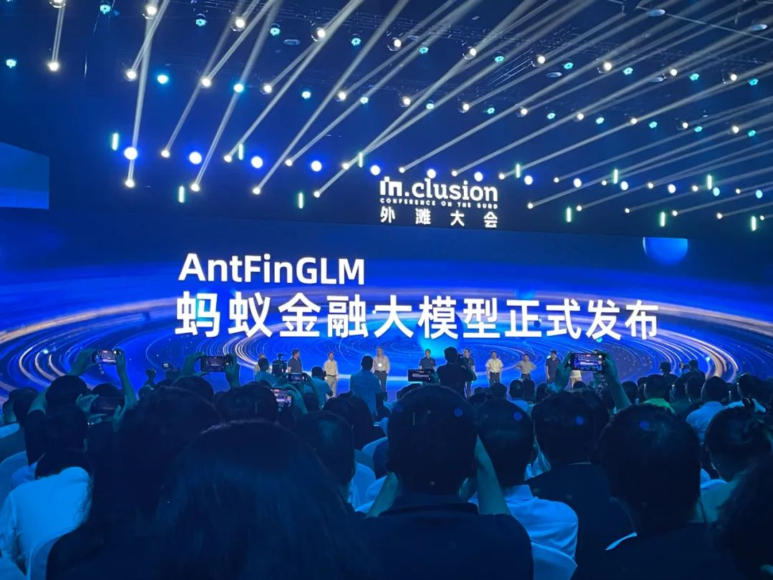
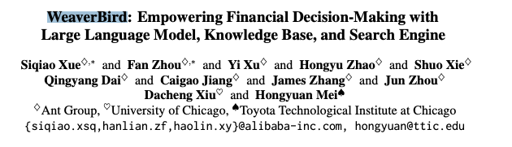
BloombergGPT
trained an LLM using a mixture of finance data and general-purpose data, which took about 53 days, at a cost of around $3M)
Improving existing financial NLP tasks, such as sentiment analysis, named entity recognition, news classification, and question answering.
Open Financial LLMs. Can be fine-tuned swiftly to incorporate new data (the cost falls significantly, less than $300 per fine-tuning).
Notes:
BloombergGPT represents the first step in the development and application of this new technology for the financial industry.

Slide 4
Example 1
Financial News Analysis with Llama Index, GPT-4, and Streamlit

Slide 5



LlamaIndex: Swiftly start LLM apps, create (retrieval-augmented generation) RAG systems in minutes, access advanced data tools for customization.
A free and open-source framework to rapidly build and share beautiful machine learning and data science web apps. It is a Python-based library specifically designed for machine learning engineers.
GPT-4 is OpenAI's most advanced system, producing safer and more useful response

Slide 6
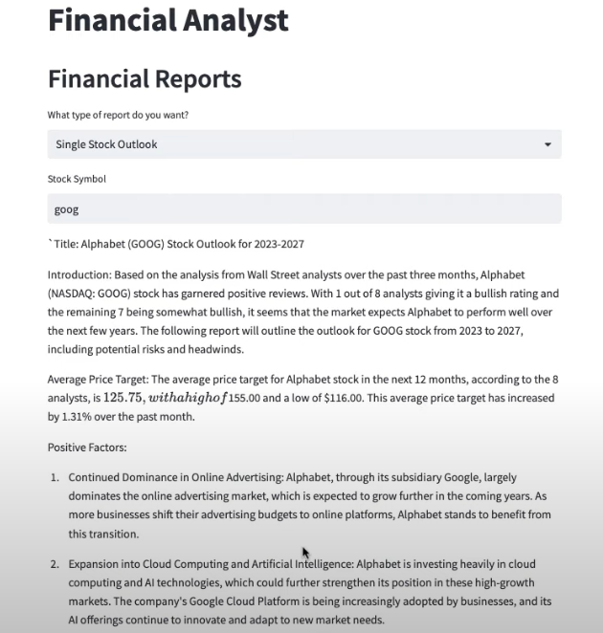
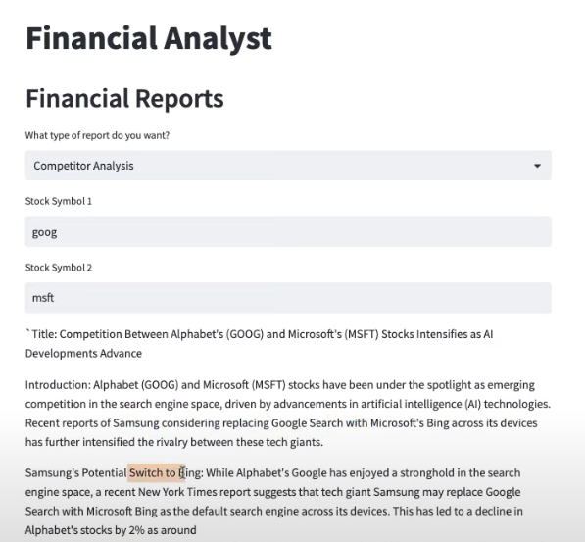
What we will build?
Single Stock Outlooks
Competitor Analysis

Slide 7
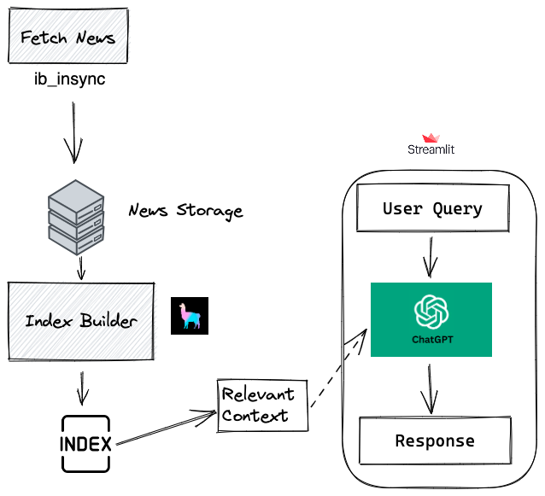
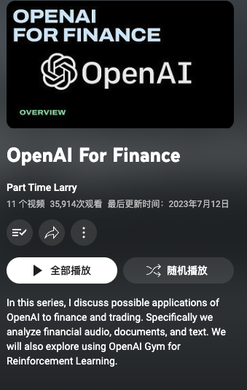
Overall Framework
Few line codes
Very clear infrastructure
Courses on Youtube
Code Example
https://github.com/hackingthemarkets/financial-news-llama-index

Slide 8
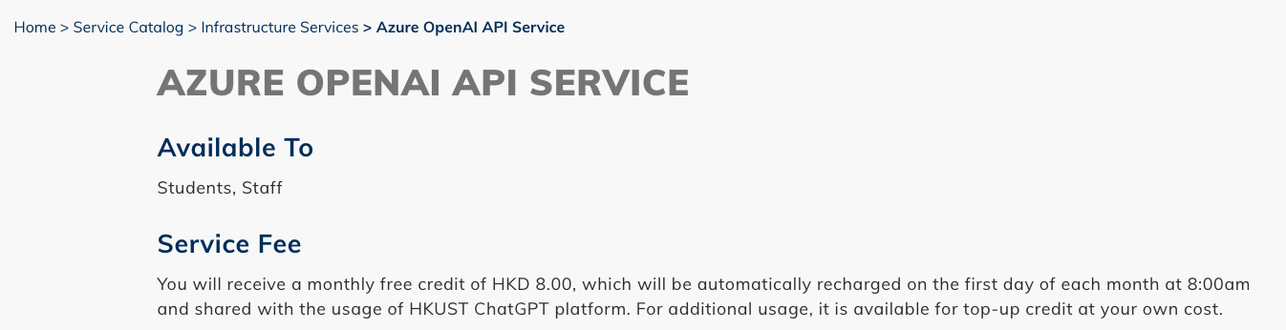

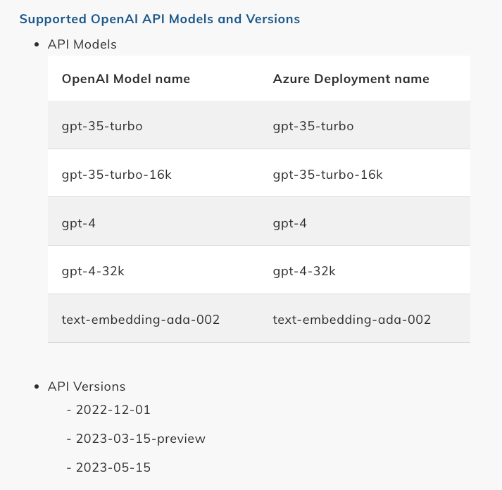
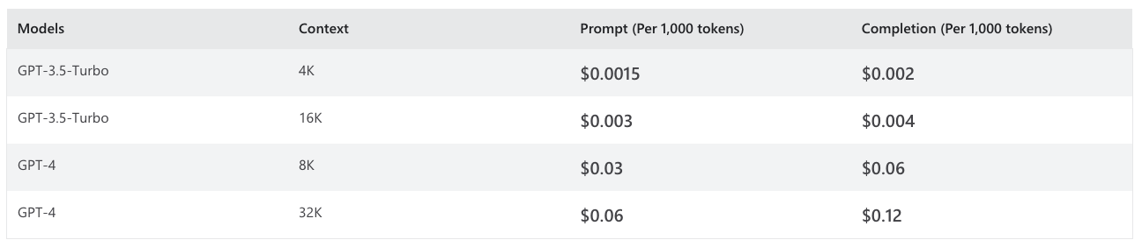

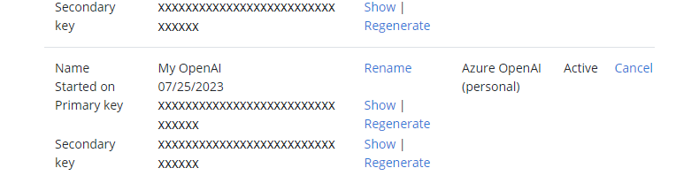
hkust azure-openai-api-service
Get the OpenAI API Key step by step

Slide 9

Example 2
Local-deployed FinGPT-Forecaster

Slide 10


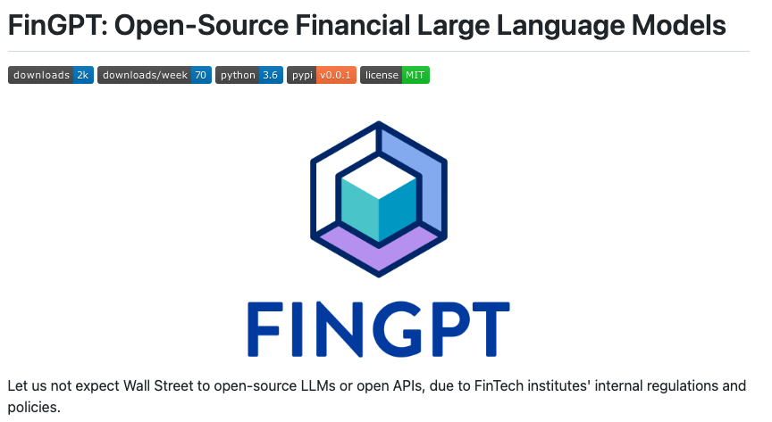

What is FinGPT-Forecaster?
an AI tool analyzing market news and optional financial data for a specific company.
Offers a stock price movement forecast for the upcoming week along with summarized analysis.
Fine-tuned on Llama-2-7b-chat-hf with LoRA using past year's DOW30 market data.
Demonstrates adaptability and generalization capabilities across various stock symbols.
GitHub link
Huggingface Demo
Build by
An open-source organization focused on advancing AI within the finance sector

Slide 11
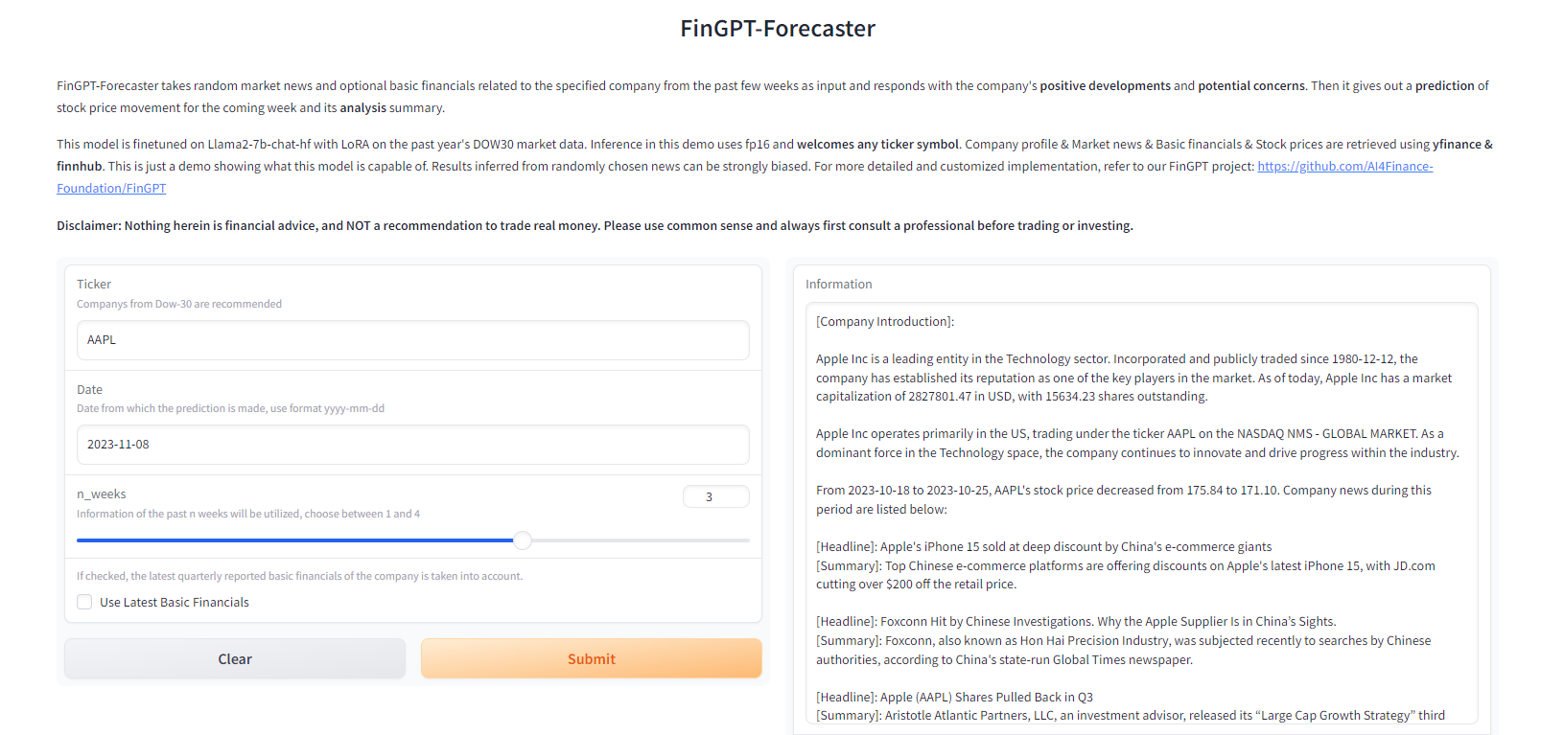

Slide 12
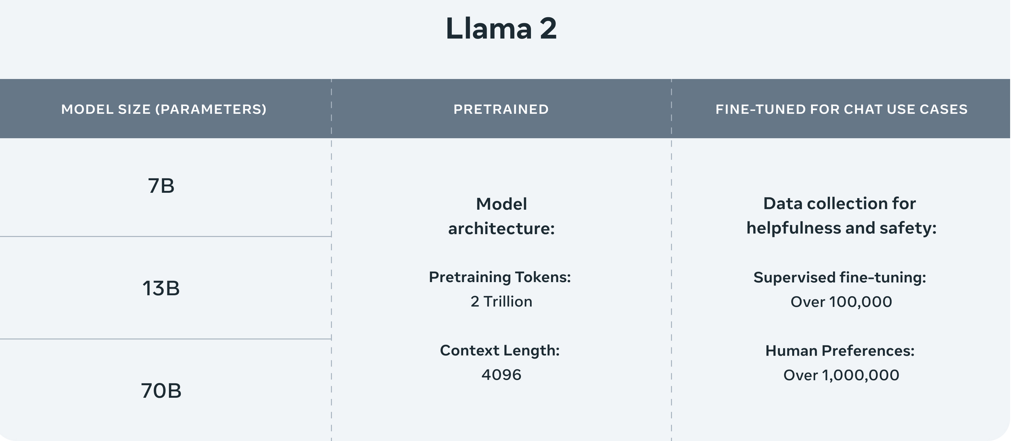
Llama 2 is Meta's open source large language model (LLM). It's freely available for almost anyone to use for research and commercial purposes. 7B model could deploy on RTX-3090(24GB)

Slide 13
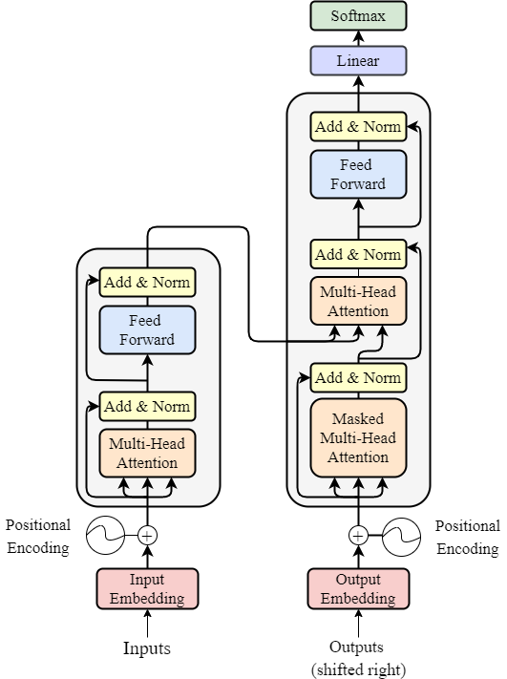
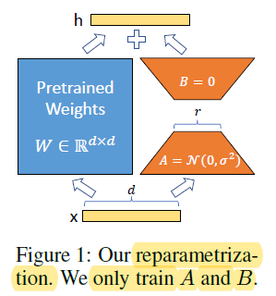
LoRA (Low-Rank Adaptation of Large Language Models) is a popular and lightweight training technique that significantly reduces the number of trainable parameters. It works by inserting a smaller number of new weights into the model and only these are trained.

Slide 14

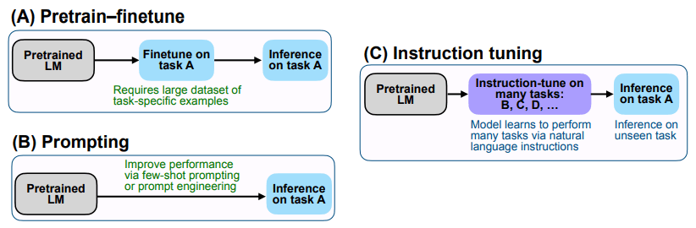

Slide 15

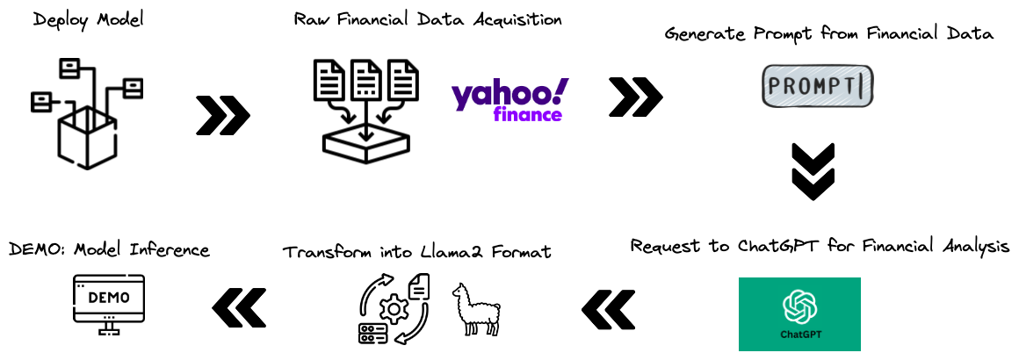
Try to deploy the FinGPT-Forecaster locally
Overall Framework

Slide 16

References
Data Preparation Reference
CODE
Demo Reference
CODE
FinGPT-forecaster Huggingface Page
Huggingface
[Optional] OpenAI API Key: see previous slides
Huggingface Tutorials:
Generation with LLMs link
NLP Course link
RTX 3090 Application: only 4 group quota due to limited resource

